Slide 1
IoT Data Pipeline Template

Slide 2
Team GR
Gabriel Rodriguez (rodrigg@mail.uc.edu)
  Student developer
Peter Kroeger (peter14mail@gmail.com)
  Project Advisor

Slide 3
Project Description
The purpose of this project is to devise a data pipeline template that can used by other developers to create a data pipeline in house that meets their arbitrary requirements. For the purposes of this project, this data pipeline template will demonstrate how to collect atmospheric data from the interior of multiple facilities as an example exercise.

Slide 4
Intellectual Merits
This project follows the microservice architectural pattern
  This implies that the functionality of each service is limited to a few well defined tasks
  Communication between each service uses Protobuf, which allows data to be quickly encoded/decoded in a compact binary format
  Reproducible builds for each service are enforced by using multi-stage Docker images
The languages used by this project were chosen to prioritize memory and concurrency safety, in addition to performance

Slide 5
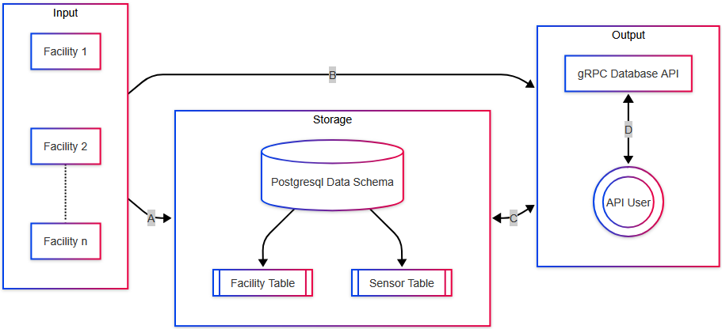
Design Specification Overview

Slide 6
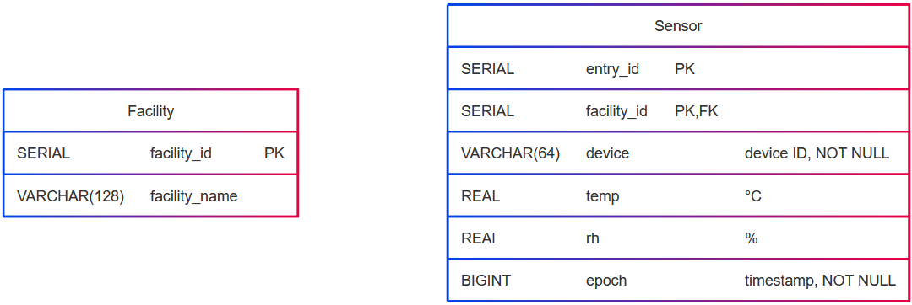
Database Table Specification

Slide 7
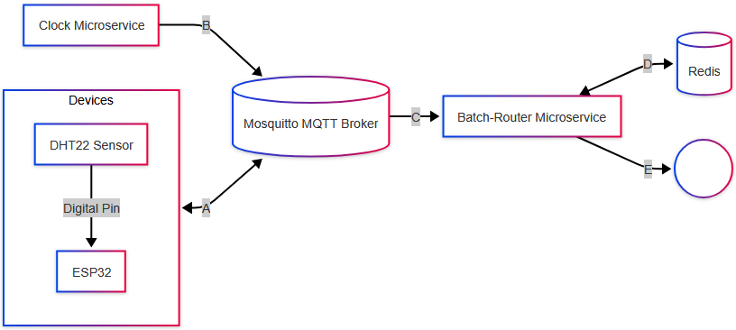
Facility-wide Design Specification

Slide 8

gRPC API Design Specification

Slide 9
Technology Used
Each microservice is developed using Go, built using Docker, and executed via a Docker Compose service definition
Firmware for the ESP32s was developed using Rust. This includes the DHT22 sensor driver
PostgreSQL was used as this project’s database
Communication is mainly handled by the project’s Mosquitto MQTT Broker
Redis is used to store batches of data via Redis Queues. The connection state of each ESP32 is also tracked using Redis Keys

Slide 10
Results
Current Progress:
  An integrated system of microservices that is capable of batching, storing, and retrieving atmospheric data collect from a simulated IoT device
  Firmware written in Rust for the ESP32 that is capable of reporting the temperature and relative humidity of a given room using a DHT22 sensor
Next Steps:
  Deployment to physically owned hardware
  Deployment to the cloud, most likely Google Cloud Platform
  Automated unit tests and software verification using formal methods tooling

Slide 11
Challenges
Balancing program simplicity with performance and memory overhead for each microservice
Prior to using Go, each microservice was implemented in C++. This made ensuring memory and concurrency safety difficult
  Building each microservice and its dependencies in C++ was also a time consuming and complicated task when compared to Go’s build system
  The execution environment of each microservice also needed to have the exact same libc and libstdc++ versions. This is why multi-staged Docker images were originally introduced to the project

