Slide 1
What is a Service Oriented Architecture?
Prof. Paul A. Strassmann
George Mason University, November 19, 2007

Slide 2
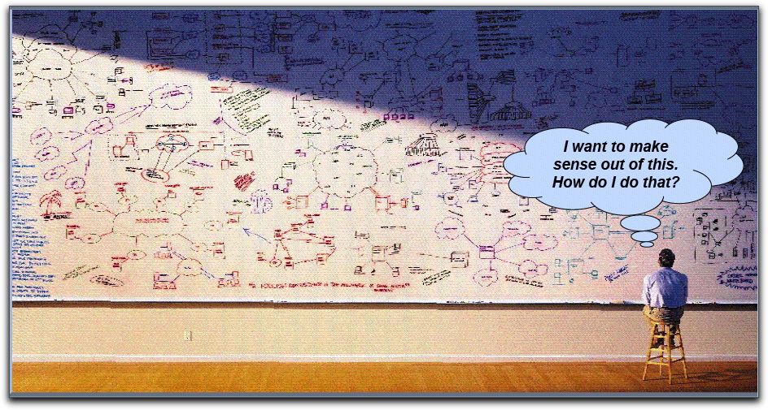
Problems Addressed by a Service Oriented Architecture

Slide 3
Purpose of Architecture: To Manage Interdependencies

Slide 4
Directions of System Architecture
1960 - 1980
1990 - 2000
2010 - 2050
Organization Focus
Mainframe Centric
Internal Use
Unique Data
Process Focus
Client Server
Partial Connectivity
EDI File Transfer
Distributed Functions
Data Centric
Universal Interoperability
Real-time Connectivity

Slide 5
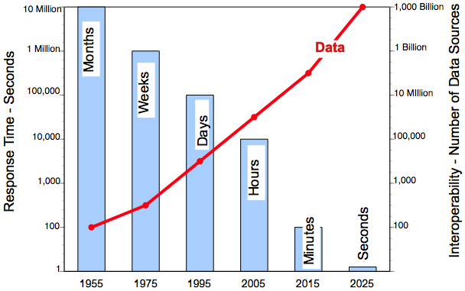
Data Interoperability Expands as Response Time Shrinks

Slide 6
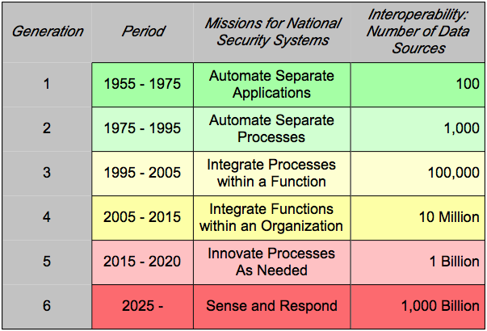
Interoperability Does not Scale

Slide 7
What is a Service Oriented Architecture (SOA)?
A method of design, deployment, and management of both applications and the software infrastructure where:
  All software is organized into business services that are network accessible and executable.
  Service interfaces are based on public standards for interoperability.

Slide 8
Key Characteristics of SOA
Quality of service, security and performance are specified.
Software infrastructure is responsible for managing.
Services are cataloged and discoverable.
Data are cataloged and discoverable.
Protocols use only industry standards.

Slide 9
What is a “Service”?
A Service is a reusable component.
A Service changes business data from one state to another.
A Service is the only way how data is accessed.
If you can describe a component in WSDL, it is a Service.

Slide 10
Information Technology is Not SOA
Business Mission
Information Management
SOA
Information Systems
Systems Design
Information
Technology
Computing & Communications

Slide 11
Current Infrastructure Costs are Excessive ($ Millions, I.T. Costs)
SOA

Slide 12
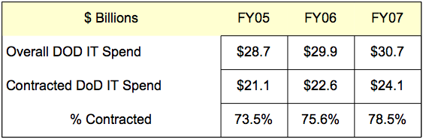
Contractors Will Build Separate Infrastructures without SOA

Slide 13
Why Getting SOA Will be Difficult
Managing for Projects:
  Software: 1 - 4 years
  Hardware: 3 - 5 years;
  Communications: 1 - 3 years;
  Project Managers: 2 - 4 years;
  Reliable funding: 1 - 4 years;
  User turnover: 30%/year;
  Security risks: 1 minute or less.
Managing for SOA:
  Data: forever.
  Infrastructure: 10+ years.

Slide 14
Why Managing Business Systems is Difficult?
40 Million lines of code in Windows XP is unknowable.
Testing application (3 Million lines) requires >10¹⁵ tests.
Probability correct data entry for a supply item is <65%.
There are >100 formats that identify a person in DoD.
Output / Office Worker: >30 e-messages /day.

Slide 15
How to View Organizing for SOA
P
E
R
S
O
N
A
L
L
E
V
E
P
L
r
i
v
a
t
e
A
p
p
l
i
c
a
t
i
o
n
s
a
n
d
F
i
l
e
s
P
r
i
v
a
c
y
a
n
I
d
VARIETY HERE
n
d
i
v
i
d
u
a
S
l
e
c
u
r
i
t
y
B
a
r
r
i
e
r
G
r
a
p
h
i
c
I
n
f
o
W
i
n
d
o
w
,
P
e
r
s
o
n
a
l
T
o
o
l
s
,
I
n
q
u
i
r
y
L
a
n
g
u
a
g
e
s
C
u
s
t
o
m
i
z
e
d
A
p
p
l
i
c
a
t
i
o
n
s
,
P
r
o
t
o
t
y
p
i
n
g
T
o
o
l
s
,
L
o
c
a
l
L
O
C
A
L
L
E
V
E
A
L
p
p
l
i
c
a
t
i
o
n
s
a
n
d
F
i
l
e
s
A
p
p
l
i
c
a
t
i
o
n
S
s
e
c
u
r
i
t
y
B
a
r
r
i
e
r
A
p
p
l
i
c
a
t
i
o
n
s
D
e
v
e
l
o
p
m
e
n
t
&
M
a
i
n
t
e
n
a
n
c
e
A
P
P
L
I
C
A
T
I
O
N
L
E
V
E
L
B
u
s
i
n
e
s
S
s
e
c
u
r
i
t
y
B
a
r
r
i
e
r
Service A
Service B
OSD
B
U
S
I
N
E
S
S
L
E
V
E
L
P
r
o
c
e
s
S
s
e
c
u
r
i
t
y
B
a
r
r
i
e
r
F
u
n
c
t
i
o
n
a
l
P
r
o
c
e
s
s
A
F
u
n
c
t
i
o
n
a
l
P
r
o
c
e
s
s
B
P
R
O
C
E
S
S
L
E
V
E
F
L
u
n
c
t
i
o
n
a
l
P
r
o
c
e
s
s
C
F
u
n
c
t
i
o
n
a
l
P
r
o
c
e
s
s
D
C
o
r
p
o
r
a
t
e
P
o
l
i
c
y
,
C
o
r
p
o
r
a
t
e
S
t
a
n
d
a
r
d
s
,
R
e
f
e
r
e
n
c
e
M
o
d
e
l
s
,
D
a
t
a
M
a
n
a
g
e
m
e
n
t
a
n
d
T
o
o
l
s
,
I
n
t
e
g
r
a
t
e
d
S
y
s
t
e
m
s
E
N
T
E
R
P
R
I
S
E
L
E
V
E
C
L
o
n
f
i
g
u
r
a
t
i
o
n
D
a
t
a
B
a
s
e
,
S
h
a
r
e
d
C
o
m
p
u
t
i
n
g
a
n
d
T
e
l
e
c
o
m
m
u
n
i
c
a
t
i
o
n
s
STABILITY HERE
I
n
d
u
s
t
r
y
S
t
a
n
d
a
r
d
s
,
C
o
m
m
e
r
c
i
a
l
O
f
f
-
t
h
e
-
S
h
e
l
f
G
L
O
B
A
L
L
E
V
E
P
L
r
o
d
u
c
t
s
a
n
d
S
e
r
v
i
c
e
s

Slide 16
SOA Must Reflect Timing
Private Applications and Files
PERSONAL
Graphic InfoWindow, Personal Tools, Inquiry Languages
SHORT TERM
Customized Applications, Prototyping Tools, Local
LOCAL
Applications and Files
ADAPTABILITY &
TECHNOLOGY
Applications Development & Maintenance
APPLICATION
SIMPLICITY
Business A
Business B
Infrastructure
Support
BUSINESS
Functional Process A
Functional Process B
Functional Process C
PROCESS
LONG TERM
Functional Process D
STABILITY &
Corporate Policy, Corporate Standards, Reference Models,
TECHNOLOGY
Data Management and Tools, Integrated Systems
ENTERPRISE
Configuration Data Base, Shared Computing and
COMPLEXITY
Telecommunications, Security and Survivability
Industry Standards, Commercial Off-the-Shelf
Products and Services
GLOBAL

Slide 17
SOA Must Reflect Conflicting Interests
Personal
Local
Organizations
Missions
Enterprise

Slide 18
DoD Concept How to Organize for SOA
Programs
Army, Navy
Air Force
Agencies
Combatant
Commands
Business Mission
WarFighting Mission
Intelligence Mission
Focus of this
Presentation
Enterprise Information Environment

Slide 19
Organization of Infrastructure Services
Infrastructure
Services
(Enterprise Information)
Data
Services
Security
Services
Computing
Services
Communication
Services
Application
Services

Slide 20
Organization of Data Services
Data
Services
Discovery
Services
Management
Services
Collaboration
Services
Interoperability
Services
Semantic
Services

Slide 21
Data Interoperability Policies
Data are an enterprise resource.
Single-point entry of unique data.
Enterprise certification of all data definitions.
Data stewardship defines data custodians.
Zero defects at point of entry.
De-conflict data at source, not at higher levels.
Data aggregations from sources data, not from reports.

Slide 22
Example of Data Pollution

Slide 23
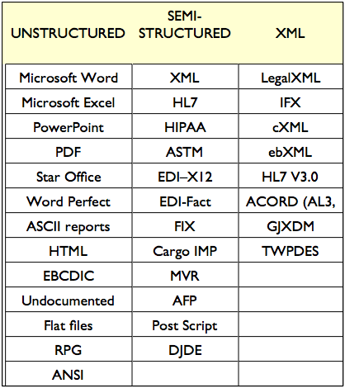
What Data?

Slide 24
Data Concepts
Data Element Definition
  Text associated with a unique data element within a data dictionary that describes the data element, give it a specific meaning and differentiates it from other data elements. Definition is precise, concise, non-circular, and unambiguous. (ISO/IEC 11179 Metadata Registry specification)
Data Element Registry
  A label kept by a registration authority that describes a unique meaning and representation of data elements, including registration identifiers, definitions, names, value domains, syntax, ontology and metadata attributes. (ISO 11179-1).

Slide 25
Data and Services Deployment Principles
Data, services and applications belong to the Enterprise.
Information is a strategic asset.
Data and applications cannot be coupled to each other.
Interfaces must be independent of implementation.
Data must be visible outside of the applications.
Semantics and syntax is defined by a community of interest.
Data must be understandable and trusted.

Slide 26
Organization of Security Services
Security
Services
Transfer
Services
Protection
Services
Certification
Services
Systems
Assurance
Authentication
Services

Slide 27
Security Services = Information Assurance
Conduct Attack/Event Response
    Ensure timely detection and appropriate response to attacks.
    Manage measures required to minimize the network’s vulnerability.
Secure Information Exchanges
    Secure information exchanges that occur on the network with a level of protection that is matched to the risk of compromise.
Provide Authorization and Non-Repudiation Services
    Identify and confirm a user's authorization to access the network.

Slide 28
Organization of Computing Services
Computing
Services
Computing
Facilities
Resource
Planning
Control &
Quality
Configuration
Services
Financial
Management

Slide 29
Computing Services
Provide Adaptable Hosting Environments
  Global facilities for hosting to the “edge”.
  Virtual environments for data centers.
• Distributed Computing Infrastructure
  Data storage, and shared spaces for information sharing.
• Shared Computing Infrastructure Resources
  Access shared resources regardless of access device.

Slide 30
Organization of Communication Services
Communication
Services
Interoperability
Services
Spectrum
Management
Connectivity
Arrangements
Continuity of
Services
Resource
Management

Slide 31
Network Services Implementation
From point-to-point communications (push communications) to network-centric processes (pull communications).
Data posted to shared space for retrieval.
Network controls assure data synchronization and access security.

Slide 32
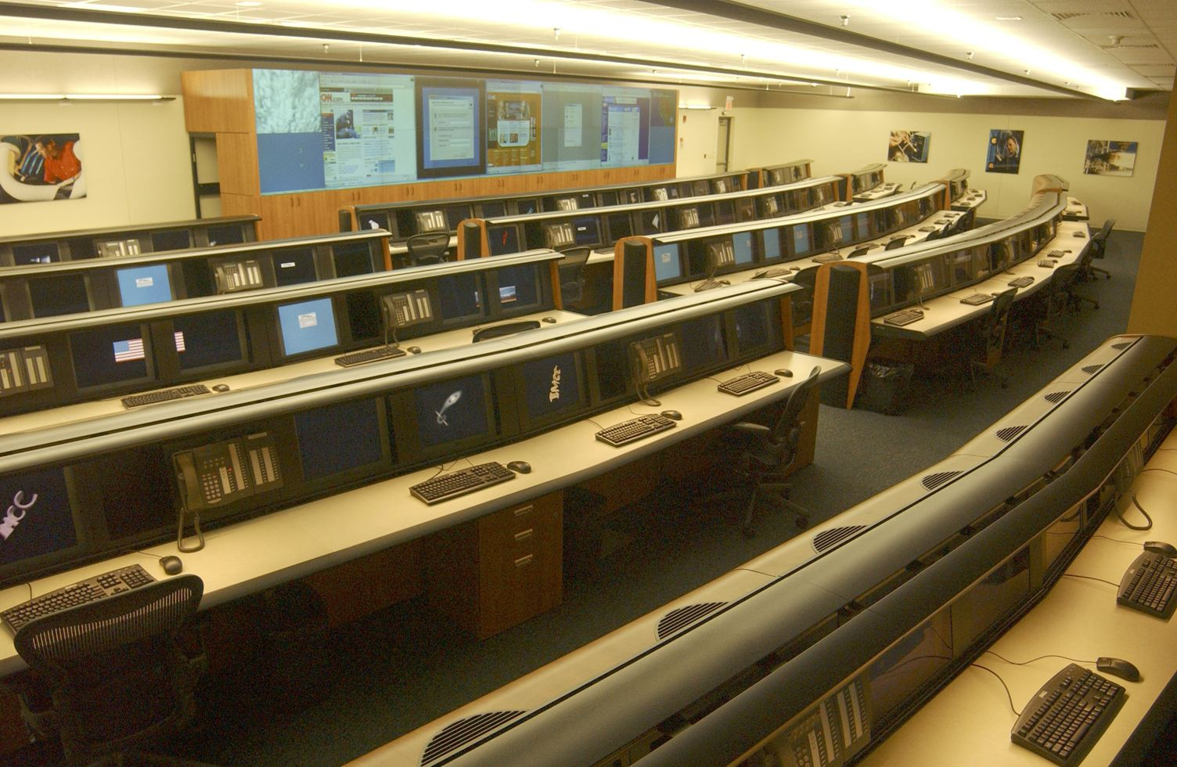
Network Control is the Key

Slide 33
Communication Services
Provide Information Transport
  Transport information, data and services anywhere.
  Ensures transport between end-user devices and servers.
  Expand the infrastructure for on-demand capacity.

Slide 34
Organization of Application Services
Application
Services
Component
Repository
Code Binding
Services
Maintenance
Management
Portals
Experimental
Services

Slide 35
Application Services and Tools
• Provide Common End User Interface Tools
  Application generators, test suites, error identification, application components and standard utilities.
Common end-user Interface Tools.
  E-mail, collaboration tools, information dashboards, Intranet portals, etc.

Slide 36
Example of Development Tools
Business Process Execution Language, BPEL, is an executable modeling language. Through XML it enables code generation.
Traditional Approach BPEL Approach
- Hard-coded decision logic - Externalized decision logic
- Developed by IT - Modeled by business analysts
- Maintained by IT - Maintained by policy managers
- Managed by IT - Managed by IT
- Dependent upon custom logs - Automatic logs and process capture
- Hard to modify and reuse - Easy to modify and reuse

Slide 37
A Few Key SOA Protocols
Universal Description, Discovery, and Integration, UDDI. Defines the publication and discovery of web service implementations.
The Web Services Description Language, WSDL, is an XML-based language that defines Web Services.
SOAP is the Service Oriented Architecture Protocol. It is a key SOA in which a network node (the client) sends a request to another node (the server).
The Lightweight Directory Access Protocol, or LDAP is protocol for querying and modifying directory services.
Extract, Transform, and Load, ETL, is a process of moving data from a legacy system and loading it into a SOA application.

Slide 38
SOA Interoperability Goals for the Department of Defense
Interoperability of solutions across the DoD strategic goal.
Rules for sharing of data and services across the enterprise.
Enforcement of standards.
All data, services, and applications shall be accessible, understandable, and trusted.
Global Information Grid for sharing of information with Federal Departments, Department of Homeland Security, the Intelligence Community, state and local governments, allied, coalition, non-governmental organizations (NGOs), academic, research and business partners.

Slide 39
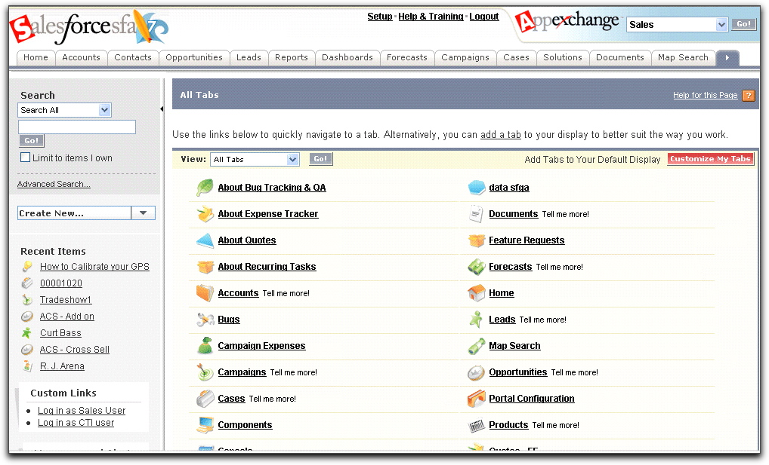
Example of Customizable Web Services (www.salesforce.com)

Slide 40
Why SOA Saves Code
Provides a standard way of interacting with shared software.
Enables software to become building blocks for reuse.
Shifts focus to application assembly rather than design.
Creates new applications out of existing components.
Integrates with applications in other enterprises.

Slide 41
Preservation of Assets is the Purpose of SOA
Data &
Systems Integration;
Communications
Infrastructure
Architecture
Open Systems,
Equipment,
Software,
Communications
What the Customer
Trains to Apply;
Applications
Usage
Short-term
Asset
(An Enterprise Function)
>70% of Cost
Obsolescent
Commodity Asset
(Outsource According to
Architecture)
<20% of Cost
Long - term
Asset
(An Enterprise Function)
<10% of Cost

Slide 42
Impacts of Information Technologies
Information drives economic “arms race”.
Obsolete assets will be discarded.
Collaboration favors global consolidation.
I.T. becomes an economic weapon.

Slide 43
A Historical Perspective

