Slide 1
Service Oriented Architecture
(SOA) for DoD
Prof. Paul A. Strassmann, George Mason University
2009 SOA Symposium: Government and Industry Best Practices
April 2, 2009

Slide 2
Part 1
What is SOA?

Slide 3
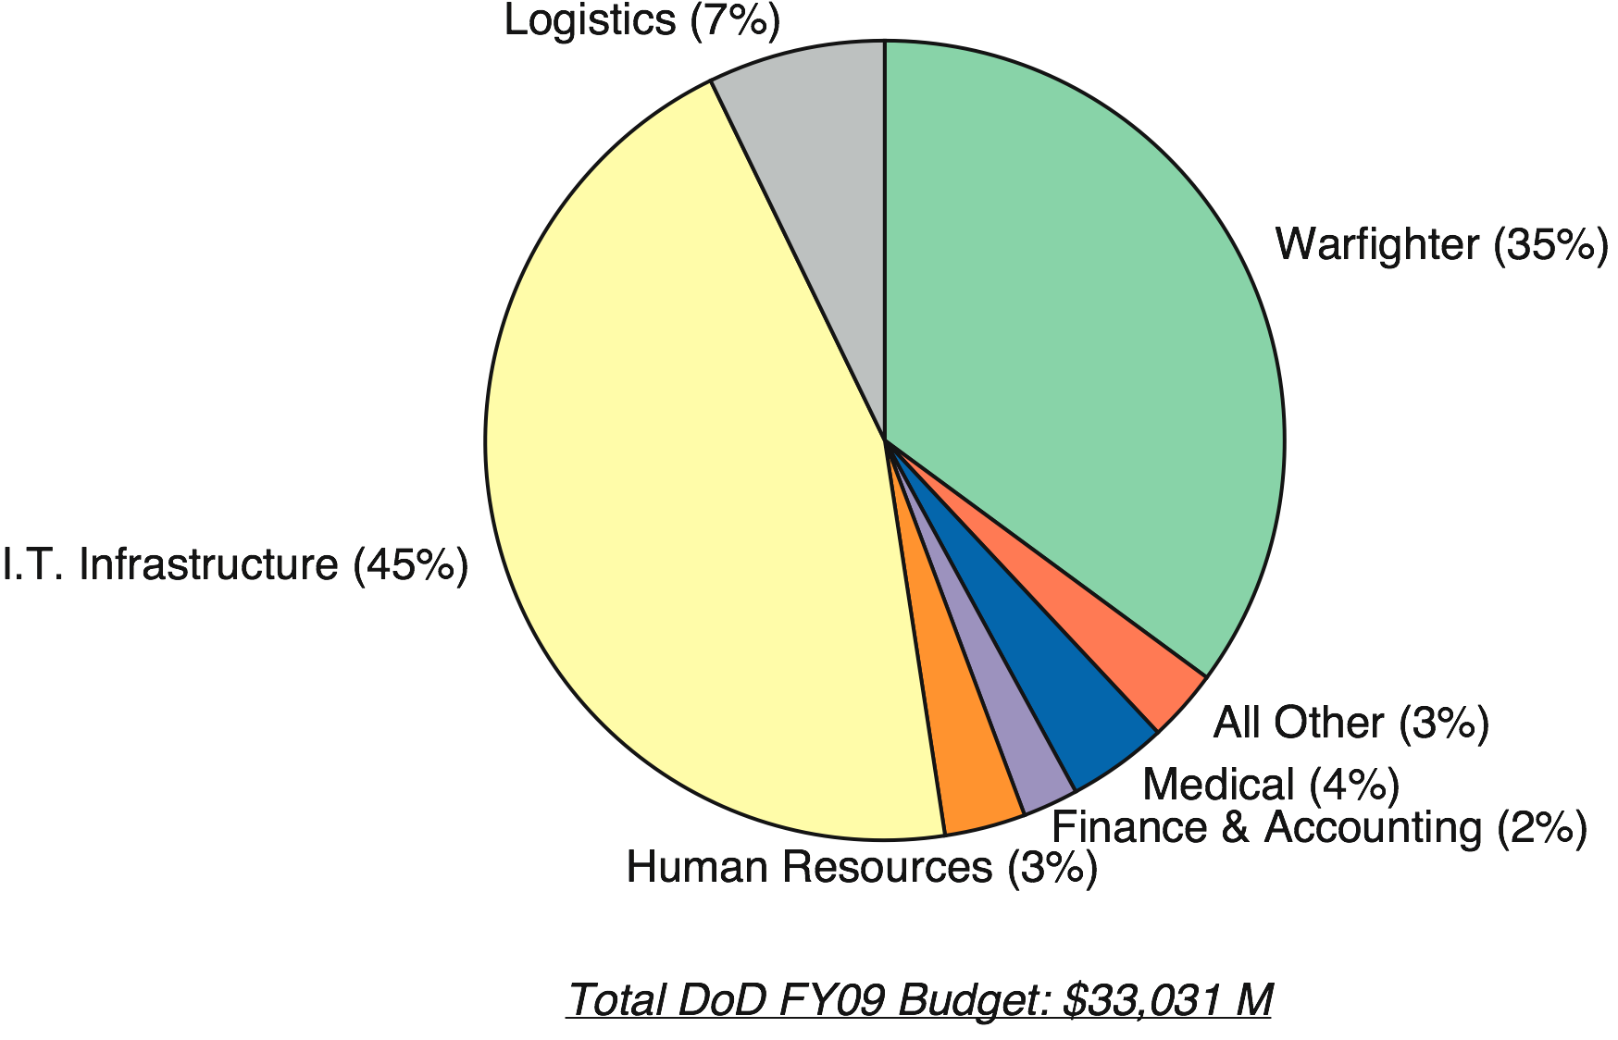
DoD I.T. Spending ($ Millions)
Main SOA
Cost
Reductions
Here
Spending does not include Services labor costs, avionics, weapon electronics, intelligence

Slide 4
What is the Objective of SOA in DoD?
The capacity to:
  Discover Applications Anywhere;
  Display the Capabilities of All Applications;
  Discover Network Data from a Data Registry;
  Mediate the Extraction of Data from Data Bases;
  Execute Requests from Multiple Servers;
  Provide Credentials Validation to Everyone;
  Deliver Results at “Google Speed” of <0.25 second;
  Operate Network with Downtime of < 5 minutes/year.

Slide 5
Part 2
Focus of SOA

Slide 6
Where is the SOA Infrastructure? (FY09)
Business Mission
WarFighting Mission
Intelligence Mission
Cost of Infrastructure: $14.9 Billion
583 Infrastructure Projects
% of Total DoD Spending: 45%

Slide 7
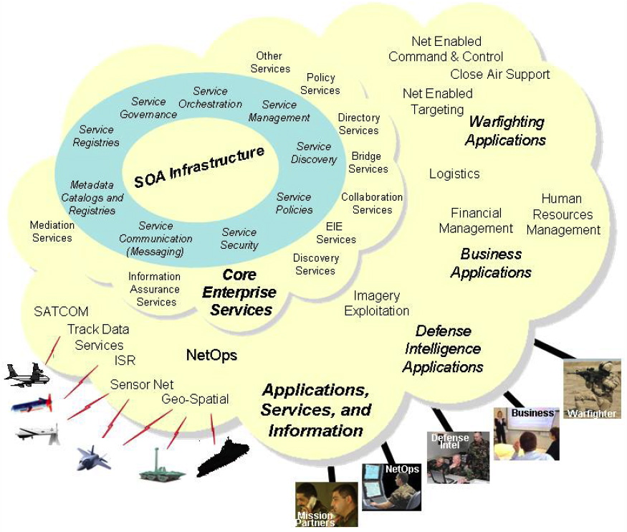
The Roots of SOA Are in a Shared Infrastructure

Slide 8
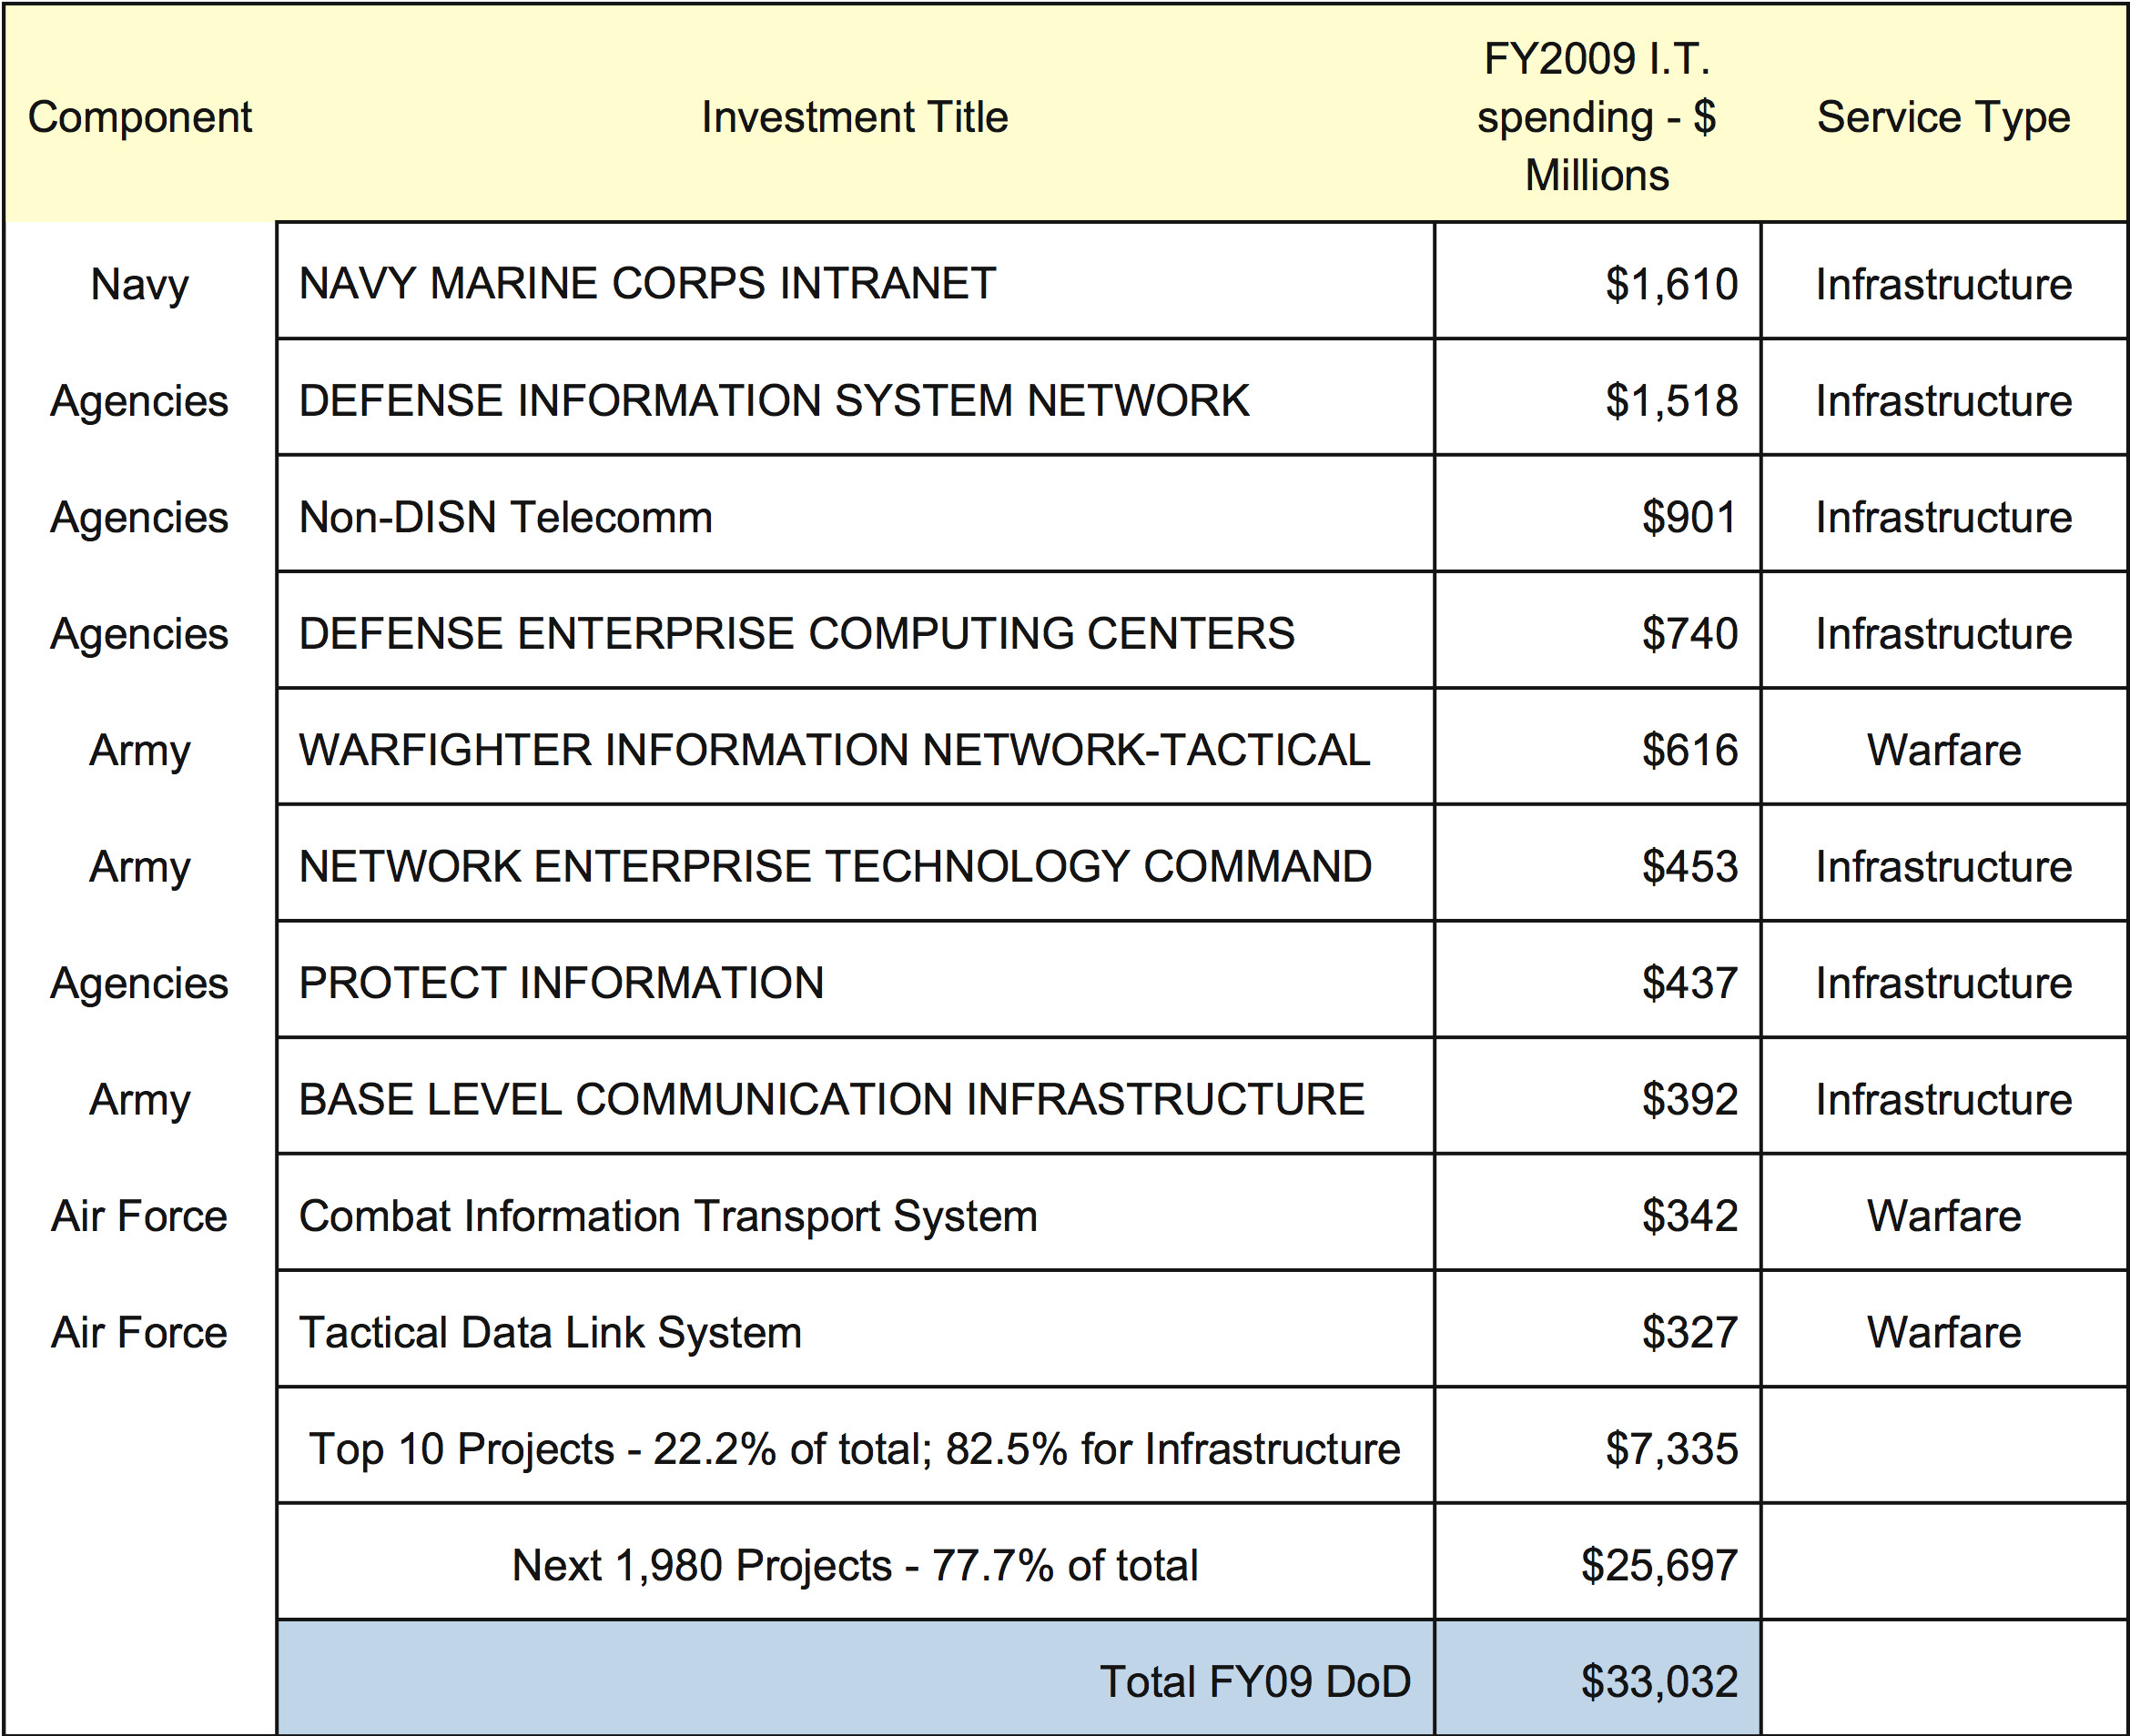
Top 10 DoD Projects Support Mostly the Infrastructure

Slide 9
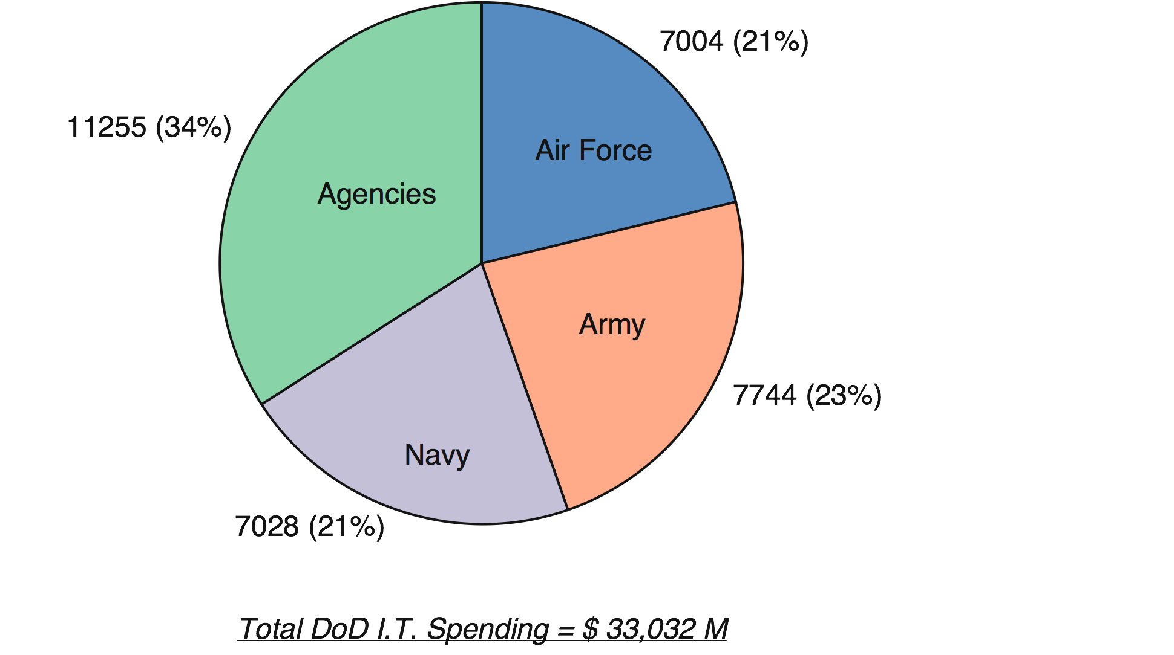
Concentration of Costs in Agencies (34%)

Slide 10
Where Are the Agencies?
Defense Information Systems Agency (DISA)
Defense Finance and Accounting Service (DFAS)
Defense Logistics Agency (DLA)
Business Transformation Agency (BTA)
Defense Commissary Agency (DeCA)
TRICARE Military Health System
Defense Manpower Data Center (DMDC)
Defense Technical Information Center (DTIC)
Defense Contract Audit Agency (DCAA)
Defense Security Services (DSS)
Washington Headquarters Services

Slide 11
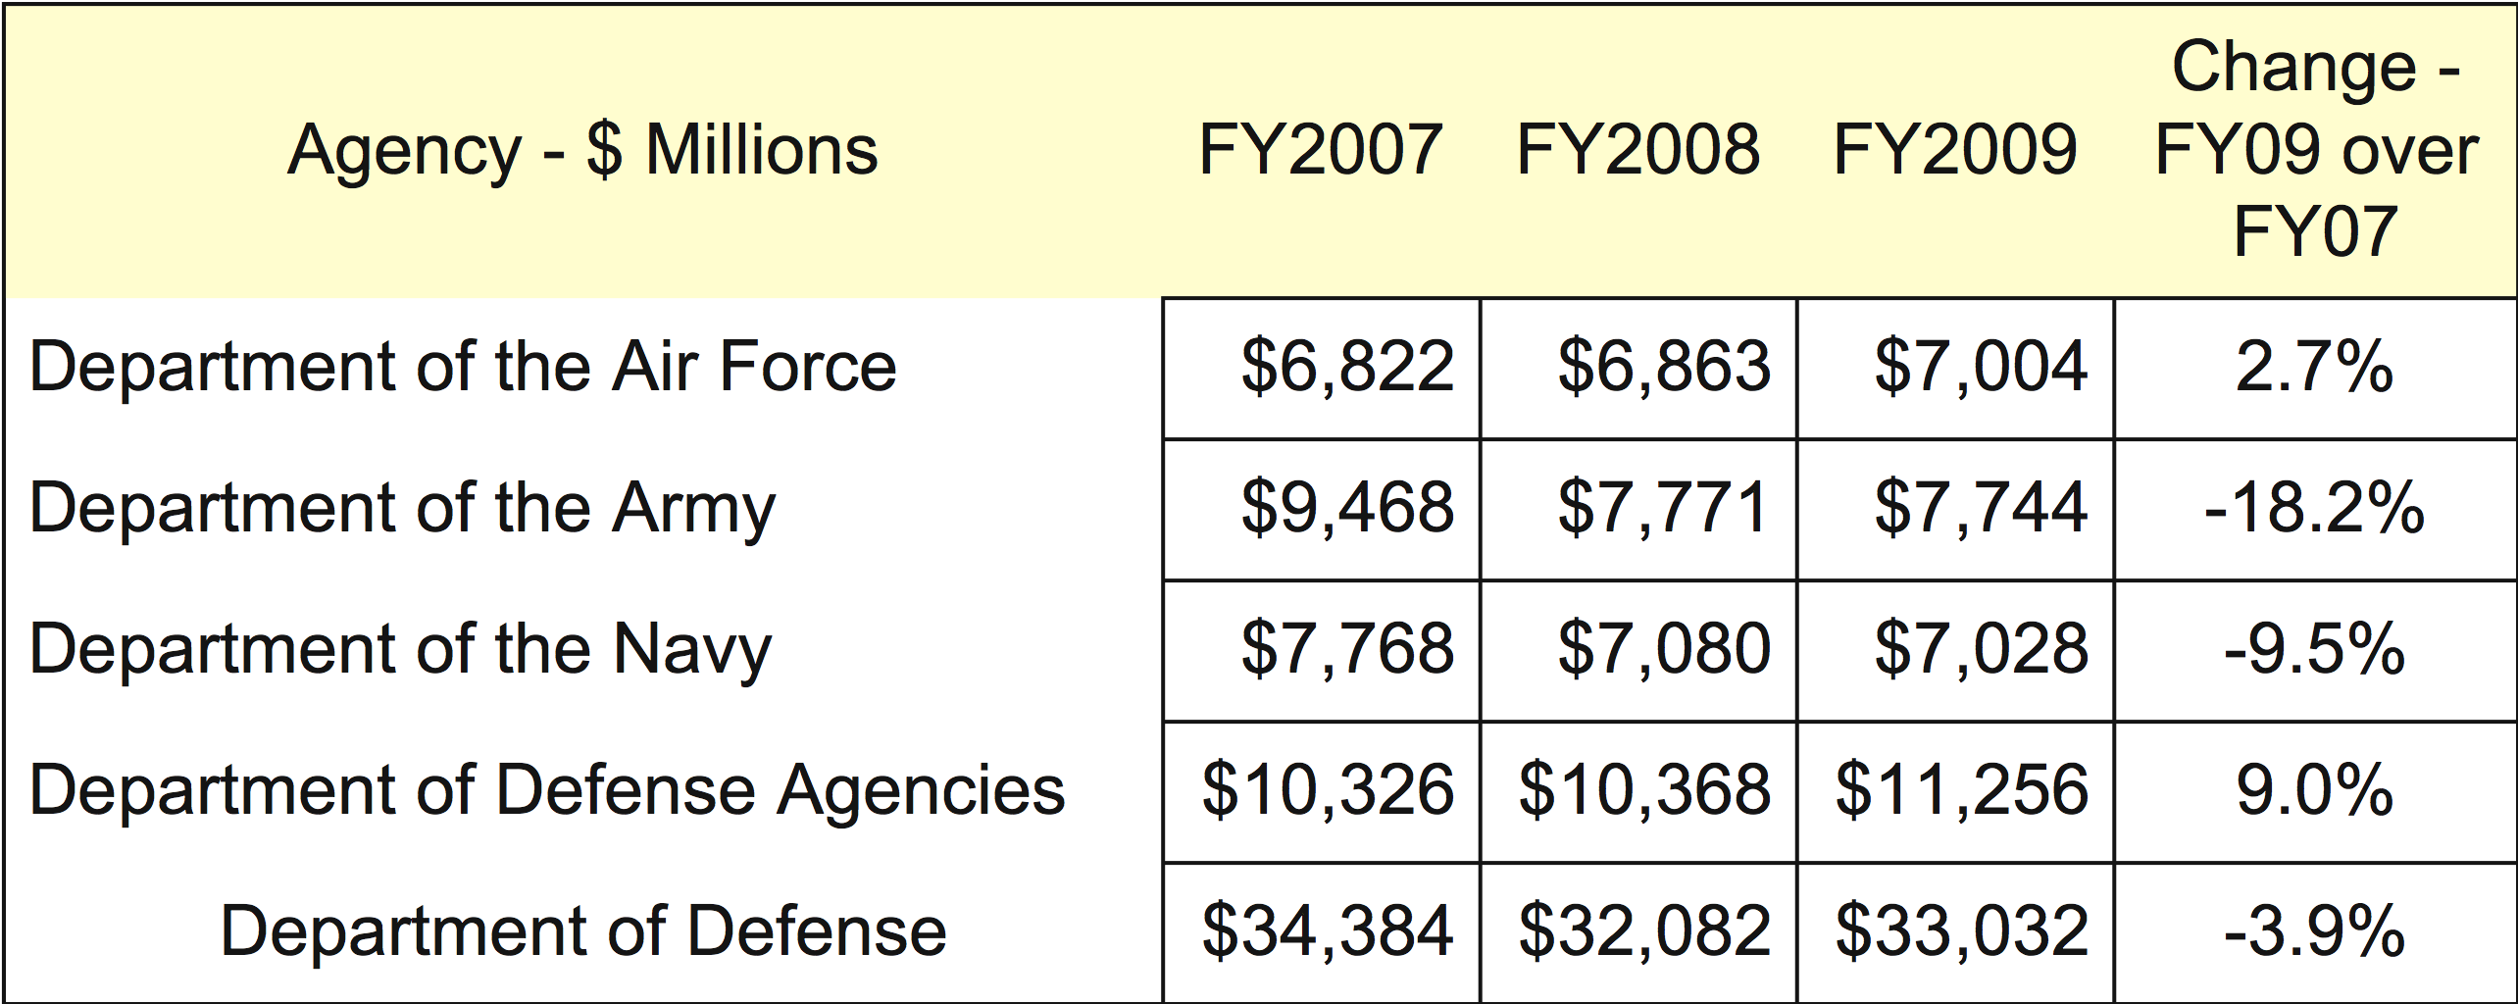
Importance of Agencies is Rising

Slide 12
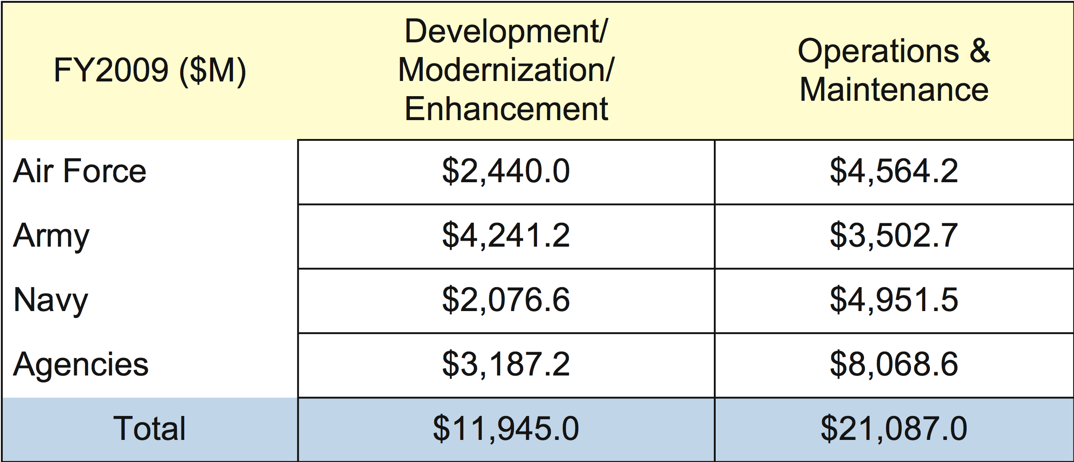
Agencies Have a Large Share of I.T. Spending
Does not include costs of Military and Civilian Employees
Does not include costs of DIA, NGA, NRO, NSA, etc.
Does not include avionics, weapon electronics, shipboard electronics

Slide 13
Part 3
SOA Policies & Governance

Slide 14
SOA Related Policies (Partial List)
DoD Directive 8000.1, “Management of DoD Info Resources”, November 21, 2003
DoD Manual 8020.1-M, “Functional Improvement Process”, August 1992
DoD Directive 8100.1, “GIG Overarching Policy”, September 19, 2002
DoD Directive 8100.2, “Wireless Technologies and the GIG”, April 14, 2004
DoDI 8110.1 “Multinational Information Sharing Networks Implementation”.
DoD Directive 8115.1, "I.T. Portfolio Management", October 10, 2005
DoD Manual 8320.1-M, “Data Administration Procedures”, March 1994.
DoD Manual 8320.1-M-1, “Standard Data Element Development”, May 1992.
DoD Directive 8320.2, “Data Sharing in DoD”, December 2, 2004.
DoD Directive 8320.03, “Identification Standards”, March 23, 2007.
DoD Directive 8500.1, “Information Assurance”, October 24, 2004.
DoD Net-Centric Data Management Strategy: Metadata Registration, April 3, 2003
DoD Net Centric Strategy, May 9, 2003
Department of Defense Discovery Metadata Specifications
DEPSECDEF Memorandum on “Information Technology Portfolio Management”, March 22, 2004
Director of Central Intelligence, “Intelligence Information Sharing”, June 9, 2004

Slide 15
Example of Foundations of SOA
DoD Directive 8320.02, Data Sharing
  Data shall be visible, accessible, and understandable to any user.
  Data assets shall be made visible by associating metadata (“tagging”) for each data asset.
  Data assets shall be made understandable by publishing semantic and structural metadata in a DoD metadata registry.

Slide 16
DoD Directive 7045.20 Defines Capability Portfolios
Example of SOA Implementation
  Command & Control: ASD(NII)
  Net Centric Systems: ASD(NII)
  Force Protection: USD(AT&L)
  Force Applications: USD(AT&L)
  Force Support: USD(P&R)
  Logistics: USD(AT&L)
  Battle Space Awareness: USD(I)
  Building Partnerships: USD(P)
  USD(P) JROC
  Corporate Management: DCMO

Slide 17
Example of Implementation of Business Mission
Functions of the Chief Management Officer
  Planning and budgeting, including performance measurement.
  Acquisition.
  Logistics.
  Facilities, installations, and environment.
  Financial management.
  Human resources and personnel.
  Management of information resources, including information technology, networks, and telecommunications functions related to above.

Slide 18
Problem: Who Oversees SOA? (Partial List)
DoD CIO Executive Board (CIO EB)
Military Communications and Electronics Board (MCEB)
GIG E2E Systems Engineering Advisory Board (SSEB)
IT Standards Oversight Panel (ISOP)
Information Assurance Senior Leadership Group (IASLG)
Interoperability Senior Review Panel (ISRP)
GIG Waiver Board and Panel
DISN Flag Panel
DISN Designated Approving Authority (DAA)
DISN Security Accreditation Working Group (DSAWG)
DIAP (Defense-Wide Information Assurance Program.)
Joint Battle Management Board (JBMC2 BoD)
Defense Business Systems Management Committee (DBSMC)
CCB (Configuration Control Board)

Slide 19
Part 4
Organizing for SOA

Slide 20
Organization of Infrastructure Services for SOA
Infrastructure
Services
(Enterprise Information)
Data
Services
Security
Services
Computing
Services
Communication
Services
Application
Services

Slide 21
Organization of Data Services
Data
Services
Discovery
Services
Management
Services
Collaboration
Services
Interoperability
Services
Semantic
Services

Slide 22
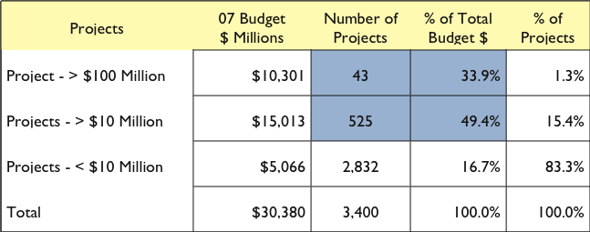
DoD Projects Have Own Data

Slide 23
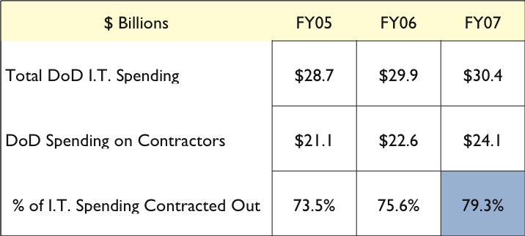
DoD Contractors Build Separate Infrastructures & Dictionaries

Slide 24
Organization of Communication Services
Communication
Services
Interoperability
Services
Spectrum
Management
Connectivity
Arrangements
Continuity of
Services
Resource
Management

Slide 25
Organization of Computing Services
Computing
Services
Computing
Facilities
Resource
Planning
Control &
Quality
Configuration
Services
Financial
Management

Slide 26
Organization of Application Services
Application
Services
Component
Repository
Code Binding
Services
Maintenance
Management
Portals
Experimental
Services

Slide 27
Part 5
Why SOA?

Slide 28
The Economics of Transformation Through SOA
Equipment,
Software.
Data &
Communications.
Customer,
Integration
Short-term Asset
>50% of Cost
Commodity
<20% of Cost
Long-term Asset
<30% of Cost
Infrastructure
Adaptation

Slide 29
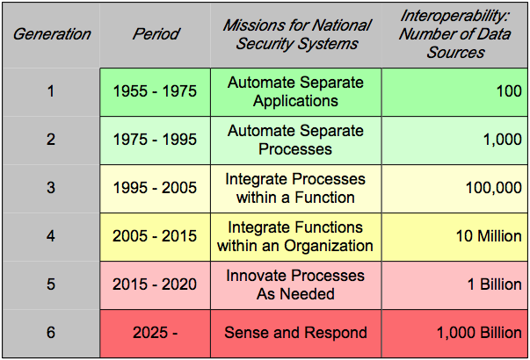
2025 SOA Forecast: >1,000 Billion Transactions / Hour

Slide 30
Summary
SOA requires standardization.
SOA requires discarding of obsolete assets.
SOA is a driver in an “arms race”.
SOA enables a weapon of Information Warfare.
Current pace of SOA implementation is unsatisfactory.
WW IV has already started.
WW IV requires Information Superiority.
SOA is necessary for DoD Information Superiority.

Slide 31
References:
Questions? E-mail: pstrassm@gmu.ed
Further Reference: www.strassmann.com
AFCEA Signal article: http://www.strassmann.com/pubs/afcea/2008-11.html
Video Lecture: “What is a Service Oriented Architecture”
http://video.google.com/videoplay?docid=-2644274303432509757

