Slide 1

The Next I.T. Tsunami
Paul A. Strassmann

Slide 2
Perspective
MultiMedia
Data+Text
Billions Sources
Data
Million Sources
Hundred Sources
1955-1975
1975-1995
1995-2015
Real-Time Connections
Days⇒Seconds
Weeks⇒Days
Months⇒Weeks

Slide 3
Perspective
MultiMedia
Data+Text
Billions Sources
Data
VoIP
Million Sources
Hundred Sources
1955-1975
1975-1995
1995-2015
Real-Time Connections
Days⇒Seconds
Weeks⇒Days
Months⇒Weeks

Slide 4
Today’s Presentation
Organization of multi-media communication.
Internet services.

Slide 5
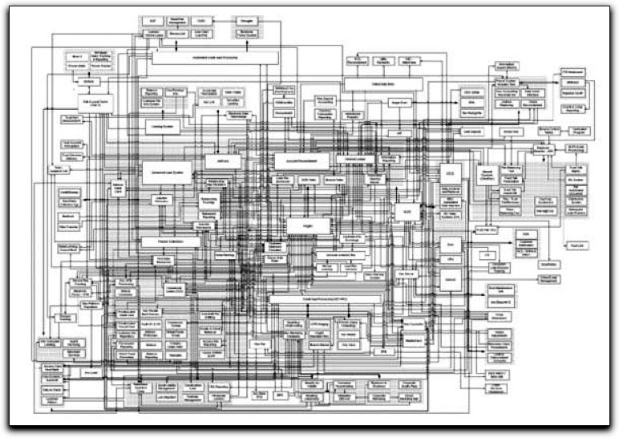
A View of Corporate Networks

Slide 6
The Challenge
Infrastructure costs = >50% of total spending;
Networks insecure;
Integration costs = >50% of application costs;
Network downtime = >20 hrs/year;
Desktop costs = Excessive;
Time to innovation = Excessive.

Slide 7
Metrics for the Future
Integrated data, voice and video services:
Six Sigma+ Reliability (<5 min downtime/yr);
Workstation Speed (200 Billion ops/sec);
Workstation Connectivity (>1 Gigabyte/sec);
Systems Reconfiguration (<1 min delay);
Access to petabytes of data (<0.25 sec);
Customizing an Application (<1 hr implementation);
Strong authentication for access.

Slide 8

Example of Next Generation Design

Slide 9
The Google Infrastructure
>200,000 commodity Linux servers;
Storage capacity >5 petabytes;
Indexed >8 billion web pages;
Capital and operating costs at fraction of large scale commercial servers;
Traffic growth 20-30%/month.

Slide 10
Dimensions of a Google Cluster
• 359 racks
• 31,654 machines
• 63,184 CPUs
• 126,368 Ghz of processing power
• 63,184 Gb of RAM
• 2,527 Tb of Hard Drive space
Appx. 40 million searches/day

Slide 11
Architecture for Reliability
Replication (3x +) for redundancy;
Replication for proximity and response;
Fault tolerant software for cheap hardware.
Policy: Reliability through software architecture, not hardware.

Slide 12
Query Serving Infrastructure
Processing a query may engage 1000+ servers;
Index Servers manage distributed files;
Document Servers access distributed data;
Response time = <0.25 seconds anywhere.

Slide 13
Systems Engineering Principles
Overwhelm problems with computational power;
Impose standard file management;
Manage through standard job scheduling;
Apply simplified data processing discipline.

Slide 14
Google: The Network is the System
Coordinates servers in real-time;
Automates distribution of workload;
Assures fault tolerance;
Performs systems-wide cluster scheduling;
Delivers status and performance monitoring.

Slide 15
Intelligence Built into Services
Tools examine millions of documents in real time;
Automated learning for logical processing
  Query: “Bay Area Cooking Classes”
  Matches: “San Francisco College Classes”;
  “The Magic of Thai Cuisine”

Slide 16
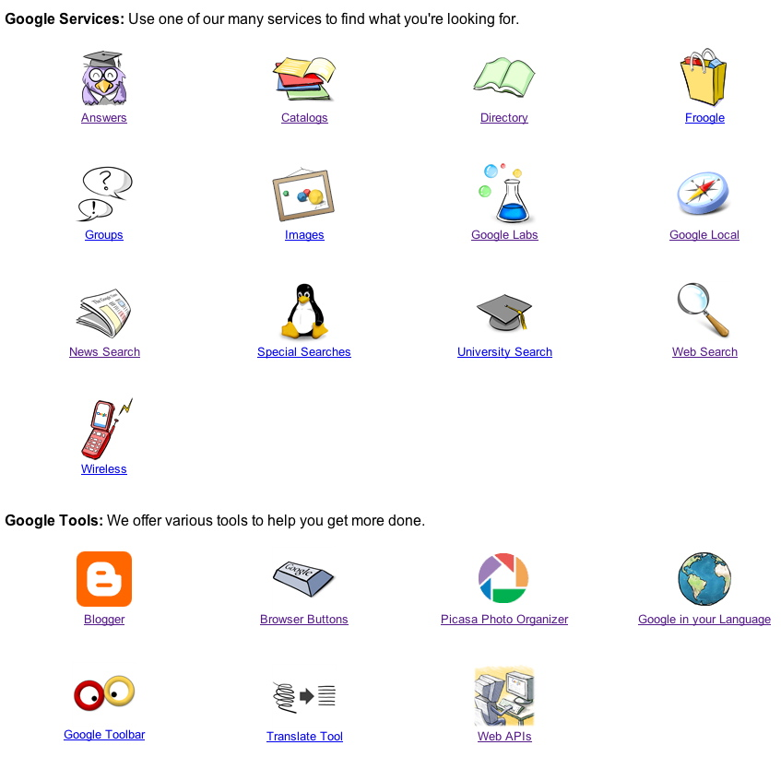
Rapid Additions to Robust Infrastructure

Slide 17
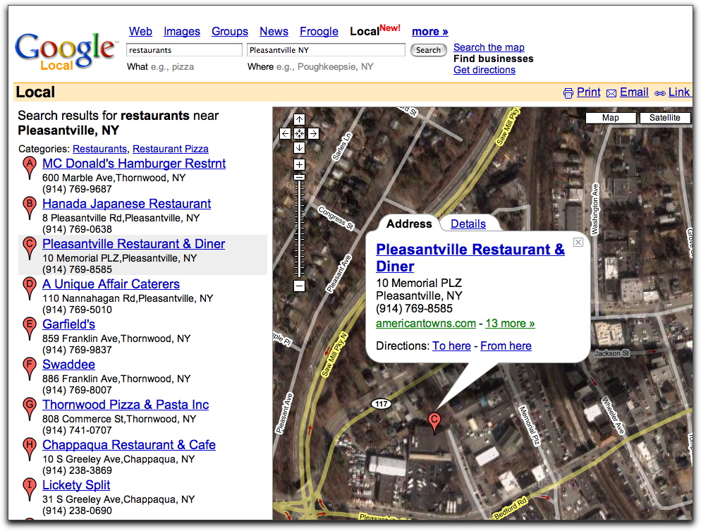
An AJAX Application

Slide 18
Future: Rich Internet Applications
“Thin-clients” deliver Internet services.
Browsers display graphic interfaces.
Standard browsers, not plug-ins.
Packaged applications available on Internet.
Delivery of data, voice and video.
Replaces phones, TV and print media.

Slide 19
Summary
Computer-centric solutions will be replaced by network-centric services.
A Google-like architectures open a way for significant reductions in the costs of Internet services.
We know what will happen, just do not know how to get there.

Slide 20
