Slide 1
Stevens Institute of Technology
The Structure of
I.T. Spending as Measure of
Organizational Disorder
Paul A. Strassmann, May 19, 2005

Slide 2
Outline of Presentation
A theory of organizational order;
I.T. indicators of DoD organization;
Data management as key to systems order;
Entropy reversal rules;
Organization for entropy reversal.
Summary

Slide 3
The Second Law of Thermodynamics (The Law of Entropy)
Energy spontaneously disperses
if not hindered by organization.

Slide 4
“Entropy” is a Measure of Organizational Disorder
Measures randomness in a system;
Measures loss of information in a message*;
Measures deterioration in performance.
* Claude Shannon, “Mathematical Theory of Communications”

Slide 5
The Effects of Entropy on Organizations
Disorder
Organization
Integration
Reduced Costs - Increased Capabilities
Increased Costs - Reduced Capabilities

Slide 6

The First Systems Organizer

Slide 7



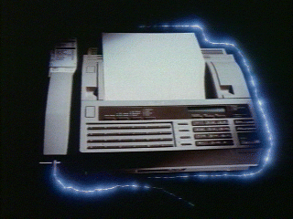

Integration is More than Connecting
E-Commerce
SAP
15
BFDI
14
17
DRP
2
3
11
16
Customer Call
Email
9
CBCF
BW
6
Computer
Telephony
12
Financials
Customer Call
7
COPS
1
JDA
Tax System
BW
6
Computer
Telephony
13
4
5
8
1
10
?
7
COPS
1
JDA
E-Commerce
14
SAP
15
BFDI
13
4
1
10
14
E-Commerce
14
5
8
BFDI
2
16
17
DRP
14
SAP
15
9
3
11
2
17
DRP
Email
12
Financials
CBCF
9
3
11
16
Tax System
Email
12
Financials
CBCF
Tax System
BW
Customer Call
6
COPS
1
Computer
Telephony
JDA
Customer Call
7
BW
6
Computer
Telephony
13
4
5
8
1
10
7
COPS
1
JDA
E-Commerce
14
SAP
15
BFDI
13
1
10
14
17
4
14
5
8
BFDI
2
3
11
16
DRP
Customer Call
E-Commerce
14
SAP
15
Email
9
CBCF
BW
6
Computer
Telephony
2
17
DRP
12
Financials
7
COPS
1
JDA
9
3
11
16
Tax System
13
4
1
10
Email
12
Financials
CBCF
E-Commerce
14
5
8
BFDI
Tax System
14
SAP
15

Slide 8
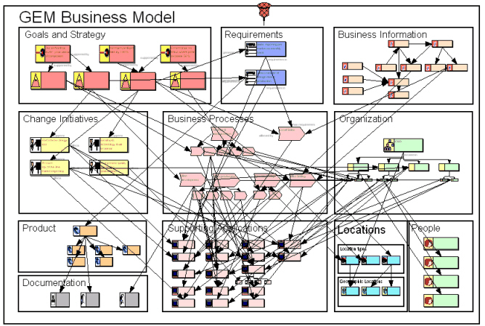
Systems Integration Policy & Organizational Conflicts
Goals
Strategy
Requirements
Changing scope
Processes
Standards
Security
Organization
Products
Operations
Maintainability
Locations
People
Politics

Slide 9
Outline of Presentation 2
A theory of organizational order;
I.T. indicators of DoD organization;
Data management as key to systems order;
Entropy reversal rules;
Organization for entropy reversal.
Summary

Slide 10
DoD FY 2006 I.T. Budget by Function (Final Budget)
T-T Ratio: 25.4%/(100-25.4) = 34%

Slide 11
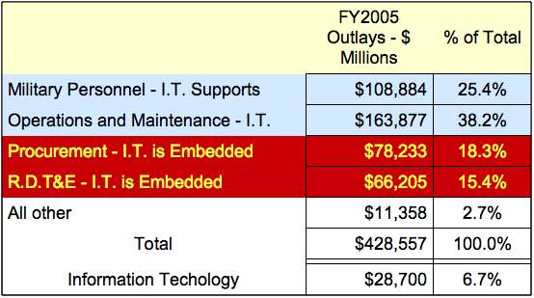
Support I.T. Excludes Embedded I.T. (FY2005)

Slide 12
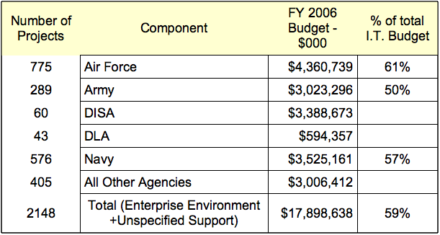
Preliminary FY06 I.T. Infrastructure Budget by Component

Slide 13
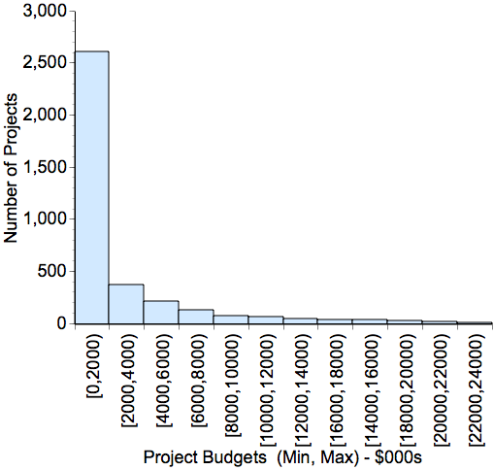
80% of DoD I.T. Projects <$2 Million

Slide 14
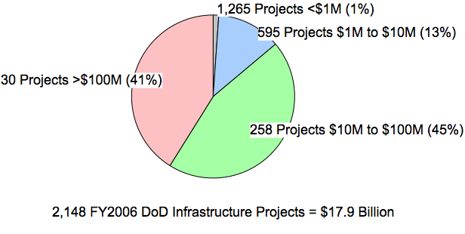
87% of DoD Infrastructure Projects are Small

Slide 15
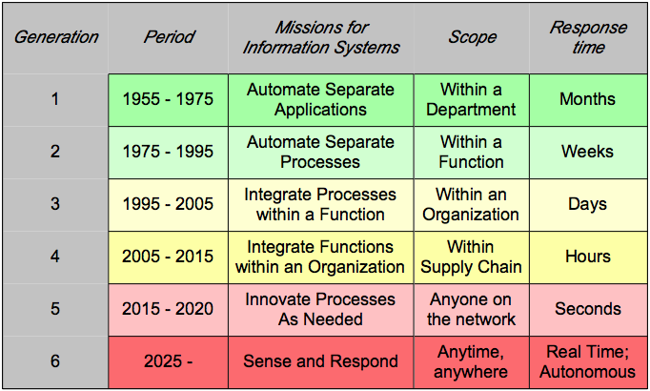
Challenge: Changes in Scope and Response Time

Slide 16
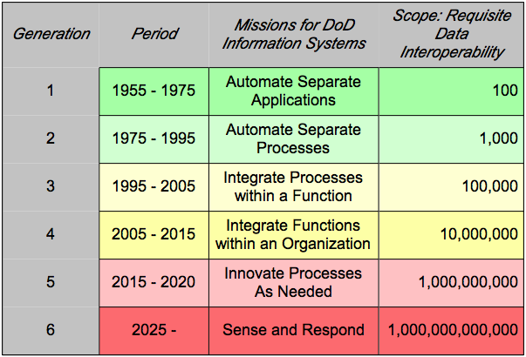
Challenge: “Transformation” Does not Scale

Slide 17
Outline of Presentation 3
A theory of organizational order;
I.T. indicators of DoD organization;
Data management: key to systems order;
Entropy reversal rules;
Organization for entropy reversal.
Summary

Slide 18
DoD Directives Support DoD Data Management
DoD Directives 5000.12 and 5000.18 issued in 1964.
DoD Directive 5105.19, “Defense Information Systems Agency – DISA”, June 25, 1992.
DoD Manual 8320.1-M-1, “Standard Data Element Development, Approval, and Maintenance Procedures”, May 1992.
DoD Manual 8020.1-M, “Functional Improvement Process”, August 1992
DoD Manual 8320.1-M, “Data Administration Procedures”, March 1994.
DoD Directive 8320.2, “Data Sharing in a Net-Centric Department of Defense”, December 2, 2004.

Slide 19
Support and Infrastructure Consumes Most of the Resources
Support Staff
Applications
Equipment &
Software,
Infrastructure
For Warfighter
$7.6 Billion
25%
$17.9 Billion
60%
$4.6 Billion
15%

Slide 20
Example: Program Management & Integration As Cost

Slide 21
Implementation of MetaData Policies Lagging

Slide 22
Outline of Presentation 4
A theory of organizational order;
I.T. indicators of DoD organization;
Data management: key to systems order;
Entropy reversal rules;
Organization for entropy reversal.
Summary

Slide 23
How to Decrease Complexity and Costs
1. Bar application logic from the infrastructure;
2. Remove application data from the infrastructure;
3. Migrate systems intelligence to the periphery for variety and innovation;
4. Enforce standards for access to infrastructure;
5. Shift to variable transaction costs

Slide 24

A Variable Cost Service - A Demand Infrastructure

Slide 25
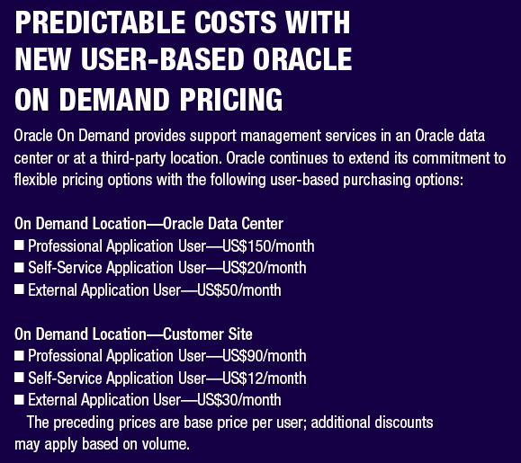
A Volume Scaleable Infrastructure of Low Cost of Services

Slide 26
IBM’s ASCENTIAL Data/Infrastructure Consolidation Suite
One integrated platform for all data integration tasks
• Integrated enterprise metadata management
• Scalable dictionaries to meet the largest demands of data migration
Open, Service-Oriented Architecture
Data Profiling & Data Quality
Real-time Data Transformation and Routing
Reusable Components & Rules
Anytime, Anywhere Connectivity

Slide 27
Outline of Presentation 5
A theory of organizational order;
I.T. indicators of DoD organization;
Data management: key to systems order;
Entropy reversal rules;
Organization for entropy reversal.
Summary

Slide 28
DoD Directive 5144.1, May 2, 2005
Responsibilities, functions, relationships and authorities of the DoD Chief Information Officer.

Slide 29
1. Organization
Reports directly to the office of the SECDEF.
Acts the Principal Decision Authority on behalf of the SECDEF whenever questions arise with regard to priority in using information resources or services.

Slide 30
2. Authority
Oversees and exercises direction and control over the costs and performance of data centers, communication networks and all purchased services. There are no exemptions from the scope of the CIO roles.
Covers staff oversight over both administrative as well as all mission-related activities.
Does not exercise direct supervision over day-to-day I.T. operations.

Slide 31
3. Information Resources
Sets policies, evaluation criteria and assesses the effectiveness of the uses of all information resources, including records management, corporate archives and printing services.

Slide 32
4. Information Assurance
Specifies and validates information assurance measures, inclusive of information security, reliability, backup, redundancy, recovery from failure and capacity to support extraordinary demands for services.

Slide 33
5. Systems Integration
Designated as the Chief Architect, responsible for the integration of information communications and data elements across the entire organization, with emphasis on assuring full interoperability of all systems components.
Issues standards for guiding the development and maintenance of all information technologies.

Slide 34
6. Data Management
Prescribes and monitors the execution of all data management and data standardization policies for the entire enterprise.

Slide 35
Summary
Complexity and costs will rise without structure and enterprise-wide order;
DoD high cost infrastructure reveals entropy;
A “dumb” infrastructure is more scaleable and upgradeable than local solutions.
DoD can be improved by first simplifying the infrastructure, then imposing metadata discipline and only then consolidating applications.
DoD will improve through restructuring management.

Slide 36

Purpose of Information Management

