Slide 1
The Death of Money
Paul A. Strassmann, Investment Club, January 5, 2015

Slide 2
The Death of Money
The Coming Collapse of the International Monetary System
by James Rickards
SMC Meeting, December 5, 2014

Slide 3
Recommended Rickards Portfolio
Gold coins 20%
Undeveloped land 20%
Fine art 10%
Hedge funds, Private Equity 20%
Singapore & Canadian Cash 30%

Slide 4
Seven Signs of Incipient Collapse of the Dollar
The price of gold >$6,000/oz
Acquisition of gold by China >8,000 tons
IMF takes over with SDR currency to replace the dollar
Failure of US regulatory controls
Increase in stock market crashes
End of Quantitative Easing
Ultimately Chinese government replaces dollars with Yuan

Slide 5
Current SMC Investment Club Position
Collapse of dollar premature
US continues to be a $100 trillion economy
Continue investing in high value equity
Keep liquid portfolio – expect higher interest
Expect inflation
Buy small amounts of personal gold
Follow SMC portfolios for diversification

Slide 6
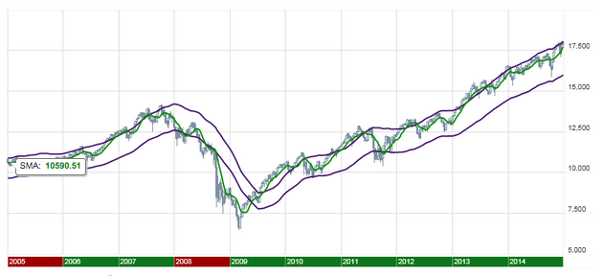
Dow Jones Index over 20 Years

Slide 7
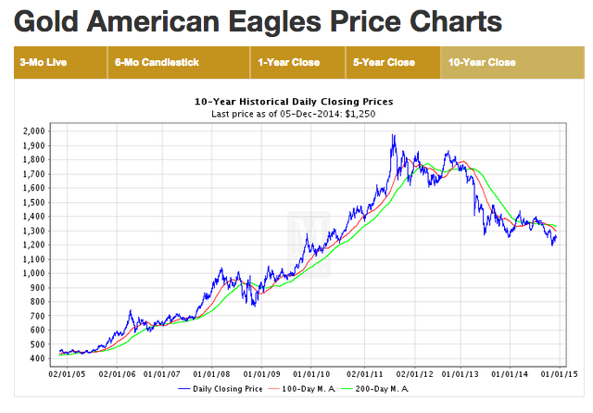

Slide 8
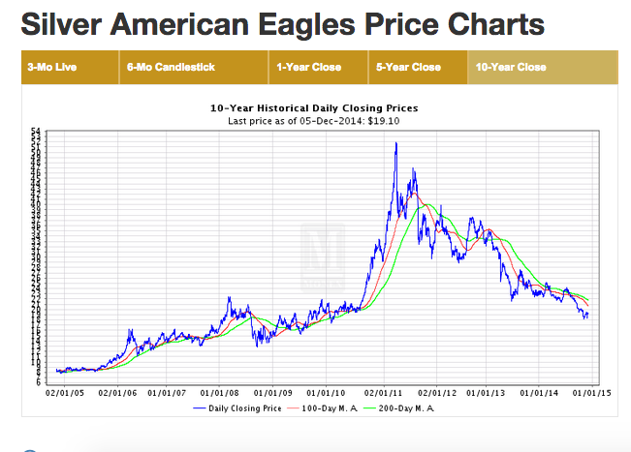

Slide 9


Slide 10
Analysis of SMC Portfolio
Paul A. Strassmann, Senior Investment Club, January 5, 2015

Slide 11
Summary from November 3 Investment Club Meeting
Market is getting ready for a major correction
Selective long term investments for retirement
Investment Club to track investment methods
Portfolio #1: Value Line
Portfolio #2: No Load Fund
Portfolio #3: Prudent Speculator
Portfolio #4: Independent Adviser (Vanguard)

Slide 12


Slide 13
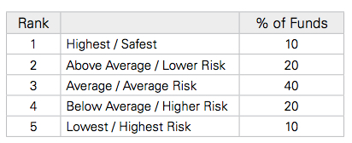
Value Line Ranking
* http://www3.valueline.com/pdf/ValueLineFundAdvisor.pdf

Slide 14
Reposition Portfolios from Index Funds to Targeted Investments
Reposition from Index Funds
to
High Value Individual Stocks

Slide 15
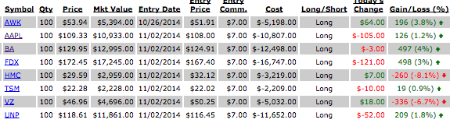
From: http://www.newcanaan-smc.com

Slide 16
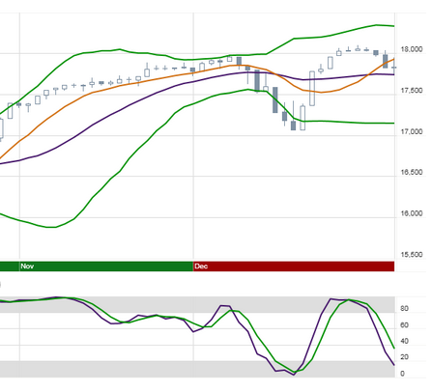
Dow Jones Industrial Average – November 2 to December 31

Slide 17
Performance of SMC Portfolio
Total Market Value 11/02/2014: $67,362
Total Market Value 12/31/2014: $68,311
Total Gain: $949.00 (1.409%)
$DJI Gain: (2.63%)

Slide 18
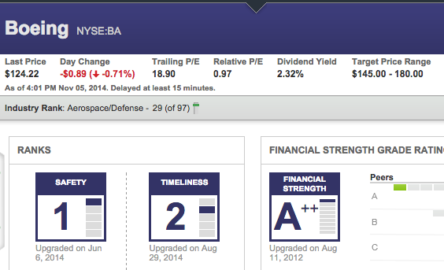

Slide 19
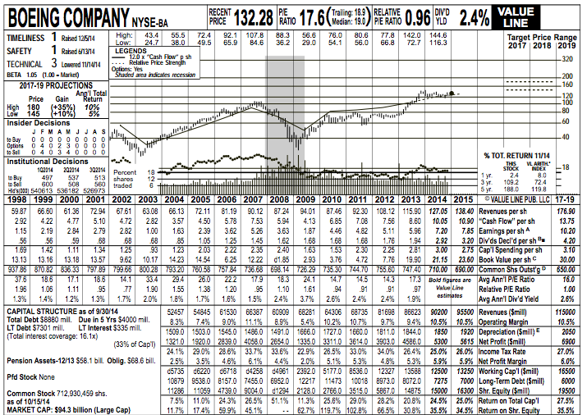

Slide 20
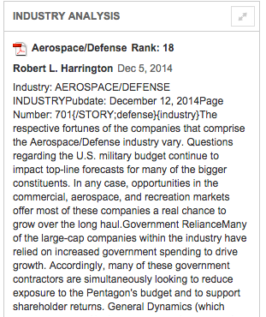

Slide 21
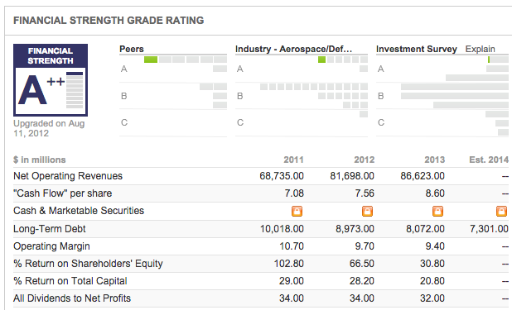

Slide 22
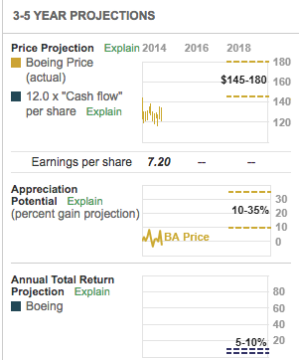

Slide 23
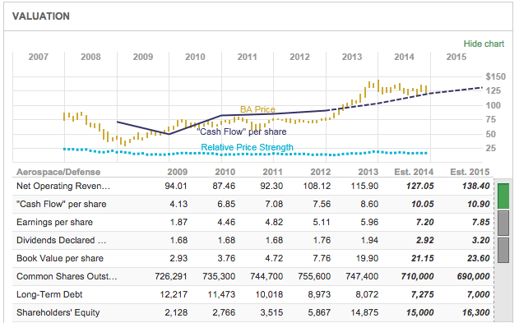

Slide 24
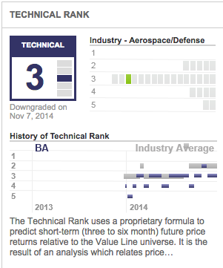

Slide 25
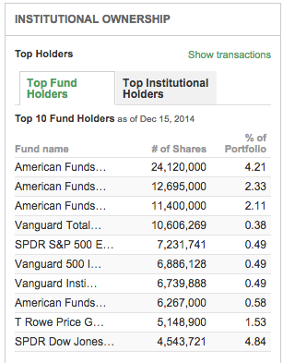

Slide 26
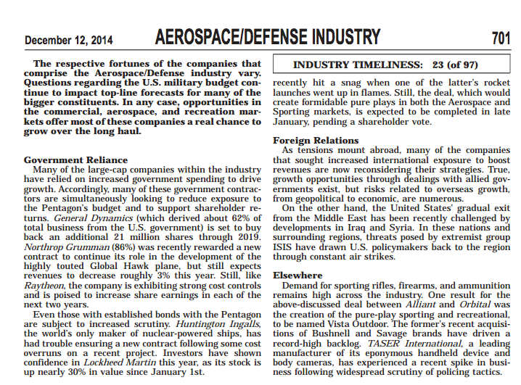

Slide 27
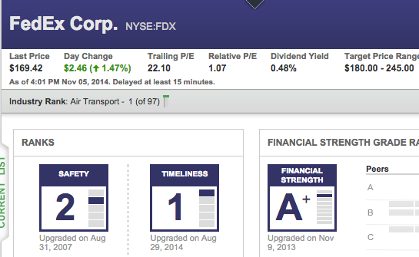

Slide 28
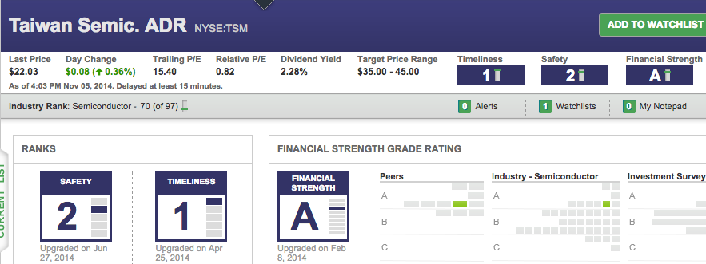

Slide 29
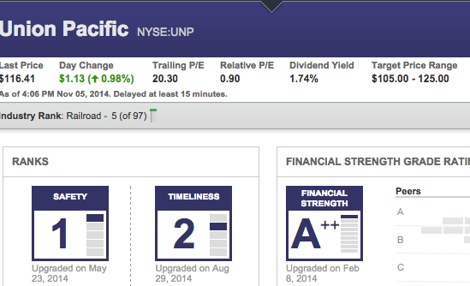

Slide 30
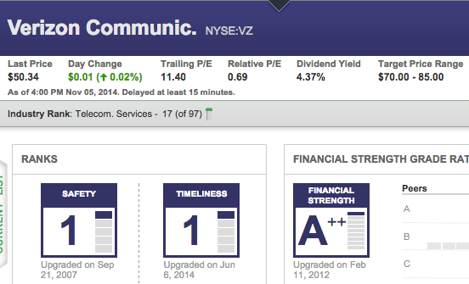

Slide 31
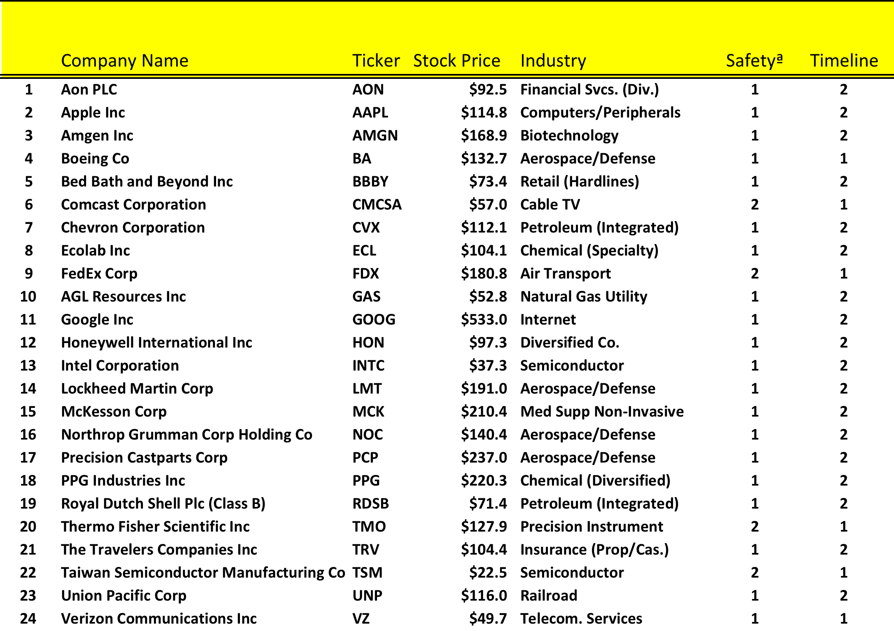
Example of a Custom Personal Portfolio

Slide 32
Latest Investment Advice
Prepare for the worst.
Hope for the best.
Count on being surprised.

