Slide 1

StreamApprox Approximate Stream Analytics in Apache Spark https://streamapprox.github.io
Do Le Quoc, Pramod Bhatotia,
Ruichuan Chen, Christof Fetzer, Volker Hilt, Thorsten Strufe
10/2017

Slide 2

Modern online services
Stream
Aggregator
Stream Analytics System
Useful
Information

Slide 3


Modern online services
Approximate computing
Tension
Low latency
Efficient resource
utilization

Slide 4
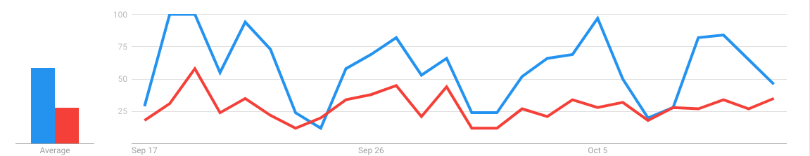
Approximate Computing
Many applications: Approximate output is good enough!
The trend of data is more important than the precise numbers
E.g. : Google Trends --- “Spark SQL” vs “Spark Streaming” (Sep/2017 – Oct/2017)
100
50
0
Average
Sep 17
Sep 26
Oct 5

Slide 5
Approximate Computing
Idea: To achieve low latency, compute over a sub-set of data items instead of the entire data-set
Approximate computing
Take a
sample
Approximate output ± Error bound
Compute

Slide 6
State-of-the-art systems
BlinkDB [EuroSyS’13]
Using pre-existing samples
Not designed for
stream analytics
ApproxHadoop [ASPLOS’15]
Using multi-stage sampling
Quickr [SIGMOD’16]
Injecting samplers into query plan

Slide 7
StreamApprox: Design goals
Transparent
Targets existing applications w/ minor code changes
Practical
Supports adaptive execution based on query budget
Efficient
Employs online sampling techniques

Slide 8
Outline
Motivation
Design
Evaluation

Slide 9
StreamApprox: Overview
Input data stream
Streaming query
Query budget
S₁
Stream
aggregator
(E.g Kafka)
Data stream
StreamApprox
S₂
Approximate output error bound
…
S_{n}
Query budget:
Latency/throughput guarantees
Desired computing resources for query processing
Desired accuracy

Slide 10
Key idea: Sampling
Simple random sampling (SRS):
Stratified sampling (STS):
SRS
SRS
SRS
SRS

Slide 11

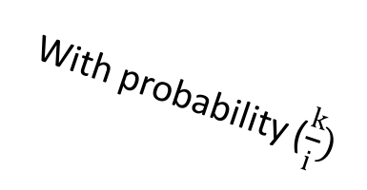
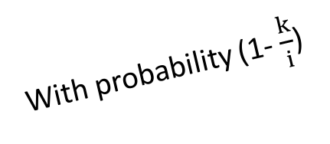
Key idea: Sampling
Reservoir sampling (RS):
With probability (1- $\frac{k}{i}$)
Drop item i
i
With probability ($\frac{k}{i})$
Replace by item i
Size of reservoir = k

Slide 12
Spark-based Sampling
Spark-based Simple Random Sampling (Spark-based SRS)
Step
#1
Step
#2
Step
#3
0.01
0.08
0.02
0.01
0.02
0.06
0.01
0.02
0.06
0.06
0.12
0.68
0.08
0.12
0.15
0.08
0.12
0.15
0.26
0.88
0.26
0.68
0.88
Assign each item
with a random
number in [0, 1]
Sort items based
on assigned value
Take out k
smallest items
Sorting big data is very expensive

Slide 13
Spark-based Sampling
Spark-based Stratified Sampling (Spark-based STS)
Step
#1
Step
#2
Step
#3
Create strata
using groupByKey()
Apply SRS
to each stratum S_{i}
Synchronize between
worker nodes
to select a
sample of size k
These steps are very expensive

Slide 14
StreamApprox: Core idea
Online Adaptive Stratified Reservoir Sampling (OASRS)
RS
S₁
Weight = #items/k = 8/4
Size of reservoir = k
RS
Weight = #items/k = 6/4
S₂
RS
Weight = 1
S₃
RS : Reservoir Sampling
k = 4
Easy to parallelize, doesn't need any synchronization between workers

Slide 15
StreamApprox: Core idea
Worker 1
OASRS
Weight = 2
Weight = 1.5
Weight = 1
Worker 2
Weight = 1
OASRS
Weight = 2
Weight = 1.5
Size of reservoir = 4

Slide 16

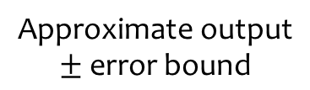
Implementation
S₁
Stream
aggregator
Data stream
StreamApprox
S₂
Approximate output error bound
…
S_{n}

Slide 17
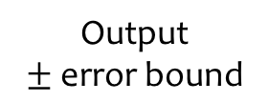
Implementation
S₁
S₂
Stream
aggregator
Sampling module
Batch generator
Batched RDDs
Spark computation engine
…
S_{n}
Error estimation module
Refined sampling parameters
Output
error bound

Slide 18
Outline
Motivation
Design
Evaluation

Slide 19
Experimental setup
Evaluation questions
Throughput vs sample size
Throughput vs accuracy
End-to-end latency
Testbed
Cluster: 17 nodes
Datasets:
Synthesis: Gaussian distribution, Poisson distribution datasets
CAIDA Network traffic traces; NYC Taxi ride records
See the paper for more results!

Slide 20
Throughput
Higher
the better
Spark-based StreamApprox: ~2X higher throughput over Spark-based STS
Flink-based StreamApprox: 1.3X higher throughput over Spark-based StreamApprox
With sampling fraction < 60%

Slide 21
Throughput vs Accuracy
Higher
the better
Spark-based StreamApprox: ~1.32X higher throughput over Spark-based STS
Flink-based StreamApprox: 1.62X higher throughput over Spark-based StreamApprox
With the same accuracy loss

Slide 22
Latency
Lower
the better
Spark-based StreamApprox: ~1.68X faster than Spark-based STS
Spark-based StreamApprox: ~1.45X faster than Spark-based SRS

Slide 23
Conclusion
StreamApprox: Approximate computing for stream analytics
Transparent
Supports applications w/ minor code changes
Practical
Adaptive execution based on query budget
Efficient
Online stratified sampling technique
Thank you!
Details: StreamApprox [Middleware’17]
https://streamapprox.github.io

