Slide 1
CSC4524: Streaming algorithms
Bloom filter

Slide 2
Mini-project 1
Be able to know if a given Wikipedia page was visited the 01-08-2016
    Input: domain code + page title
    Output: Yes | No
    Work due to 17-11- 2019 23:59

Slide 3
Solution
Bloom filter

Slide 4
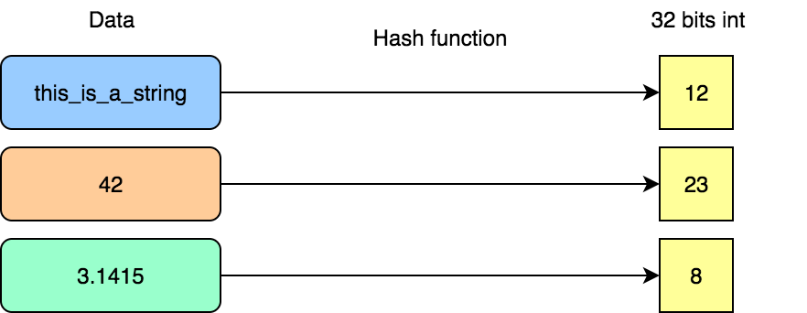
Hash function
A hash function is any function that can be used to map data (string, integer, float …) of arbitrary size to fixed-size values.
Example:

Slide 5
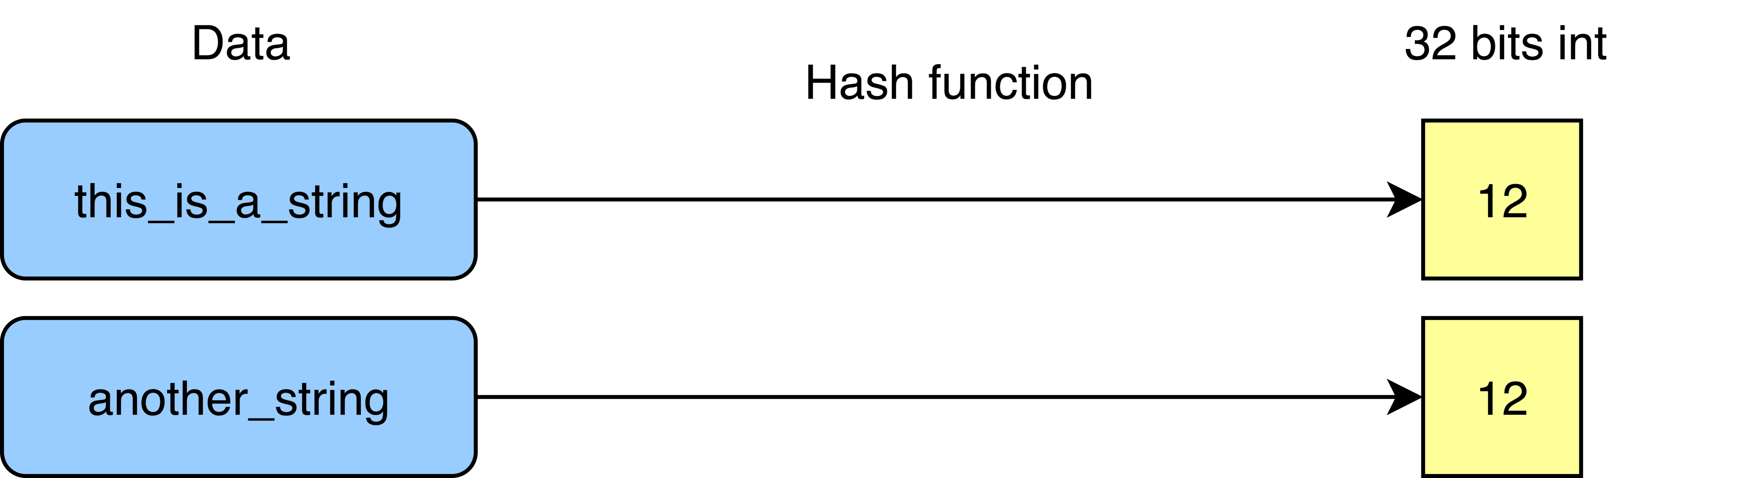
Hash function
Uniformity
A good hash function should map the expected inputs as evenly as possible over its output range. That is, every hash value in the output range should be generated with roughly the same probability. This is an important criteria to reduce collisions.
Collisions

Slide 6
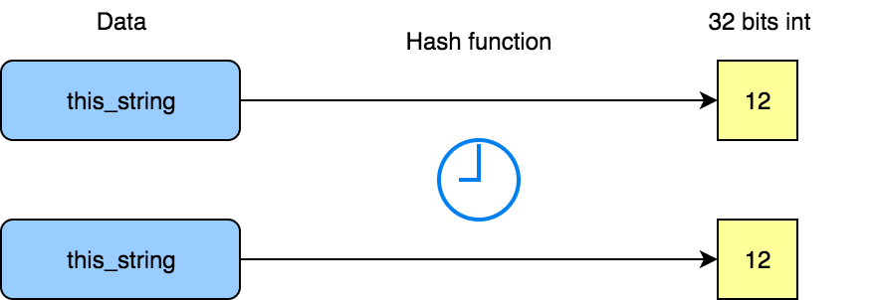
Hash function
Deterministic
A hash procedure must be deterministic, meaning that for a given input value it must always generate the same hash value.

Slide 7
Hash function
Applications
  Hash tables
  Bloom filter
  Pseudonymization
  A/B test engine

Slide 8
Bloom filter
A Bloom filter is a space-efficient probabilistic data structure used to test whether an element is a member of a set. False positive matches are possible, but false negatives are not. In other words, a query returns either "possibly in set" or "definitely not in set". The more elements that are added to the set, the larger the probability of false positives.

Slide 9
Bloom filter
Structure: bit array of m bits, all initialized to 0
k different hash functions defined, each of which maps or hashes some set element to one of the m array positions. Example: f(item) = hash(item) % m

Slide 10
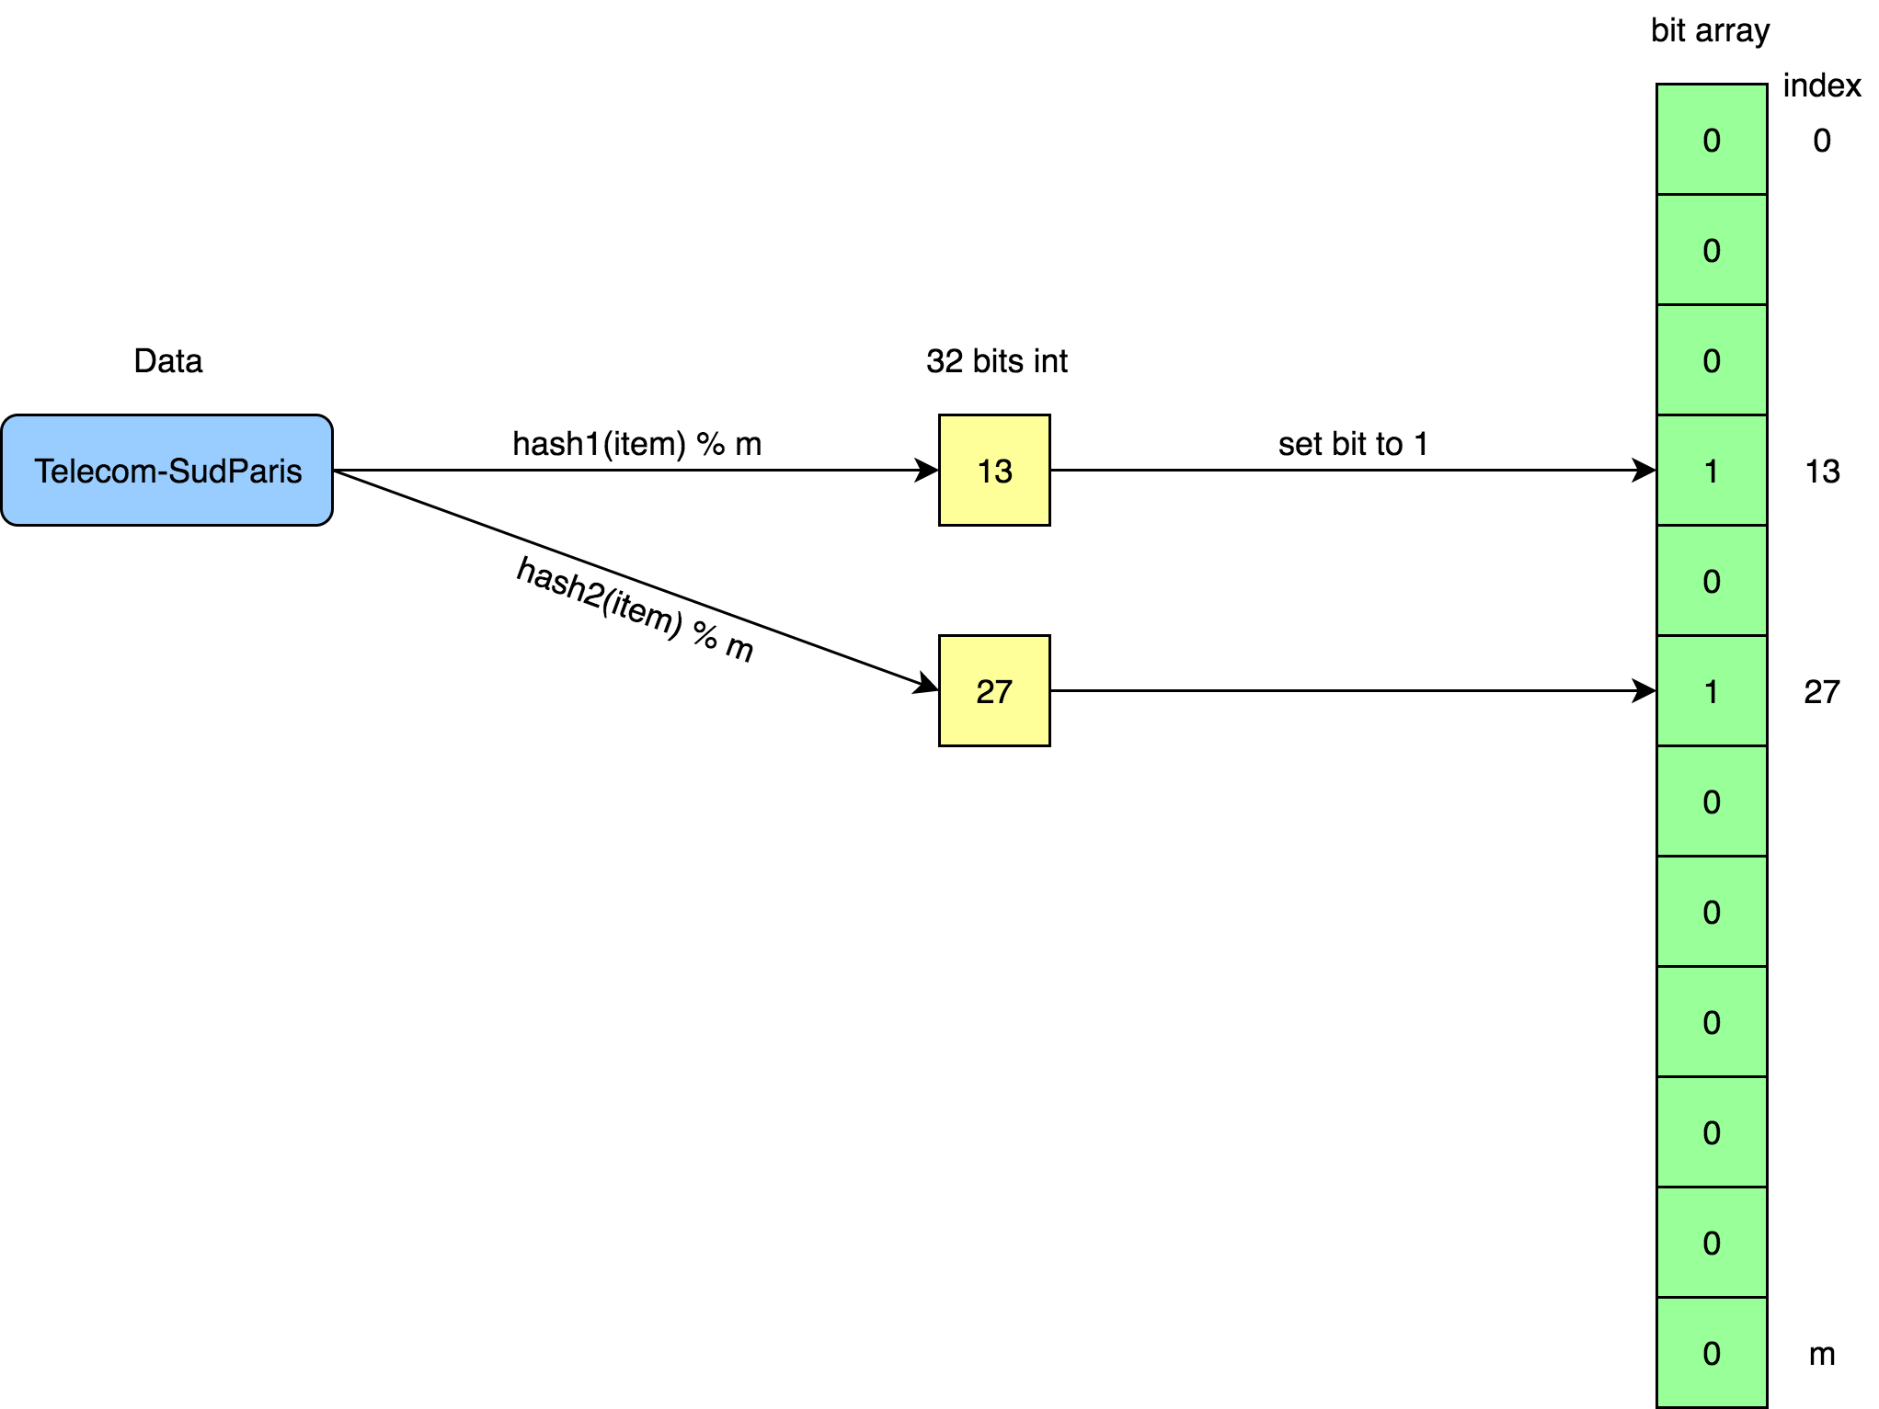
Add item

Slide 11
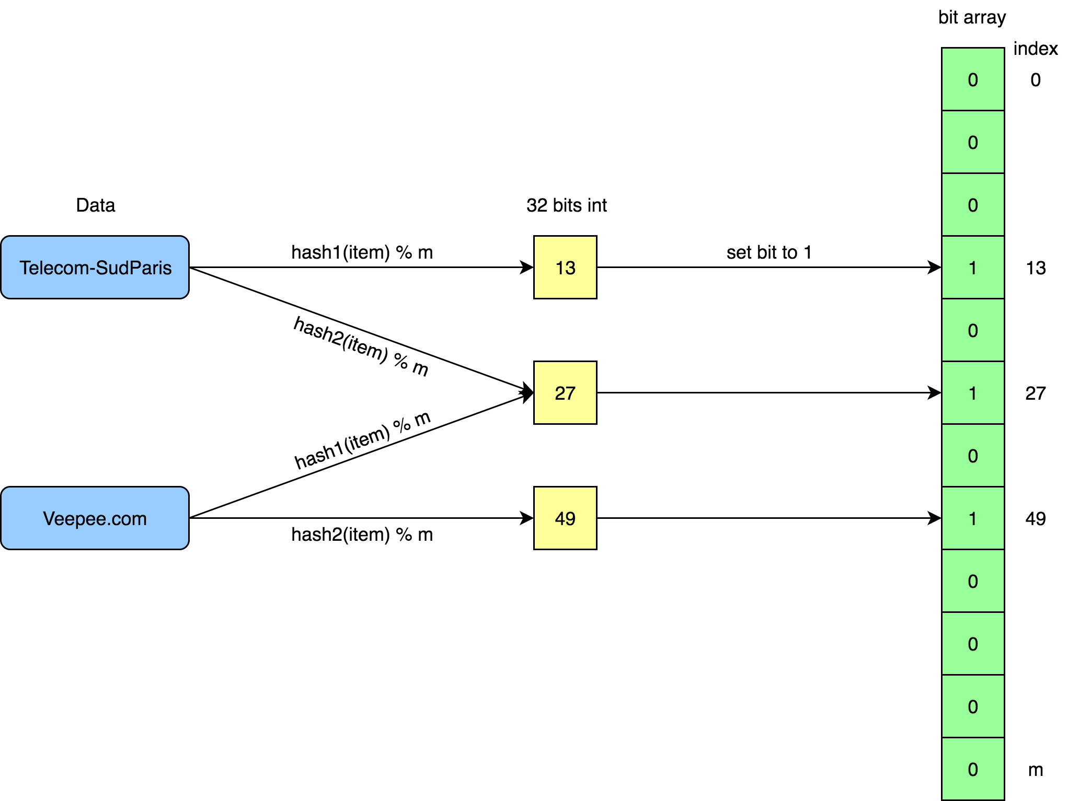
Add item: collision

Slide 12
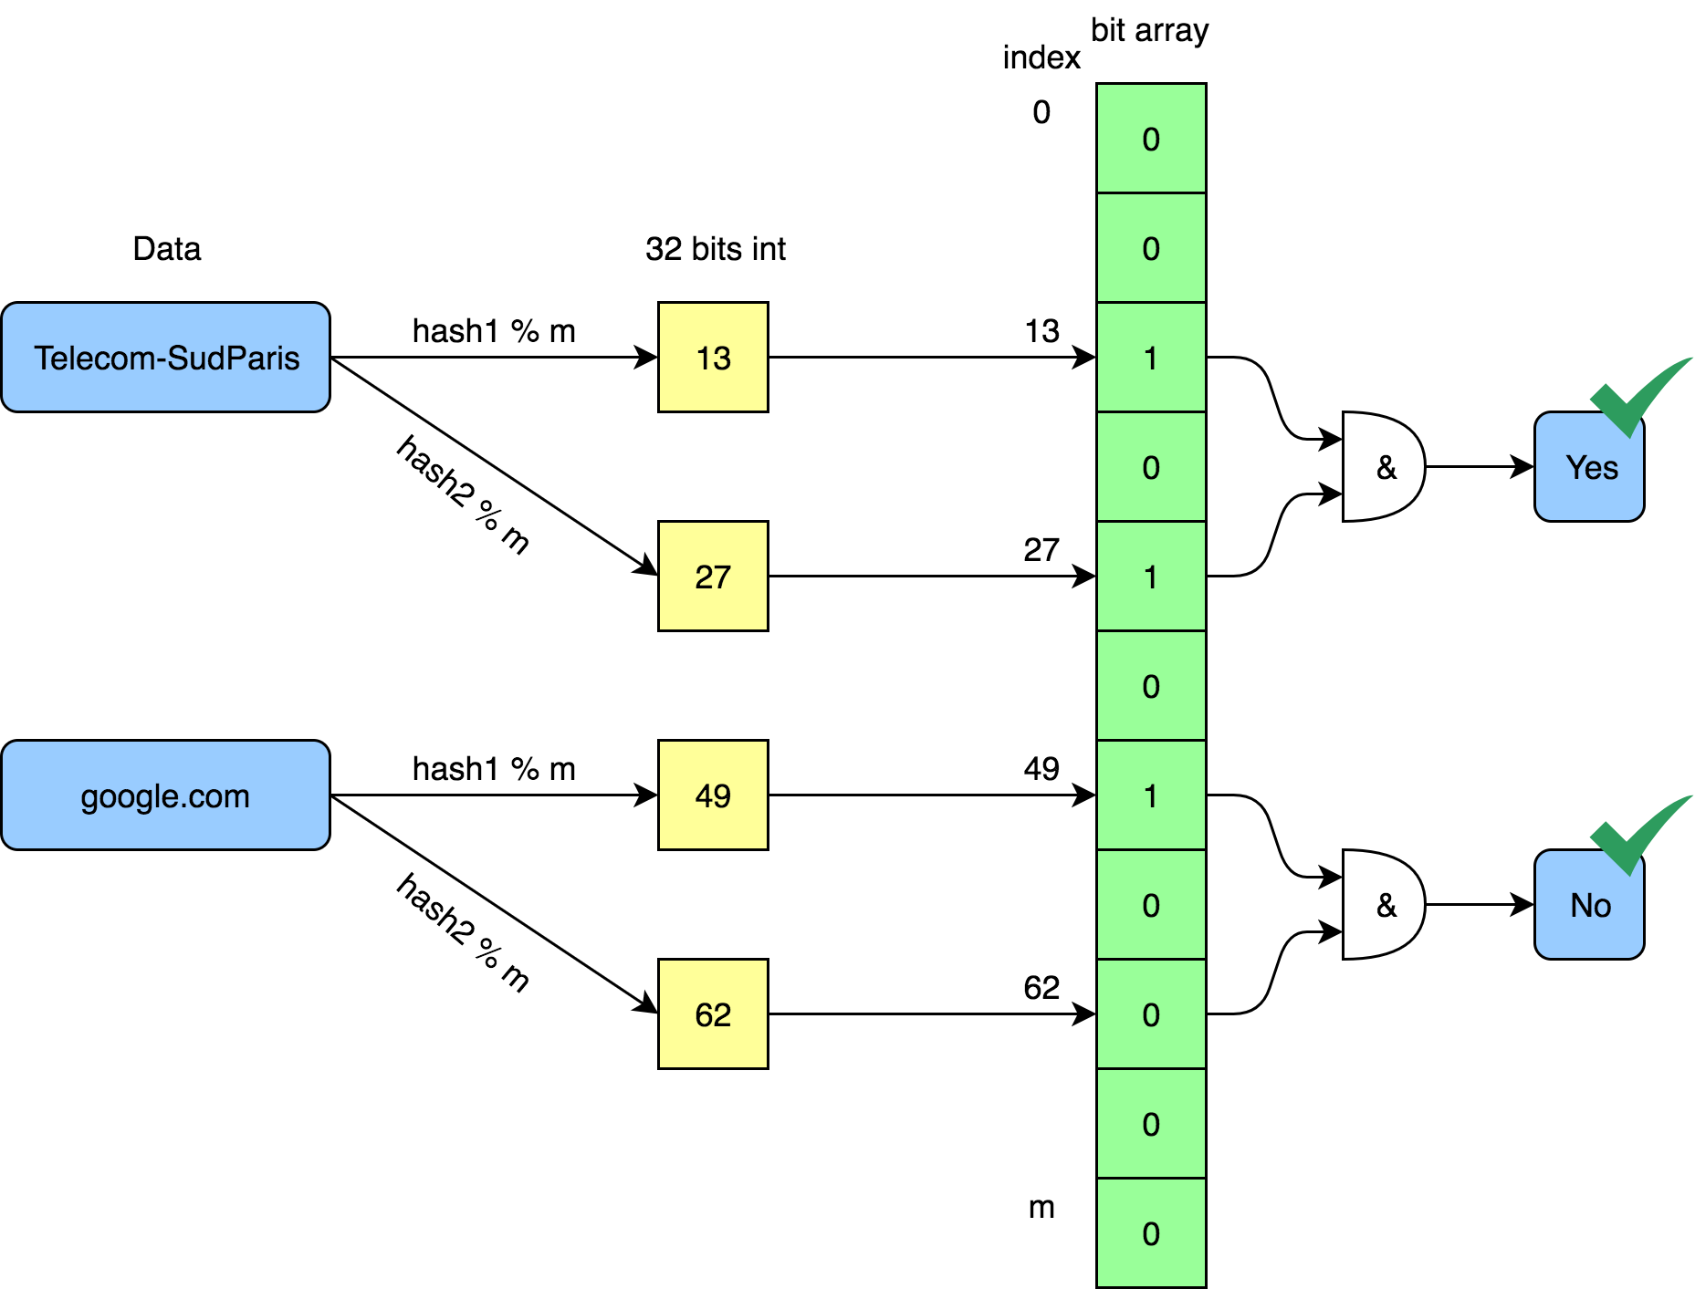
Retrieve item

Slide 13
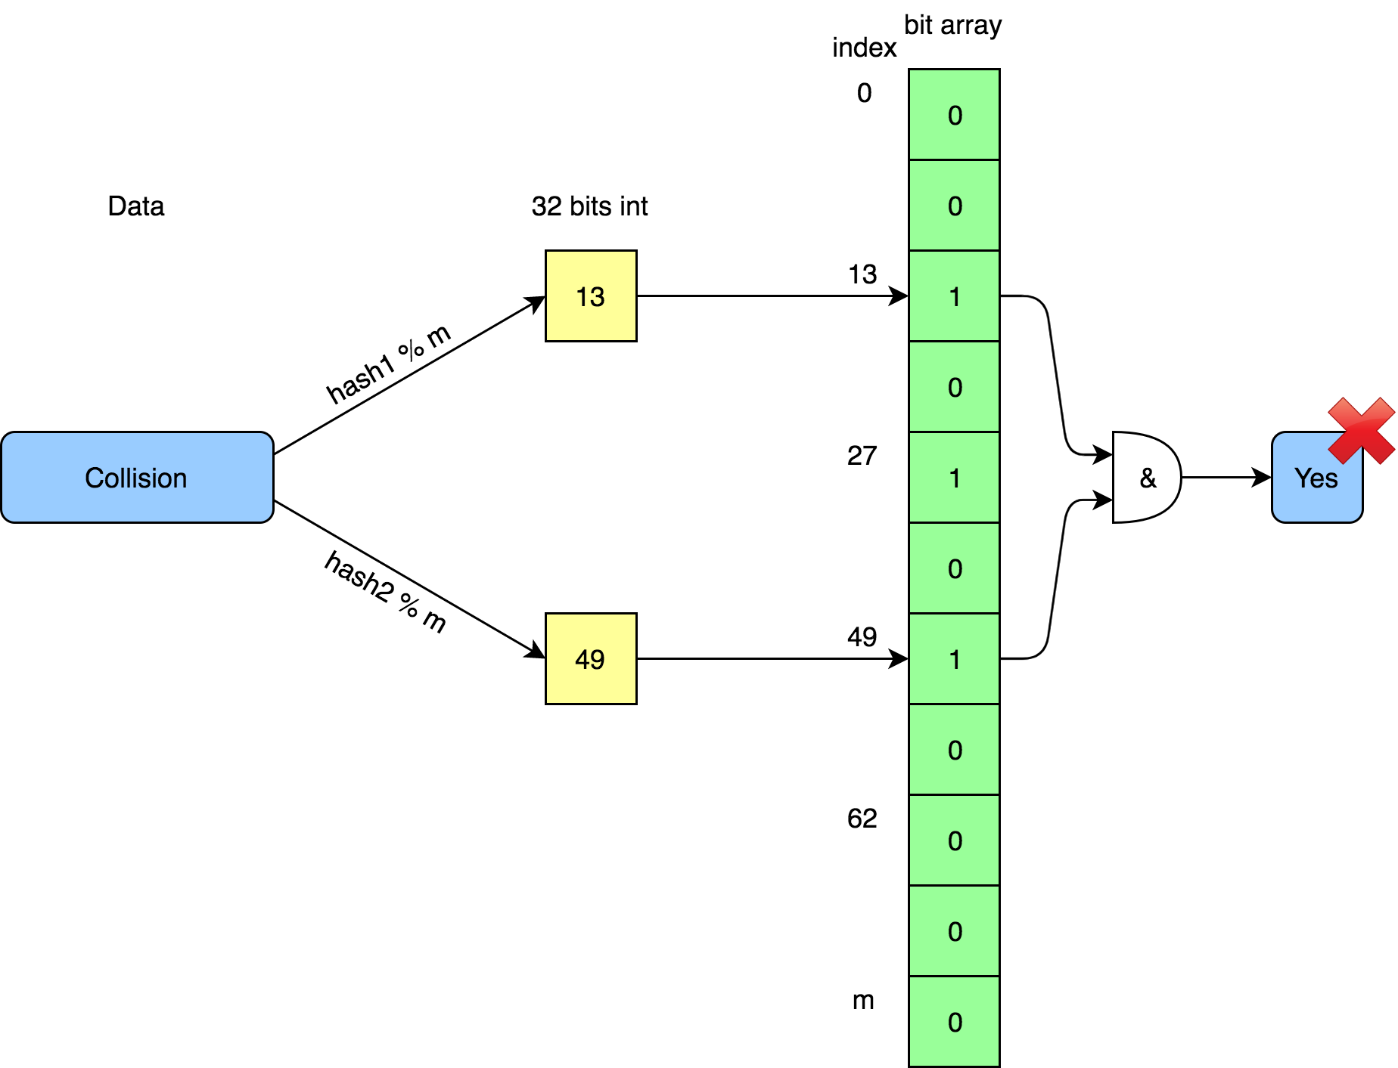
Retrieve item: collision

Slide 14
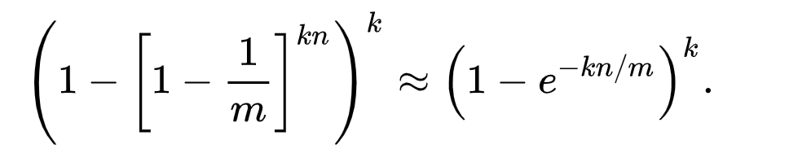
Error rate
False negatives rate
False positives rate
0
m: bit array size
k: number of hash functions
n: input cardinality

Slide 15
Complexity
Time
        O(input size)
Memory
        O(1)

Slide 16
Advantages
1 unique pass through the data
Fast processing
Drastic dimension reduction

Slide 17
Applications
Cache filtering (solve the "one-hit-wonders » issue)
Malicious sites listing
Data base item existence

Slide 18
Mini-project 2
What is the number of unique (domain name, page title) couples visited the 01-08-2016 ?
    Output: Input cardinality
    Work due to 25-11- 2019 23:59

