Slide 1
CSC4524: Streaming algorithms
Count-min Sketch

Slide 2
Mini-project 3
Compute the number of views for each (domain name, page title) couple
    Input: domain name + page title
    Output: #views
    Work due to 01-12- 2019 23:59

Slide 3
Solution
Count-min sketch

Slide 4
Count-min sketch
The Count-min sketch is a probabilistic data structure that serves as a frequency table of events in stream of data. It uses hash functions to map events to frequencies. It uses only sub-linear space ate the expense of overcounting some events due to collisions.

Slide 5
Count-min sketch
Int32 table with
      w columns
      d rows
d hashing functions

Slide 6
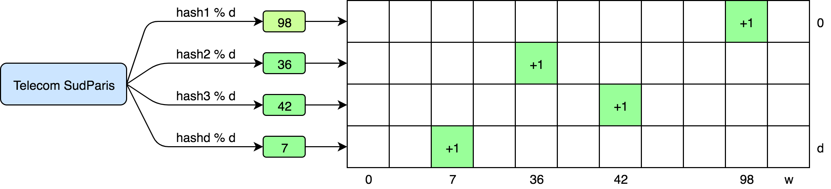
Add item
Let’s add the item “streaming_algo”
      w columns
      d rows

Slide 7
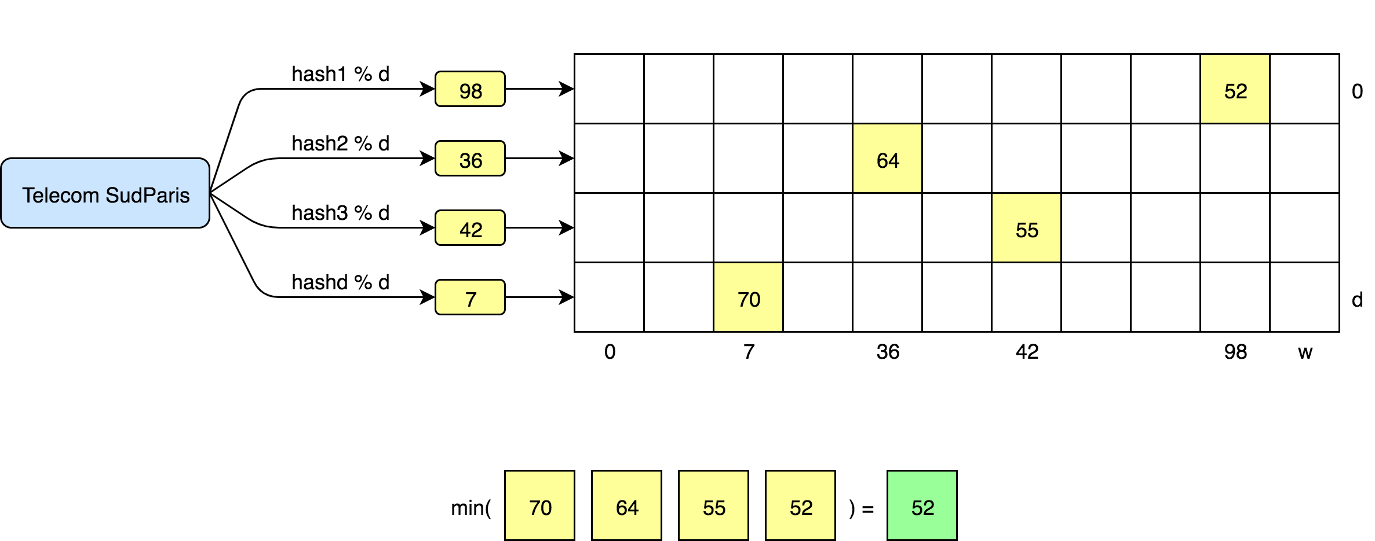
Retrieve item frequency

Slide 8
Application
Finding heavy hitters
    Social networks (Facebook, Twitter …)
    E-commerce web sites (Amazon …)
    Entertainment web sites (YouTube …)

Slide 9
Mini-project 4
Sub-sample the stream to a fixed size representative sub-set
    Input: k the size of the desired sub-set
    Output: representative sub-set of size k
    Work due to 09-12-2019 23:59

