Slide 1
CSC4524: Streaming algorithms
HyperLogLog

Slide 2
Mini-project 2
What is the number of unique (domain name, page title) couples visited the 01-08-2016 ?
    Output: Input cardinality
    Work due to 25-11- 2019 23:59

Slide 3
Solution
HyperLogLog

Slide 4
HyperLogLog
HyperLogLog is an algorithm for the count-distinct problem, approximating the number of distinct elements in a multiset. Calculating the exact cardinality of a multiset requires an amount of memory proportional to the cardinality, which is impractical for very large data sets. HyperLogLog algorithm, uses significantly less memory than this, at the cost of obtaining only an approximation of the cardinality.

Slide 5
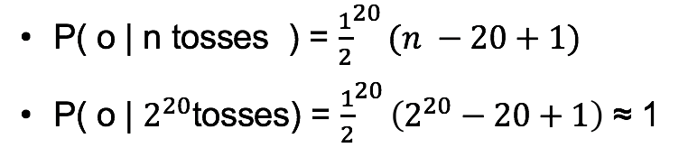
Intuition
Experience: We toss a coin multiple times
Observation: We observed a series of 20 consecutive heads
Question: How many times was the coin tossed before observing these 20 consecutive heads ?

Slide 6
Intuition
The basis of the HyperLogLog algorithm is the observation that the cardinality of a multiset of uniformly distributed random numbers can be estimated by calculating the maximum number of leading zeros in the binary representation of each number in the set. If the maximum number of leading zeros observed is n, an estimate for the number of distinct elements in the set is 2^{n}

Slide 7
Hypothesis
Hypothesis: Uniformly distributes random numbers multiset.
A hash function is applied to each element in the original multiset to obtain a multiset of uniformly distributed random numbers with the same cardinality as the original multiset.

Slide 8
Large variance
The simple estimate of cardinality obtained using the number of leading zeros over all items has the disadvantage of large variance. HyperLogLog minimizes, the variance is by splitting the multiset into numerous subsets, calculating the maximum number of leading zeros in the numbers in each of these subsets, and using a harmonic mean to combine these estimates for each subset into an estimate of the cardinality of the whole set.

Slide 9
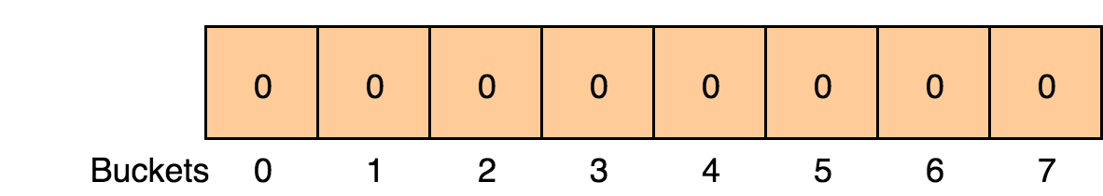
HyperLogLog
Structure: m buckets initialized to 0.
Stream cardinality: n
Example: m = 8

Slide 10
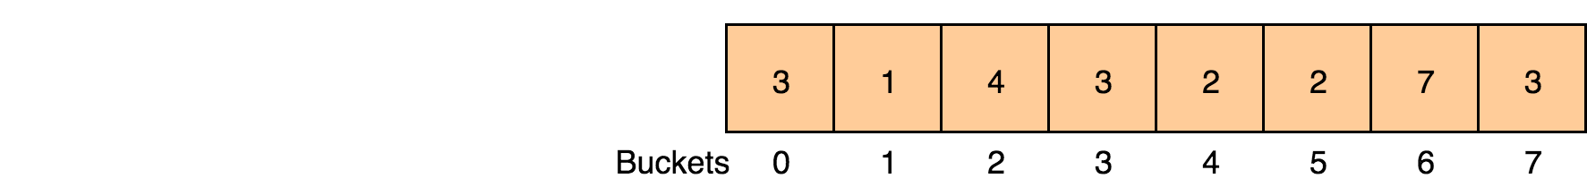
Add item
m = 8
We added items and would like to add ”streaming_algo”

Slide 11
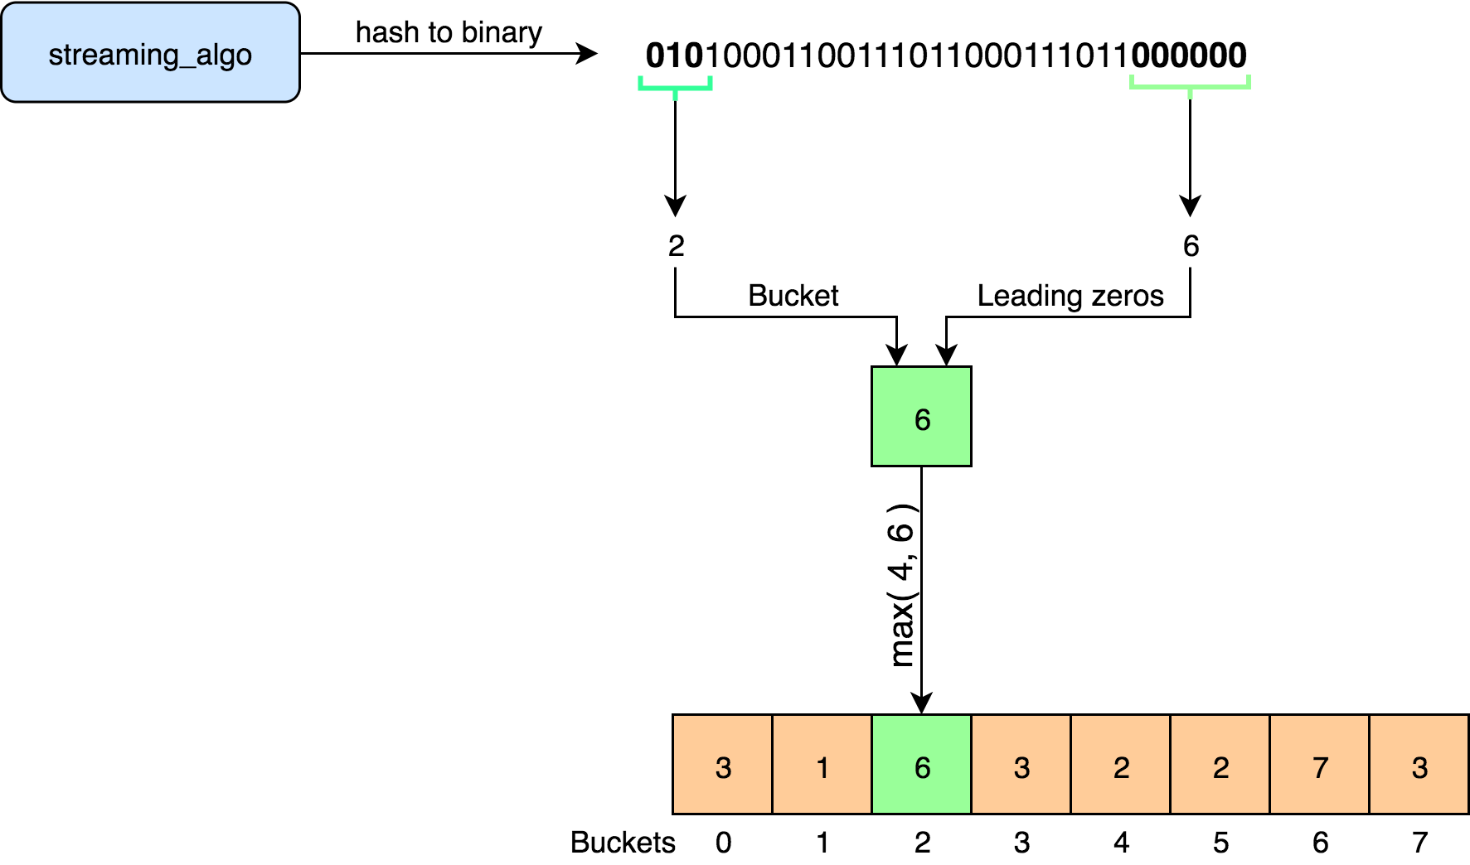
Add item

Slide 12

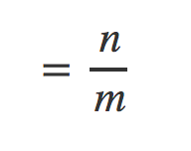
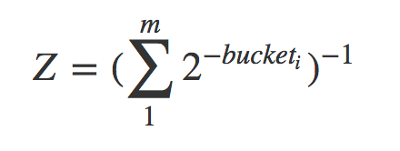


Estimate cardinality
Intuition: each bucket has cardinality
Harmonic mean
n

Slide 13

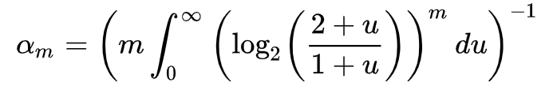
Estimate cardinality
n
The constant is introduced to correct a systematic multiplicative bias present due to hash collisions.

Slide 14
Applications
Google’s BigQuery uses HyperLogLog to efficiently count unique elements in a table(APPROX_COUNT_DISTINCT()).
Reddit uses HyperLogLog to retrieve the number of distinct views a post has gathered.

Slide 15
Mini-project 3
Compute the number of views for each (domain name, page title) couple
    Input: domain name + page title
    Output: #views
    Work due to 01-12- 2019 23:59

