Slide 1
CSC4524: Streaming algorithms
Reservoir sampling

Slide 2
Mini-project 4
Sub-sample the stream to a fixed size representative sub-set
    Input: k the size of the desired sub-set
    Output: representative sub-set of size k
    Work due to 09-12-2019 23:59

Slide 3
Solution
Reservoir sampling

Slide 4
Reservoir sampling
Reservoir sampling is a family of randomized algorithms for choosing a simple random sample without replacement of k items from a population of unknown size n in a single pass over the items. The size of the population n is not known to the algorithm and is typically too large to fit all n items into memory. The population is revealed to the algorithm over time, and the algorithm cannot look back at previous items. At any point, the current state of the algorithm must permit extraction of a simple random sample without replacement of size k over the part of the population seen so far.

Slide 5
Reservoir sampling
Data stream
Unknown size
Sample
Size = k
Goal : Select each item in the stream with equiprobability.

Slide 6
Reservoir sampling
Data stream
Unknown size
k first
items
Step 1 : The first k items are selected with probability 1
Sample
Size = k

Slide 7
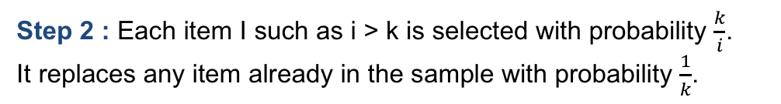
Reservoir sampling
Data stream
Item i
Unknown size
k first
items
Step 1 : The first k items are selected with probability 1
Sample
Size = k

Slide 8
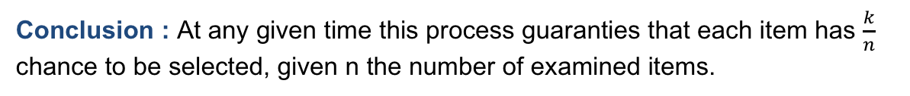
Reservoir sampling
Data stream
Item i
Unknown size
k first
items
Step 1 : The first k items are selected with probability 1
Sample
Size = k

Slide 9
Next step
Paper lectures

