Slide 1
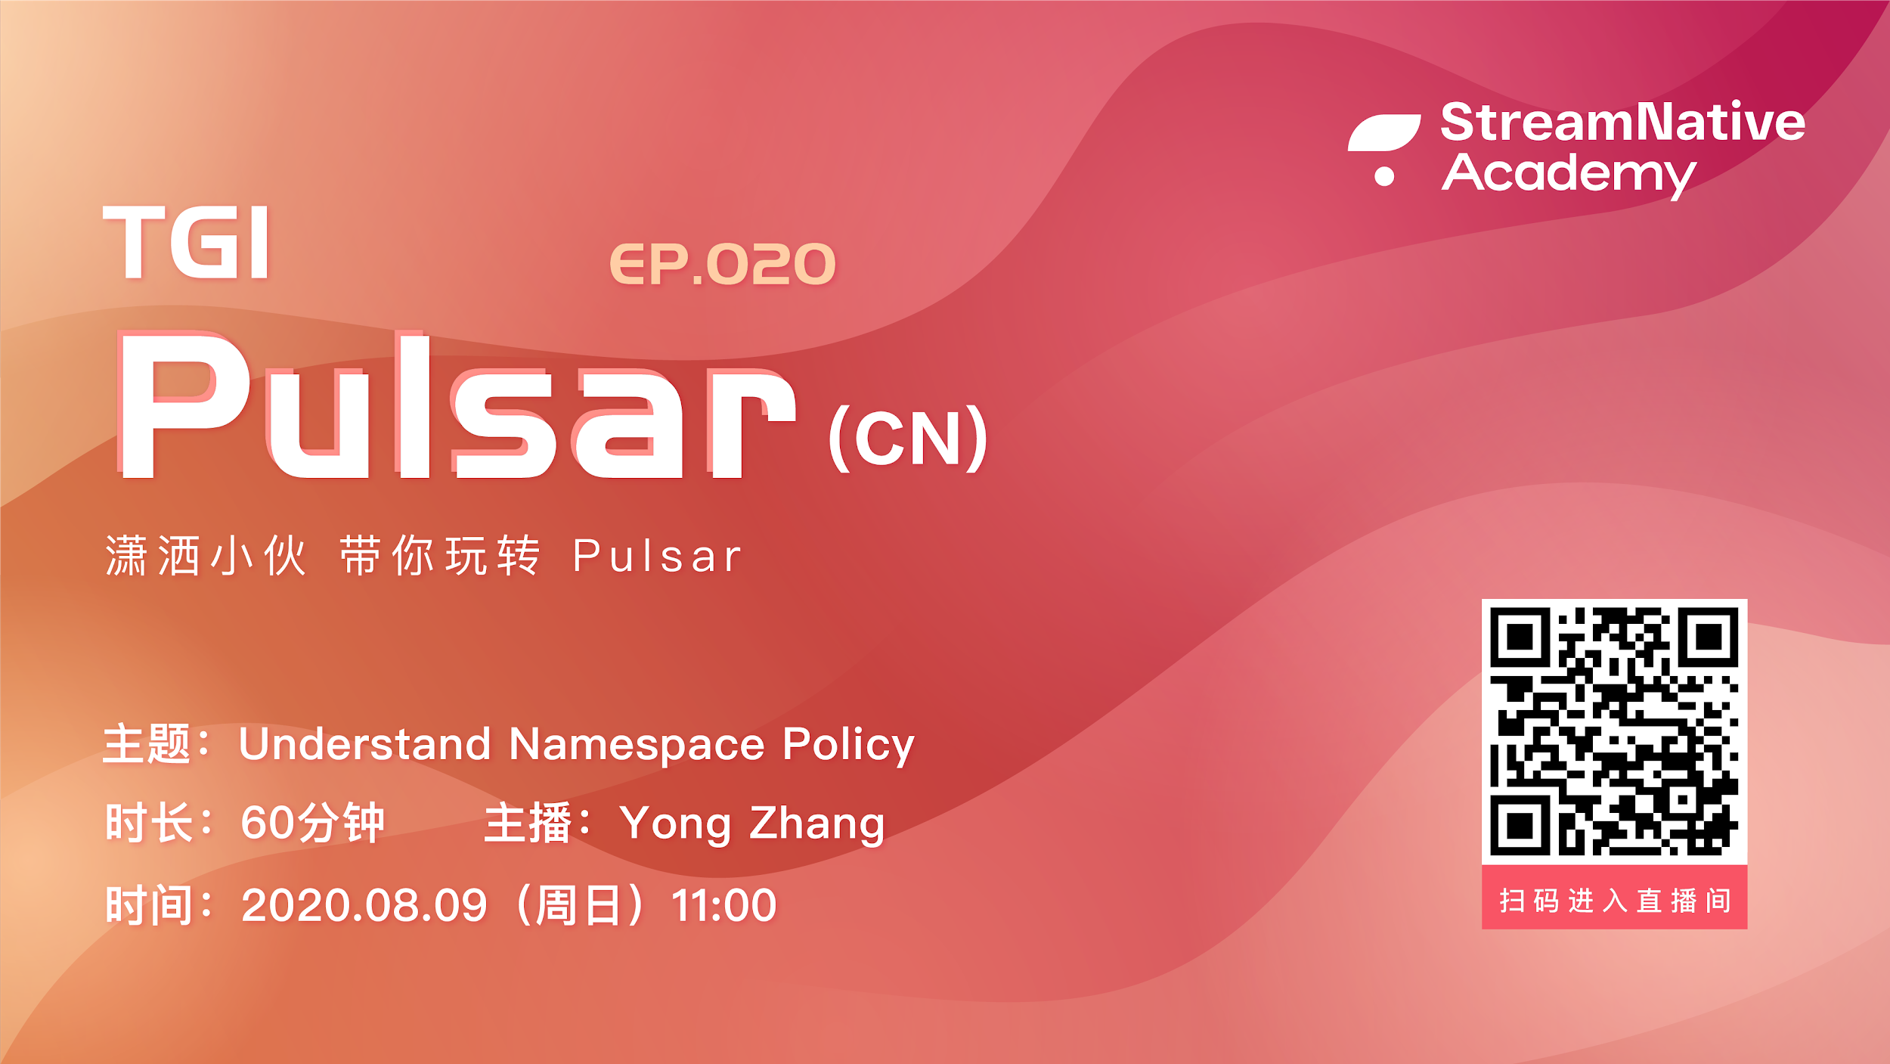

Slide 2
Who am I
Yong Zhang (张勇)
Apache Pulsar / BookKeeper contributor
StreamNative Software Engineer

Slide 3
Pulsar changes
Set message TTL on topic level (#7738)
Set retention on topic level (#7747)
Support consume transaction messages (#7781)
Support subscription position and expose the producere setting(#7772)
2.6.1 releasing (#7739)

Slide 4
Namespace Policies
TGIP-CN Episode 020

Slide 5
What is namespace policies
Configuration
Dynamic
Isolation

Slide 6
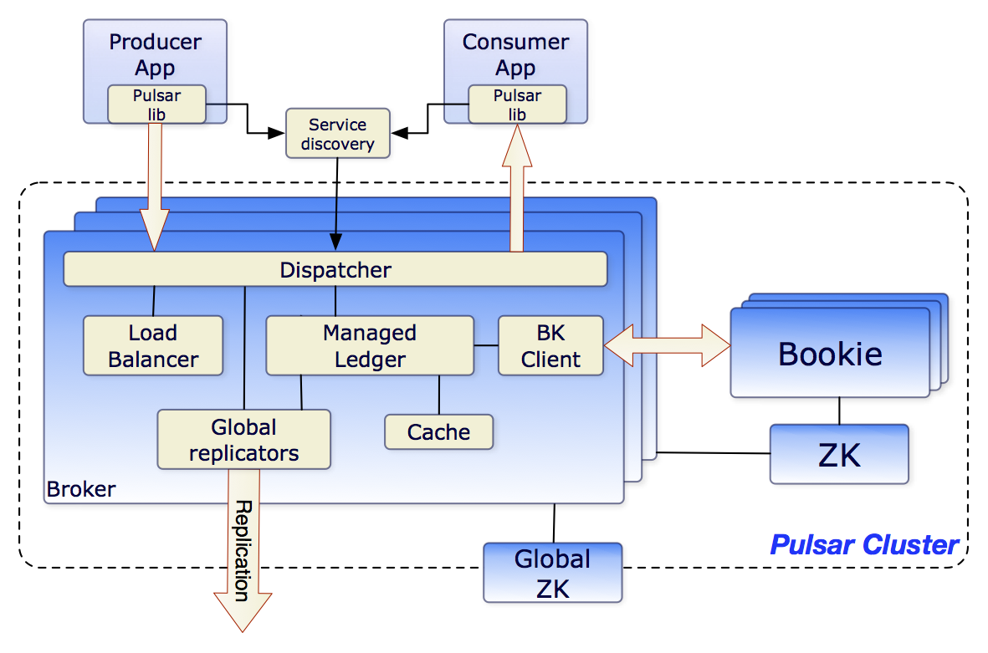
Configuration

Slide 7
Configuration

Slide 8
Dynamic
Admin
Set policy
Global ZK
Read policy
Broker

Slide 9
Isolation
ns1
ns2
ns3
Policies
Policies
Policies

Slide 10
Namespace Policies
Retention_policies
Backlog_quota_map
Message_ttl_in_seconds
Max_producers_per_topic
Max_consumers_per_topic
Max_consumers_per_subscription
Replication_clusters
topicDispatchRate
subscriptionDispatchRate
auth_policies

Slide 11
Retention_policies
Retention
retentionTimeInMinutes
retentionSizeInMB
Demo

Slide 12
Message Retention
Subscription B
(2, 2)
Subscription C
(3, 2)
Partition (Event Stream)

Slide 13
Message Retention
Subscription B
(2, 2)
Subscription C
(3, 2)
Partition (Event Stream)
OK to delete
NOT OK to delete

Slide 14
Message Retention
Subscription B
(2, 2)
Subscription C
(3, 2)
Partition (Event Stream)
OK to delete
Message Retention
NOT OK to delete

Slide 15
Message Retention
Subscription B
(2, 2)
Subscription C
(3, 2)
Partition (Event Stream)
OK to delete
Message Retention
Yet to be processed

Slide 16
Message Retention
Acked
Msg 1
Acked
Msg 2
Acked
Msg 3
Acked
Msg 4
Acked
Msg 5
Acked
Msg 6
Acked
Msg 7
Acked
Msg 8
Unacked
Msg 9
Unacked
Msg 10
Unacked
Msg 11
Deleted
Retention
Yet to be processed

Slide 17
Message_ttl_in_seconds
Demo

Slide 18
Message Expiry
Acked
Msg 5
Acked
Msg 6
Acked
Msg 7
Acked
Msg 8
Unacked
Msg 9
Unacked
Msg 10
Unacked
Msg 11
Unacked
Msg 12
Unacked
Msg 13
Unacked
Msg 14
Unacked
Msg 15
Deleted
Retention
Within the applied TTL
Not within TTL
(may still be processed)

Slide 19
Message Expiry
Acked
Msg 5
Acked
Msg 6
Acked
Msg 7
Acked
Msg 8
Acked
Msg 9
Acked
Msg 10
Acked
Msg 11
Acked
Msg 12
Unacked
Msg 13
Unacked
Msg 14
Unacked
Msg 15
Deleted
Retention
Not within TTL
(may still be processed)

Slide 20
Max_producers_per_topic
Demo

Slide 21
Max_consumers_per_topic
Demo

Slide 22
Max_consumers_persubscription
Demo

Slide 23
Replication_clusters
GEO Replication

Slide 24
Global Config Store
Cluster 2
“Cluster 1”: … “Cluster 2”: …
“Cluster 3”: …
Cluster 1
ZooKeeper
ZooKeeper
Global ZooKeeper
Cluster 3

Slide 25
Backlog_quota_map
BacklogQuotaType
Destination_storage
RetentionPolicy
Producer_request_hold
Producer_exception
Consumer_backlog_eviction
Demo

Slide 26
Msg Backlog
Acked
Msg 5
Acked
Msg 6
Acked
Msg 7
Acked
Msg 8
Unacked
Msg 9
Unacked
Msg 10
Unacked
Msg 11
Unacked
Msg 12
Unacked
Msg 13
Unacked
Msg 14
Unacked
Msg 15
Deleted
Retention
Yet to be processed

Slide 27
Msg Backlog
SUB 0
SUB 2
Backlog
Acked
Msg 5
Acked
Msg 6
Acked
Msg 7
Acked
Msg 8
Unacked
Msg 9
Unacked
Msg 10
Unacked
Msg 11
Unacked
Msg 12
Unacked
Msg 13
Unacked
Msg 14
Unacked
Msg 15
Deleted
Retention
Yet to be processed

Slide 28
topicDispatchRate

Slide 29
subscriptionDispatchRate
Demo

Slide 30
auth_policies
Namespace_auth
Destination_auth
subscription_auth_roles

Slide 31
Thanks

