Slide 1




FinSight
EXECUTIVE CLOUD INTELLIGENCE LAYER
An AI decision layer that lets a CXO ask the cloud estate a question in plain English — and get a grounded, cited answer.
Capacity-Mngt-App
Cost-Mngt-App
RAG cockpit
capacity & cost forecasting
cost anomaly detection
grounded executive Q&A
Capstone · UC Berkeley Executive Education — AI & GenAI: Business Strategies and Applications
Sachin Narayanan · Director, Cloud Operations & AI-Augmented Engineering

Slide 2

01 / 08
THE PROBLEM
Cloud answers are locked behind dashboards
In an Enterprise CX SaaS estate — 167 AWS single- and multi-tenant deployments, ~$5M annual spend — the answers leadership needs are scattered across Datadog, Cost Explorer, and a dozen tabs. When a PE investor asks “are we about to run out of capacity, and why did the bill jump?”, the answer takes an engineer hours to assemble.
INDUSTRY CONTEXT
167
AWS ST/MT deployments
$5M
annual cloud spend governed
FinSight collapses that to one question box. It unifies predictive capacity forecasting and real-time cost attribution behind a retrieval-augmented interface, so a non-technical executive gets a decisive, cited answer in seconds.
3
product lines: Engage · Analyze · Assist
91
person cross-geo cloud org
Enterprise CX SaaS · cloud operations · the gap between telemetry and an executive-ready answer

Slide 3



02 / 08
STRATEGY
How FinSight generates business value
Improvement, not net-new
Competitive advantage
Financially viable
An overlay on existing observability (Datadog, Cost Explorer) — not a rip-and-replace. It turns telemetry already paid for into decisions, so adoption cost is low and value is immediate.
Second-mover on the technique, first-mover internally. The moat isn't the models — it's the grounding contract over our own estate. Faster capacity + cost decisions during PE diligence directly protect valuation.
Investment: ~1 eng-quarter to build, marginal LLM inference cost. Return: avoided over-provisioning, faster anomaly catch, and analyst hours saved. Payback measured in a single prevented capacity incident.
ROI components — Investment: build + inference · Return: avoided over-provisioning + faster anomaly catch + analyst time

Slide 4
03 / 08
SUCCESS METRICS
What we measure, and what we do about it
METRIC
WHY IT MAPS TO THE NEED
ACTION ON THRESHOLD
Forecast accuracy (MAPE)
Capacity-Mngt-App must be trusted to act on. Tracks predicted vs. actual utilization/spend.
> 10% → retrain / add features. < 5% → safe to automate capacity alerts.
Anomaly precision / recall
False alarms erode trust; misses cost money. Measured against confirmed incidents.
Precision drop → raise z-threshold. Recall drop → lower it / shorten window.
Answer grounding rate
Every cited number must trace to an engine fact. The anti-hallucination guarantee.
< 100% → block release. Any fabricated citation is a hard failure.
Time-to-answer
The core value prop: hours of analyst work → seconds.
Rising → cache facts / tune retrieval. The exec-facing SLA.
Metrics chosen for actionability — each carries an explicit response when it crosses a floor or ceiling

Slide 5

04 / 08
TECHNOLOGY
Three AI techniques, one decision layer
Capacity-Mngt-App
Cost-Mngt-App
RAG cockpit
SUPERVISED · TIME-SERIES
UNSUPERVISED · STATISTICS
RETRIEVAL + LLM
Ridge regression on engineered temporal features (trend, day-of-week, weekly Fourier).
Readily-available algorithm (scikit-learn) — no custom model needed.
Trained per-stream on 180d history; objective: minimize forecast error + honest prediction interval.
Robust z-score on rolling median + MAD baseline; resists spike-poisoning.
No labels required at cold start — pure statistical detector.
Plus deterministic attribution: decomposes any spend delta by product/region/service.
TF-IDF retrieval over engine-derived fact cards → grounded composition with Claude.
Adopts an available LLM; the IP is the grounding contract, not the model.
No training — the engines own the numbers, the LLM only phrases them.
Modules 2–5 mapping — supervised regression · unsupervised anomaly detection · retrieval-augmented generation

Slide 6


05 / 08
DATA
Data we already own — and how it connects
SOURCES — ALREADY IN OUR SYSTEMS
OWNERSHIP & INTEGRATION
AWS Cost & Usage Report
We own it. All three sources are first-party — no vendor data acquisition, no new licensing.
Where it lives. CUR in S3; metrics in Datadog/Prometheus; incidents in PagerDuty + Git.
Linking the systems. A daily ETL keys every record on (date, product, region, service) — the same join the engines and fact cards use.
Is it data-hungry? Moderately. 180 days of daily data is enough for the seasonal forecast; the RAG layer needs only the derived facts, not raw rows.
billing by account / service / region
Utilization telemetry
EKS / EC2 metrics via Datadog + Prometheus
Incidents & runbooks
PagerDuty + internal docs for root-cause context
Demo uses deterministic synthetic data (seed=42) modeling this exact schema — no production data leaves the estate

Slide 7

06 / 08
HUMANS & AI
The organizational and ethical factors
ADOPTION
INTERACTION & ETHICS
Change required
Human interaction
Leaders must trust an AI-phrased answer. Engineers must trust it won't hallucinate numbers into a board deck.
Internal: CXO / PE / SRE leads query it directly. The cockpit keeps the human in the decision loop — it informs, it doesn't auto-act on spend.
How we earn it
Ethics & guardrails
Ship the grounding contract visibly — every answer shows its [FACT-xxx] citations and evidence. Trust is demonstrated, not asserted.
Cost attribution must not become individual blame. Forecasts carry uncertainty bands so no one over-trusts a point estimate. Off-domain questions are declined, not bluffed.
Modules 7–8 — the human stays in the loop; the system informs decisions, it does not take spend actions autonomously

Slide 8

07 / 08
MEASUREMENT
An experiment to prove it works
EXPERIMENTAL DESIGN
WHAT WE MEASURE & COMPARE
Design
Time-to-answer
Randomized A/B on decision tasks. Control = current dashboards; Treatment = FinSight cockpit.
Treatment vs. control, per task. Primary endpoint.
Answer correctness
Population
Graded against ground-truth from the engines.
~24 cloud-ops leads & EMs, randomized to the two arms across a 6-week window.
Decision confidence
Self-rated 1–5; does grounding raise trust?
Tasks
Standardized prompts: “Is any stream at capacity risk?” · “Explain last week's spend delta.”
Grounding rate
% of cited numbers that trace to a real fact (target 100%).
Primary endpoint: time-to-answer (Treatment vs Control) · guardrail endpoint: grounding rate must hold at 100%

Slide 9

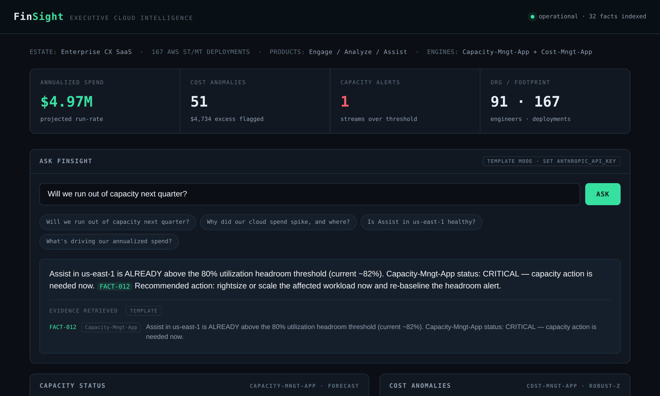
08 / 08
PROOF OF WORK
Built, tested, and running — not a concept
14 / 14
tests passing — engines + grounding contract
2.7%
Capacity-Mngt-App forecast MAPE on capacity
5 / 5
injected cost anomalies recovered by Cost-Mngt-App
100%
answer grounding rate — zero fabricated citations
Live FinSight cockpit — grounded answer with inline [FACT] citations
Full repo: working engines · FastAPI cockpit · reproducible notebook · test suite
Optional Slide 8 — deployment evidence · the system is demoable live and defensible in technical interviews

