Slide 1
Ground reaction force metrics are not strongly correlated with tibial bone load when running across speeds and slopes: Implications for science, sport and wearable tech
September 2023
Jan David Strehl I Course Title

Slide 2
15min goal time 7 slides a 2min
Content
Introduction
Who and Why? 1 slide
Experimental Setup using one person (video and results on one slide -> make it fancy) 2 slides
Main Results of paper 2 slides
Increased GRF metrics are not correlated with increased bone loading or risk for tibial stress fractures
Applications in science, sports and wearable decise are often flawed and highly mesleading
My contribution / projekt 2 slides
Open source python wrapper for c3d file format (link to a fancy github)
Open source python implementation for typical GRF metrics and tibial load -> plausibility with opensim -> fancy?
Open source python implementation for statistical calcualtions (maybe use other library here)
Conclusion & Thank u!

Slide 3
Introduction
Why we should care about this paper?

Slide 4
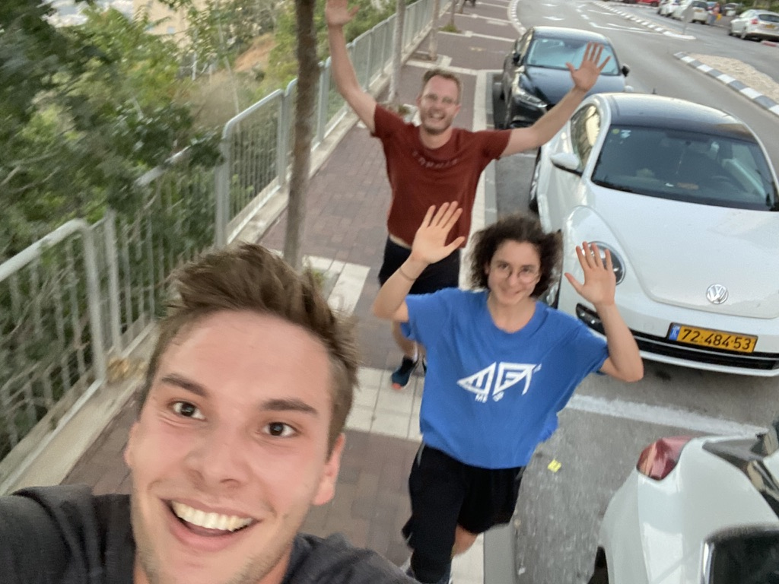
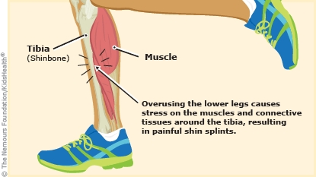
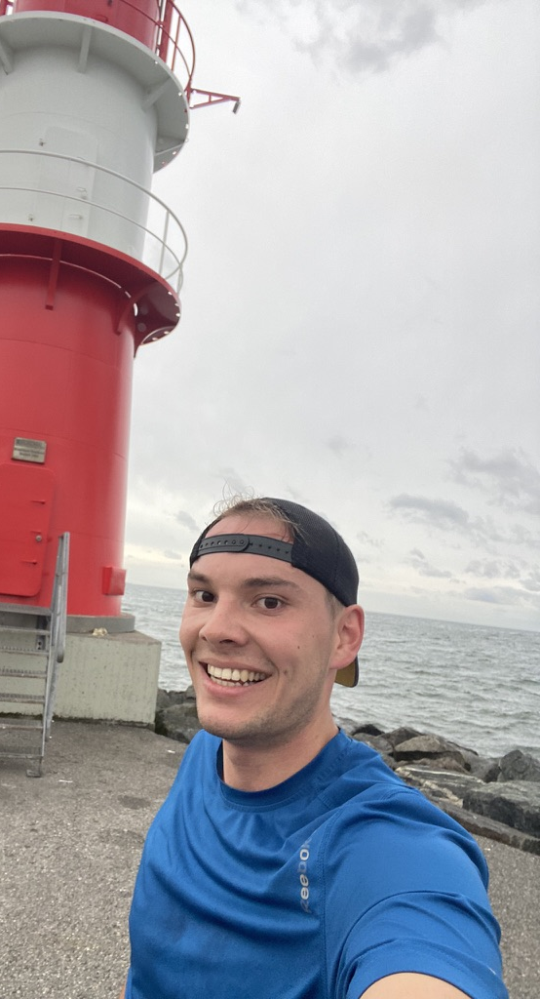
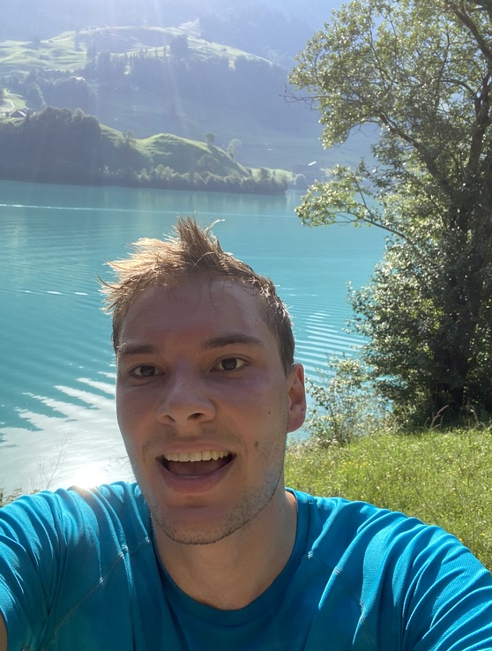
Why and What?
How can we effeciently measure (and predict) tibia pain?
Comman approach is measuring the Ground Reaction Forces
Paper studies the relation between GRF and tibia load – risk for tibial stress fractures
Passionated runner with some times problems due to refusing legs

Slide 5
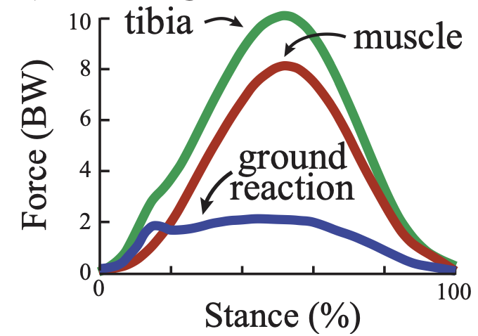
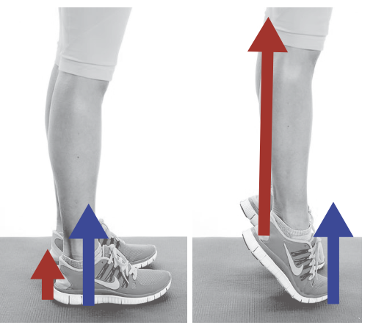
Why and What?
Bone stress due to
Bone load intensity (magnituede, direction and duration of load)
Rate of bone remodeling (length of activity and rest)
Intrinsitc factors (age, gender, bone density, geamtry, minerak content, etc.)
Idea: Monitor risk factors by bone fatigue models
-> Alert the indidviudal to modify training and allow bone to recover before injury
Approach: Use wearables to estimate bone load via Ground Reaction Forces
Are Increases in common GRF metrics (impact peak, loading rate, active peak, impulse) with increases in tibial bone load metrics (peak force and impulse) across this range of running conditions?

Slide 6
Experimental SetUp
What is the scope?

Slide 7
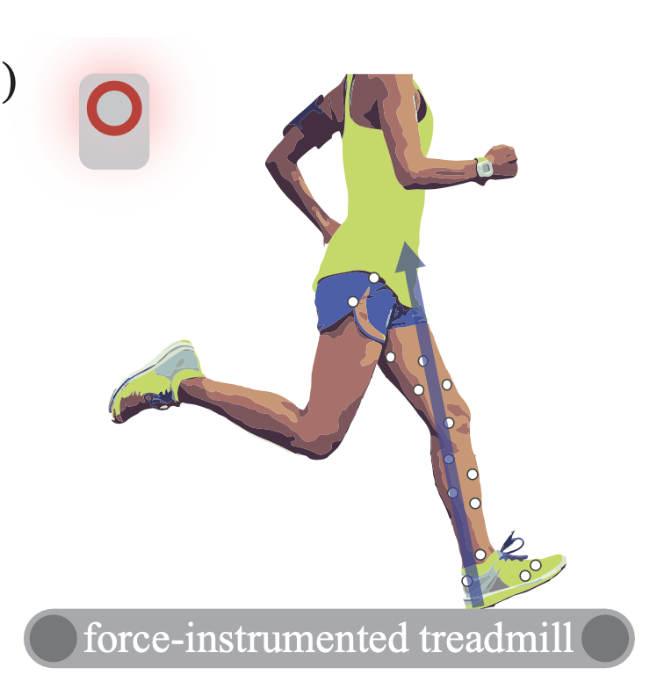
Experimantal Set Up
Running conditions for a recreational runner on a daily run
10 subjects (5 male / 5 female)
Speeds and slopes typical for recreational runners
Slow (2.6-3 m/s) | -9° to +9°
Middle (3.2 m/s) | -6° to +6°
High (3.4-4 m/s) | 0°
Each condition for 30 sec (10 sec calibration 20 sec measurement)
Force-instrumented treadmill (Bertec)
Motion capture system (Vicon)

Slide 8
Results
What are the three main results?

Slide 9
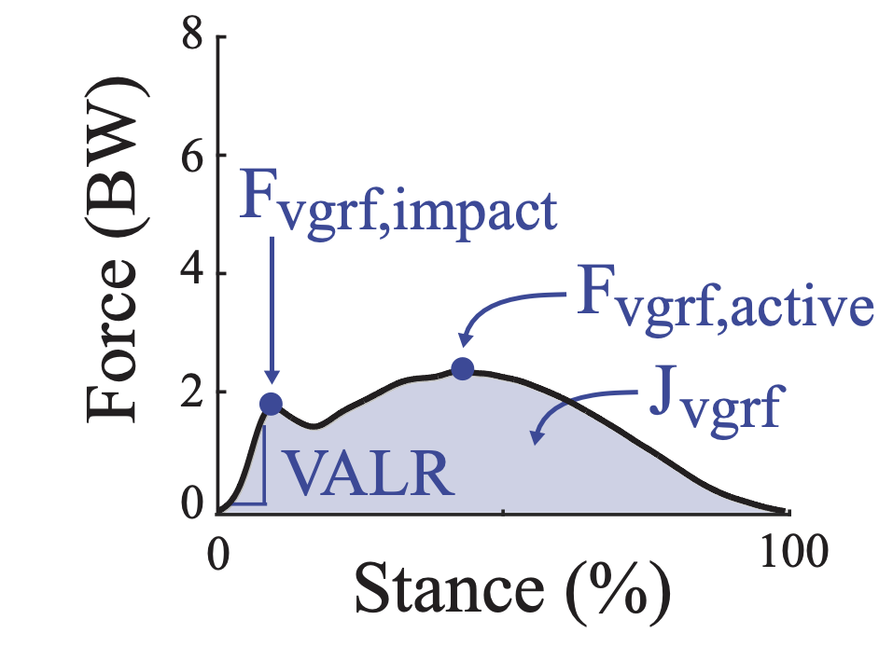
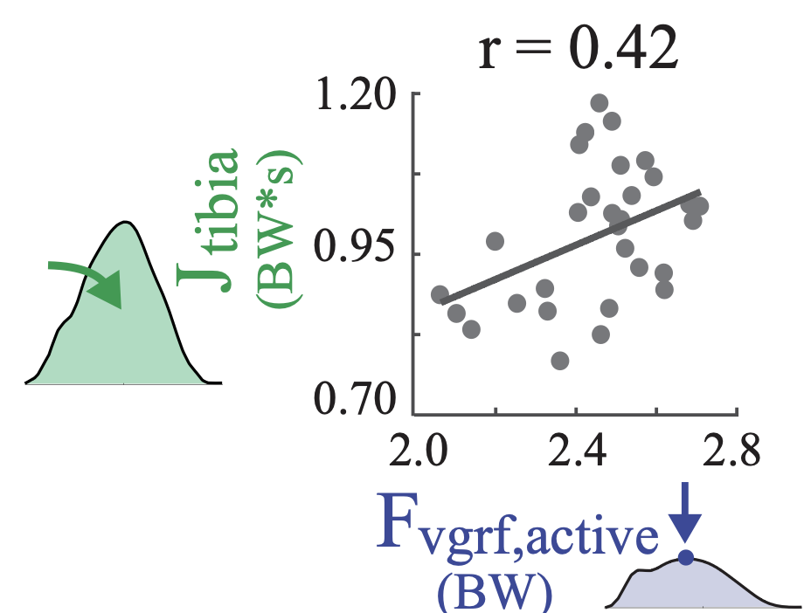
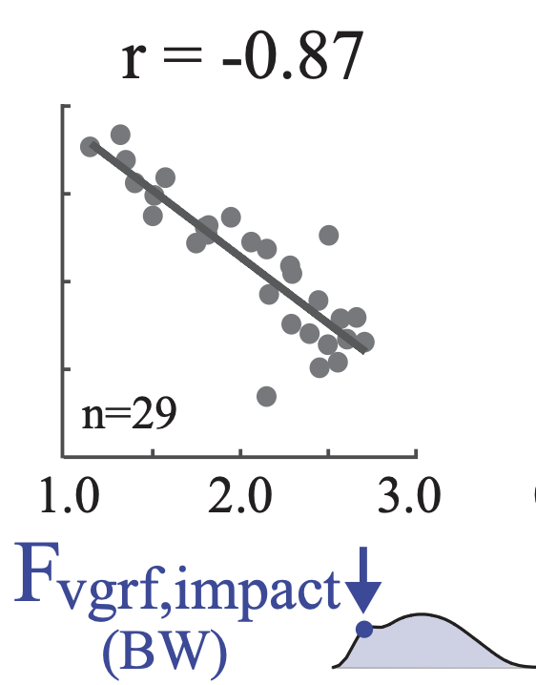
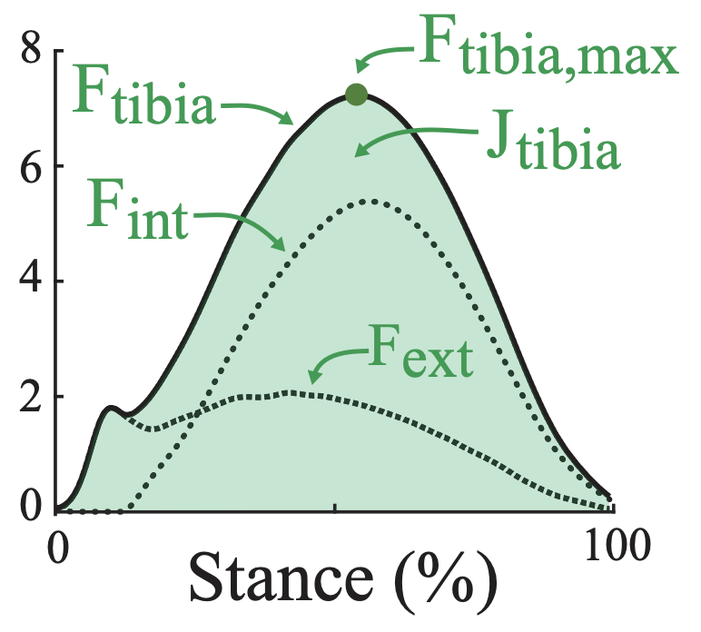
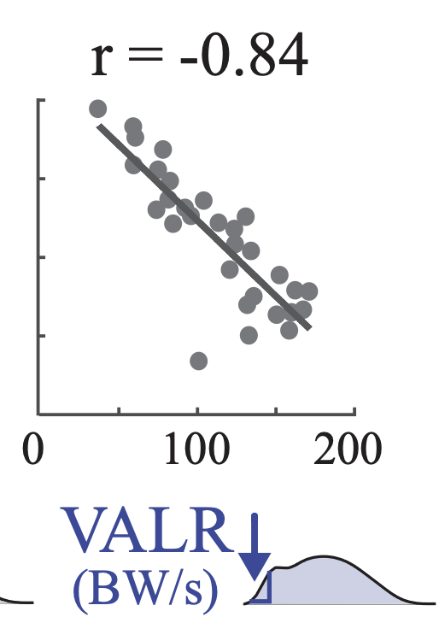
Toolchain
Based on the date various GRF and tibia metrics are calculated and regression is tested.
GRF metrics
tibia metrics

Slide 10
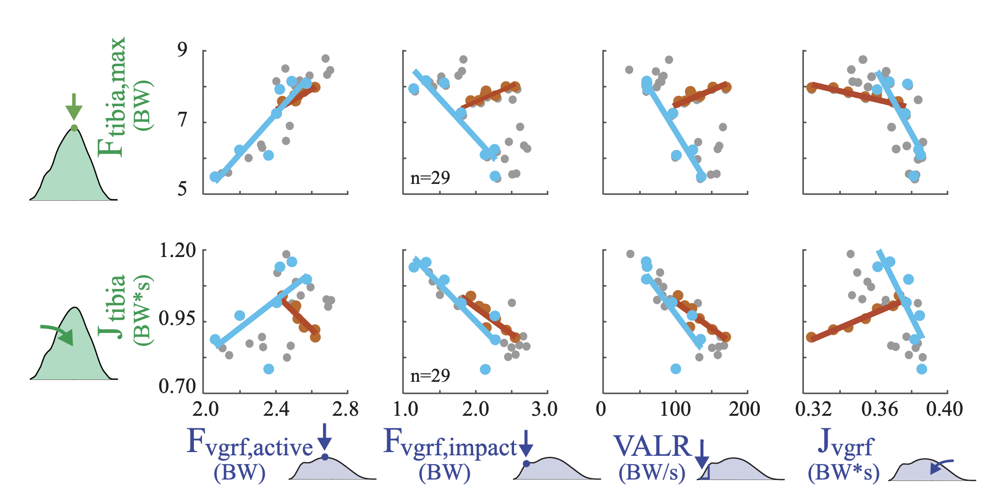

Slide 11
Discussion
What are the broader implications?

Slide 12
Discussion of the results
Limitations
Additional factors (subject-sepcific bone modelling and intrinsic factors)
Not able to directly measure tibial bone loading
Only performed linea, univariate regression analysis
Only quantified tibial compression loads -> (future) bendeing, shear, torsional loads
Other internal structures (e.g. calcaneus bone, muscel and tendons) out of scope
Broader picture: Maybe GRF is a poor metric to understand loading of the vast majority of structures in the body?

Slide 13
Discussion of the results
Key implications related to scientific research
GRF are widely researched. However, the is not clear relation to injury risk (e.g. tibial stress fracture)
Sport science, training, product development and coaching is based on GRF hypothesis -> wrong?!
Supports that epidemicocal studies cannot find a correltation between impact and injuries
“the impact loading is the primary cause of bone microdamage. To our knowledge, there is no evidence to support this assumption “
-> most load is due to muscle contraction
Field woul dbenefit from ceal an dcareful reassessment and bone mechanics studies to appropriatey interpret the oversuse injury studies -> mistakes in often cited paper

Slide 14
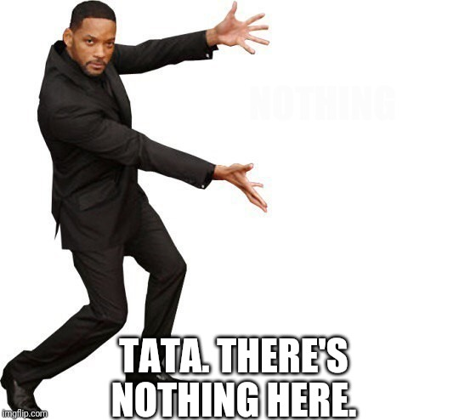
Reflection of my contributions
Open source python wrapper for c3d file format (link to a fancy github)
Open source python implementation for typical GRF metrics and tibial load -> plausibility with opensim -> fancy?
Open source python implementation for statistical calcualtions (maybe use other library here)

