Slide 1
Workshop: Software Engineering for Connected Vehicle Platforms
by Ievgen Strepkov, Peter Sommerhoff, Stefan Vasiljevic, Alexander Kölsch, Christoph Richter

Slide 2
Use case – Theft Detection
Theft Detection
FMS available
has engine
Car / Truck
check via Portal
can be connected to a truck
stand alone
few data if not connected to truck
User
Trailer

Slide 3
Theft Detection Algorithm - Decision Tree

Slide 4
Decision Tree
predefined depends on use case

Slide 5
Decision Tree - Trailer
external power connection
see car

Slide 6
Decision Tree - Trailer
geo fencing
see car

Slide 7
Decision Tree - Trailer
GPS / accelerometer
see car

Slide 8
Decision Tree - Trailer
FMS data available
see car

Slide 9
Decision Tree - Trailer
GPS / accelerometer
see car

Slide 10
Decision Tree - Trailer
GPS / accelerometer
see car

Slide 11
Decision Tree – Car / Truck
from trailer
GPS / accelerometer

Slide 12
Decision Tree – Car / Truck
from trailer
FMS

Slide 13
Decision Tree – Car / Truck
from trailer
FMS

Slide 14
Decision Tree – Car / Truck
from trailer
optional

Slide 15
Decision Tree – Car / Truck
from trailer
FMS / Portal

Slide 16
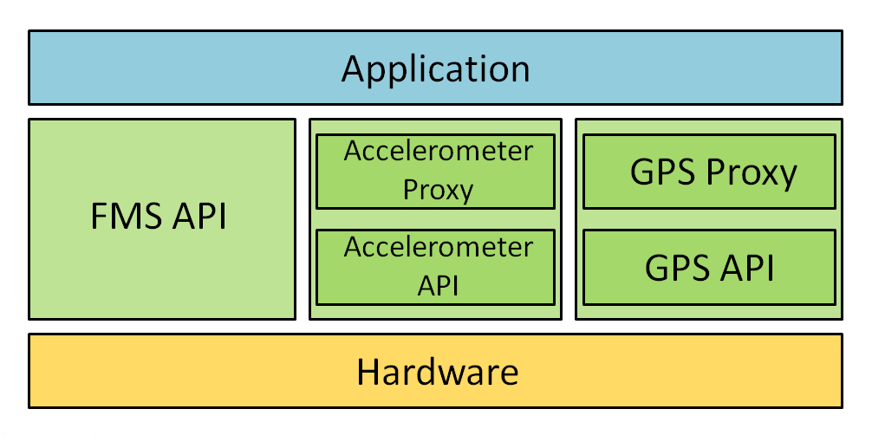
Application Architecture

Slide 17
Movement Detection
Accelerometer
GPS
Moved if:
acceleration > 0.05m/s² averaged over past 500ms
Moved if:
GPS position change is greater than the GPS accuracy compared to the last 60s
OR

