Slide 1
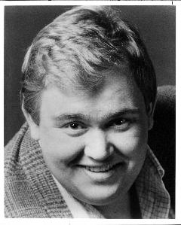
Adam Keppie
Vital Statistics
Location : London
Married : To Rhyll Davey (5yrs)
Children : None
Career : Deloitte Corporate Finance (10 yrs)
Contact Details: akeppie@deloitte.co.uk
Reflections
Notable Memory of Ruse:
A bunch of bright kids with no real idea what they were doing with their lives.
Notable Achievement since Ruse:
Completing the 2002 London Marathon (ouch!).
Messages to Reunion Attendees
I feel quite privileged to have grown up with such a great group of people.
We are not here for a long time we are here for a good time.

