Slide 1
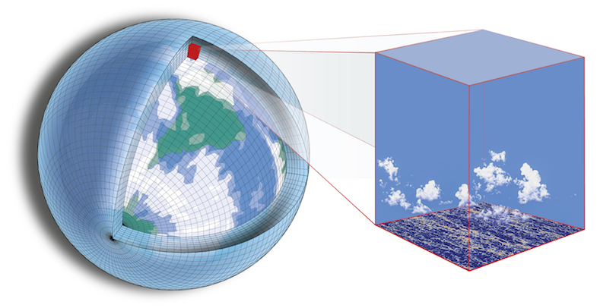




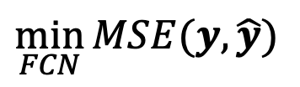










Pre-train Base Models on Each Datasets
Benchmark Model Generalization
Fine-tune Pre-trained Model on
Higher Fidelity Data
$R^{2}(y,\hat{y}$)
Fully Connected Network (FCN)
CAM4
Pretrained Base Model
on CAM4
$$x$$
$$\hat{y}$$
x
FCN
SPCAM
$$\hat{y}$$
FCN
CAM4
Q
Norm
Denorm
dQ
T
FC
Batch
Norm
Leaky
Relu
dT
…
x7
…
SPCAM
FCN
CAM4
Base Models
Fine-tuned on SPCAM
x
$$\hat{y}$$
FCN
$$\min_{FCN}{MSE(y,\hat{y})}$$
CAM4
FCN
CAM4
Measure Model Disagreement
FCN
x
$$\hat{y}$$
$R^{2}({\hat{y}}_{CAM4},{\hat{y}}_{SPCAM}$)
$$\left(x,y\right)$$
$$\left(x,y\right)$$
Increasing amount of SPCAM data used in fine-tuning
FCN
SPCAM
FCN
SPCAM
x
FCN
CAM4
$${\hat{y}}_{CAM4}$$
x
$$\hat{y}$$
CAM4
$$\left(x,y\right)$$
$$\left(x,y\right)$$
Upper Bound:
Model trained on full SPCAM dataset
FCN
SPCAM
x
FCN
SPCAM
$${\hat{y}}_{SPCAM}$$

