Slide 1
Calculating Material Allowables
Jan 2026

Slide 2
Calculating Material Allowables
The goal of this presentation is to show the equations and fundamentals of creating a Python program that will take material values and compute A,B basis material design data.
The program itself is found on github:
https://stressjock.github.io/matstats.html
- Future work: remove outliers
m

Slide 3
Calculating Material Allowables
Under CMH-17 guidelines, you follow this decision tree:
Step 1: Test for Normality (Anderson-Darling).
If the data is Normal, you must use the Normal Basis value.
Step 2: Test for Lognormality. If it is not Normal, you transform the data ln[x] and test for Normality again. If it passes, you use the Lognormal Basis value.
Step 3: Test for Weibull. If the data fails both Normal and Lognormal, you perform the Weibull Goodness-of-Fit test.
The Catch: Weibull has a specific "Validity" check (often called the Maximum Likelihood (MLE) check).
In many software packages, if the Weibull Shape parameter (beta) is less than 2.0, it is often flagged because it implies a distribution shape that might not be physically realistic for structural material strength.
When to use Non-Parametric
You move to Non-Parametric (like Hanson-Koopmans or the standard Rank method) when:
1. All Parametric tests fail: The data is not Normal, Lognormal, or Weibull.
2. Insufficient Data for Weibull: While the program calculates it, Weibull MLE usually requires a larger sample size to be truly stable compared to Normal.
For N < 28: If you cannot prove a distribution (Normal/Weibull) and your sample size is small (N < 28), the Hanson-Koopmans (HK) method is exactly what the industry uses. It is specifically designed to provide a B-basis for small samples without requiring a distribution fit.

Slide 4
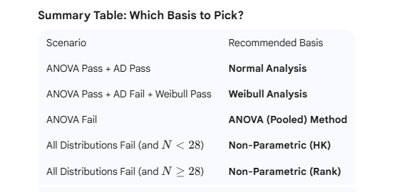
Calculating Material Allowables

Slide 5
Calculating A-B Basis Allowables
EXAMPLE
N = 20
20 values (sorted): 716, 776, 811, 909, 960, 966, 1002, 1045, 1086, 1099, 1112, 1143, 1154, 1155, 1182, 1202, 1205, 1219, 1254, 1293
Sample size = 20
Mean (xbar = 1064.45)
Standard Deviation (s) = 163.64

Slide 6
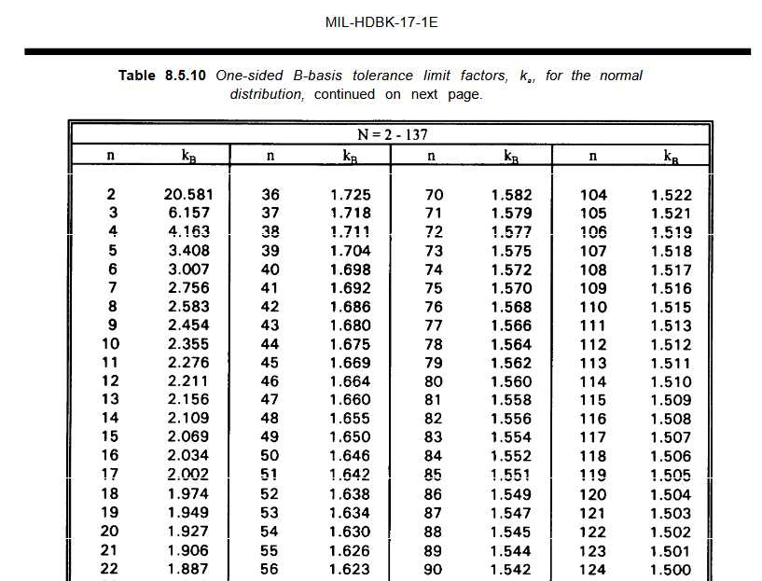
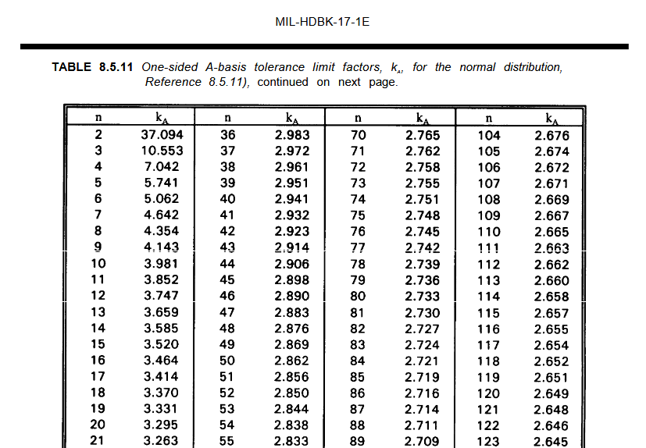
Calculating A-B Basis Allowables
STEP 1 NORMAL DISTRIBUTION
Basis = xbar – k*s
A) B-Basis (95% Confidence, 90% Reliability)
  Look up kb factor (CMH-17: Table 8.5.10):
  For N=20, the one-sided tolerance factor is k_B = 1.926.
  Calculate the product: 1.926 * 163.64 = 315.17
  Subtract from Mean: 1064.45 - 315.17 = 749.28
B) A-Basis (95% Confidence, 99% Reliability)
  Look up ka factor (CMH-17: Table 8.5.10):
  For N=20, the one-sided tolerance factor is A = 3.295.
  Calculate the product: 3.295 * 163.64 = 539.19
  Subtract from Mean: 1064.45 - 539.19 = 525.26
  NOTES:
  a) Anderson Darling test must be used to ensure data is normal
  b) For N<=15, exact non-central T distribution factors will be used.
  For N>15, the Dijkstra approx. Formula will be used.

Slide 7
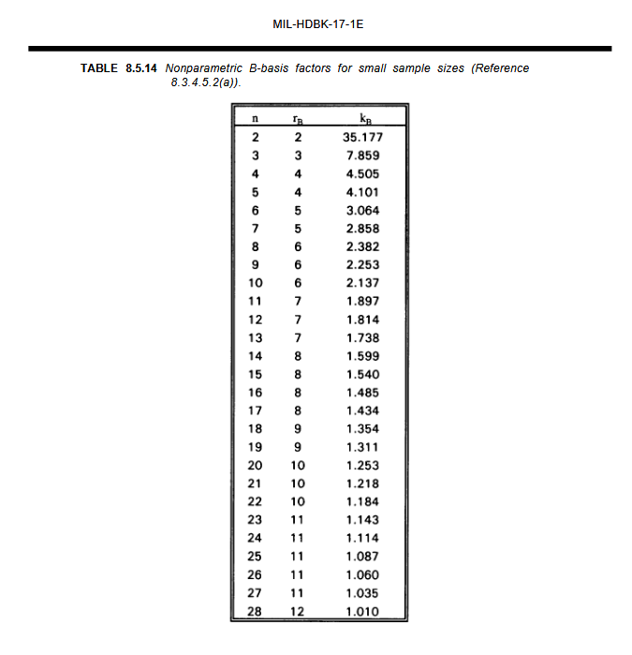
Calculating A-B Basis Allowables
STEP 2 HANSON-KOOPMANS METHOD (NON PARAMETRIC)
  The following procedure can be a useful method for obtaining a B-basis value for sample sizes not exceeding 28. This procedure requires the assumption that the observations are a random sample from a population for which the logarithm of the cumulative distribution function is concave, an assumption satisfied by a large class of probability distributions.
This method uses specific ranks (r) from the sorted data.
The formula is: Basis = xr * ( x1 / xr ) ^{k}
A) B-Basis (N=20)
  Identify r and k from Table 8.5.14 (CMH-17: Table 8.5.14):
    For N=20 (B-Basis), the table specifies rank r=10 and factor k=1.253.
      Identify values:
        x1 (1st sorted value) = 716
        x10 (10th sorted value) = 1099
  Calculate the ratio: 716 / 1099 = 0.6515
  Apply power k: 0.6515^{1.253} = 0.5845
  Multiply by x1: 1099 * 0.5855 = 642.4

Slide 8
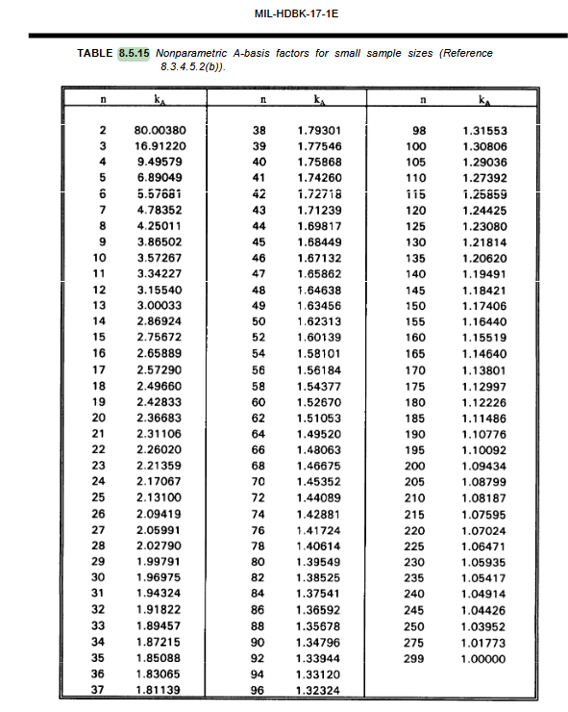
Calculating A-B Basis Allowables
STEP 2 HANSON-KOOPMANS METHOD (NON PARAMETRIC) ...cont.
B) A-Basis (N=20)
    Identify r and k from Table 8.5.14 (CMH-17: Table 8.5.15):
      For N=20 (B-Basis), the table specifies rank r=2 and factor k=2.36683.
    Identify values:
      x1 (1st sorted value) = 716
      xr (Where r = N, here N = 20) = 1293
    Calculate the ratio: 716 /1293 = 0.5537
    Apply power k: 0.5537^{2.36683} = 0.2468
    Multiply by x1: 1293 * 0.2468 = 319.2

Slide 9
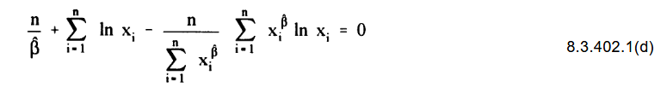
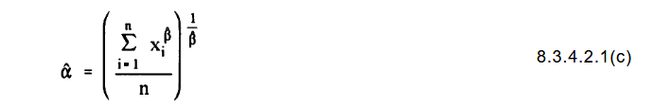
Calculating A-B Basis Allowables
STEP 3 WEIBULL (Two Parameter)
  From CMH-17, section 8.3.4.2, it is first necessary to obtain estimates of the population shape and scale parameters when using the Weibull population distribution method – if it is indicated.
  The maximum likelihood (MLE) method for estimating the Weibull parameters follows:
  1) Estimating MLE requires solving the following iterative equation:
    For N = 20,
    Shape (beta) ~ 8.6224
    Scale ~ 1130.03

Slide 10
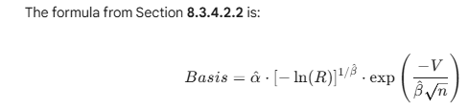
Calculating A-B Basis Allowables
STEP 3 WEIBULL (Two Parameter)
  From CMH-17, section 8.3.4.2, it is first necessary to obtain estimates of the population shape and scale parameters when using the Weibull population distribution method – if it is indicated.
  The maximum likelihood (MLE) method for estimating the Weibull parameters follows:
  2) Tolerance Factors (V) for N=20 from CMH-17, Table 8.5.8
    B-basis Vb = 5.442
    A-Basis Va = 10.038
  3) From eqt’n CMH-17, section 8.3.4.2.2
    A) B-Basis Calculation (R=0.90)
      Quantile term: -ln(0.90)]^{1/8.6224} ~ [0.10536]^{0.11597} ~ 0.7708
      Correction term: exp(-5.442/8.6624 * sqrt (20)) = exp (-5.442/38.560) ~ 0.8684
      Result: 1130.03*0.7708*0.8684 = 756.3
    B) A-Basis Calculation (R=0.90)
      Quantile term: -ln(0.99)]^{1/8.6224} ~ [0.1005]^{0.11597} ~ 0.5867
      Correction term: exp(-10.038/8.6624 * sqrt (20)) = exp (-10.038/38.560) ~ 0.7708
      Result: 1130.03*0.5867*0.7708 = 510.9

Slide 11
Calculating A-B Basis Allowables
STEP 4 ANOVA
  This test determines if multiple batches are statistically similar enough to be "pooled" into a single dataset for basis value calculation.
  Up to now, we have assumed the data is pooled. This implementation follows the One-Way ANOVA Random Effects Method defined in CMH-17-1G, Section 8.3.5.2.
  This method is used to calculate basis values that account for both within-batch and between-batch variability.
  Step 1: Mean Square Calculations (MSB & MSE)
    The program first calculates the variation between the batch means (MSB) and the variation within the batches (MSE).
      MSB (Between-batch): 1,940.45
      MSE (Within-batch): 28,156.25
      In this example, the variation between batches is actually smaller than the variation within the batches (MSB < MSE).
      When this happens, the CMH-17 logic sets the ratio u = 1, which essentially treats the batches as having no additional statistical separation beyond random noise.
  Step 2: Calculate ANOVA Standard Deviation (SANOVA)
    Instead of using a simple standard deviation of all 20 points, the ANOVA method calculates a weighted standard deviation (BigS) based on the batch sizes and mean squares.
      n' (Effective Batch Size): 10.0
      BigS (ANOVA Std Dev): 159.80

Slide 12
Calculating A-B Basis Allowables
STEP 4 ANOVA
  Step 3: Determine K-Factors
    The program uses the approximation formulas for N > 15 and lookup values (calculated via non-central t-distribution) for N<= 15.
      K0B (Factor for total N=20): 1.9259
      K1B (Factor for number of batches N=2): 20.5815
  Step 4: Calculate the T Factor (Weighted Factor)
    The variable w represents the weighting between the within-batch and between-batch components.
    Weighting (w): 0.3162 (calculated as sqrt{u / (u + n' – 1)}
    BigTB: 1.9259
    BigTA: 3.2962
    Because u=1 (the batches are well-behaved), the T factor simplifies to the standard normal k-factor for the total sample size (N=20).
  Step 5: Final Basis Value Calculation
    The basis values are calculated using the grand mean minus the product of the weighted T factor and the ANOVA standard deviation.
    Grand Mean: 1,064.45
    B-Basis (ANOVA_B): 1,064.45 - (1.9259 * 159.80) = 756.71
    A-Basis (ANOVA_A): 1,064.45 - (3.2962 * 159.80) = 537.73

