Slide 1
Visualization of embedded systems
main research directions, representative work,
common tools/datasets, and open gaps/opportunities

Slide 2
What is an embedded system?

Slide 3
Why visualization?

Slide 4
Main Types

Slide 5
Execution
Logging
Dashboards
Ressource Constrained GUIs
Timing & Scheduling
2.1 Visualization for embedded/RTOS debugging
2.2 Visualization in embedded/edge applications
constrained rendering
Ways to use visualization in embedded systems
On-device debugging
Workflow debugging
2.3 Visual/graphical programming for embedded/IoT workflows
2.4 TinyML on microcontrollers
monitoring
Node-based tooling
Live data view
Dataflow-style programming
interpretability
“edge” meaing the embedded device is doing computing right where the data is produced

Slide 6
Research Papers & Tools

Slide 7
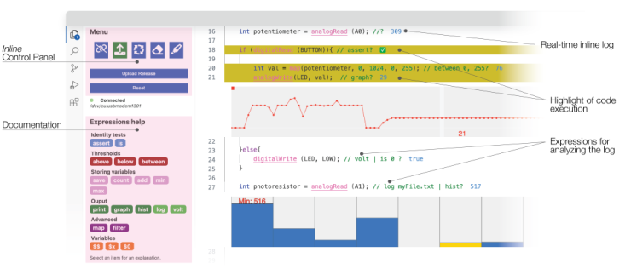
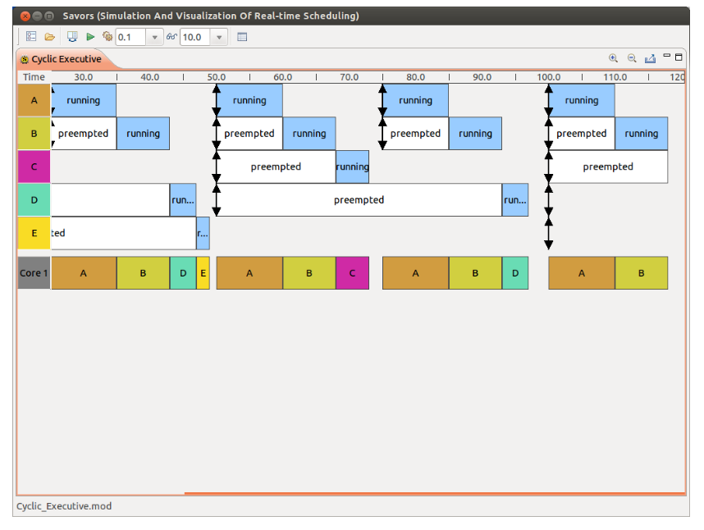
2.1 Visualization for embedded/RTOS debugging
Other Papers
“Trace Recording for Embedded Systems: Lessons Learned from Five Industrial Projects”
“Deterministic Replay Debugging of Embedded Real-Time Systems using Standard Components”
“Model-Level Debugging of Embedded Real-Time Systems”
“DEBONAIR: A Real-Time Debugger for Embedded Systems”
“Online Analysis of Debug Trace Data for Embedded Systems”
“Visualization of Scheduling in Real-Time Embedded Systems”
“Inline Visualization and Manipulation of Real-Time Hardware Log for Supporting Debugging of Embedded Programs”

Slide 8
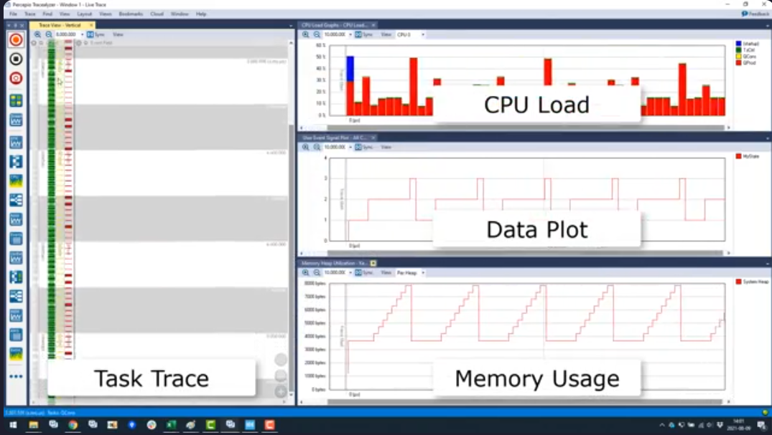
Tracelyzer

Slide 9
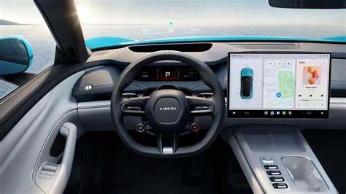
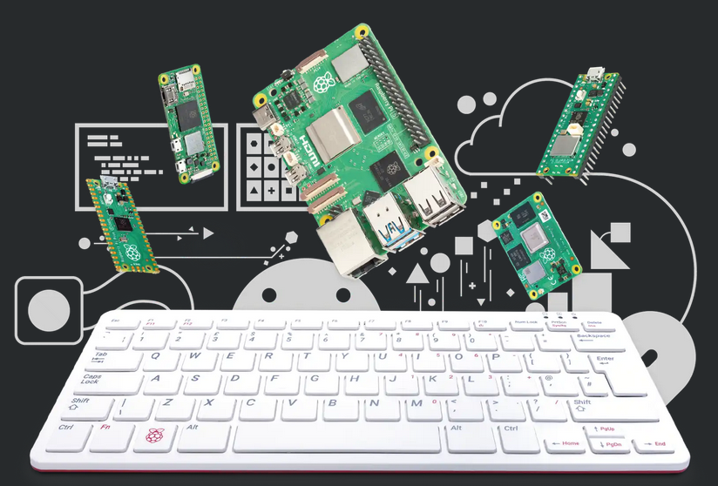
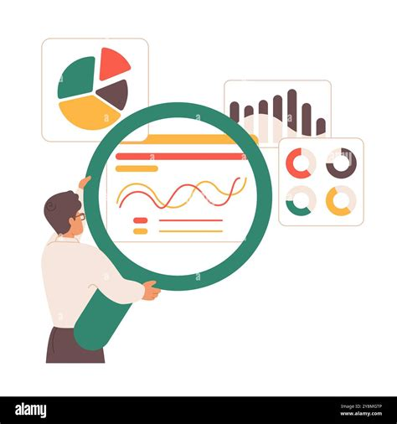
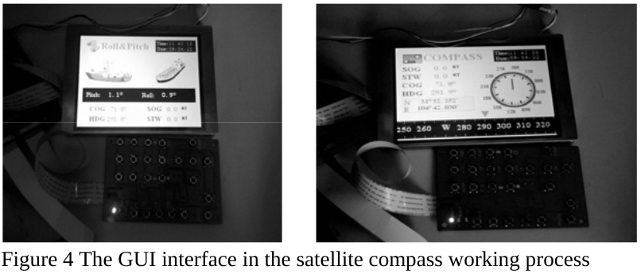

2.2 Visualization in embedded/edge applications
“Investigating the rendering capability of embedded devices for graphical-user-interfaces in mobile machines”
“Design and Implementation of Embedded GUI Middleware”
“Design of a Digital Dashboard on Low-Cost Embedded Platform in a Fully Electric Vehicle”

Slide 10
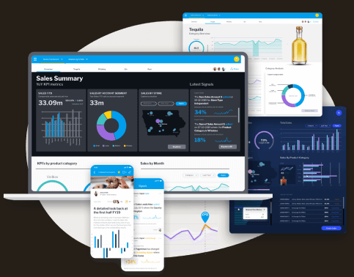
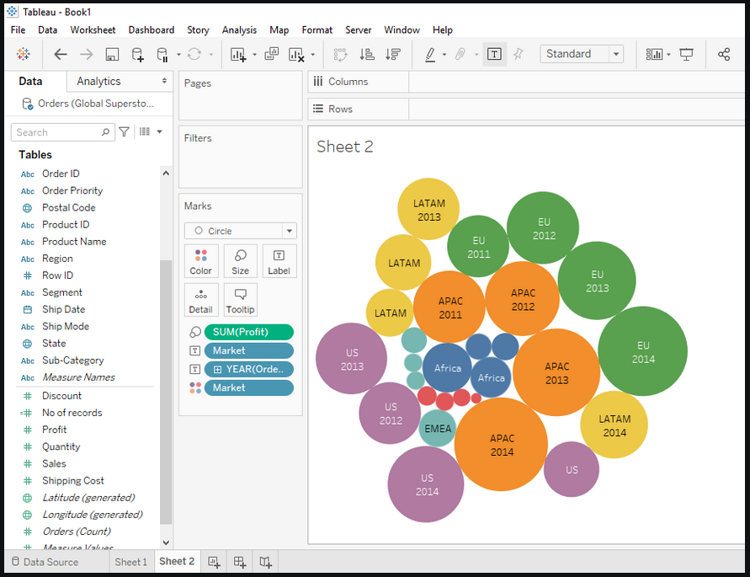
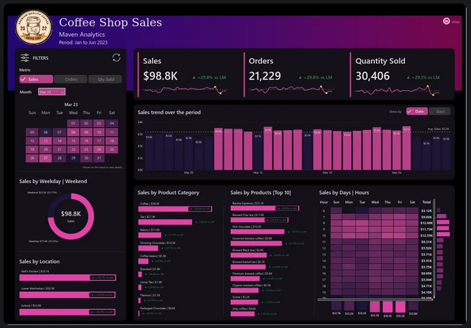
Source: https://www.yellowfinbi.com/campaign/live-demo
Tableau
Source: https://www.geeksforgeeks.org/tableau/introduction-to-tableau/
Power BI
Yellowfin BI
Source: https://www.analyticsvidhya.com/blog/2024/12/power-bi-dashboards/

Slide 11
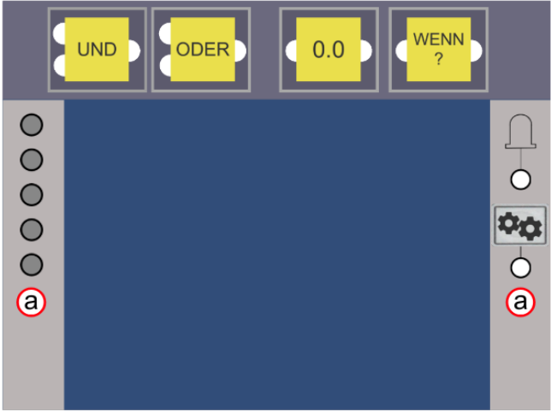
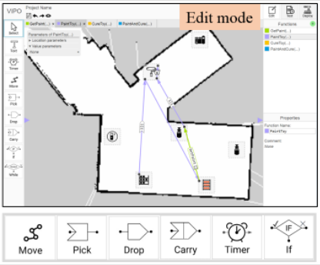
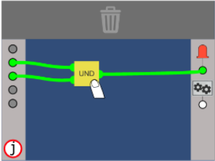
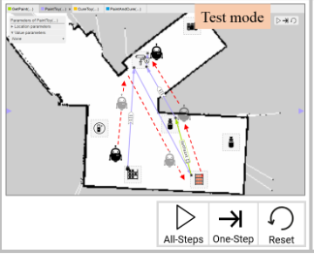
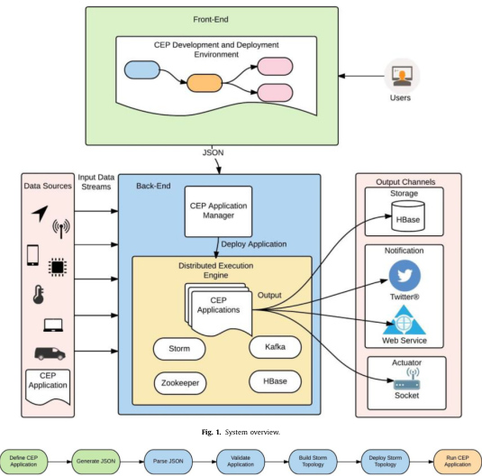
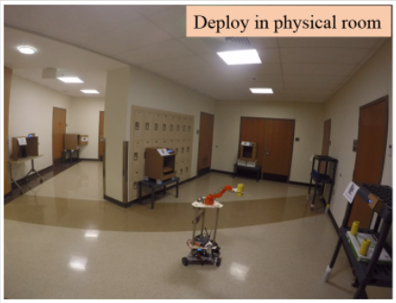
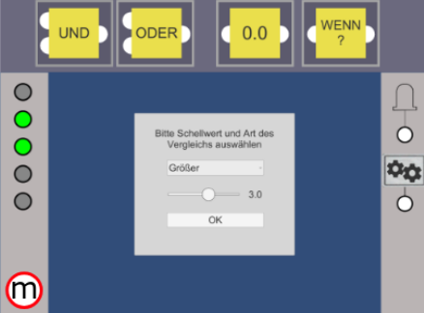
2.3 Visual/graphical programming for embedded/IoT workflows
A visual programming framework for distributed Internet of Things centric complex event processing
“Vipo: Spatial-Visual Programming with Functions for Robot-IoT Workfows”
“Towards a Flow-Based Embedded Programming Environment for School Children”

Slide 12
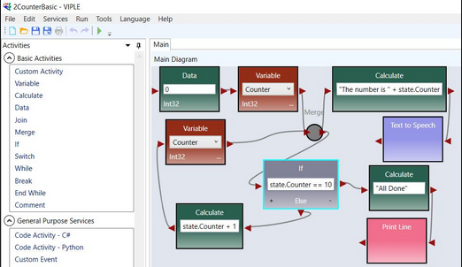
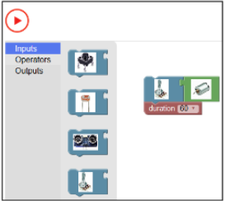
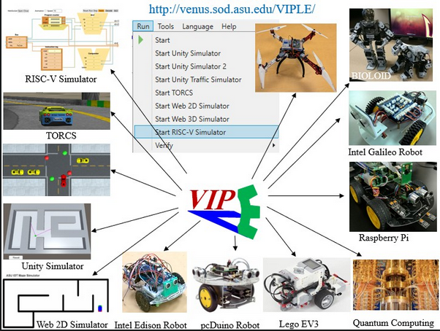
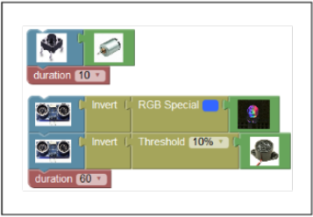
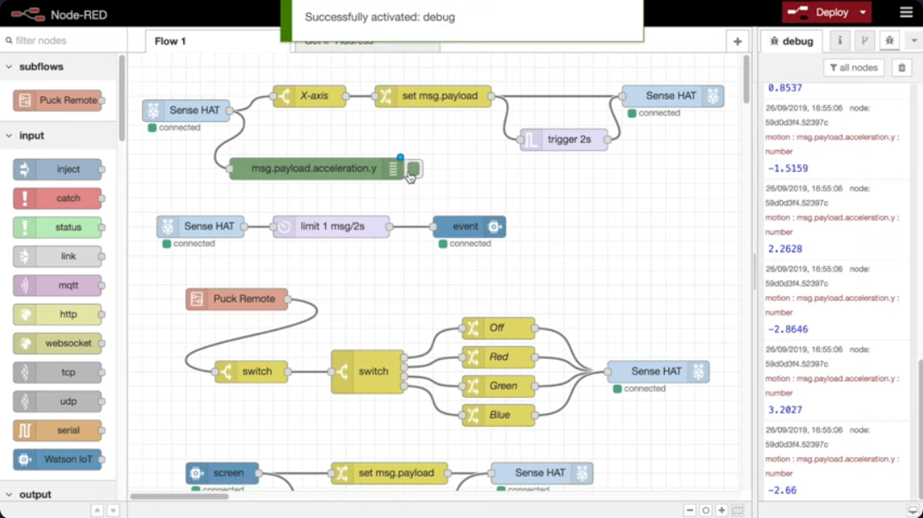
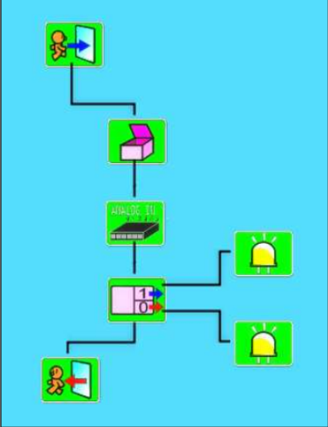
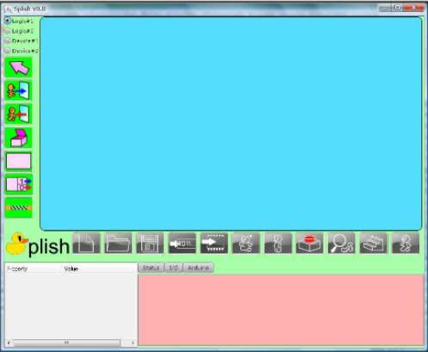
VIPLE
Tools
LAWRIS
Splish
Node-RED

Slide 13
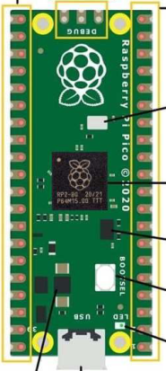
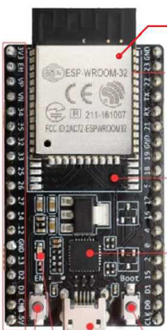
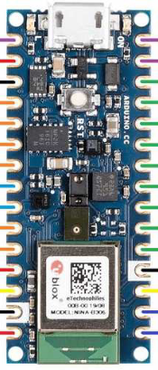
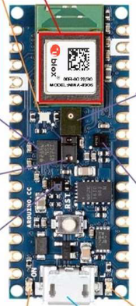
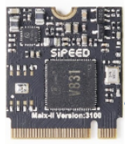
2.4 TinyML on microcontrollers
“A Review on Resource-Constrained Embedded Vision Systems-Based Tiny Machine Learning for Robotic Applications”

Slide 14
Unified HW+SW real-time visualization environment
Research Idea 1
What it covers
Could include...
Visualization for embedded debugging
Visualization in embedded applications
Microcontrollers
User studies
Comparison with existing tools
Prototype contains
Microcontroller with sensors and more
Host device for data aggregation and visualization
Interface combines
Why
Physical hardware layout
Execution timelines
Live program context
→ display hardware activity
→ display software behavior
==> all in one
Improve clarity
Better usability
Improve real-time debugging
Affordable prototype elements
Building on previous papers
Human centered system tool

Slide 15
Performance-Aware Adaptive Visualization for Embedded Systems
Both ideas could even be combined in this order
(1 → then idea 2)
Research Idea 2
Adaptive
Measure
Adjusts data amount and GUI (graphical aspect) based on system performance
Prioritizes specific things over others when adjusting for better performance
CPU, Memory, Timing, impact of different rendering (e.g.)
Prioritize
Performance over visual appeal
Could include..
Comparison of different visualization strategies
(Benchmarking)
Performance centered system tool
What?
Study runtime overhead of ressource constrained embedded systems

Slide 16

Thank you

