Slide 1
StockCompete
Aaron Nolan - 18423054
Ben Strickland - 18704489
Staff Consulted: Graham Healy

Slide 2
Project Summary
A stock trading web application using gamification to encourage and teach new traders.
Gamification has been very successful
None available outside the US (Robinhood)
Surge of new users trading

Slide 3
Market Rationale
Target Market Size:
Estimated figure of 38,750,000 customers
Customer Segment:
New, non-professional traders
Main Value Proposition:
A stock trading web application that uses gamification, simple trading information and offers low commission rates.

Slide 4
Primary and Secondary Research
Robinhood:
Based in the United States and only serves the US.
They use Social Media and adverts to publicise services.
Use Purchase for Order Flow (PFOF) as revenue source
They offer 0% Commission Fees and some gamified features
Market Validation:
Survey the customer segment
Customer Profiles
Public research and articles

Slide 5
Expected Technical Delivery
Web app with Django backend and vanilla JavaScript frontend
Prototype Content
Stock Data from Alpha Vantage
User Dashboard / Account
Prototype Features
Search for stocks
Buy and Sell Functionality
Leaderboard and points system

Slide 6
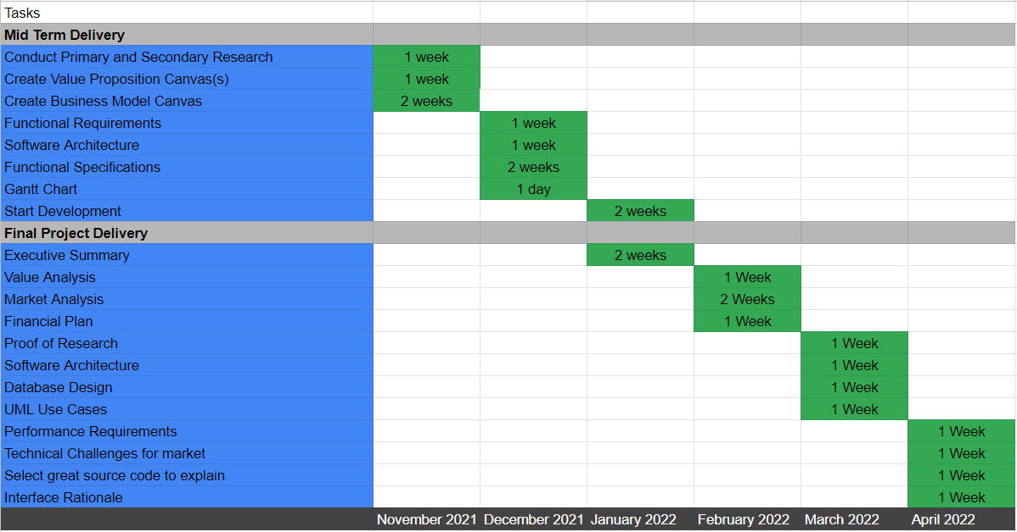
Proposed Timeline of Activities

