Slide 1
Data Structure & Algorithms – CSC 221
Lecture 2
Instructor: Dr. Erum Ashraf

Slide 2
Contents
What a Stack is?
Stack as an ADT
Implementation of Stack in C++
Applications of Stack

Slide 3
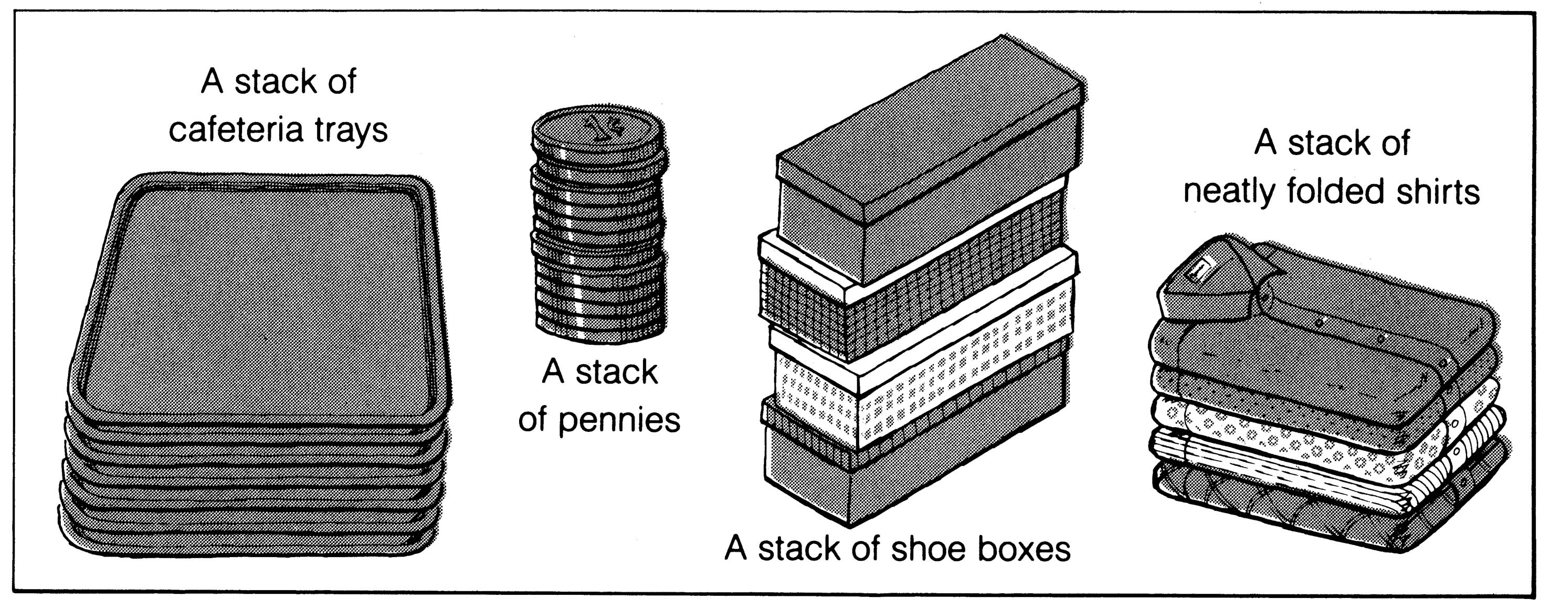
What is a stack?
It is an ordered group of homogeneous items.
Elements are added to and removed from the top of the stack (the most recently added items are at the top of the stack).
The last element to be added is the first to be removed (LIFO: Last In, First Out).

Slide 4
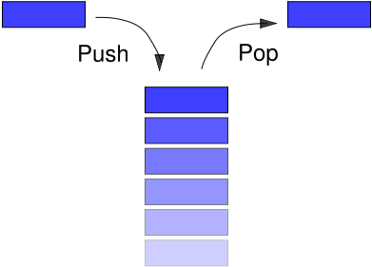
Insertion & deletion on stack

Slide 5
Examples of Stack
“Back” button of the Web Browser
History of visited web pages is pushed onto the stack and popped when the “back” button is clicked
“Undo” functionality of a text editor
Reversing the order of elements in an array
Saving local variables when one function calls another, and this one calls another, and so on

Slide 6
Stack as an ADT
A stack is an ordered collection of data items in which access is possible only at one end (called the top of the stack).
Basic operations:
Construct a stack (usually empty)
Check if the stack is empty
Push: Add an element at the top of the stack
Top: Point the top element of the stack
Pop: Remove the top element of the stack

Slide 7
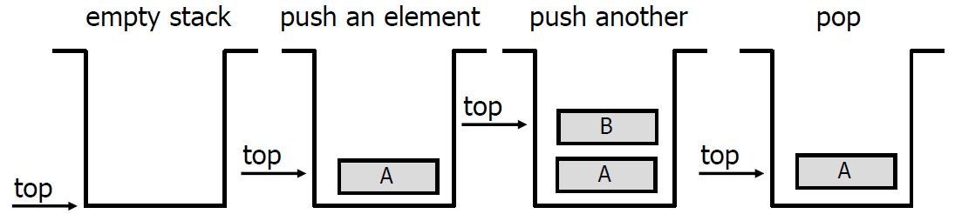
Push and Pop
Push
Add an element to the top of the stack.
Pop
Remove the element at the top of the stack.

Slide 8

Push & Pop
PUSH(A)
PUSH(B)
PUSH(C)
5
4
3
2
1
0
5
4
3
2
1
0
5
4
3
2
1
0
5
4
3
2
1
0
Top
C
Top
B
B
Top
A
A
A
Top
Top = -1
Top = 0
Top = 1
Top = 2
PUSH(D)
POP
POP
PUSH(Z)
5
4
3
2
1
0
5
4
3
2
1
0
5
4
3
2
1
0
5
4
3
2
1
0
Top
D
C
Top
C
Top
Z
B
B
Top
B
B
A
A
A
A
Top = 3
Top = 2
Top = 1
Top = 2

Slide 9
Related terminology
Top
A pointer that points to the top element in the stack.
Stack Underflow
When there is no element in the stack, we cannot pop an element: stack underflow
Stack Overflow
When the stack contains an equal number of elements as per its capacity and no more elements can be added: stack overflow

Slide 10
Implementing the Stack

Slide 11
Stack implementation
Implementation can be done in two ways
Static implementation
Dynamic Implementation
Static Implementation
Stacks have fixed size, and are implemented as arrays
It is also inefficient for the utilization of memory
Dynamic Implementation
Stack grows in size as needed, and is implemented as linked lists
Dynamic Implementation is done through pointers
The memory is efficiently utilized with Dynamic Implementations

Slide 12
Stack's Data Members
Provide:
An array data member to hold the stack elements.
An integer data member to indicate the top of the stack.
We need an array declaration of the form ArrayElementType myArray[ARRAY-SIZE];
const int SizeArray = 128; int myArray[SizeArray];

Slide 13
Stack Operations
Construction: Initializes an empty stack.
Empty operation: Determines if the stack contains any values
Push operation: Modifies a stack by adding a value to top of stack
Top operation: Points the value at the top of the stack
Pop operation: Modifies a stack by removing the top value of the stack
To help with debugging, add early on:
Output: Displays all the elements stored in the stack.

Slide 14
Stack Operations
const int STACK_CAPACITY = 128;
class Stack { public: . . .
private:
int myArray[SizeArray];
int myTop;
};
. . .

Slide 15
Stack's Function Members
Constructor:
class Stack { public:
Stack(); ... };
Stack::Stack() {
myTop = -1;
}

Slide 16
Stack’s Declaration
A declaration
Stack s;
will construct s as follows:
myArray
? ? ? ? ? . . . ?
myTop
-1

Slide 17
Empty Stack
empty:
Returns: True if stack is empty, false otherwise.
class Stack { public: . . . bool empty();
. . . };
bool Stack::empty() {
if(myTop==-1)
return true;
else
return false;
}

Slide 18
Push Elements in Stack
push: Receives Value to be added to stack
void push(int value);
void Stack::push(int value){
if (myTop < SizeArray - 1){
++myTop;
myArray[myTop] = value; }
else cout<<"*** Stack full -- can't add new value ***\n“
}

Slide 19
Stack’s Top
top:
Returns: Value at the top of the stack
int top();
int Stack::top() {
if (myTop >= 0) // or if (!empty())
return (myArray[myTop]);
else { cout << "*** Stack is empty " " -- returning garbage ***\n";
return myArray[SizeArray -1]; } }

Slide 20
Pop Element from Stack
pop:
Returns: Value at the top of the Stack and removes it from the Stack
int pop();
int Stack::pop(){
if (myTop >= 0) // or if (!empty())
return myArray[myTop--];
else {
cout << "*** Stack is empty -- " return –1;
}
}

Slide 21
The Stack Class (using Array)
Class Stack{
private:
int myArray[SizeArray];
int myTop;
public:
Stack();
bool isEmpty();
bool isFull();
void push(int);
int pop();
void displayStack();
int Top();
};

Slide 22
The Stack Class (using Pointer Array)
Class Stack{
private:
int *stackArray;
int stackSize;
int myTop;
public:
Stack(int);
bool isEmpty();
bool isFull();
void push(int);
int pop();
void displayStack();
int Top();
};
Notes:
If using new int[n], the size is still fixed once allocated (cannot grow beyond n).

Slide 23
The Stack Class
Stack::Stack(int size)
{
stackArray = new int[size];
stackSize = size;
top = -1;
}

Slide 24
The Stack Class
void main ()
{
Stack stack(5);
int choice;
do
{
cout<<“Menu"<<endl;
cout<<"1-- PUSH"<<endl;
cout<<"2-- POP"<<endl;
cout<<"3– DISPLAY "<<endl;
cout<<"4-- Exit"<<endl;
cout<<"Enter choice=";
cin>>choice;
switch(choice)
{
case 1:
int n; cin >> n;
stack.push(n); break;
case 2:
stack.pop(); break;
case 3:
stack.displayStack(); break;
}
}while(choice!=4);
getch();
}

Slide 25
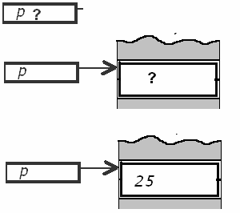
Dynamic Memory Allocation – New/Delete
A dynamic variable is created and destroyed while the program is running
int *p ;
p = new int ;
*p = 25 ;

Slide 26
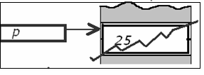
Dynamic Memory Allocation – New/Delete
delete p ; destroys the dynamic variable pointed by p
After delete p, p becomes an undefined pointer variable: a dangling pointer.
Beware: before using * again, be sure p points to something and is not a dangling pointer. Otherwise unpredictable effects.

Slide 27
Applications of Stacks
Reversing a Sequence
Function Calls
Conversion from Decimal to Binary
Symbol Balancing/ Balanced Parenthesis Checking
Conversion from infix to postfix
Evaluating RPN Expressions

Slide 28
1. Reversing a Sequence
Given a sequence:
-1.5 2.3 6.7
Push onto a stack one number at a time
Then pop each number off the stack
Top

Slide 29
Reversing a Sequence
2.3 6.7
Push onto a stack one number at a time
Then pop each number off the stack
Top
-1.5

Slide 30
Reversing a Sequence
6.7
Push onto a stack one number at a time
Top
2.3
Then pop each number off the stack
-1.5

Slide 31
Reversing a Sequence
Push onto a stack one number at a time
Top
6.7
2.3
Then pop each number off the stack
-1.5

Slide 32
Reversing a Sequence
Push onto a stack one number at a time
Top
2.3
Then pop each number off the stack
-1.5
6.7

Slide 33
Reversing a Sequence
Push onto a stack one number at a time
Then pop each number off the stack
Top
-1.5
6.7 2.3

Slide 34
Reversing a Sequence
Push onto a stack one element at a time
Then pop each element off the stack
Top
6.7 2.3 -1.5

Slide 35
2. Stack and Function Calls
In almost all programming languages, calling a function involves the use of a stack.
At a function call, all of the important information is stored on a stack, and control is transferred to the new function.
A transfer of control occurs from the calling block to the code of the function. It is necessary that there be a return to the correct place in the calling block after the function code is executed. This correct place is called the return address.
When any function is called, the run-time stack is used. On this stack is placed an activation record (stack frame) for the function call.

Slide 36
Stack and Function Calls
The activation record stores the return address for this function call, and also the parameters, local variables, and the function’s return value, if non-void.
The activation record for a particular function call is popped off the run-time stack when the final closing brace in the function code is reached, or when a return statement is reached in the function code.
At this time the function’s return value, if non-void, is brought back to the calling block return address for use there.

Slide 37
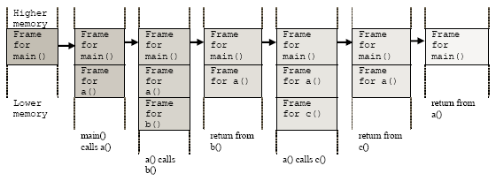
Stack and Function Calls
int a();
int b();
int c();
int a()
{ b();
c();
return 0;
}
int b()
{ return 0; }
int c()
{ return 0; }
int main()
{
a();
return 0;
}

Slide 38
3. Conversion from Decimal to Binary
Read (number)
Loop (number > 0)
digit = number modulo 2
print (digit)
number = number / 2
The problem with this code is that it will print the binary number backwards. (ex: 19 becomes 11001000 instead of 00010011.) To remedy this problem, instead of printing the digit right away, we can push it onto the stack. Then after the number is done being converted, we pop the digit out of the stack and print it.

Slide 39
Conversion from Decimal to Binary
1. Create STACK.
2. Read Num.
3. Repeat while NUM > 0
3.1 SET Digit := Num % 2.
3.2 If STACK is full, then:
3.2.1 Print “Stack Overflow”
3.2.2 Return.
3.3 PUSH(Digit).
3.5 SET Num := Num/2.
4. Repeat while STACK is not empty.
4.1 POP(Digit).
4.2 Write Digit.
5. Return.

Slide 40
4. Symbol Balancing/ Balanced Parenthesis Checking
7 - ((X * ((X + Y) / (J - 3)) + Y) / (4 - 2.5))
Rules:
There should be equal number of left and right parenthesis.
Every right parenthesis should be preceded by a matching left parenthesis.
((A +B) or A + B (
)A + B (-C or (A + B)) - (C + D)

Slide 41
Symbol Balancing
Each left parenthesis opens a scope and right parenthesis closes a scope.
Parenthesis Count =
No. of left parenthesis - No. of right parenthesis
The two conditions for valid expressions are:
Parenthesis count at the end of the expression is 0.
Parenthesis count at each point is non-negative.

Slide 42
Stack Algorithm: (Symbol Balancing)
Initialize an empty stack.
Repeat the following until the end of the expression is encountered:
Get next token
If token is “(“, push it onto the stack.
If token is “)”
If the Stack is Empty: Invalid Expression
Else pop one element
If the Stack is Empty: A valid Expression
Else: Invalid Expression

Slide 43
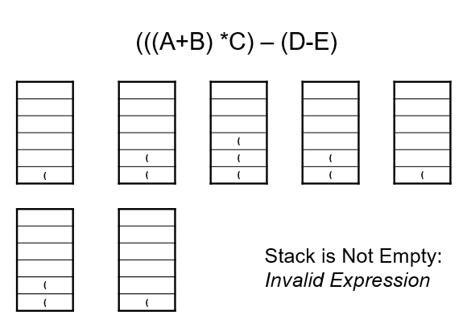
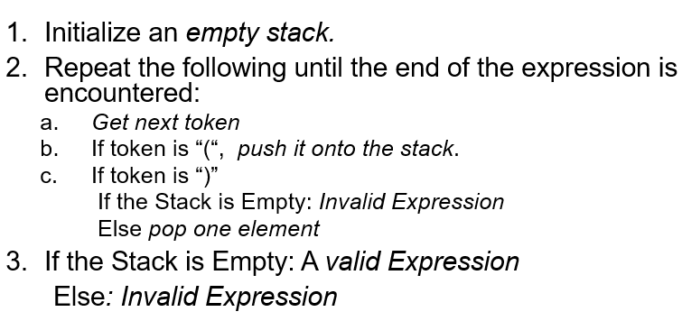
Symbol Balancing

Slide 44
Symbol Balancing
top
[
{
-
C
+
(
A
+
B
D
+
E
)
}
]

Slide 45
Symbol Balancing
top
Push( ‘[‘ );
[
[
{
-
C
+
(
A
+
B
D
+
E
)
}
]

Slide 46
Symbol Balancing
top
{
Push( ‘{‘ );
[
[
{
-
C
+
(
A
+
B
D
+
E
)
}
]

Slide 47
Symbol Balancing
top
(
{
Push( ‘(‘ );
[
[
A
+
{
B
-
C
+
(
D
+
E
)
}
]

Slide 48
Symbol Balancing
top
(
{
Pop( );
[
[
A
+
{
B
-
C
+
(
D
+
E
)
}
]

Slide 49
Symbol Balancing
top
{
[
[
{
-
C
+
(
A
+
B
D
+
E
)
}
]

Slide 50
Symbol Balancing
top
{
Pop( );
[
[
{
-
C
+
(
A
+
B
D
+
E
)
}
]

Slide 51
Symbol Balancing
top
[
[
{
-
C
+
(
A
+
B
D
+
E
)
}
]

Slide 52
Symbol Balancing
top
Pop( );
[
[
{
-
C
+
(
A
+
B
D
+
E
)
}
]

Slide 53
Symbol Balancing
top
[
{
-
C
+
(
A
+
B
D
+
E
)
}
]
Result = A valid expression

Slide 54
Practice Exercises… Symbol Balancing
(A + B) * {C + [D - E]}
Hint:
Push opening symbols ((, {, [) onto the stack.
Pop when a matching closing symbol (), }, ]) appears.
If mismatch or leftover symbols remain → Not balanced.
[(A + B) * (C - D]}

Slide 55
Infix, Postfix and Prefix Notations
A + B Infix
AB + Postfix
+ AB Prefix
Infix notation: operators written between the operands
Postfix (RPN): operators written after the operands
Prefix : operators written before the operands

Slide 56
Infix, Postfix and Prefix Notations
The usual way of expressing the sum of two numbers A and B is :
A+B
The operator ‘+’ is placed between the two operands A and B (Infix Notation)
Consider a bit more complex example:
(13 – 5) / (3 + 1)
When the parentheses are removed the situation becomes ambiguous
13 – 5 / 3 + 1
is it (13 – 5) / (3 + 1)
or 13 – (5 / 3) + 1
To cater for such ambiguity, you must have operator precedence rules to follow (as in C++)

Slide 57
Infix, Postfix and Prefix Notations
In the absence of parentheses
13 – 5 / 3 + 1
Will be evaluated as 13 – (5 / 3) + 1
Operator precedence is by-passed with the help of parentheses as in (13 – 5) / (3 + 1)
Complex parsing for computers:
Computers need rules for precedence (e.g., * before +).
They also need to handle associativity (e.g., A - B - C → (A - B) - C).
Extra work is needed for brackets (), making compiler design harder.
Notes:
1. Infix Notation (Normal way we write expressions)
Example:
A + B * C
Here, * has higher precedence than +, so result = A + (B * C).
2. Problems with Infix
Ambiguity: Without parentheses, it’s not always clear which operation to perform first. Example:
A + B * C
Could mean (A + B) * C OR A + (B * C) (ambiguous if we don’t know precedence).
Difficult evaluation: Humans can apply operator precedence easily, but machines find it inefficient to constantly check rules.

Slide 58
Postfix Notations
It is a notation for writing arithmetic expressions in which operands appear before the operator
e.g. A + B is written as A B + in postfix notation
There are no precedence rules to be learnt in it
Parentheses are never needed
Due to its simplicity, some calculators use postfix notation
This is also called the “Reverse Polish Notation or RPN”

Slide 59
Prefix Notation
It is a notation for writing arithmetic expressions in which operators symbol appears before the operands.
e.g. A + B is written as + A B in prefix notation
There are no precedence rules to be learnt in it.
Parentheses are never needed.
This is also called the “Polish Notation or PN”.

Slide 60
5. Conversion from infix to postfix
Read an item from input infix expression
If item is an operand append it to postfix string
If item is “(“ push it on the stack
If the item is an operator
If the operator has higher precedence than the one already on top of the stack then push it onto the operator stack
If the operator has lower (equal) precedence than the one already on top of the stack then
pop all the operators with precedence >= current operator and append them to postfix string, and
push lower precedence operator onto the stack
If item is “)” pop all operators from top of the stack one-by-one, until a “(“ is encountered on stack and removed
If end of infix string pop the stack one-by-one and append to postfix string

Slide 61

Example:
Push ( Output
Display A
Push +
Display B
Push *
Display C
Read )
Pop *, Display *,
Pop +, Display +, Pop (
Push /
Push (
Display D
Push -
Push (
Display E
Push -
Display F
Read )
Pop -, Display -, Pop (
Read )
Pop -, Display -, Pop (
Pop /, Display /
(A+B*C)/(D-(E-F))
(A+B*C)/(D-(E-F))
(A+B*C)/(D-(E-F))
(A+B*C)/(D-(E-F))
(A+B*C)/(D-(E-F))
(A+B*C)/(D-(E-F))
(A+B*C)/(D-(E-F))
(A+B*C)/(D-(E-F))
(A+B*C)/(D-(E-F))
(A+B*C)/(D-(E-F))
(A+B*C)/(D-(E-F))
(A+B*C)/(D-(E-F))
(A+B*C)/(D-(E-F))
(A+B*C)/(D-(E-F))
(A+B*C)/(D-(E-F))
A
*
+
AB
(
ABC
+
(
ABC*
(
ABC*+
-
ABC*+D
(
-
ABC*+DE
(
/
ABC*+DEF
-
ABC*+DEF-
(
/
ABC*+DEF--
/
ABC*+DEF--/

Slide 62
Postfix Conversion using a Stack
Input:
a + b * c + (d * e + f) * g
Output:
a
b
c
*
+
d
e
*
f
+
g
*
+
Stack:
+
*
+
+
(
+
*
(
+
+
(
+
+
*
+

Slide 63
Conversion from infix to postfix
Utility Function:
prcd(op1, op2)
Returns true if op1 has higher or equal precedence over op2, false otherwise.

Slide 64
Conversion from infix to postfix
stk = the empty stack;
while (not end of input)
{ symb = next input character;
if (symb is an operand)
add symb to the postfix string
else {
while( !stk.empty() && prcd(stk.top(), symb)) {
topsymb = stk.pop();
add topsymb to the postfix string;
} /* end while */
stk.push(symb);
} /* end else */
} /* end while */

Slide 65
Conversion from infix to postfix
/* output any remaining operators */
while ( ! stk.empty() )
{
topsymb = stk.pop();
add topsymb to the postfix string;
} /* end while
//Handle parentheses accordingly

Slide 66
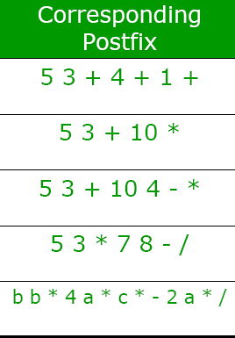
Infix VS. Postfix Notation….Practice Examples

Slide 67
6. Evaluating RPN Expressions
1. Scan the expression from left to right to find an operator.
2. Locate the last two preceding operands and combine them using this operator.
3. Repeat until the end of the expression is reached.
Example:
2 3 4 + 5 6 - - *
→ 2 3 4 + 5 6 - - *
→ 2 7 5 6 - - *
→ 2 7 5 6 - - *
→ 2 7 -1 - *
→ 2 7 -1 - * →
2 8 * →
2 8 * →
16

Slide 68
Stack Algorithm:
Receive: An RPN expression.
Return: A stack whose top element is the value of the RPN expression.
1. Initialize an empty stack.
2. Repeat the following until the end of the expression is encountered:
a. Get the next token (constant, variable, arithmetic operator) in the RPN expression.
b. If the token is an operand, push it onto the stack.
If it is an operator, then:
(i) Pop the top two values from the stack.
(ii) Apply the operator to these two values.
(iii) Push the resulting value back onto the stack.
3. When the end of the expression is encountered, its value is on top of the stack (and must have only value in the stack).

Slide 69
Stack Algorithm - Pseudocode
1. Create STACK.
2. While end of expression, Scan postfix expression RP from left to right and repeat following:
2.1 If an Operand is encountered, then:
2.1.1 PUSH(Operand).
2.2 else if an Operator is encountered, then:
2.2.1 SET OP2=POP().
2.2.2 SET OP1=POP().
2.2.3 SET Value = Evaluate(OP1,OP2,Operator).
2.2.4 PUSH(Value).
3. Return POP(STACK).

Slide 70
Sample RPN Evaluation
Example: 2 3 4 + 5 6 - - *
Push 2
Push 3
Push 4
Read +
Pop 4, Pop 3,
Push 7
Push 5
Push 6
Read -
Pop 6, Pop 5,
Push -1
Read -
Pop -1, Pop 7,
Push 8
Read *
Pop 8, Pop 2,
Push 16
4
3
2
6
3 + 4 = 7
5
7
2
5 - 6 = -1
-1
7
7 - -1 = 8
2
8
2
2 * 8 = 16
16

Slide 71
Evaluating postfix expression
int evaluatePostfix(string postfix)
{
Stack s;
int x;
int y;
int temp;
for(int i=0;i<postfix.size();i++)
{
if (postfix[i]>='0' && postfix[i]<='9') // This condition checks if that character is a digit between '0' and '9'.
s.push((int)(postfix[i]-'0')); // digit character is converted into an integer.

Slide 72
Evaluating postfix expression
else { x=s.pop();
y=s.pop();
switch(postfix[i])
{
case'+': temp = y+x; break;
case'-': temp = y-x; break;
case'*': temp = y*x; break;
case'/': temp = y/x; break;
case'%': temp = y%x; break;
case '^': temp = pow((double)y,x); break;
}
s.push(temp);
}
} return s.pop();}

Slide 73
Driver program
int main()
{
string expression;
getline (cin,expression);
int result = evaluatePostfix(expression);
cout << "Result: " << result;
return 0;
}

Slide 74
Driver program
int main()
{
ifstream file("MyFile.txt");
string expression;
getline (file,expression);
int result = evaluatePostfix(expression);
cout << "Result:" << result;
return 0;
}

Slide 75
Driver program
int main()
{
ifstream file("MyFile.txt");
string expression;
while (getline (file, expression))
{
int result = evaluatePostfix (expression);
cout << "Result:" << result;
return 0;
}
}

