Slide 1
TraceLog monitor

Slide 2
目的
在Cola因執行緒超量，造成當機之前，能夠提前發出警告。

Slide 3
系統功能
定時將TraceLog path 底下的traceLog檢查當下pending的筆數及單筆pending所hang住的時間，若超過所設定限制筆數或時間，則發送email通知及SMS(option)所設定收件者。
可自定義RegularExpress pattern 及所設定的最大允許數量，超過就會發通知給收件者。

Slide 4




Application Flow
WAS
Monitor
Scan files
TraceLog Folder
Temp Folder
(option)
TraceLogs
IssueLog Folder
(only keep last logs)

Slide 5
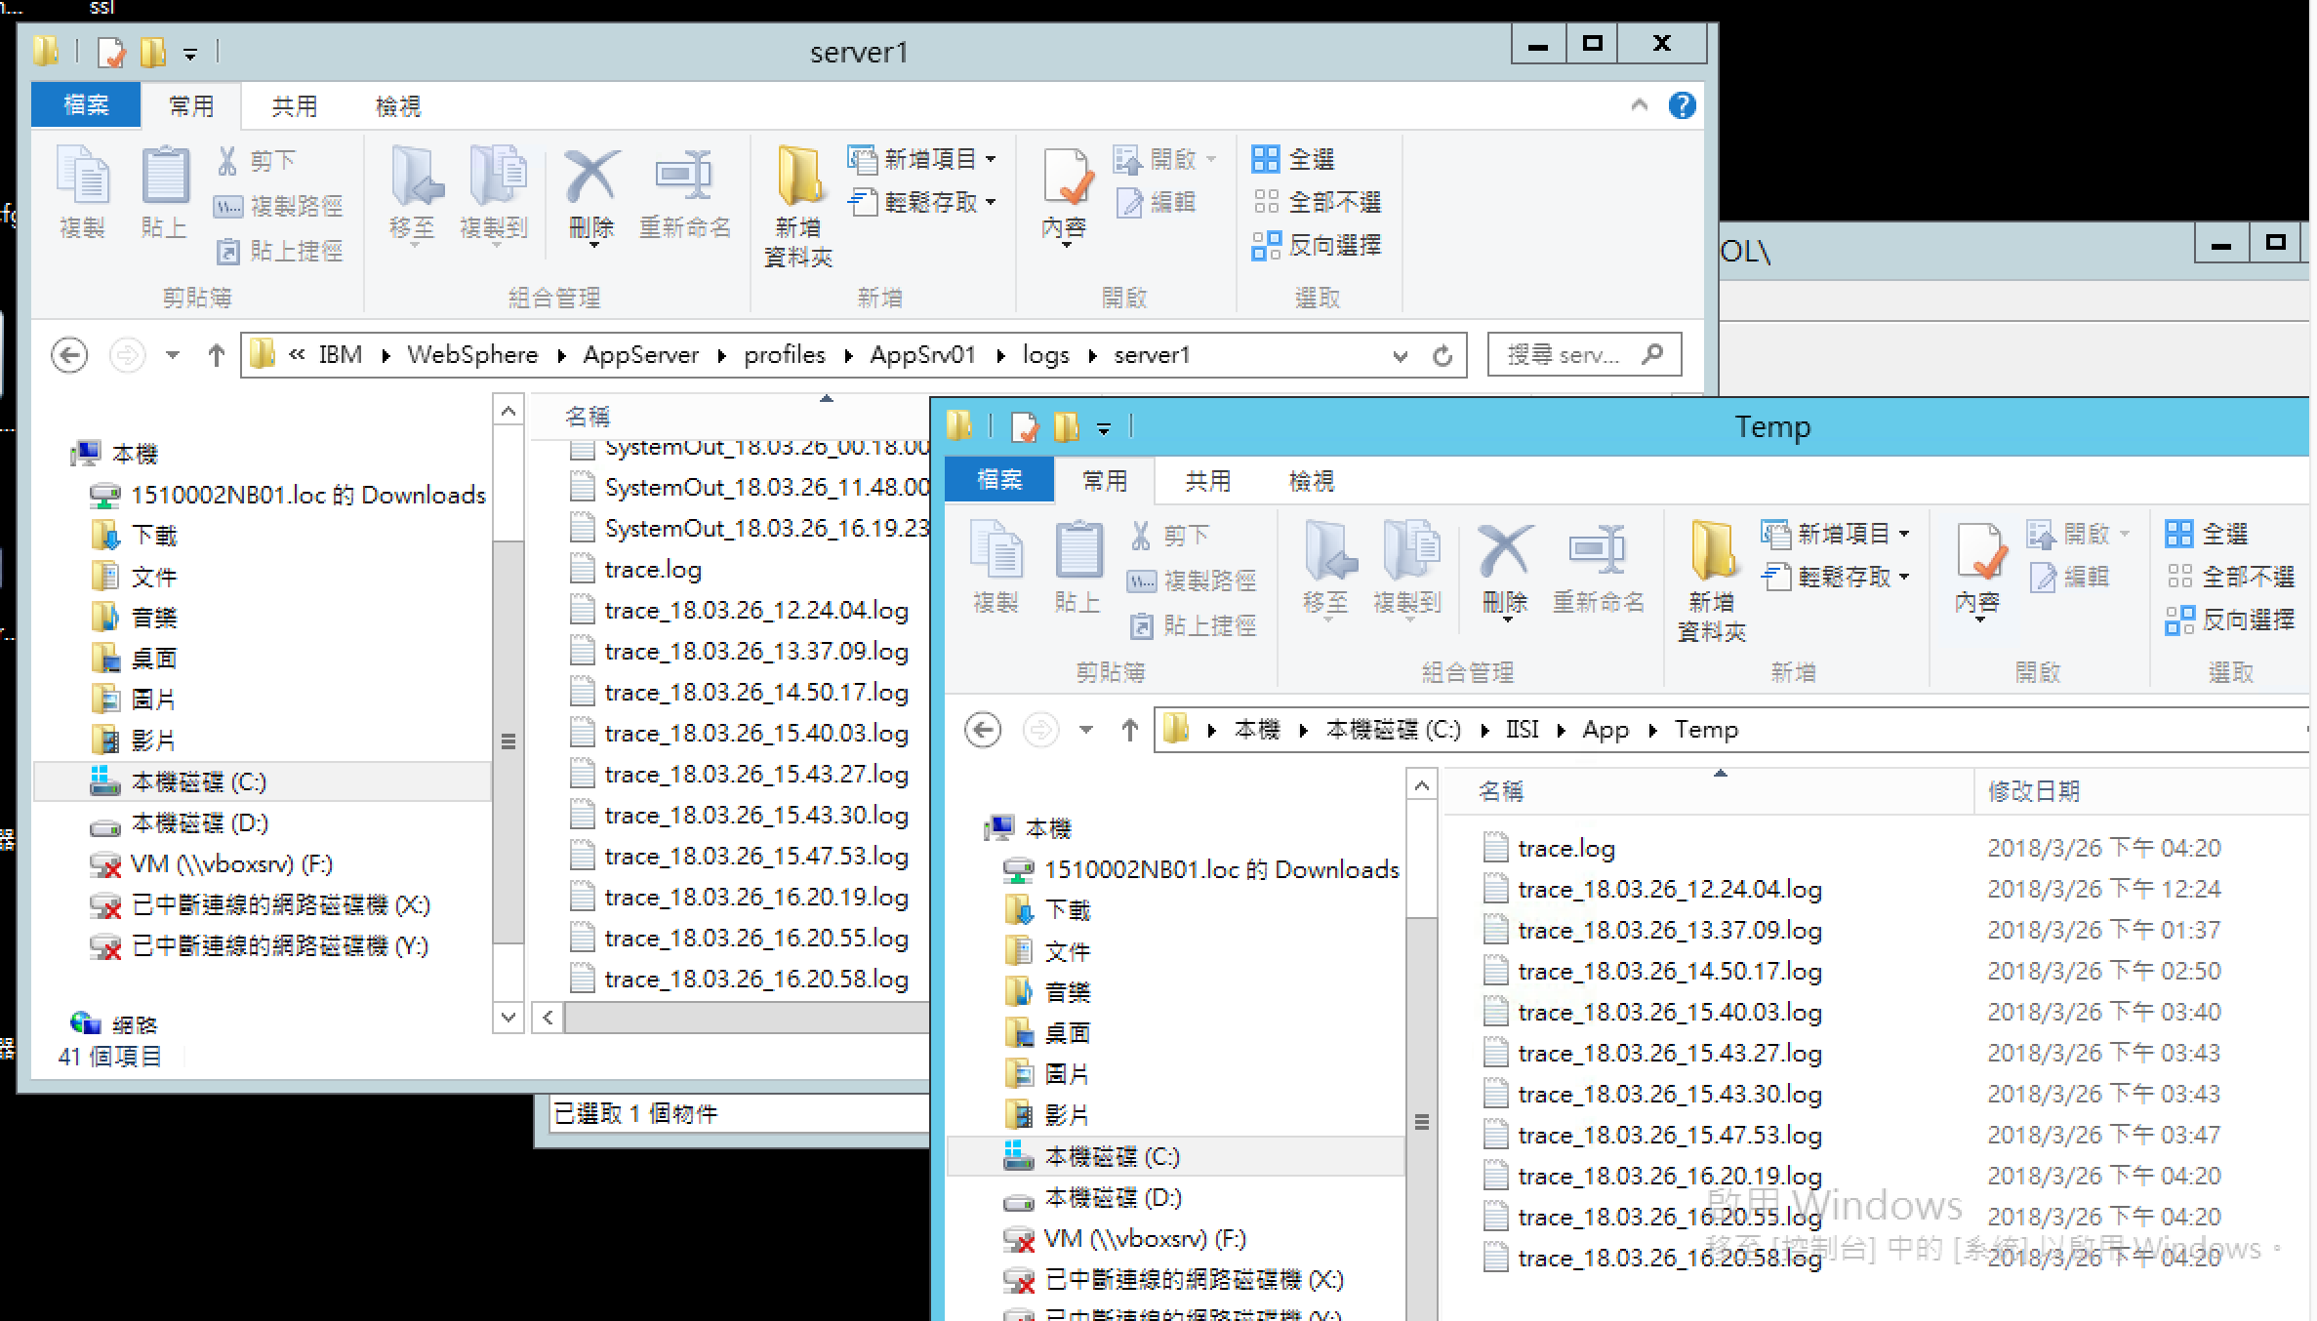
Files and TempFolder

Slide 6
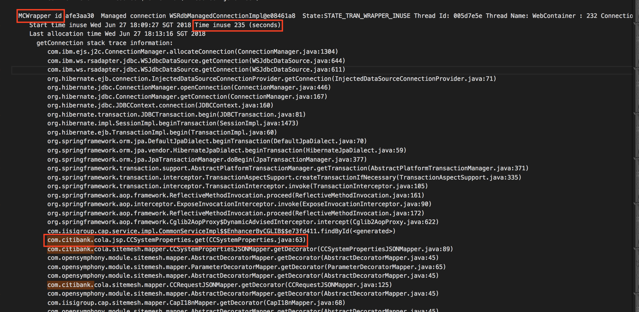
Files scaning
find line had key words “MCWrapper id”.
Record thread name and start time and time inuse.
Scan next each line find which start with “com.citibank.”.
If found it, make it as pending procedure.
Continue scan until find next step1 keywords.

Slide 7

Alert with pending
Pending allow setting in Config.properties:
After scanning files will got all pending procedure and pending time.
Compare allowPendingLimit with all number of pending if over it, will send alert mail.
Compare allowPendingTimeLimit with each pending time, if over it, will send alert mail.

Slide 8
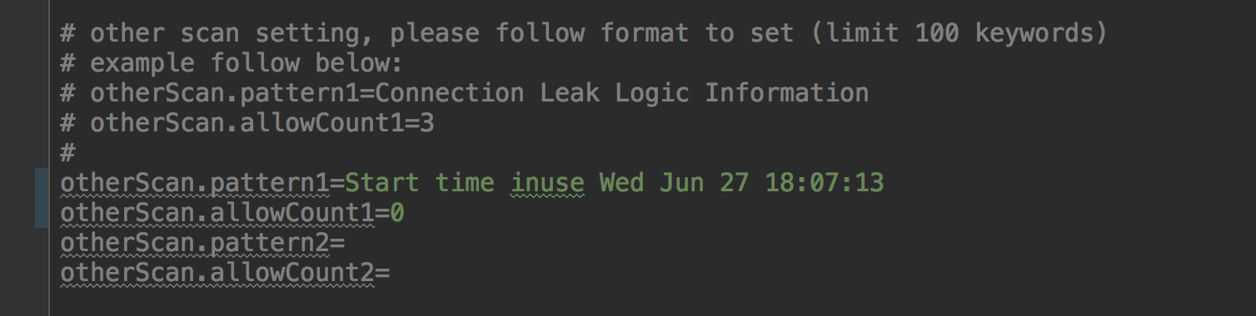
customize scanning setting from config.properties
Files scanning each line and use regular express mapping.
Counting all match line and compare with allowCount setting from config.properties.
List all lines contains keywords.

Slide 9
After Recovery
When every over allow pending happened, if next scan is not over allow number,
service will send recovery mail to notify system is back to normal.
Polite mode
當該flag設置為true，當pending情況發生，下一次掃描會檢查該次pending數量/時間
與上次寄出alert mail時的數量/時間有無超過10%，若有則才會再次發送alert mail。
* 若上次寄送alert mail時間點為前日，則會無視前項規則發送。

Slide 10
轉windows service
使用Yet Another Java Service Wrapper將執行jar打包安裝成window service

Slide 11
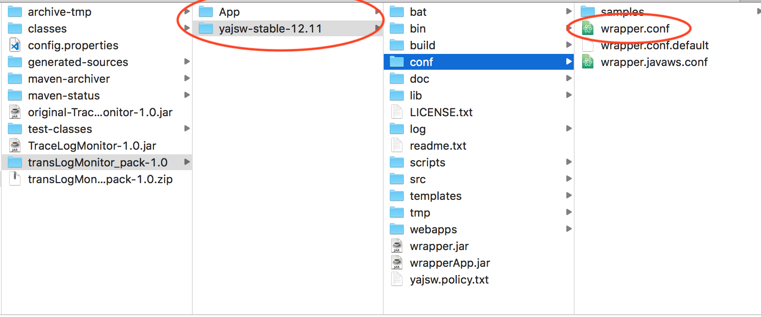
How to install windows service
打包出來的zip中會含有兩個folder: App and yajsw-stable-12.11
修改wrapper.conf檔，將 wrapper.working.dir對應的值修改為上述App folder的絕對位置。 Ex: wrapper.working.dir=C:\\\\IISI\\\\APP\\\\

Slide 12
How to install windows service
執行yajsw-stable-12.11/bat/installService.bat，就會於該系統安裝service。
後續要移除即執行上述資料夾中uninstallService.bat即可。
註：必須具有administrator權限，及App folder必須置於本地磁碟空間。

Slide 13
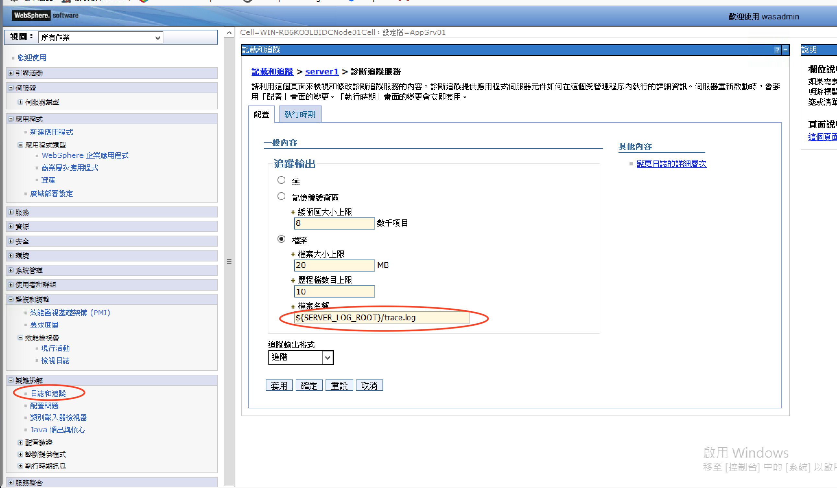
How to Config TraceLog in WAS
Path: On the left expand "Troubleshooting" --> Logs and Traces -->server1 --> Diagnostic Trace
Make sure file place folder is same with config.properties
參考資料 http://www-01.ibm.com/support/docview.wss?uid=swg21902513

Slide 14
參數檔變數
intervalTime (啟動間隔)
logFolderPath (TraceLog place folder)
tempFolderPath=./Temp/ (use default)
issueLogFolderPath=./IssueLog/ (use default)
allowPendingLimit (允許pending數量)
allowPendingTimeLimit (允許單thread能pending的秒數)
emailSendTargets (email寄送目標)
smsSendTargets (sms寄送目標)

Slide 15
參數檔變數(自定義)
自定義要掃描的pattern，N為排序數字，至多100筆自訂pattern
otherScan.patternN (regular express pattern)
otherScan.allowCountN (該掃描所允許的數量) ex: otherScan.pattern1=[0-9]{10} otherScan.allowCount1=10

Slide 16
參數檔變數(email)
LOCAL_TEST(是否要用內建gmail帳號寄送email)
EDM_FROM_ADDR
EDM_FROM_PERSON
EDM_HOST
EDM_USR
EDM_PWD

Slide 17
參數檔變數(SMS)
sms.host
sms.port
sms.entry
sms.username
sms.password
proxy.enable
proxy.host
proxy.port
sms.encoding

Slide 18
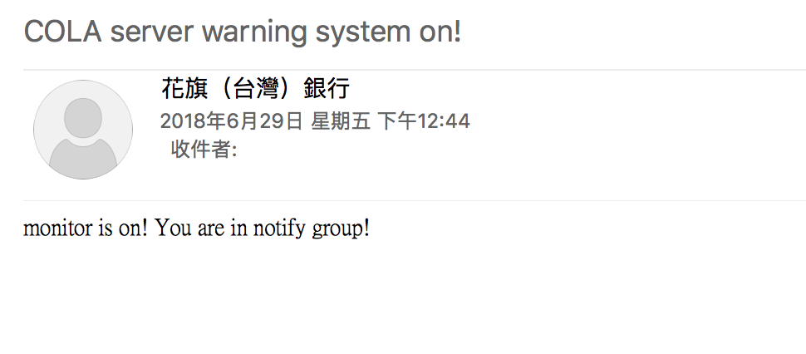
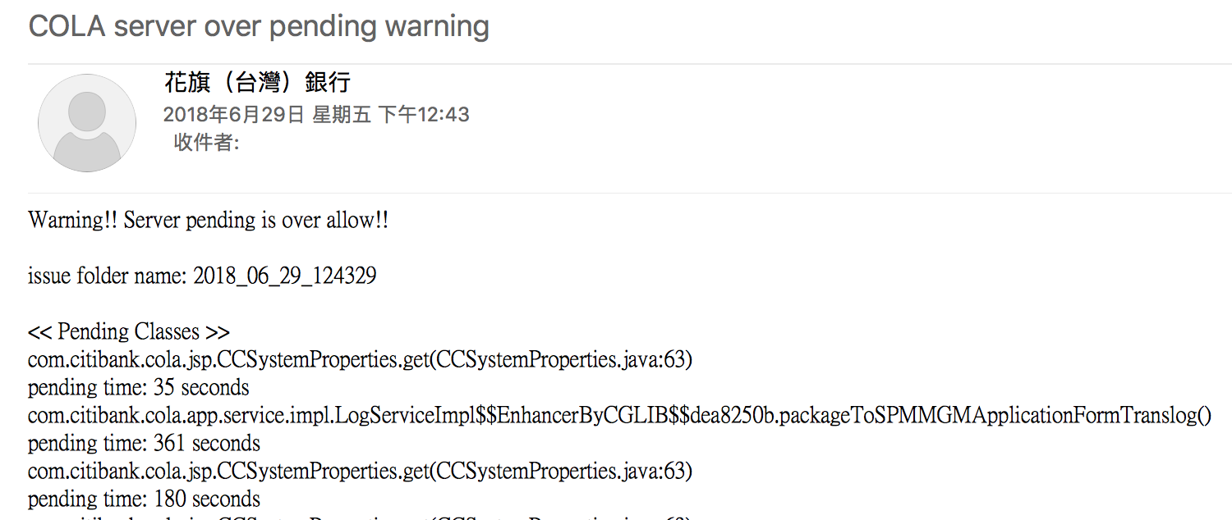
All mails format
Service on:
2. Over allow pending number:

Slide 19
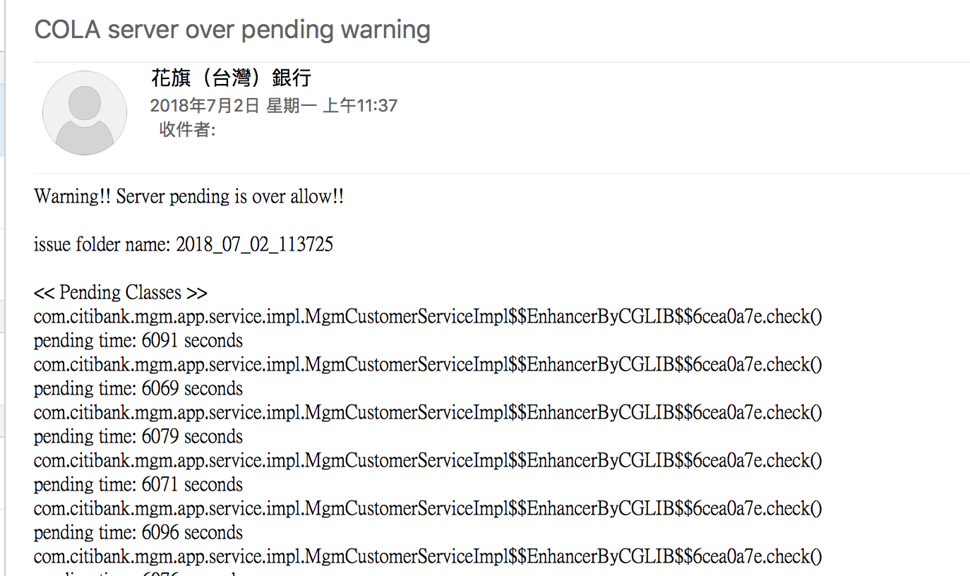
All mails format
3. Over allow pending time

Slide 20
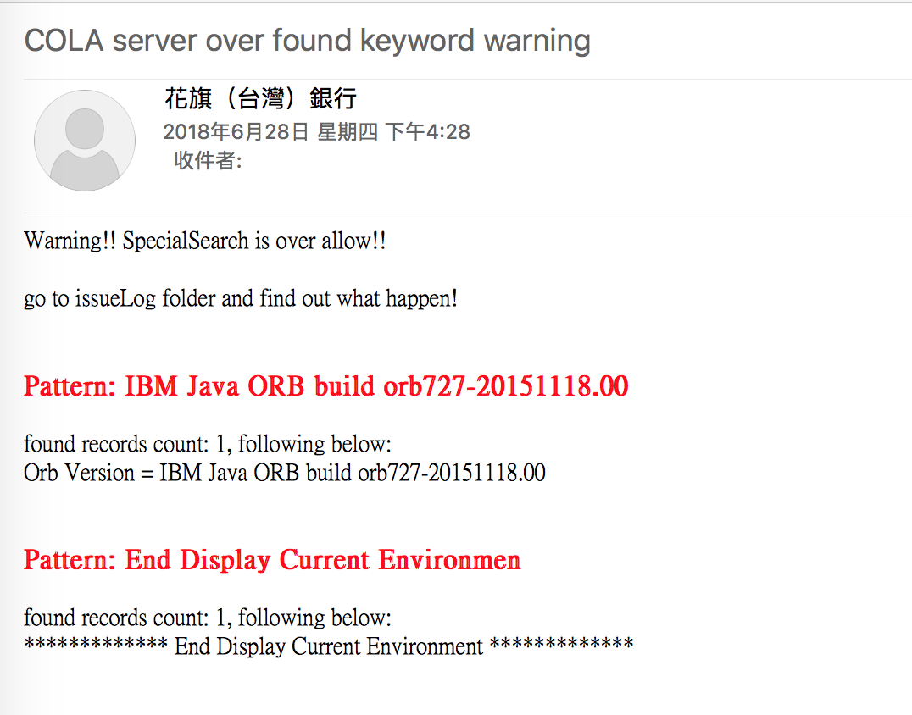
All mails format
4. Customize search over allow:

Slide 21
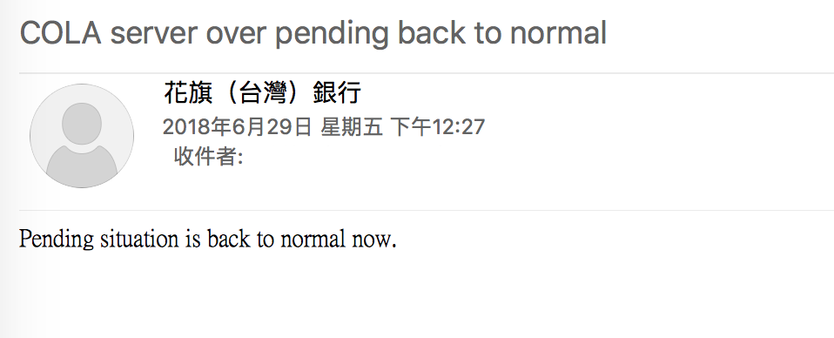
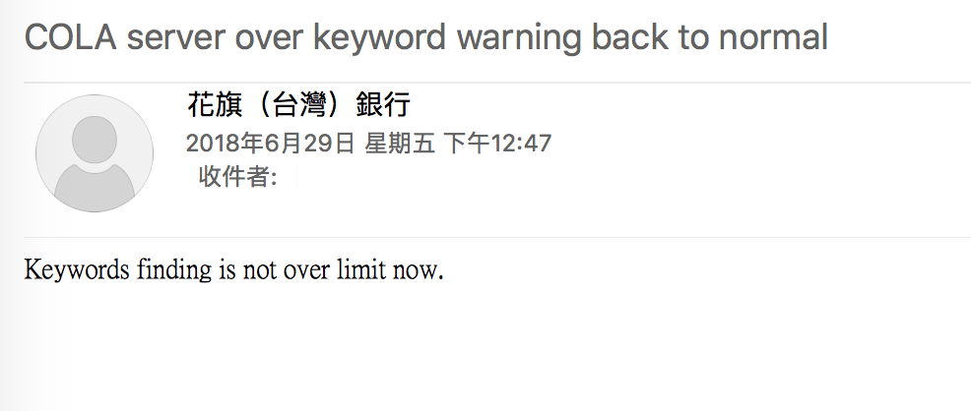
All mails format
5. After pending recovery:
6. After customize recovery:

Slide 22
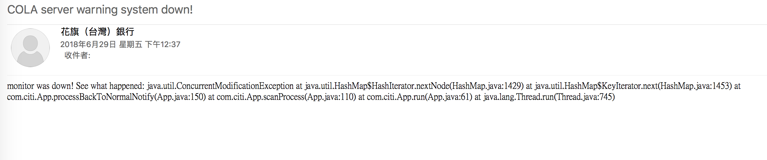
All mails format
7. Other exception of service:

