Slide 1
TraceLog monitor

Slide 2
目的
在Cola因執行緒超量，造成當機之前，能夠提前發出警告。

Slide 3
解決方案
定時將TraceLog path 底下的traceLog檢查當下pending的筆數，若超過所設定限制筆數，則發送email通知及SMS(option)所設定收件者。

Slide 4




Application Flow
WAS
Monitor
TraceLog Folder
Temp Folder
(option)
TraceLogs
IssueLog Folder
(only keep last logs)

Slide 5
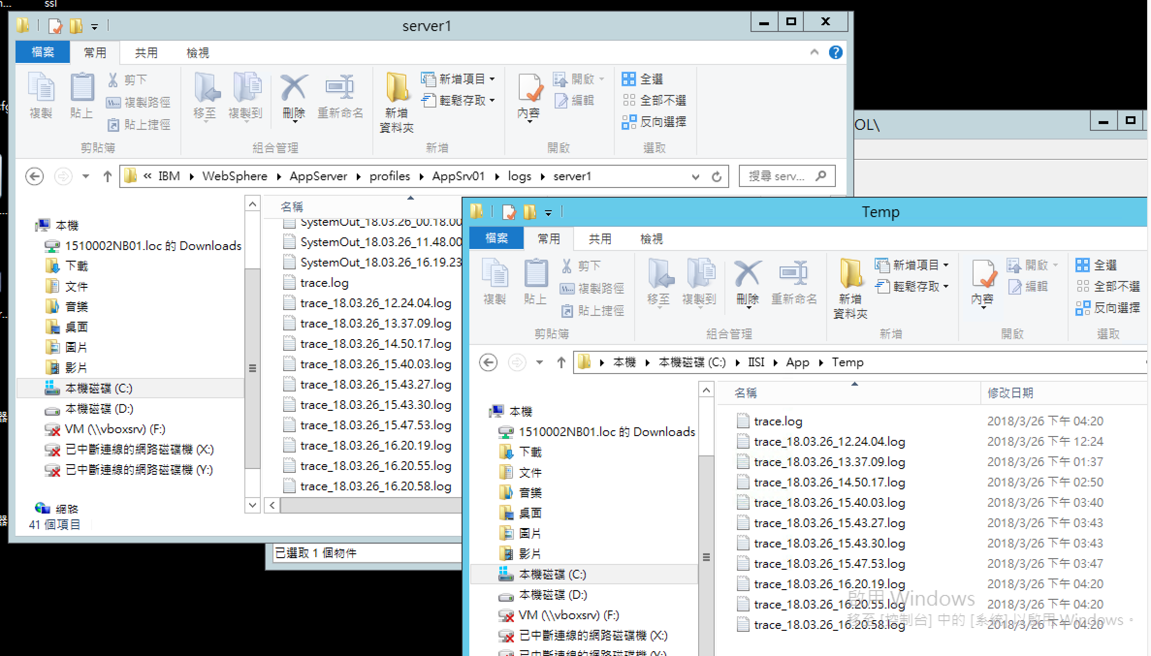
Files and TempFolder

Slide 6
轉windows service
使用Yet Another Java Service Wrapper將執行jar打包安裝成window service

Slide 7
參數檔變數
traceLog path
啟動間隔
Pending limit
Send Email address (xxx@gmail.com,yyy@gmail.com)
Email host
Email user
Email password
Email port
Snapshot files folder
IssueLogs folder

Slide 8
參數檔變數
sms.host
sms.port
sms.entry
sms.username
sms.password
proxy.enable
proxy.host
proxy.port
sms.encoding
emailSendTargets(09XXXXXXXX,09XXXXXXXX)
*Optional

