Slide 1
CRÈME BRULEE

Slide 2



OUR PRODUCT : SummarEase

Slide 3
TEAM MEMBERS
Μανδαλάκης Χρήστος
Δενδρινός Άγγελος Γιώργος
Γκαραβέλας Στέφανος

Slide 4
WHAT PROBLEM DOES OUR APP SOLVE?

Slide 5
WHAT PROBLEM DOES OUR APP SOLVE?
It produces:
Summaries
Quiz
Q&A

Slide 6
WHAT PROBLEM DOES OUR APP SOLVE?
It produces:
Summaries
Quiz
Q&A
From:
PDF Files
Video and
Lesson Slides

Slide 7
HOW IT WORKS
Developed in Python
LLMs Utilization: IBM-WATSON, Google-Gemini
Frontend: React
Backend: Flask
User Uploads File
Conversion and Parsing with AI Tools
Creation of Desired Task Using LLM’s

Slide 8
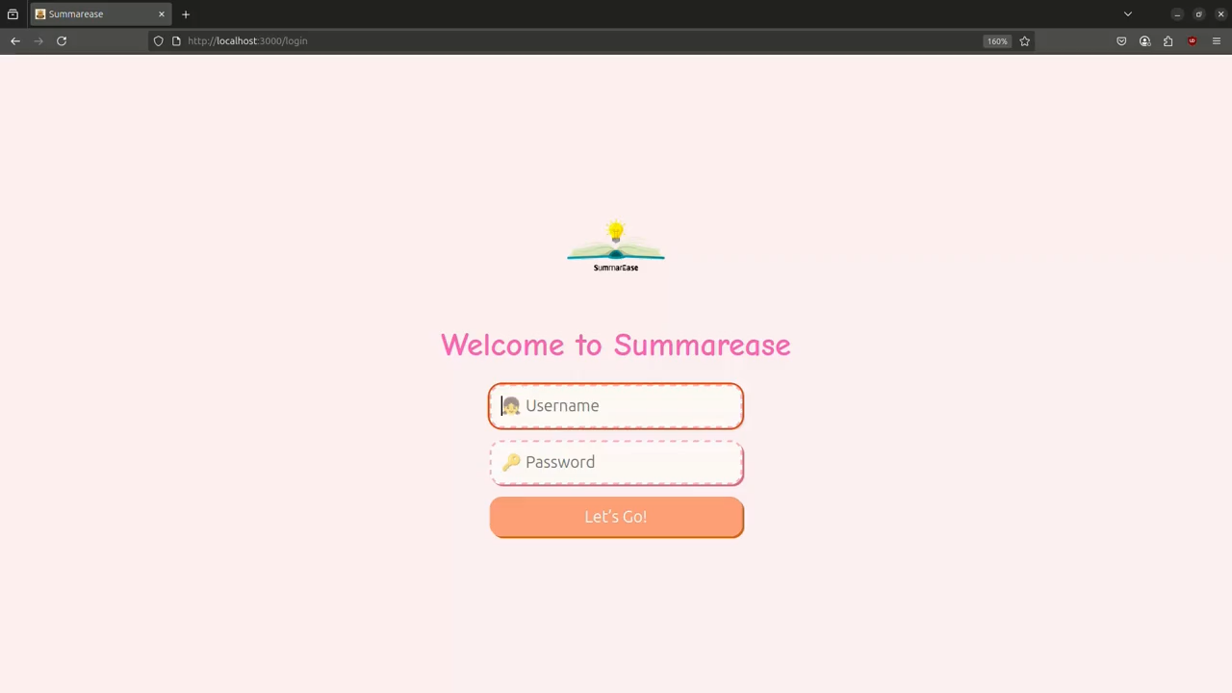

Slide 9
WHAT TO EXPECT NEXT?
Search Engine with Keywords
User History
Interactive Chatbot
Image Support (Input/Output)
Rating System
Progress Tracking
More Quiz Types
Accessibility Settings

Slide 10
THANK YOU FOR YOUR TIME

