Slide 1

Implementation of Connect 4 using TCP
CSE302: COMPUTER NETWORKS
By Tharik Sherief B

Slide 2
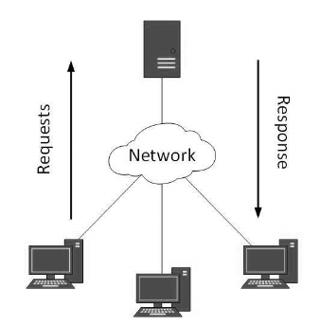
Client-Server model
Consists of single server and allows connection from multiple clients.

Slide 3
Client-Server model
Advantages
Disadvantages
All the data is stored in a server. Thus, there is a centralized system with all data in a single place. Data recovery is possible.
The model is scalable, i.e., the number of clients and servers can be increased separately. Any new node can be added into the network at any time.
The presence of a dedicated server results in the increase of speed in the sharing of resources. Thus as a result, there is an increase in the performance of the overall system as well.
Has a less maintenance cost.
Lacks in robustness. Whenever the server is down, the requests cannot be met by the server and the thus the entire model is down
Spoofing and modification of Data packets is possible during the transmission
The entire model is prone to viruses, Trojans, if any of this is present or uploaded into the server.

Slide 4
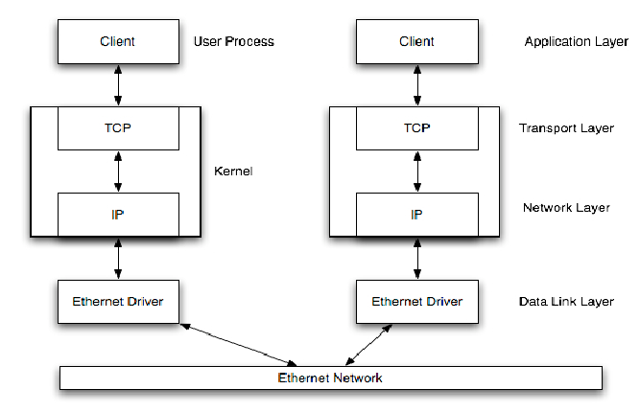
Communication Protocol

Slide 5
Communication Protocol
Common used protocol in socket programming are datagram communication (UDP) and stream communication (TCP)
The datagram communication is considered a connectionless protocol and is known as the UDP. In UDP, every time the client sends a datagram, it is also required for it to send the local socket descriptor and as well the address of the receiving socket
The stream communication is a connection oriented protocol and is known as the TCP. In TCP, firstly a connection has to be established between two identified sockets in order to establish a communication. The server socket listens for the connection request and the other client socket asks for connection. The transmission of data is possible in both the ways only when they have an already established connection.

Slide 6
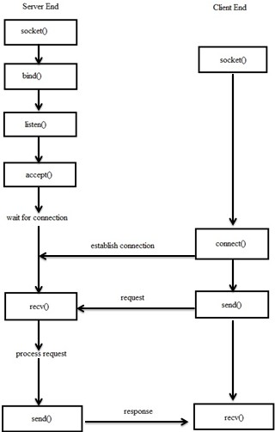
TCP Socket API

Slide 7
SNAPSHOTS

Slide 8
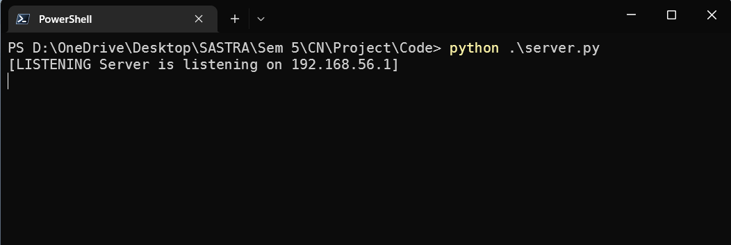
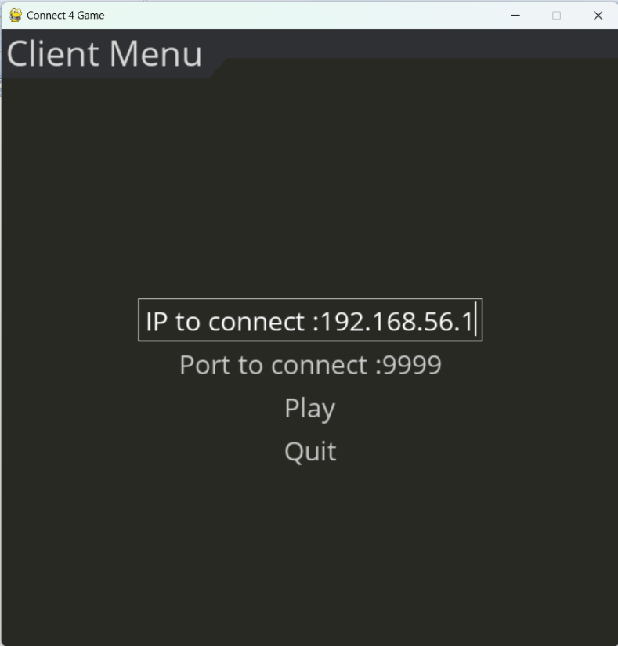
Server terminal listening
Client menu

Slide 9
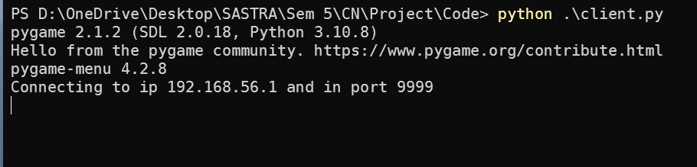
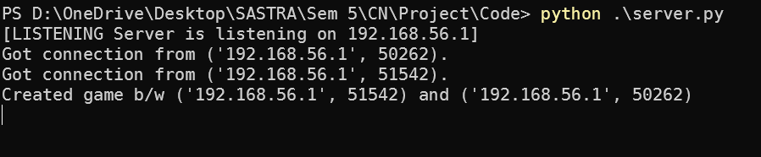
Client Terminal connecting to server
Server Terminal after game starts

Slide 10
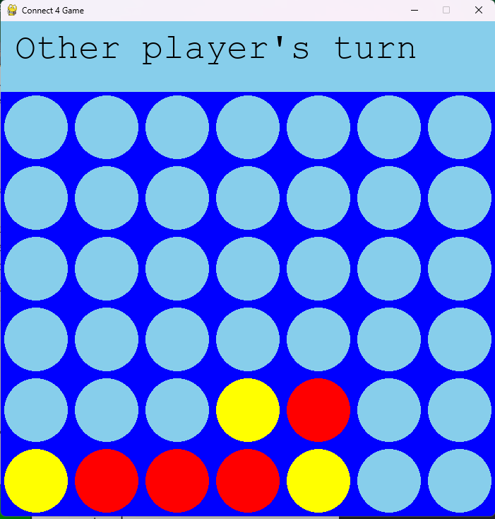
Client waiting for other player move from server

Slide 11
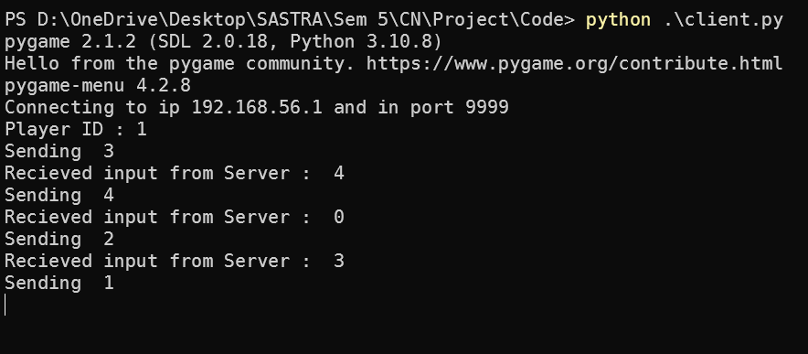
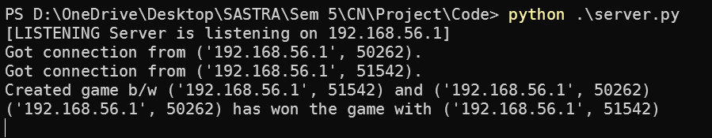
Client Terminal when game in progress.
Terminal of the Server completion of a game

Slide 12
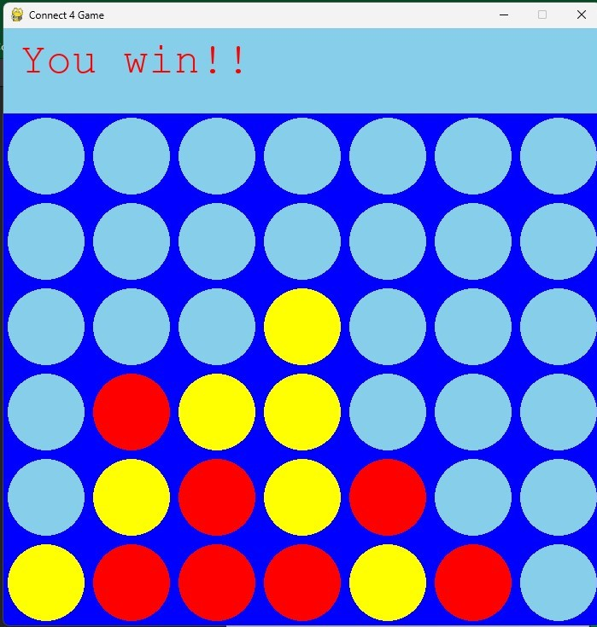
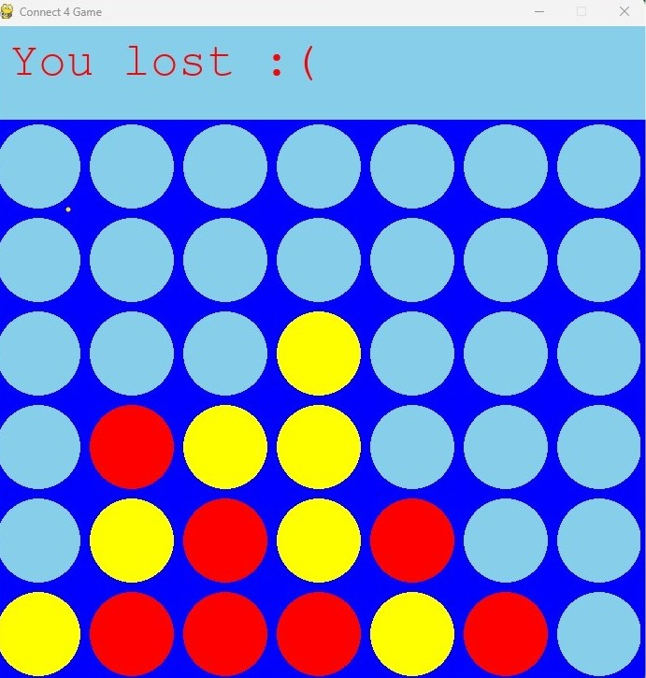
Game window when player wins
Game window when player loses

Slide 13
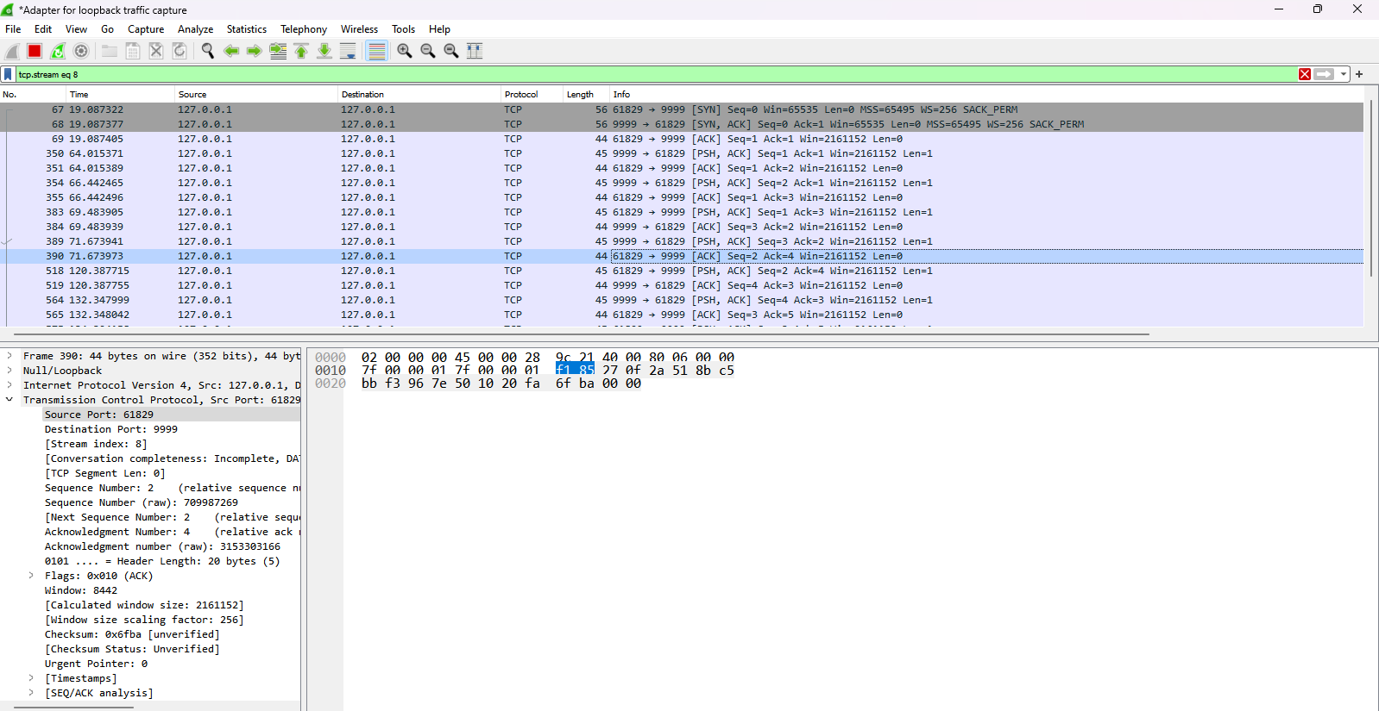
Wireshark analysis

Slide 14
Thank you

