Slide 1
Music Box Sales and Special-Orders
Computer Science project
Keith Tullius
April 22, 2020

Slide 2





Project Background
Music Box
A Music Store specializing in VINYL LP located in Pensacola, FL

Slide 3

The Music Box Operates with:
Sales tracking – Excel spreadsheet
Special-order tracking – Works database
No customer data retention

Slide 4
The Plan: Design and Develop a System That:
Provides Sales tracking with customizable, printable reports
Special-order tracking with customer data retention and printable reports

Slide 5
The Design
components

Slide 6
The Design Included:
A Windows application
A database
A laptop (Windows 10)

Slide 7
Windows Application
Written in .NET C# using Visual Studio 2019
Written using the Universal Windows Project framework
Utilize Github for hosting the repository
Contains the following Modules:
Sales
Create Special-Orders
Special-Order Maintenance

Slide 8
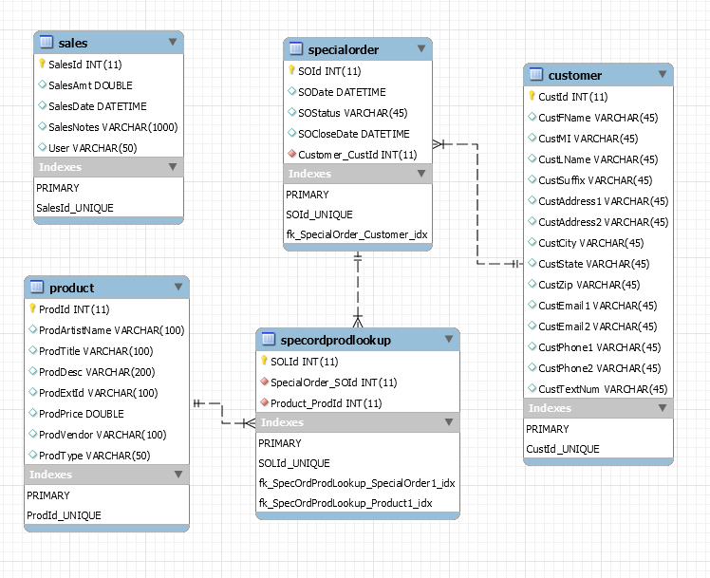
Database
MySQL 8.0 for Windows
ERD Diagram

Slide 9
Design
Artifacts

Slide 10
Design Artifacts Created During Both Semesters
Project Definition Document
Software Requirements Specification (SRS)
Software Design Document (SDD)
Software Project Management Plan (SPMP)
Detailed Timeline and Budget Spreadsheet
Several Project Status Reports
Project Progress Reports
PowerPoint Presentation
Youtube Video
Final Report

Slide 11
Semester 2
Development, Testing and Deployment

Slide 12
Development Tools
Visual Studio 2019
Github https://github.com/strimpf/MusicBoxWTS
UWP Framework
MySQL 8.0 for Windows
Agile Methodology

Slide 13
Testing
Unit Test
Manual Test Scripts
System Integration Testing
Regression Testing
User Acceptance Testing (UAT)

Slide 14
Deployment
Testing will use a test/development laptop
Production will use an existing Music Box laptop
Deploy the application to the hard drive of the laptop
Deploy the database engine to the laptop
Run the build scripts for the database

Slide 15
The Music Box Application

Slide 16
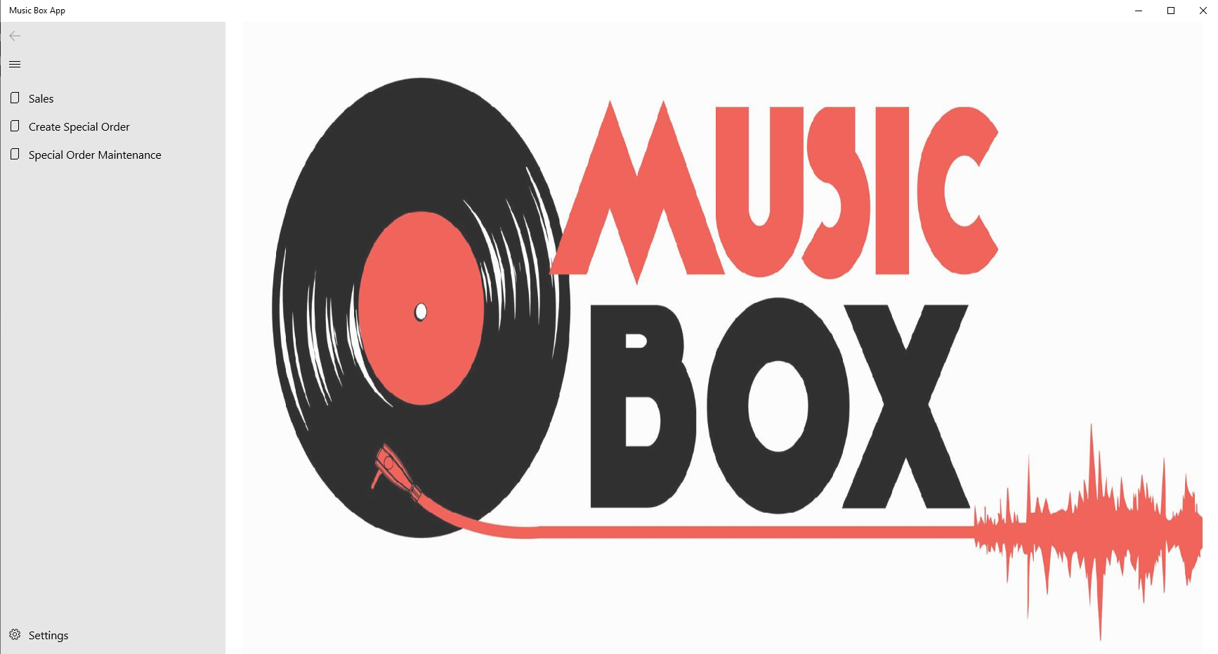
Music Box Application Splash Page
Modules
Sales
Basic Window Functionality
Minimize, Maximize, Close
Create Special Order
Maintain Special Orders
Settings
Collapse Left Menu

Slide 17
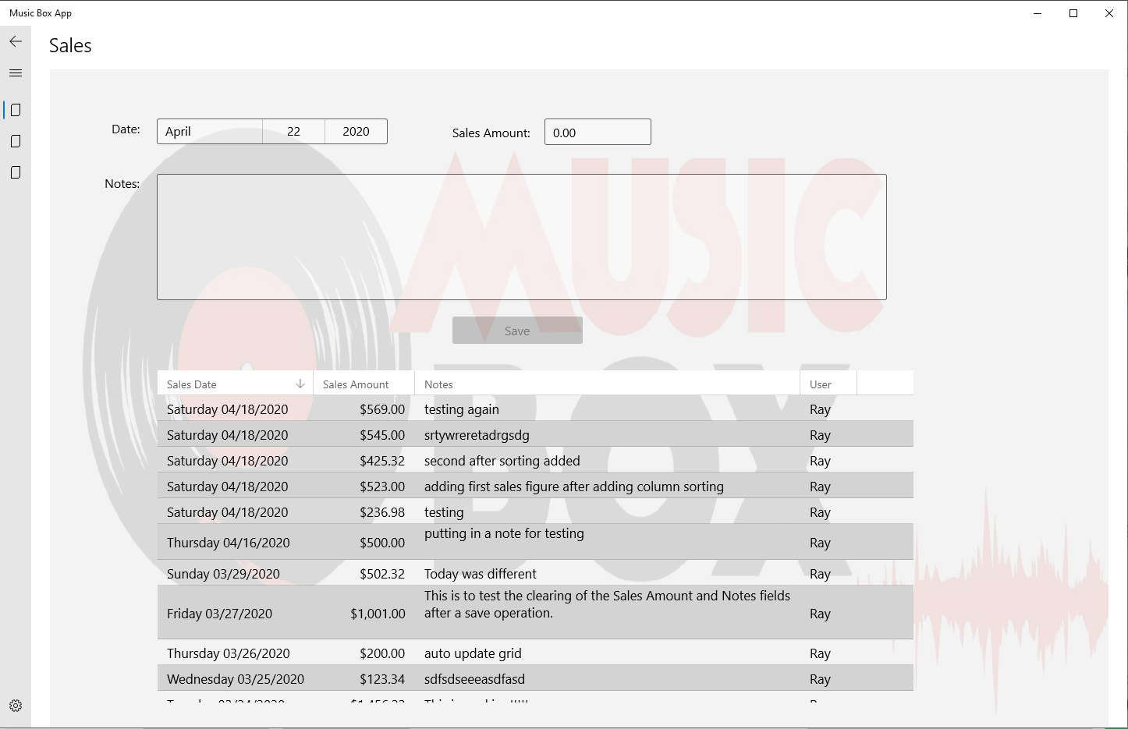
Music Box Sales Module
Form
Date
Grid
Displays existing Sales Entries in Descending order
Sales Amount
Notes
Save button

Slide 18
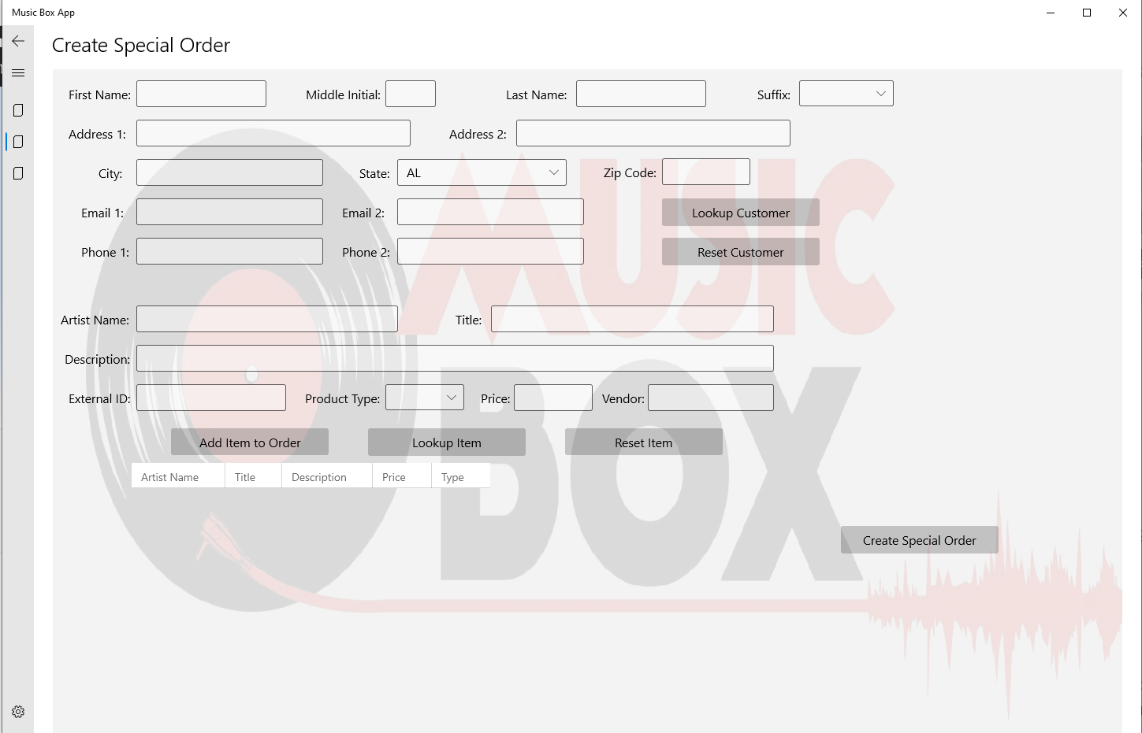
Music Box Create Special Order Module
Forms
Customer Entry Form
Item Grid
List of items to be included in special order
Product Entry Form
Lookup Item button
Lookup Customer button
Reset Customer button
Reset Item button
AddItem to Order button
Create Special Order button

Slide 19
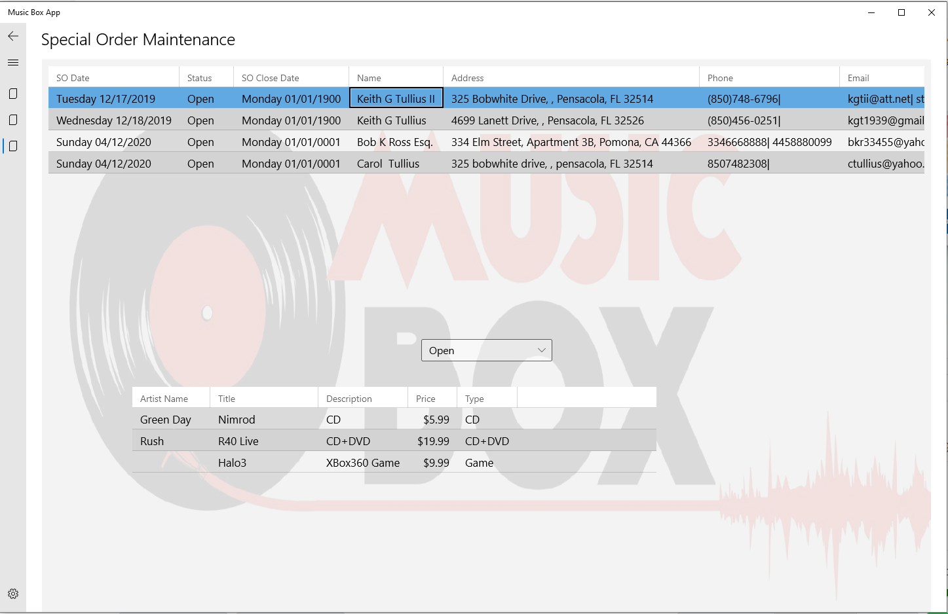
Music Box Maintain Special Order Module
Special Order Grid
List of special orders with status in combo box selection
Product Grid
List of products included in the special order selected in the Special Order grid above
Status combo box to select special order status to display

Slide 20
Demonstration
The developer will now provide a demonstration of the application

Slide 21
Lessons Learned

Slide 22
Creating software is the sum of all the decisions made throughout the process
Sufficient time should be included in the timeline to learn new technologies
You cannot start any task too early
The final design and final product was affected by factors unknown at design time. For instance, UWP applications are meant to be deployed from the Microsoft Store. Publishing to the Microsoft store has a large amount of overhead.
Doing a one man show provides efficiencies but also creates blind spots

Slide 23
Contact Info
Email : kgt3@students.uwf.edu
Email1 : strimpf@gmail.com
I would appreciate your input.

Slide 24
The End!
Thank you for Watching

