Slide 1
AlchemyAPI
IBM Watsons
https://string-args.github.io

Slide 2
Alchemy API
uses natural language processing technology and machine learning algorithms to extract semantic meta-data from content, such as information on people, places, companies, topics, facts, relationships, authors, and languages.

Slide 3
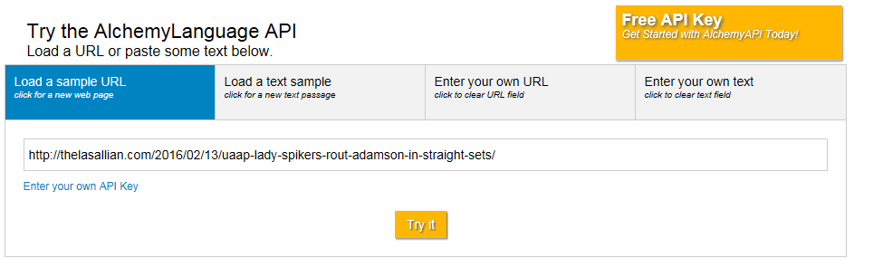
Demo – Alchemy Language

Slide 4

Demo – Alchemy Language

Slide 5
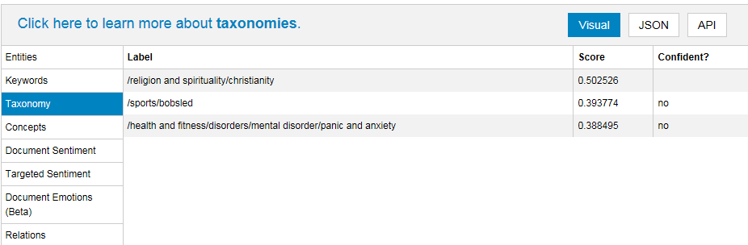
Demo – Alchemy Language

Slide 6
AlchemyAPI
IBM Watsons
https://string-args.github.io

Slide 7
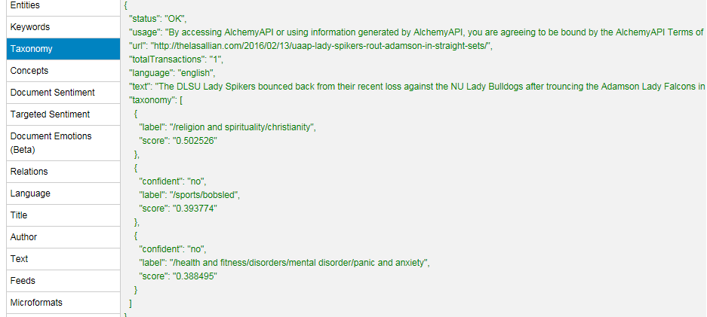
Demo – Alchemy Language

Slide 8
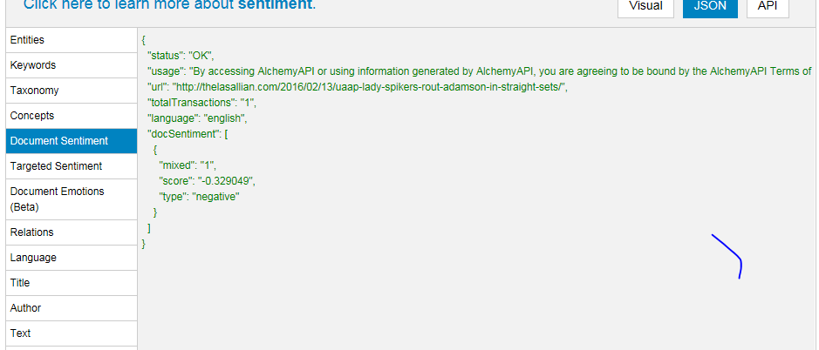
Demo – Alchemy Language

Slide 9

Demo – Alchemy Vision

Slide 10
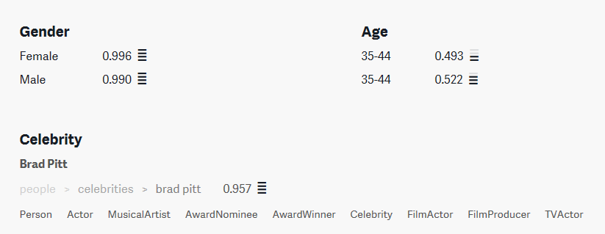
Demo – Alchemy Vision

Slide 11
ENDPOINT URLS – Feature Extraction
Taxonomy:
"http://gateway-a.watsonplatform.net/calls/url/URLGetRankedTaxonomy" Language: "http://access.alchemyapi.com/calls/url/URLGetLanguage" Authors:
"http://gateway-a.watsonplatform.net/calls/url/URLGetAuthors" Sentiment:
"http://gateway-a.watsonplatform.net/calls/url/URLGetTextSentiment" Title:
"http://gateway-a.watsonplatform.net/calls/url/URLGetTitle"

Slide 12
ENDPOINT URLS – Image Analysis
Face Recognition:
"http://gateway-a.watsonplatform.net/calls/url/URLGetRankedImageFaceTags"

Slide 13
How to use it?
URL title_url = new URL({ENDPOINT_URL}?url={input url}&apikey= {apikey}&outputMode=json");

Slide 14
How to use it?
URL title_url = new URL({ENDPOINT_URL}?url={input url}&apikey= {apikey}&outputMode=json");

Slide 15
AlchemyAPI
IBM Watsons
https://string-args.github.io

