Slide 1


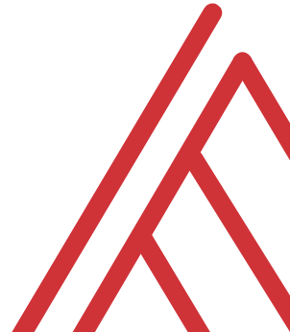
Advancing into Analytics: From Excel to R and Python
Notes:
Welcome everyone to the presentation, I am looking forward to it.

Slide 2


Follow along
Download resources: https://github.com/stringfestdata/london-excel
Click through these links now to interact later:
(this could take some time so feel free to ask questions now)…
Alan Turing (23 June 1912 – 7 June 1954)
Notes:
If you’d like to follow along with the presentation, all resources are available at this link.
I also wanted to give a shout-out to Alan Turing, born on this day in 1912.

Slide 3
Learning objectives
Situate Excel in the data analytics stack
Chart a clear learning path from Excel to R and Python
Demonstrate tangible use cases for combining these tools
Notes:
So what do we want to do today – well this is an Excel meetup, so this would be a weird meetup for me to be trashing Excel as an inherently inferior tool. I love Excel and it’s my home base for working with data, and I’ve found for some tasks that R and Python are just better fits. I want to contextualize R and Python as complementary resources.
So if you are interested in learning these tools as an Excel user, I want to give you a clear learning path and provide you an overview here. Now it probably seems really intimidating to go anywhere near R or Python but by the end of this hour you’ll have a good lay of the land – I’ll have some demos here where you can use the industry standard software for these languages without having to download anything.
I also want to go a bit further than I necessarily do in the book and show some tangible demos for combining these two tools – again I want to show that you should think of these tools as complements and not substitutes.
So those are the official learning objectives.

Slide 4
Unofficial learning objective
Having fun with data & computers
Notes:
The unofficial objective is to have fun with data and computers, if you are in this group you are probably a geek, so you can take this meetup as an opportunity to geek out with other geeks and learn something new.

Slide 5
Excel and the analytics stack
Notes:
Now I’ll start out here just with a conceptual overview of how Excel fits in with other tools you might use for analytics, and when I say analytics I mean using data to make recommendations about what to do given what’s happened. You’ll learn a bit about open source tools and how to think about how they related to Microsoft’s own stack.

Slide 6
What is analytics?
using data to make recommendations about what to do given what’s happened.
Mount, George. Advancing into Analytics: From Excel to Python and R. O’Reilly Media, 2021
Notes:
Now this figure comes from my book and it’s a very broad conceptualization of the various slices of the stack. You know we hear engineers or web developers talk about being “full stack” all the time but it’s not so common an expression as it could be.

Slide 7
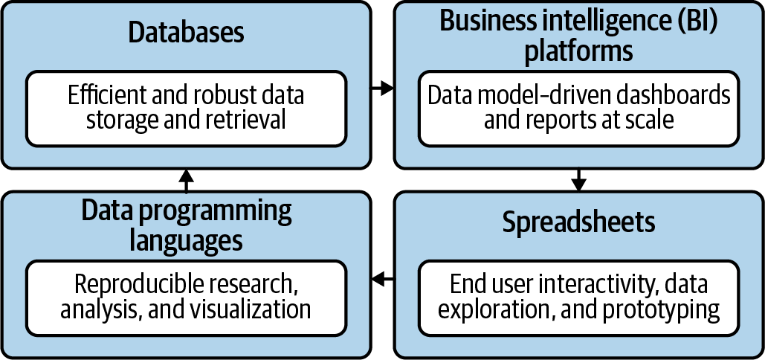
Spare no tools…
Mount, George. Advancing into Analytics: From Excel to Python and R. O’Reilly Media, 2021
Notes:
Now this figure comes from my book and it’s a very broad conceptualization of the various slices of the stack. You know we hear engineers or web developers talk about being “full stack” all the time but it’s not so common an expression as it could be.

Slide 8
What is Excel good for?
Good at…
Visual calculations
End-user interactivity
Rapid prototyping
Not so much…
Storing data
Mobilizing data
Implementing advanced analytics
Notes:
So this seems patronizing
How about add a slide defining what analytics is.

Slide 9

Open source:
Don’t take my word for it…
Free to
Use
Build on
Repurpose
Redistribute
https://docs.microsoft.com/en-us/archive/blogs/wikininjas/tnwiki-article-spotlight-consuming-azure-storages-python-sdk-using-ptvs
Notes:
Now, it may seem superfluous to learn a statistical programming language when Microsoft keeps rolling out new features to help with data analysis. And this has been a huge change at how Microsoft itself looks at open source languages. They are now seen as allies.

Slide 10
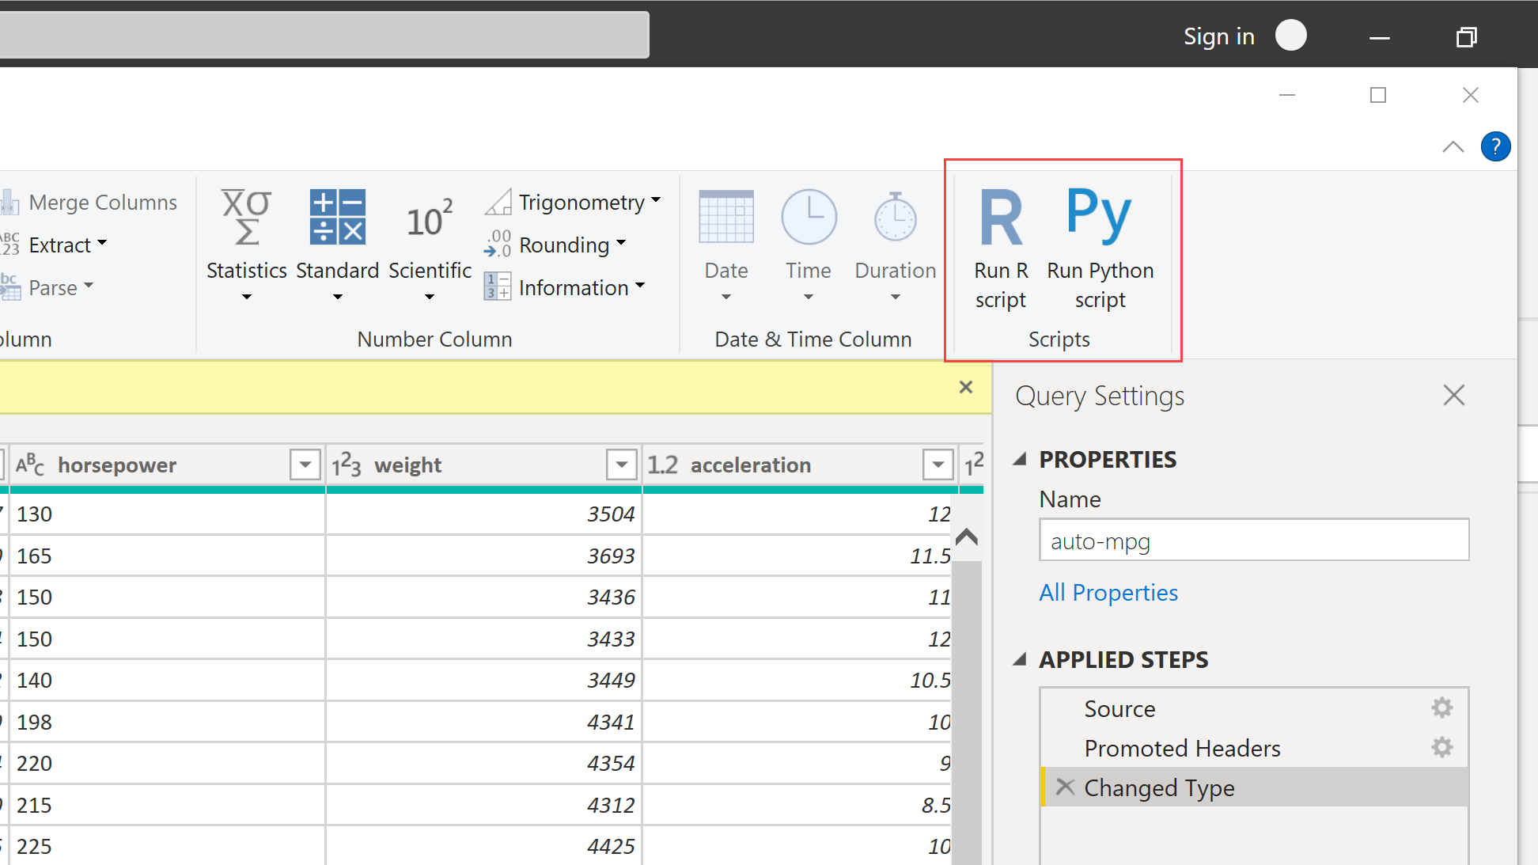
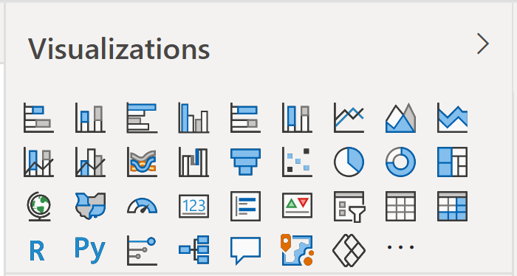
Don’t take my word for it…
Insert Power BI visuals here
File: r-python-power-bi.pbix
Notes:
And here is a great example, now these are some visualizations you’ll see later in the book.
But the fact that you are able to run R and Python visualizations tells you a lot.
You are going to see

Slide 11
The dialects of data
Adding, removing, calculating columns
Sorting and filtering
Aggregating and joining
Pivoting and reshaping
Notes:
Column-wise
Row-wise
Aggregations
Joins
Re-shaping
The interesting thing is that regardless of these tools used we’re often really speaking the same language when it comes to data analysis. Whether you’re doing it in a spreadsheet or a statistical programming languages, these sorts of operations are the same.
So what I want to help you do is take that mental model of working with data that you’ve so finely honed and show you how to transfer that knowledge into working with these other tools.

Slide 12
Welcome to the R Project for Statistical Computing
Notes:
OK, first let’s start with R, and yes its full name is the R Project for Statistical Computing.

Slide 13


R + RStudio
The code base
The interface
Notes:
So R was really built by statisticians, for statisticians.
Add a slide here who uses it and so forth.

Slide 14
R + RStudio
Microsoft R Open (FYI)
The code base
The interface
Notes:
Now like I mentioned when something is open source that means anyone is welcome to build on the code base however they like. RStudio is a very popular integrated development environment which is used to interact with the code base.
In Excel we are used to the code base and interface all being wrapped up in one package so this is something that could take some getting used to for you.

Slide 15
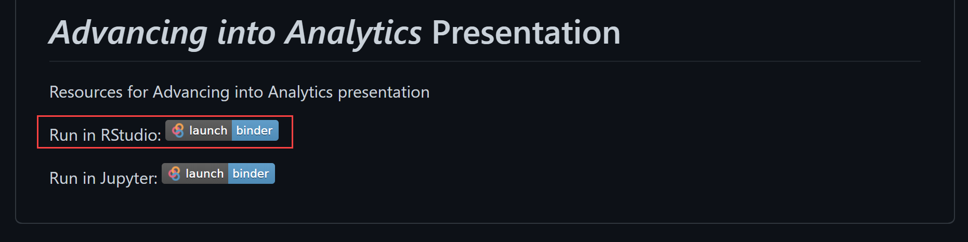
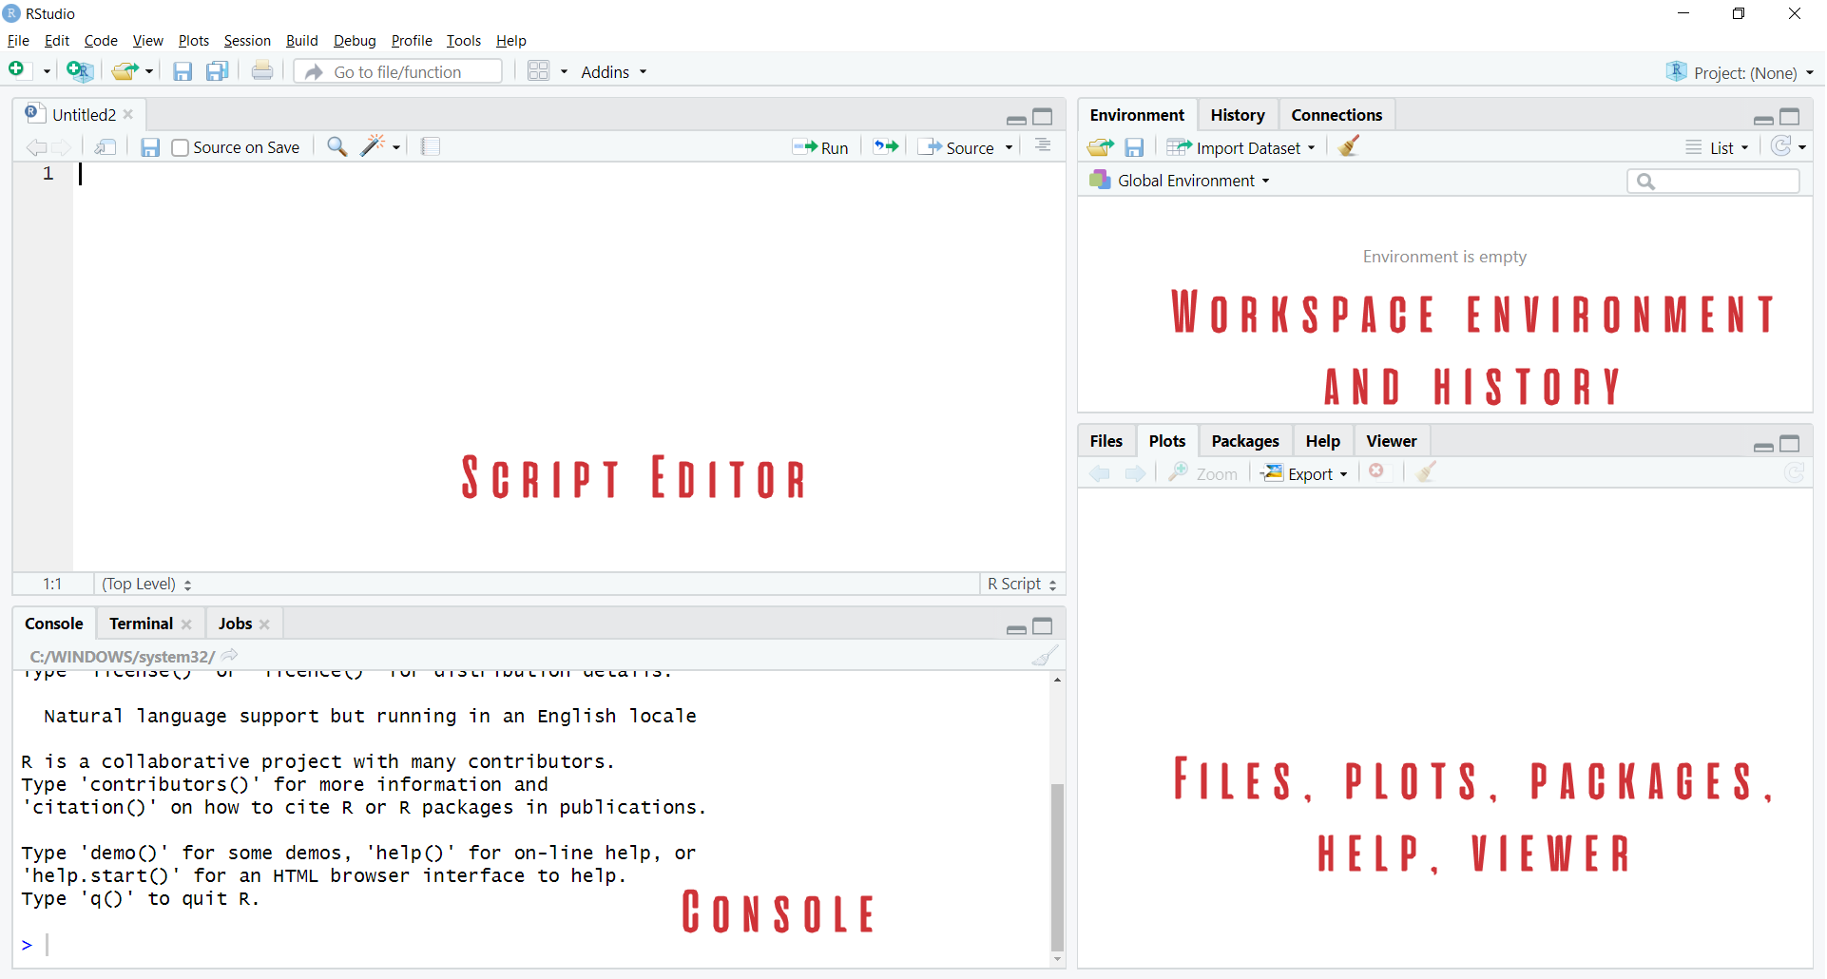

Demo
Navigate RStudio, beginning with 1+1
Notes:
OK so now it’s time for a demo. I want this meetup to be as interactive as possible. You will see in the repo there is a button that says Run in Rstudio. This is going to launch Rstudio right in your browser window. And when you get there you are going to see these four screens.
So what I want to do now is just show you what Rstudio looks like. We aren’t going to get too into depth about all the object types and so forth, just a little tour here.

Slide 16

The dialects of data
Group by origin
Find average for each group
Sort the results
“Get me the average price for each cut, sorted from high to low.”
Notes:
OK so now that you are familiar with the basics of working in R and Rstudio let me kick you a scenario of a typical data analysis example, let’s say you are analyzing diamond prices. You’ve been asked to return the average price for each cut, sorted from high to low. Now you’ve worked with data enough that you’re able to parse it into these three steps. Now, R is going to make it really easy to apply this sort of dialect of data – or more specifically there is a package that will help with this.

Slide 17

Packages: “There’s an App for that!”
Install the package
Open the package
Notes:
Now another thing unique to open source programs is this idea of packages. You can kind of think of this as like add-ins for Excel – the analogy I like to use is as apps on a phone.

Slide 18
Demo
Speaking the language of data with the tidyverse
Load and explore diamonds dataset
Write a “sentence” in dplyr:
“Get me the average price for each cut, sorted from high to low.”
File: diamonds.r
Notes:
OK so what we are going to do here is go back to your session or open a new one. Go to the diamonds.r dataset. And let’s actually conduct the analysis that was hinted at earlier.

Slide 19
Questions?
Notes:
Any questions so far about using R?
Again I just want to show you how easy it is to get up and running there as an Excel user and what to expect when working with open source programs.
Now I guess one of the questions I might have in your shoes is what’s the big deal, we can do the same kind of stuff with Power Query. So I want to acknowledge that.

Slide 20
Prancing into Python
Notes:
Well this is the name of the section just because I couldn’t think of anything else that started with a P….
Anyway let’s situate Python here for a sec. If you are wondering about the difference between R and Python – like I mentioned earlier R is best known for its statistical capabilities, it was born and raised to be a statistical language.
On the other hand Python was built primarily as a computer scripting language, sort of like VBA. So they were built for somewhat different needs which means they both have their strengths and weaknesses. For example, Python does not include a built-in data structure for a tabular data source, so we’ll need to rely on open source packages to implement it.

Slide 21



Python+ Anaconda + Jupyter
The (open) source code
The distribution of code & apps
The browser-based app
Notes:
OK now remember that being open source means anyone is free to repackage and redistribute code. In the case of Python the official source code lives with the Python foundation and can be found there. It’s more common however to download from the Anaconda _distribution_ of that code. One of the reasons why is Anaconda comes with some goodies that don’t come with the raw Pyhon installation. One of those is the Jupyter notebook, which is a browser-based app we’ll be using to work with Python.

Slide 22

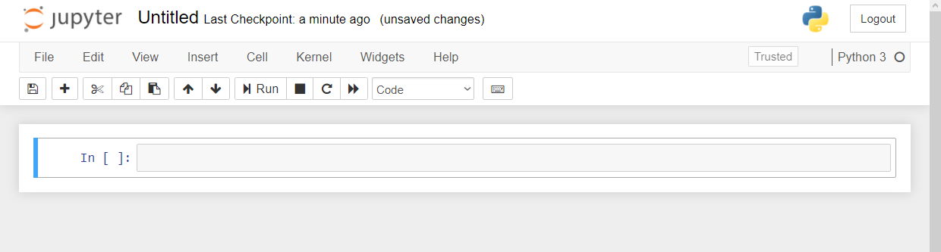
Demo
Navigate Jupyter, starting with 1 + 1
File: Open a new .ipynb notebook
Notebook name
Menu bar
Toolbar
Code cell
Notes:
OK again, what I want to do here is just show you the basics of working with Jupyter. You will see in the repo there is an option to launch an interactive session, so do that and let’s navigate the four sections of Jupyter and get comfortable working there.
Possibly come up with some demo notes for this

Slide 23
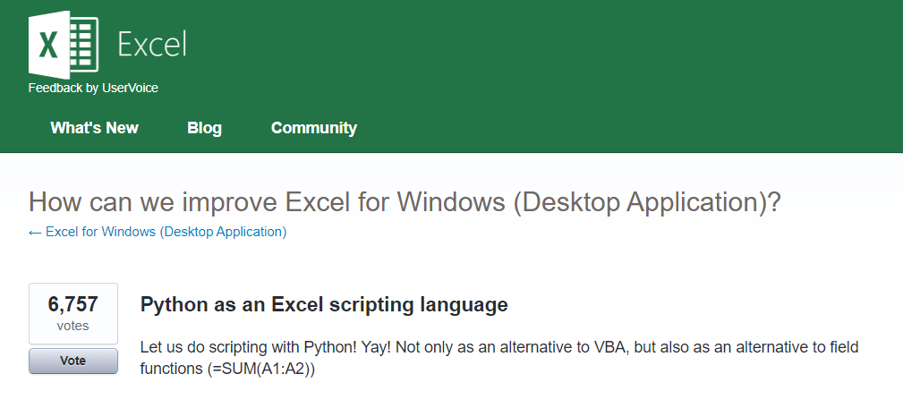



Python for Excel
More: http://www.python-excel.org
https://excel.uservoice.com/forums/304921-excel-for-windows-desktop-application/suggestions/10549005-python-as-an-excel-scripting-language
Notes:
OK so let’s talk about Python. In particular as an Excel user something to be aware of is the growing interest in integrating it with Python. Now I’ve linked to the infamous UserVoice survey above asking for this feature. I won’t press Alan or any of our MVPs on the matter but something is happening there…
There are also some popular packages over here but there are even more. So in this demo I am going to share a really brief example for “Python-Powered Excel.”

Slide 24
Demo
Export & format a dataset to Excel
Working with modules (packages) in Python
Working with tabular data in Python with pandas
“Python-Powered Excel”
File: python-powered-excel.ipynb
Notes:
OK so if you want to head back to that file on your browser what we’ll do here is export and format a dataset from Python to Excel. We’ll need to use some modules, what you know as packages, to do this.

Slide 25
Questions?
Notes:
Any questions about Python?

Slide 26
The data world is your oyster shell
Notes:
OK now for one last demo. I want to show you an example of “remixing” some of these different tools and really using each resource to its full potential.

Slide 27
Demo
Export an R regression to Excel
Jupyte”R”
“R-powered Excel” with openxlsx
The magic of ggplot2 visualizations
File: r-powered-excel.ipynb
Notes:
Like I mentioned earlier R is best known for statistical analysis. It’s also well-loved for its visualizations. So what we are going to do in this example is conduct a linear regression in R. We will plot the results and we will send all this work to Excel. Now I think this is a good example of some stuff that Power Query cannot help you do.

Slide 28
Questions?

Slide 29
Conclusion/Resources

Slide 30
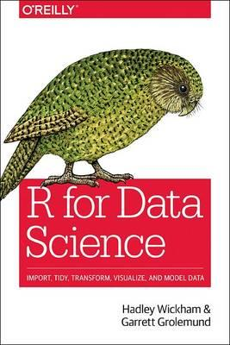
After you’ve bought my book
R for Data Science by Hadley Wickham and Garrett Grolemund

Slide 31
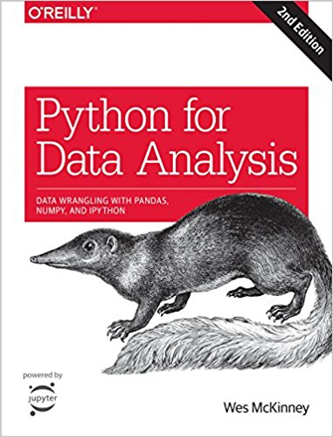
After you’ve bought my book
Python for Data Analysis, 2nd Edition by Wes McKinney

Slide 32
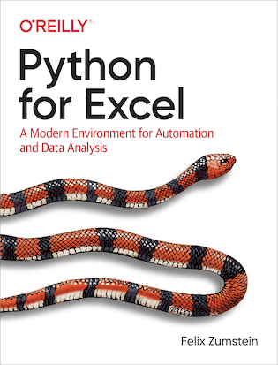
After you’ve bought my book
Python for Excel by Felix Zumstein

Slide 33
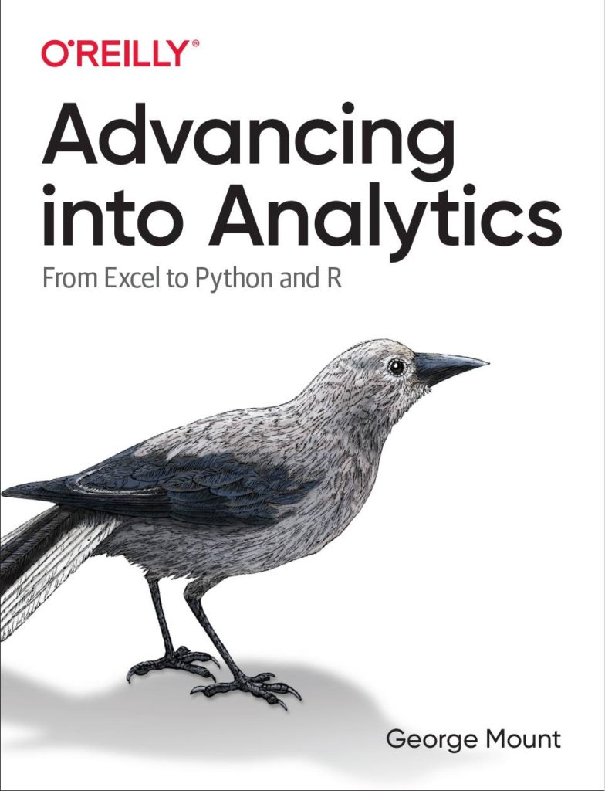
After you’ve bought my book
Advancing into Analytics by George Mount
georgejmount.com/book
Notes:
By the end of this book, you should be able to conduct exploratory data analysis and
hypothesis testing using a programming language.

Slide 34
Get in touch
george@stringfestanalytics.com
stringfestanalytics.com/book
linkedin.com/in/gjmount

Slide 35
Questions?

