Slide 1

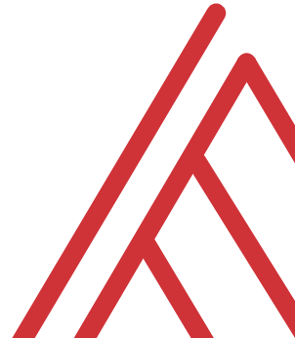
Advancing into Analytics: From Excel to R and Python

Slide 2
Learning objectives
Situate Excel in the data analytics stack
Chart a clear learning path from Excel to R and Python

Slide 3
Unofficial learning objectives
Having fun with data & computers

Slide 4
What is the data analytics stack?

Slide 5
Spare no tools…
Insert your O’Reilly-drawn data analytics stack image here

Slide 6
What is Excel good for?
Good at…
Visual calculations
End-user interactivity
Rapid prototyping
Not so much…
Storing data
Mobilizing data
Implementing advanced analysis

Slide 7
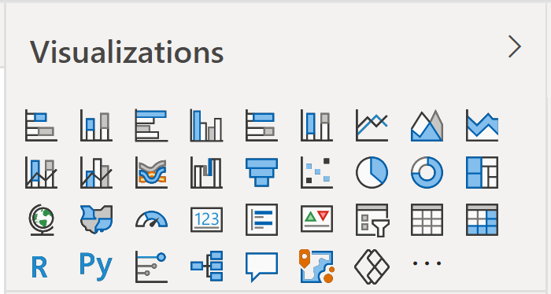
Don’t take my word for it…
Insert Power BI visuals here

Slide 8

Don’t take my word for it…
https://docs.microsoft.com/en-us/archive/blogs/wikininjas/tnwiki-article-spotlight-consuming-azure-storages-python-sdk-using-ptvs

Slide 9
The dialects of data
Adding, removing, calculating columns
Sorting and filtering
Aggregating and joining
Pivoting and reshaping

Slide 10

Demo
File: monty-hall.xlsx
Three doors: one car, two goats
You pick a door
Monty opens another door: it has a goat
Do you stick to your door, or switch doors? Does it matter?
🚪🚪🚪
🐐🚗🐐

Slide 11
Welcome to the R Project for Statistical Computing

Slide 12


R + RStudio
The code base
The interface

Slide 13
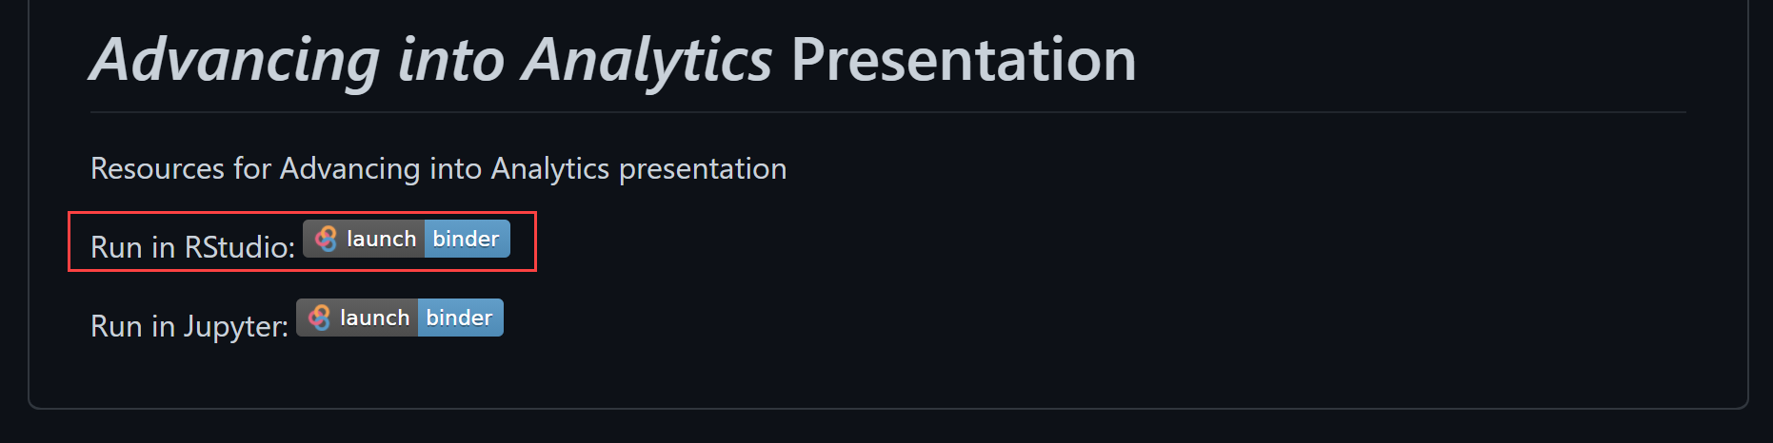
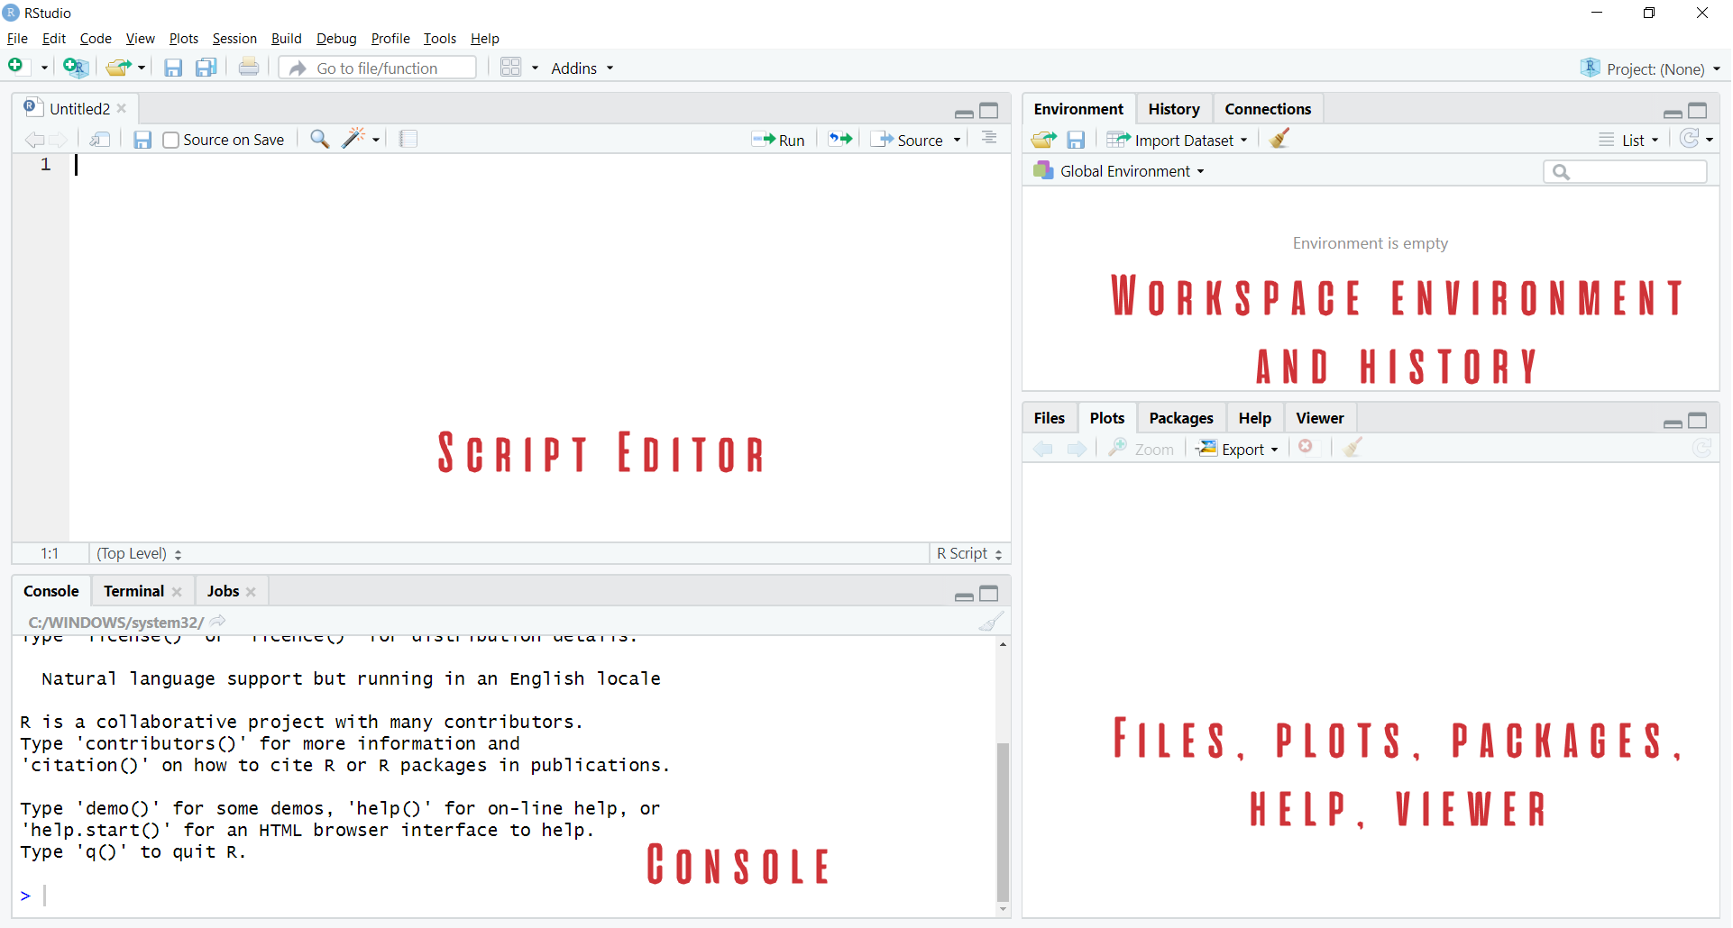
Demo
Navigate RStudio, beginning with 1+1

Slide 14

The dialects of data
Group by origin
Find average for each group
Sort the results
“Get me the average price for each cut, sorted from high to low.”

Slide 15

Packages: “There’s an App for that!”
Install the package
Open the package

Slide 16
Demo
Speaking the language of data with the tidyverse
Load and explore diamonds dataset
Write a “sentence” in dplyr:
“Get me the average price for each cut, sorted from high to low.”
File: diamonds.r

Slide 17
Questions?

Slide 18
Prancing into Python

Slide 19



Python+ Anaconda + Jupyter
The (open) source code
The distribution of code & apps
The browser-based app

Slide 20

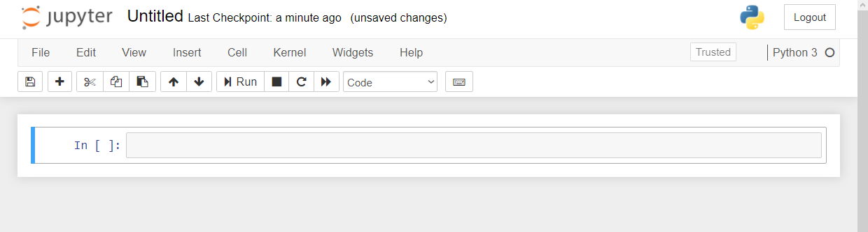
Demo
Navigate Jupyter, starting with 1 + 1
File: Open a new .ipynb notebook
Notebook name
Menu bar
Toolbar
Code cell

Slide 21
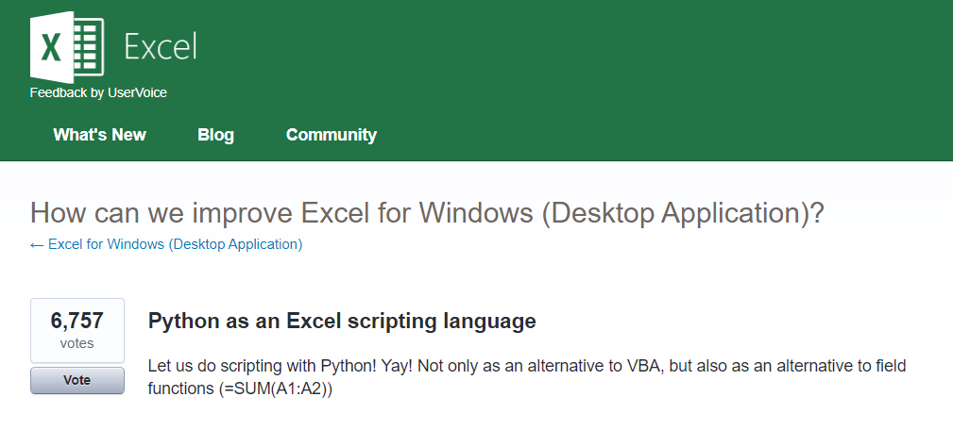



Python for Excel
More: http://www.python-excel.org
https://excel.uservoice.com/forums/304921-excel-for-windows-desktop-application/suggestions/10549005-python-as-an-excel-scripting-language

Slide 22
Demo
Export & format a dataset to Excel
Working with modules in Python
Working with tabular data in Python
“Python-Powered Excel”
File: python-powered-excel.ipynb

Slide 23
Questions?

Slide 24
The data world is your oyster shell

Slide 25
Demo
Export an R regression to Excel
Decoupling of platforms and applications
The magic of ggplot2 visualizations
File: r-powered-excel.ipynb

Slide 26
Questions?

Slide 27
Conclusion/Resources

Slide 28
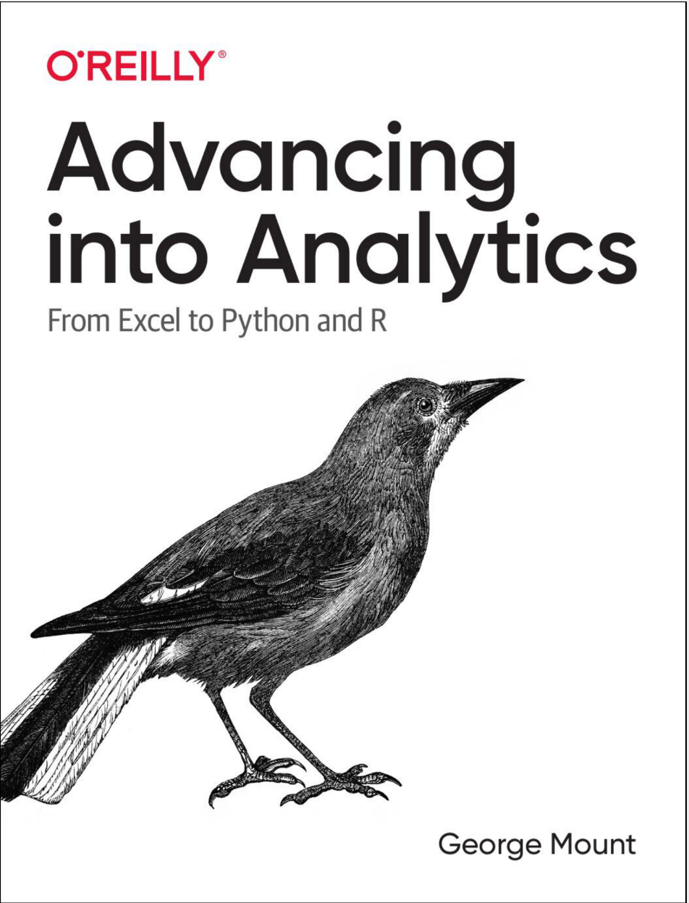
Buy my book
http://georgejmount.com/book/
Learning objective: By the end of this book, you should be able to conduct exploratory data analysis and
hypothesis testing using a programming language.

Slide 29
After you’ve bought my book
R for Data Science by Hadley Wickham and Garrett Grolemund
Python for Data Analysis, 2nd Edition by Wes McKinney
Python for Excel by Felix Zumstein

Slide 30
Get in touch
george@stringfestanalytics.com
stringfestanalytics.com/book
linkedin.com/in/gjmount

