Slide 1


Notes:
https://swiy.co/musopen

Slide 2
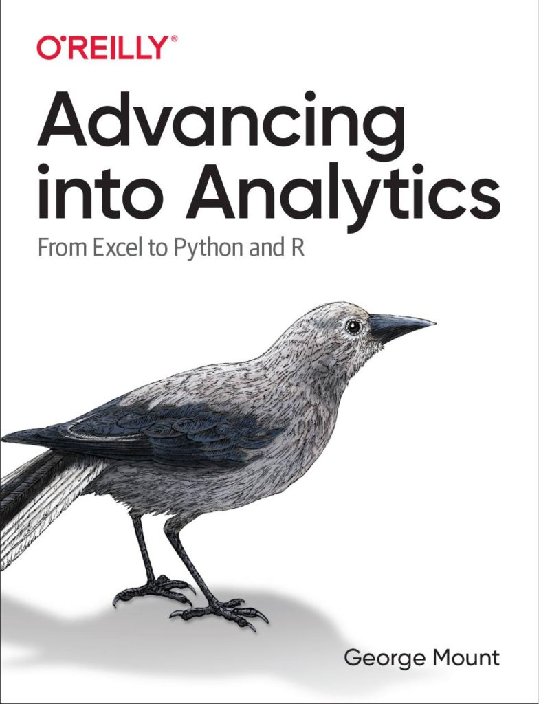



Hi, I’m George

Slide 3

OBJECTIVES
Pattern recognition with Flash Fill
C﻿haracter recognition with Data from Picture
A﻿I-powered insights with Recommended PivotTables and Charts

Slide 4
FOLLOWING ALONG
Download files are now Patreon ONLY:
https://www.patreon.com/user?u=80541000
Notes:
https://swiy.co/amx

Slide 5
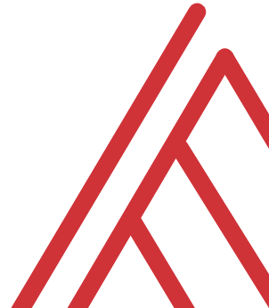
Terms of engagement
Participation is welcome via the chat/unmute
Demos work best with 365 for PC
Recording goes out later today, moves to Patreon after 2 days
I will do my best to answer your questions

Slide 6

QUESTIONS?

Slide 7
Demos
File: ai-for-excel-101.xlsx
Flash fill
Data from picture
Recommended PivotTables and Charts

Slide 8
Demos
File: wholesale-customers.xlsx
Getting AI-powered insights with Analyze Data
Optimizing the data’s structure with Power Query

Slide 9


Find me
stringfestanalytics.com
Linkedin.com/in/gjmount
Twitter.com/gjmount

Slide 10
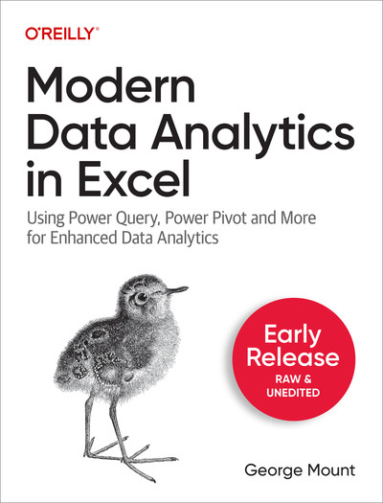
Modern Data Analytics in Excel
Available in early release: https://stringfestanalytics.com/maxl/

Slide 11
Join my Patreon
https://social.stringfestanalytics.com/patreon
Get lifetime access to all past webinar recordings & downloads

Slide 12
FINAL QUESTIONS?
Thanks for joining!
A recap email with recording, survey and more will be coming…
The recording stays up for 48 hours, then moves to my Patreon
I appreciate your reviews & referrals.
Notes:
Any questions on descriptive statistics?

