Slide 1


Notes:
https://swiy.co/musopen

Slide 2
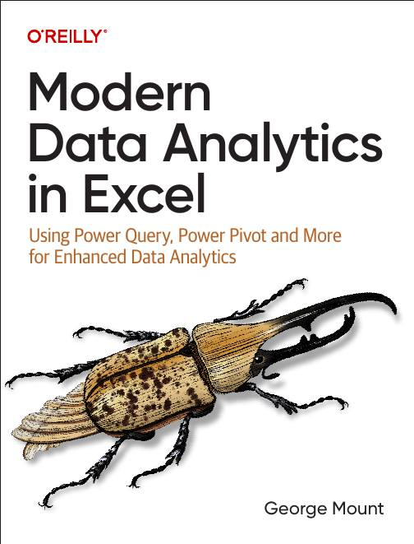


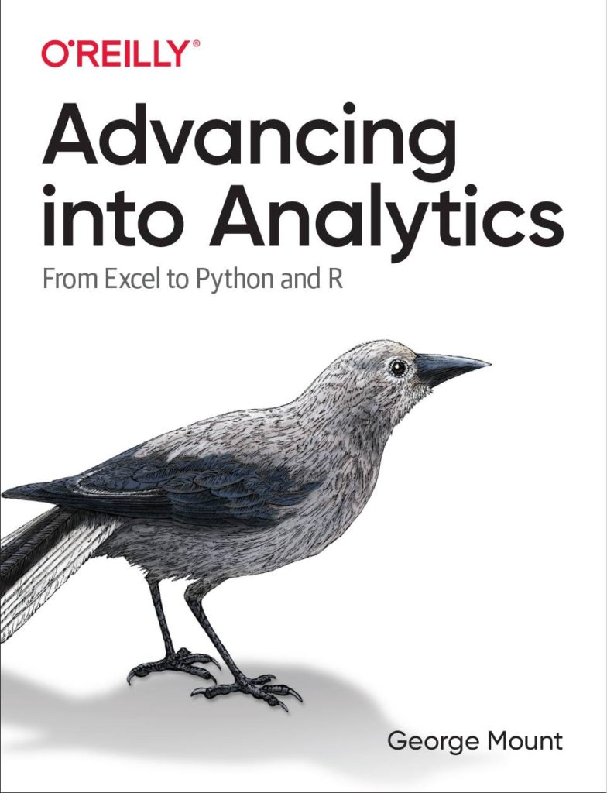


Hi, I’m George

Slide 3

OBJECTIVES
Pattern recognition with Flash Fill
C﻿haracter recognition with Data from Picture
A﻿I-powered insights with Recommended PivotTables and Charts

Slide 4

QUESTIONS?

Slide 5
Demos
File: ai-for-excel-101.xlsx
Flash fill
Data from picture
Recommended PivotTables and Charts

Slide 6
Demos
File: wholesale-customers.xlsx
Getting AI-powered insights with Analyze Data
Optimizing the data’s structure with Power Query

Slide 7
THANK YOU

Slide 8


Find me
stringfestanalytics.com
Linkedin.com/in/gjmount
Twitter.com/gjmount

