Slide 1


Notes:
https://swiy.co/musopen

Slide 2
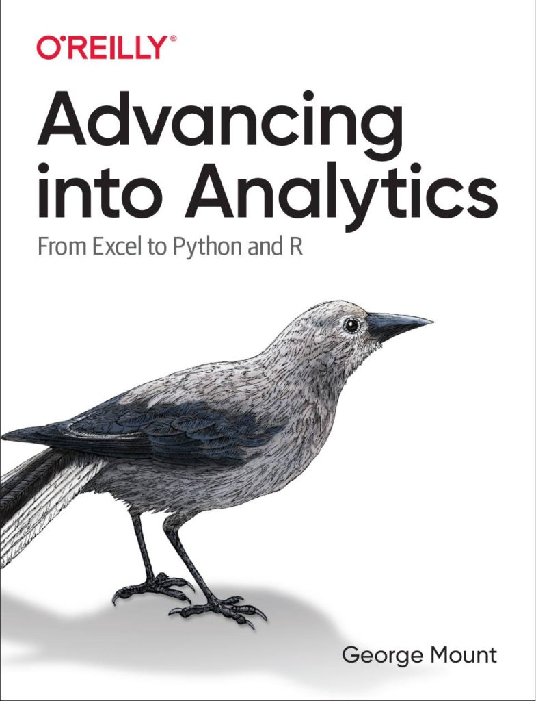



Hi, I’m George

Slide 3

OBJECTIVES
Pattern recognition with Flash Fill
C﻿haracter recognition with Data from Picture
A﻿I-powered insights with Recommended PivotTables and Charts

Slide 4
FOLLOWING ALONG
Download resources:
https://social.stringfestanalytics.com/G2Se
Notes:
https://swiy.co/amx

Slide 5
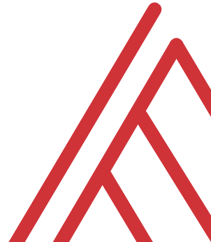
Terms of engagement
Feel free to share the download link with latecomers ☺
Participation is welcome via the chat/unmute
Demos work best with 365 for PC
Recording goes out later today, moves to Patreon after 2 days
I will do my best to answer your questions

Slide 6

QUESTIONS?

Slide 7
Demos
File: ai-for-excel-101.xlsx
Flash fill
Data from picture
Recommended PivotTables and Charts

Slide 8


Find me
stringfestanalytics.com
Linkedin.com/in/gjmount
Twitter.com/gjmount

Slide 9
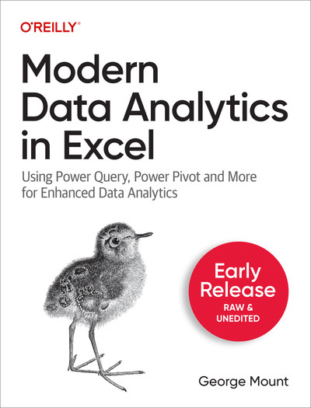
Modern Data Analytics in Excel
Available in early release: https://stringfestanalytics.com/maxl/

Slide 10
Join my Patreon
https://social.stringfestanalytics.com/patreon
Get lifetime access to all past webinar recordings & downloads

Slide 11

TAKE THE SURVEY
How did I do today? Testimonials or other data welcome.
https://social.stringfestanalytics.com/event-feedback
Notes:
I’m a data analyst give me data on how I did
Testimonials also VERY helpful.

Slide 12
FINAL QUESTIONS?
Thanks for joining!
A recap email with recording, survey and more will be coming…
The recording stays up for 48 hours, then moves to my Patreon
I appreciate your reviews & referrals.
Notes:
Any questions on descriptive statistics?

