Slide 1


AI for Excel in a Week
Day 3: Copilot in Excel
Notes:
Welcome to Day 3. Today is about Copilot in Excel — the AI that lives inside the app. Quick context before we dive in: Advanced Analysis with Python and Agent Mode have both been rolled back into regular Copilot, so there is one pane to learn instead of three. Our job is to use it with confidence, not just convenience, so what we hand off on Friday can survive a review.

Slide 2

Day 2 recap
Saw why messy data breaks AI
Used Copilot to diagnose issues (but not fix them)
Use Copilot to tidy our M code
Pushed the cleaning logic into a Dataflow
Published a clean, governed table into Dataverse
Notes:
Yesterday we fought messy data. We used Copilot to diagnose issues in Power Query, had it tidy our M code, pushed the cleaning logic into a Dataflow, and landed a governed table in Dataverse. The point: before AI can help you analyze, it needs data it can trust. Today we move one layer up — using AI inside the workbook itself.

Slide 3
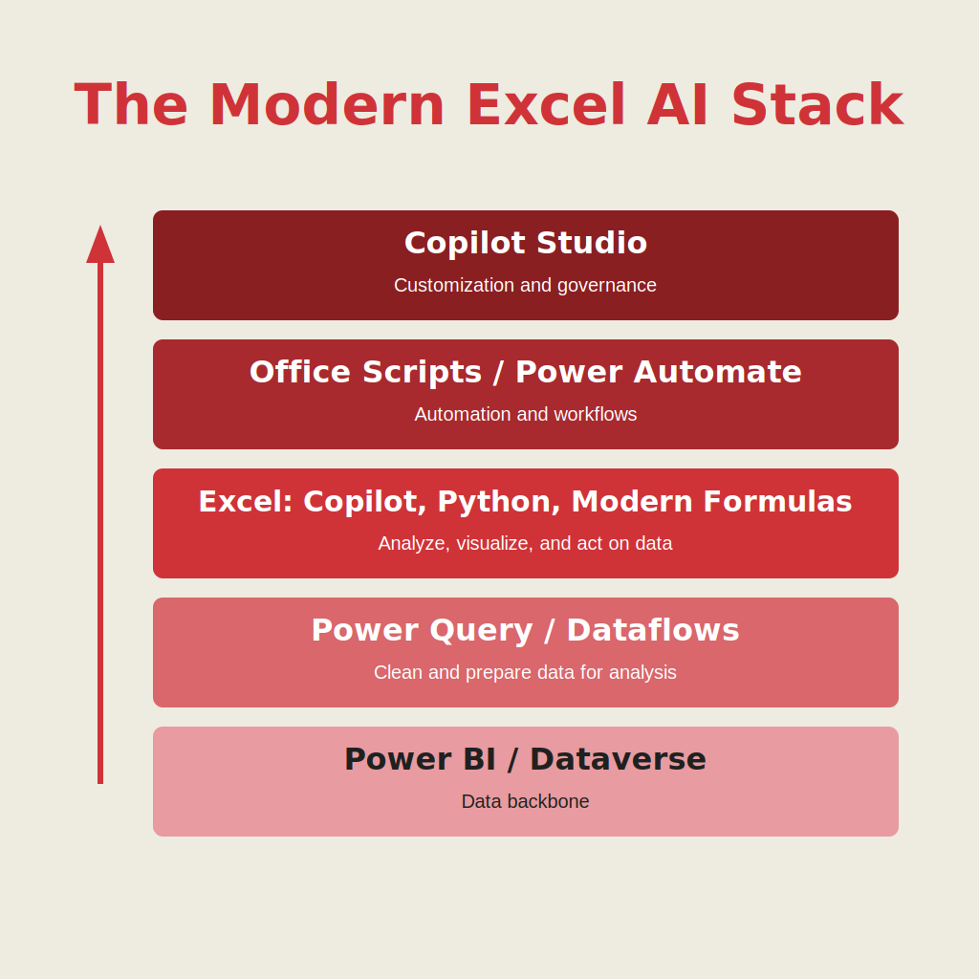
Welcome to the modern Excel AI stack
https://stringfestanalytics.com/how-to-understand-the-modern-excel-ai-stack/
Notes:
Quick orientation. This diagram shows where Copilot fits in the modern Excel AI stack. Data comes in from the bottom, moves through cleaning and governance, then lands in the analytical layer where Copilot lives. Above that sits the automation and delivery layer we will cover in Day 4. The important thing: Copilot is one layer of the workflow, not the whole thing.

Slide 4
What Copilot in Excel does today
Copilot is now the single AI surface inside Excel
Advanced Analysis with Python has been folded back into Copilot
Agent Mode's multi-step build features now run inside regular Copilot
One pane, one subscription, broader reach across your workbook
Our job today: use it with confidence, not just convenience
Notes:
Heads-up on what has changed. Advanced Analysis with Python — the feature that let Copilot run clustering or regression directly — has been folded back into regular Copilot. Same for Agent Mode, the multi-step build-me-a-whole-model feature. So instead of three surfaces and three license tiers, you now have one Copilot pane that is broader and deeper than it used to be. The risk: it is more tempting to treat it as a black box. Our job today is to stay in the driver's seat.

Slide 5

Demo 1: Copilot basics + Style Guide
Workbook: energydata.xlsx (75 rows)
Part 1: Baseline
Formatting, calc columns, Pivot + charts
SUMPRODUCT → FILTER/LET
Defaults: cell refs, VLOOKUP, messy charts
Part 2: Style Guide (EITI)
Apply guide → re-run 4 viz types
Charts align to clear goals
Takeaway: reference doc → better outputs
Notes:
What I like to show here is how Copilot behaves when you don’t really give it much to go on. It’ll do the job, but you start to see some patterns pretty quickly—things like defaulting to cell references, using older functions like VLOOKUP, and producing charts that aren’t all that consistent. Nothing is technically wrong, it just feels a little… generic. The shift happens when you give it a reference point, like a data visualization style guide. Now instead of just generating something, it’s making decisions based on a standard. When you rerun the exact same prompts, the output feels a lot more intentional and a lot more defensible, which is really the goal.

Slide 6
Demo 2: Copilot vs. Claude
Categorize, summarize, flag anomalies
Compare:
Consistency
Where work lives
Data security
Decision
Copilot: in-Excel + sensitive
Claude: deliverables
Takeaway: use both wisely
Folder: 2-claude-vs-copilot
Notes:
Here the setup is simple on purpose: same data, same prompts, just two different tools. That lets you really see how each one behaves. Copilot works directly in Excel, so it’s editing your file in place, which is great for speed and workflow but does require some trust. Claude, on the other hand, tends to give you output that you then bring into Excel, so there’s a bit more separation. What I usually tell people is this isn’t about picking a winner. It’s more about understanding where the work lives and how sensitive your data is. In practice, most teams end up using both—Copilot for hands-on Excel work, and Claude for things that sit around Excel like summaries or deliverables.

Slide 7
Demo 3: Audit and Change Log
Problem → Fix
Copilot forgets → no audit trail
Solution: log work in-file
3 prompts
Setup log (once)
Do task + log it
Reopen: read log + resume
Demo
Add Profit + Margin → close → reopen
Takeaway
In-file log = persistent, reviewable
Notes:
This is probably the biggest practical issue people run into: Copilot doesn’t remember what it did last time, so there’s no real trail of what changed or why. That’s where this logging pattern comes in. Instead of relying on the chat, you have the AI write a log of its own actions directly into the workbook. It’s a simple three-step approach: set up the log once, have it add to the log every time it does work, and then when you reopen the file, have it read the log and pick back up. What’s nice is you can actually demonstrate continuity—close the file, reopen it, and keep going. It turns the whole experience from something a bit opaque into something you can actually explain and defend, especially if someone else needs to review your work.

Slide 8
So what for AI?
AI in Excel is only one layer of the workflow
You still need to get data in, secure it, and move it across systems
Power Automate connects Excel logic to real business processes
Dataverse keeps everything consistent so AI can trust your data
These tools together make AI reliable, scalable, and production ready
Notes:
Pulling back to the big picture for a second. AI in Excel is only one layer. You still need to get data in, secure it, and move results across systems. Power Automate connects Excel logic to business processes. Dataverse keeps the data consistent enough that AI can trust it. Together these tools make Copilot reliable and scalable, not just impressive in a demo.

Slide 9
Day 4 preview: Turning analysis into action
Office Scripts automate the clicks and steps you already take in Excel
Power Automate turns those scripts into real workflows that run on their own
Flows push data and results to Teams, Outlook, SharePoint and more
Together they form the execution layer that carries your work beyond the workbook
Notes:
Tomorrow we move from getting analysis done inside Excel to pushing analysis out of Excel automatically. Office Scripts automate the clicks you already take. Power Automate turns those scripts into real workflows. Flows push results to Teams, Outlook, SharePoint. Together they form the execution layer that carries your work beyond the workbook.

Slide 10
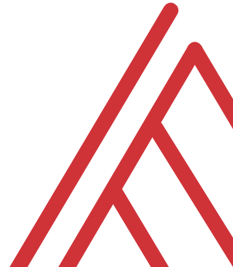
Questions?
Notes:
Open it up. Good questions to seed if the room is quiet: which of the three patterns — style guide or logging — would you try first on Monday? Are there workbooks you would NOT want to use Copilot on even with the shield, and why?

Slide 11
THANK YOU
Notes:
Thanks for hanging in. See you tomorrow for Day 4 — Office Scripts and Power Automate.

