Slide 1


AI for Excel in a Week
Day 3: The Excel Intelligence Layer – Copilot, Python, Agent Mode
Notes:
Welcome to Day 3 — the most exciting day of the week, in my opinion. This is the day we actually turn Excel into the intelligent workspace it was always supposed to be.
We have three big tools to cover today and they each represent a different point on the AI spectrum. Copilot inside Excel, which most of you have probably touched. Python in Excel, which gives you genuine analytical horsepower right inside your workbook. And Agent Mode, which is the new thing this year and is the closest Excel has ever come to having a junior analyst sitting next to you.
By the end of the hour you'll have a clear sense of when to use which tool, what each one is good at, where each one falls down, and how they fit together with everything else we've built this week.

Slide 2

Day 2 recap
Saw why messy data breaks AI
Used Copilot to diagnose issues (but not fix them)
Use Copilot to tidy our M code
Pushed the cleaning logic into a Dataflow
Published a clean, governed table into Dataverse
Notes:
Yesterday we tackled the unglamorous but essential question: how do you turn messy real-world Excel data into something AI can actually work with?
We started by pointing Copilot at a deliberately messy dataset — quarterly columns spread sideways — and watching it stumble. Not because Copilot is bad, but because the data structure was fundamentally hostile to any analytical tool. Garbage in, garbage out.
Then we used Copilot as a diagnostic partner — great at flagging issues, less great at fixing them — and went into Power Query to do the real cleanup. Unpivot, types, naming, the works. We even fed our M code back to Copilot and asked it to make the script cleaner.
Once the local cleanup worked, we lifted the entire logic into a Dataflow. Same transformations, but now running in the cloud against the source file, on a schedule, with the cleaned output landing in Dataverse. That table is now governed, refreshable, and reusable across everything we'll build the rest of this week.
The big takeaway from yesterday is the same takeaway for today: AI experiences are only as good as the data foundation underneath them. We've now built that foundation. Today we get to enjoy the payoff.

Slide 3
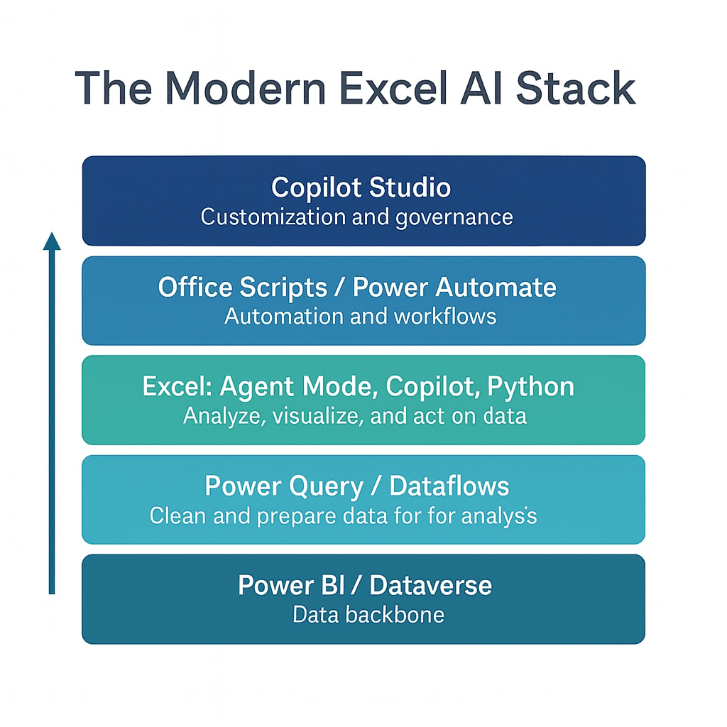
Welcome to the modern Excel AI stack
https://stringfestanalytics.com/how-to-understand-the-modern-excel-ai-stack/
Notes:
Same stack, climbing one more rung. Foundation, preparation, intelligence, execution, orchestration. Yesterday we finished preparation. Today we're squarely in the intelligence layer.
Notice that intelligence is not the top of the stack. It's the middle. That's intentional. AI inside Excel is powerful, but it's only one piece of the system. Without governed data underneath it (Days 1–2) and automation around it (Days 4–5), Copilot is just a slightly smarter assistant. The magic happens when all the layers connect.

Slide 4
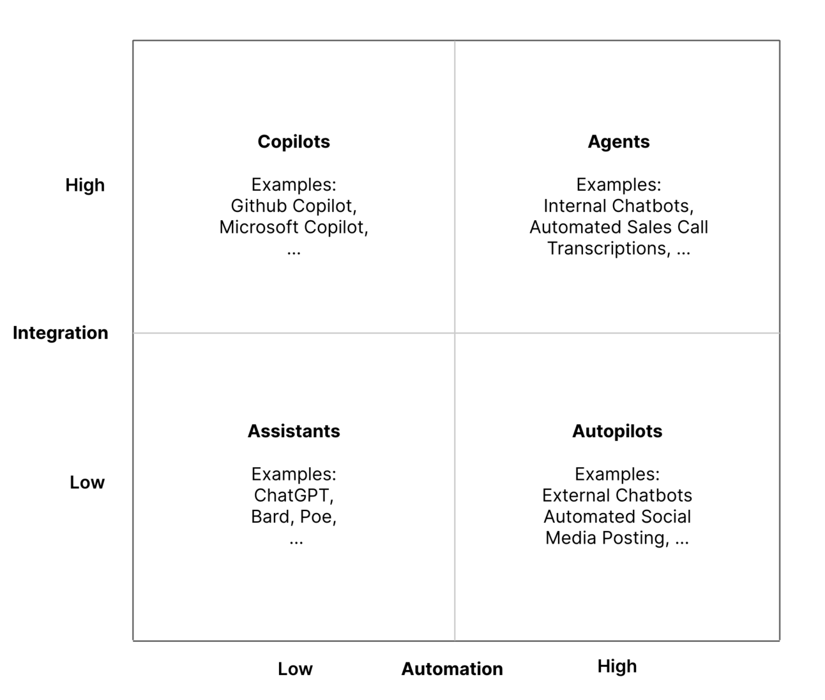
The integration-automation AI framework
https://blog.tobiaszwingmann.com/p/integration-automation-ai-framework
Notes:
This chart is from Tobias Zwingmann and it's the cleanest mental model I've found for thinking about AI tools. Two axes — how deeply integrated the tool is into your daily workflow, and how much work it can take off your plate without supervision.
Bottom-left: assistants. ChatGPT, Claude, Gemini in their plain web interfaces. Smart, conversational, flexible — but they live outside your tools. You have to copy and paste data in and out. They don't know what's in your workbook unless you tell them.
Top-left: copilots. Microsoft Copilot inside Excel. Deeply integrated — it sees your workbook, your formulas, your tables. But still assistive. You drive, it helps. It doesn't act unless you prompt it.
Bottom-right: autopilots. Scheduled tasks, simple automations. They run on their own but they don't really understand your work — they just execute predefined steps.
Top-right: agents. The new frontier. Agents combine deep integration with high autonomy. They understand your data AND they can plan and act on their own across multiple tools. This is where Agent Mode in Excel lives. This is where Copilot Studio agents live.
Here's the line I want you to remember: Copilot helps you do the work. Agent Mode begins to do the work. We'll see both today, side by side.

Slide 5

Studying penguins with Copilot
Workbook: penguins.xlsx
Getting data Copilot-friendly
Formatting data as a Table
Creating calculated columns
Building summary charts
Using PivotTables
Going deeper with Python in Excel
Notes:
Time for a hands-on tour of Copilot in Excel. We're going to use the penguins dataset because it's small, it's clean, and it has just enough variety to make Copilot do interesting things.
Step one is the unsexy but critical setup: get the data Copilot-friendly. That means formatting the range as a Table — Ctrl-T. Copilot in Excel only really comes alive when it's pointed at a Table object. If you take one workflow habit away from this hour, let it be that.
From there, we'll walk through the natural progression of asking Copilot for help: conditional formatting first, then calculated columns, then pivot tables and pivot charts. The agent-mode-prompts.docx file in the folder has a great library of prompts you can use for practice.
Then I want to show you Python in Excel, which is the part of Copilot that doesn't always get the love it deserves. You can ask Copilot to write Python for you in PY() cells — scatter plots, correlation matrices, clustering, even simple regression. The same Python code that used to require Jupyter and pandas now lives directly in your workbook, runs in the Microsoft cloud, and refreshes alongside your data.
A quick note for those of you wondering about Claude or other AI tools: Copilot is the one with native access to your Excel workbook, so it's the right tool for in-cell help. But for thinking through an analytical approach — "should I cluster these penguins by mass or by flipper length, what would each tell me?" — there's nothing wrong with copying the question over to Claude or your preferred AI for a second opinion. Use the right tool for the right step. We'll talk more about this Friday.

Slide 6
Excel Copilot vs Excel Agent Mode
Feature | Excel Copilot | Agent Mode
Interaction | One-shot prompts | Iterative, self-guided workflow
Task Scope | Single actions (formulas, charts, summaries) | Multi-step processes across sheets
Error Handling | User re-prompts or fixes | Agent reviews, retries, self-corrects
User Role | You do, Copilot helps | You manage, Agent executes
Output Quality | Fast but shallow | Verified and repeatable
Best For | Quick wins, ad-hoc tasks | Structured, high-stakes workflows
Analogy | Smart assistant | Junior analyst
Notes:
Let me unpack this comparison table because it's the most important conceptual slide of the day. People hear "Copilot" and "Agent Mode" and think they're variations of the same thing. They're not. They're different stages of how AI works inside Excel, and they call for different mental models from you.
Copilot is reactive. You prompt, it responds. Single action at a time. You're the one driving. This is great for fast wins — generate a formula, build a chart, summarize a range, explain a slice of data. You're still doing the analysis. Copilot is just shaving minutes off each step.
Agent Mode is proactive. You give it a goal, and it plans, executes, and evaluates multiple steps on its own. It will create sheets, build tables, write formulas, format outputs, and check its own work. If it makes a mistake, it'll often catch and fix it without you having to say anything. Think of it less like an assistant and more like delegating a project to a junior analyst.
That changes your role. With Copilot, you're an analyst with a power tool. With Agent Mode, you're a manager reviewing an analyst's work. Your job shifts from "Can I get this formula right?" to "Did the agent do the right thing? Is this output trustworthy?" That's a real skill, and it's the skill that will distinguish modern Excel users in the next few years.
In terms of when to use what: Copilot for quick, ad-hoc tasks. Agent Mode for structured, repeatable, higher-stakes work — financial models, reconciliations, recurring report packs. The output of Agent Mode is generally more auditable and refreshable, which matters when the stakes are high.
Short version: Copilot accelerates your work. Agent Mode begins to do the work. And the real opportunity for Excel professionals is learning to manage and guide these new digital teammates effectively.

Slide 7
Demo: Agent Mode in action
Loan calculator
Variance analysis
Monthly close pack
What does Agent Mode do well, poorly, or not at all?
How does this relate to other tools in the Excel AI stack?
Notes:
OK, let's actually watch Agent Mode work. I have three prompts queued up for us, each one a different flavor of "junior analyst, build me this thing."
First, a loan calculator with an amortization table. This is a great starter because it's a self-contained, unambiguous task. Watch how Agent Mode plans the structure, builds the inputs, generates the schedule, formats it. Then we'll critique the result together — what did it do well, what would I have done differently, what assumptions did it make that we should question?
Second, a budget vs actuals variance analysis with conditional formatting on variances over 10 percent and an executive summary. This one is more open-ended and you'll see the agent make some choices. Some good, some you might disagree with. That's the point — the agent is making interpretive calls and you're the reviewer.
Third, the boss-level prompt: a financial close pack with P&L, balance sheet, and a KPI dashboard. This is where things get genuinely impressive — and where you'll also see the limits. Agent Mode is closer to a mid-level intern than a senior analyst, but mid-level interns are pretty useful.
After each one, three questions. What did Agent Mode do well? What did it do poorly or skip entirely? And how does this connect back to the rest of the Excel AI stack — what would have to be true upstream for this output to be production-grade?

Slide 8
So what for AI?
AI in Excel is only one layer of the workflow
You still need to get data in, secure it, and move it across systems
Power Automate connects Excel logic to real business processes
Dataverse keeps everything consistent so AI can trust your data
These tools together make AI reliable, scalable, and production ready
Notes:
Wrapping up the day with the so-what. Everything we just saw is exciting — Copilot, Python, Agent Mode all running inside the spreadsheet — but I want you to keep some perspective. AI in Excel is one layer of the workflow. It is not the whole workflow.
You still have to get data in. You still have to govern it. You still have to move results out to the people and systems that need them. Copilot can analyze, but it can't refresh your source. Agent Mode can build a report, but it can't email it to your team or push it to SharePoint without help.
That help is the rest of the Power Platform. Power Automate connects your Excel logic to real business processes — refreshes, notifications, approvals, file handling. Dataverse keeps the underlying structure consistent so AI can trust what it's working with. Copilot Studio wraps the whole thing in something a non-technical user can actually pick up and use.
When you put all of this together — Excel intelligence plus governed data plus automation plus orchestration — that's when AI stops being a feature and starts being a system. Reliable. Scalable. Production-ready. That's the through-line for the rest of the week.

Slide 9
Day 4 preview: Turning analysis into action
Office Scripts automate the clicks and steps you already take in Excel
Power Automate turns those scripts into real workflows that run on their own
Flows push data and results to Teams, Outlook, SharePoint and more
Together they form the execution layer that carries your work beyond the workbook
Notes:
Quick preview of tomorrow. Day 4 is the execution layer — the part of the stack where insights stop being insights and start being actions.
Office Scripts let you automate the exact clicks and keystrokes you already do in Excel. Click record, do the thing, save the script, reuse it forever. It's the same idea as the old VBA macros, except cloud-native and far easier to share.
Power Automate takes those scripts and runs them on triggers. Schedule, file upload, email arrival, form submission. Now your Excel logic doesn't depend on you opening the file. It runs itself.
And — this is the part I'm adding more of this year — Power Automate has its own AI capabilities. AI Builder actions, prompt actions, Copilot in Power Automate that can build flows from a sentence of plain English. We're going to spend real time on those tomorrow because they're a step-change from the Power Automate of two years ago.
By the end of Day 4 you'll see the execution layer clearly: AI gives you insights, scripts capture the steps, flows run them on schedule, and the business actually receives the result.

Slide 10
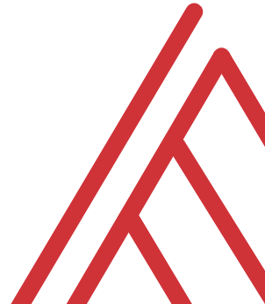
Questions?

Slide 11
THANK YOU

