Slide 1


AI for Excel in a Week
Day 1: Power BI and Dataverse – The Foundation Layer
Notes:
Welcome everyone — and congratulations on signing up for AI for Excel in a Week. Over the next five days we are going to build something I'm calling the Modern Excel AI Stack. It's the layer cake of tools that turns Excel from a single file on your laptop into a connected, AI-ready piece of your organization's data ecosystem.
Day 1 is all about the foundation. Before we touch Copilot, before we touch Python, before we touch a single agent, we have to get honest about where our data lives and how trustworthy it is. Today is the unglamorous but critical day. Get this right and the rest of the week clicks. Skip this and you'll spend the rest of the week fighting your data.
Quick housekeeping while people are joining: I'll record every session, files go in the Teams channel, and you can email me anytime at george@stringfestanalytics.com.

Slide 2
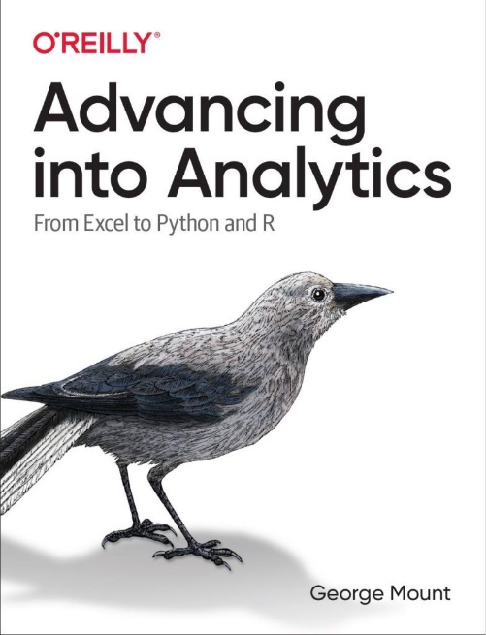
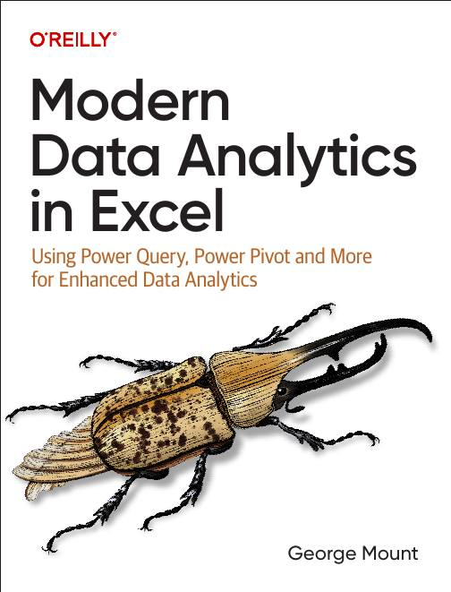




I help Excel users move from fragile spreadsheets
to confident, scalable analysis.

Slide 3

Objectives for this course
Connect Excel to Power BI and Dataverse for live, governed data
Build repeatable cleaning workflows with Power Query and Dataflows
Use Copilot, Python in Excel, and Agent Mode for analysis and automation
Automate Excel work with Office Scripts and AI-powered Power Automate
Build and deploy custom copilots in Copilot Studio for real workflows
Notes:
Here's the week at a glance. Five days, five layers of the stack.
Day 1 is the foundation — connecting Excel to the cloud sources where your real data lives. Power BI semantic models for governed analytics, Dataverse for governed operational data. This is what makes everything else this week possible.
Day 2 is the preparation layer. Power Query and Dataflows. We take messy, real-world data and turn it into something that's reliable, refreshable, and ready for AI to actually reason over.
Day 3 is the intelligence layer. Copilot inside Excel, Python in Excel for the deeper analytical work, and Agent Mode — the big addition this year — which lets Excel plan and execute multi-step analyses on your behalf.
Day 4 is the execution layer. Office Scripts and Power Automate. This is where insights stop being insights and become actions: scheduled refreshes, Teams notifications, AI-powered flows that read your data and respond.
Day 5 is the orchestration layer. Copilot Studio. We build your own custom copilot and connect everything we've built earlier in the week as actions it can call.
By Friday you'll have hands-on experience with every layer. You won't be an expert in all of them, but you'll know what each tool is for and how they connect. That's the real value — knowing the shape of the stack.

Slide 4
Class logistics
All meetings will be on Teams URL
All recordings and messages will be sent to the email you used to register
Email me with any questions: george@stringfestanalytics.com
Notes:
Quick logistics. Everything happens in the Teams channel I sent you — recordings get posted there, demo files get posted there, and that's where you'll ask questions between sessions. Make sure you're using the same email you signed up with so you have access.
I keep all the recordings and the Teams group up for at least 60 days after we wrap, so if life happens and you miss a session, you're fine. Just catch up at your own pace.
Email me anytime at george@stringfestanalytics.com. I genuinely read everything — if something isn't clicking or you want a deeper dive on a topic, just say so.

Slide 5
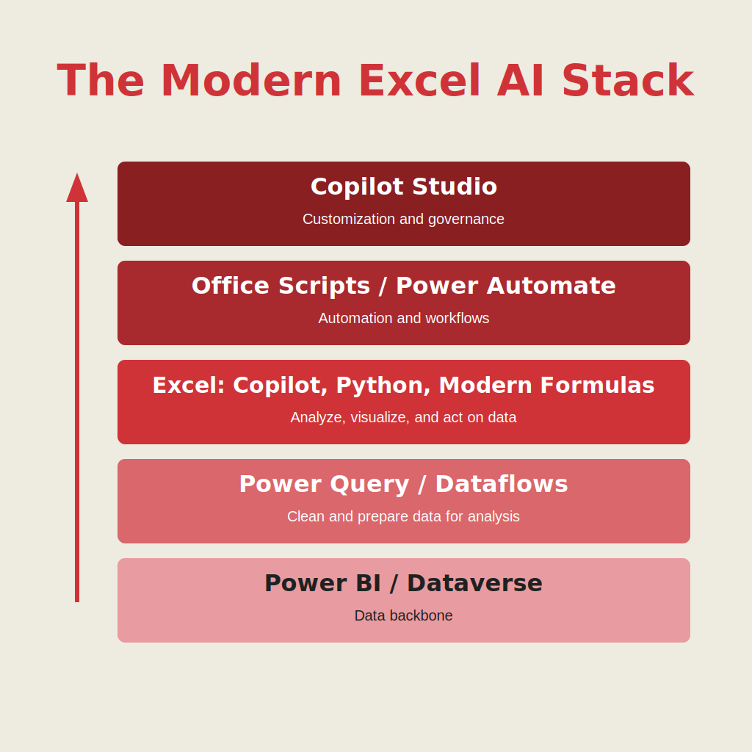
Welcome to the modern Excel AI stack
https://stringfestanalytics.com/how-to-understand-the-modern-excel-ai-stack/
Notes:
This is the picture I want you to keep in your head all week. I call it the Modern Excel AI Stack, and it's the framework I write about on the Stringfest blog — link is on the slide.
There are five layers, and we're walking up them in order this week.
Layer one — foundation. Where does your data live? Is it governed? Is it refreshable? That's today.
Layer two — preparation. How do you clean it once and reuse the cleaning everywhere? That's tomorrow with Power Query and Dataflows.
Layer three — intelligence. Once the data is clean, how do you reason over it with Copilot, Python, and Agent Mode? That's Wednesday.
Layer four — execution. How do you turn insights into actions that run automatically? That's Thursday with Office Scripts and Power Automate.
Layer five — orchestration. How do you wrap all of that into a custom copilot your team can actually use? That's Friday with Copilot Studio.
The reason I draw it as a stack is that each layer depends on the one below. AI without clean data is theatre. Automation without governed data is risk. And custom copilots without all of the above are toys. We're building this in the right order on purpose.

Slide 6
Demo: to Excel and back
Excel model → Power BI semantic model
Power BI → back into Excel
Excel ↔ Dataverse (round trip)
Workbook: superstore.xlsx
Notes:
Time for the first demo. The goal here is simple — I want you to see, with your own eyes, that Excel doesn't have to be the end of the data journey anymore. It can be a starting point, a destination, or a window into governed data sitting somewhere else.
We're going to do three things. First, push a small data model from Excel up into Power BI. Excel can load directly into a Power BI semantic model — relationships and measures included — so you don't have to rebuild anything. Second, pull data from that same semantic model back down into Excel. This is where the lightbulb usually goes on for people. You're not importing a CSV anymore. You're connecting to a live, curated dataset that always has the latest numbers and the latest logic. No more emailing files around.
Third, and this is the part I really want you to pay attention to, we connect Excel directly to a Dataverse table. Quick framing on Dataverse before we click anything: Dataverse is Microsoft's governed data layer for the Power Platform. Think of it as a shared filing cabinet for your organization, except every drawer knows who's allowed to open it, every folder knows which other folders it relates to, and every form knows what kind of data should go in it. Tables, not files. Types, relationships, permissions, and history all built in. Excel, Power BI, Power Automate, and Copilot Studio all share it.
Why does that matter to an Excel user? Three reasons. One — when you pull a Dataverse table into Excel, you're pulling from a single, governed source. Everyone on your team sees the same numbers. Two — because Dataverse already knows the types and relationships, Copilot and Power Automate can reason about your data without you having to explain it every time. The structure is just there. Three — and this is the big one for Friday — the most powerful thing we can give a custom copilot in Copilot Studio is a Dataverse table to work with. It's the difference between a chatbot that hallucinates and an agent that actually knows your business.
Dataverse is going to look weird the first time you see it. There are GUIDs, system columns, ownership fields. That's normal — Dataverse tables aren't files, they're enterprise objects. They track everything a real business system needs to track. We'll talk through how to clean that up in Power Query so you only see the columns you actually care about.
The big takeaway: each of these connections gives you something different. Power BI semantic models give you a clean, modeled view. Dataverse gives you the full governed object. Knowing the difference is the foundation for everything we do this week.

Slide 7
So what for AI?
AI depends on clean, governed, trusted data
Cloud connected Excel gives Copilot real context and structure
Semantic models teach AI the meaning of your data
Dataverse provides consistent tables and relationships AI can use
Better data foundations mean better prompts, better answers, fewer errors
Notes:
AI depends on clean, governed, trusted data When people think “AI,” they think prompts — but the real magic actually comes from your data foundation. Copilot can only work with what you give it. If your data is messy, inconsistent, or missing key fields, your AI results will reflect that. Garbage in, garbage out… just faster.
Cloud-connected Excel gives Copilot real context and structure When your workbook is connected to the cloud — OneDrive, SharePoint, Fabric, Dataverse — Excel actually knows what your tables are, how they relate, and how often they change. That gives Copilot a stable structure to work with instead of trying to interpret a bunch of disconnected spreadsheets.
Semantic models teach AI the meaning of your data A semantic model is basically the “brain” of your data: it defines your tables, your relationships, your measures, and your business logic. When you connect to a Power BI semantic model from Excel, Copilot can reason about the meaning behind your fields — not just their labels. It understands what “Revenue,” “Customer,” or “Region” actually mean in your organization.
Dataverse provides consistent tables and relationships AI can use Dataverse is your governed, standardized data layer. Everything has proper types, relationships, and metadata. When Excel pulls from Dataverse, Copilot works with data that’s already clean and modeled, instead of 50 different versions of the same dataset floating around in personal spreadsheets.
Better data foundations mean better prompts, better answers, fewer errors At the end of the day, strong data foundations make you look like a genius with AI. Prompts land more accurately. Copilot produces cleaner results. And you spend far less time debugging formulas or rewriting analyses. This is why Modern Excel isn’t just about AI — it’s about preparing your data so AI can actually help you.

Slide 8
Day 2 preview: Data cleaning the modern way
Build repeatable cleaning and shaping steps with Power Query
Publish transformations to the cloud as Dataflows
Feed clean, certified data into Excel and Power BI
Set the stage for reliable AI, automation, and reporting
Notes:
Day 2 preview: Data cleaning the modern way Tomorrow we shift from “what AI needs” to “how we actually get there.” The modern data stack starts with cleaning and shaping your raw data so everything downstream — AI, automation, reporting — actually works.
Build repeatable cleaning and shaping steps with Power Query Power Query is where you stop fixing data manually. Every transformation you apply — splitting columns, fixing data types, removing errors — is recorded as a step. So instead of rebuilding cleanup every week, you just click Refresh. This is where analysts start saving hours per report.
Publish transformations to the cloud as Dataflows Once your Power Query steps are working locally, you can publish them as Dataflows in the cloud. That turns your one-off cleanup into a reusable, centralized process that your whole team can use. It’s the same logic, just elevated from “my file” to “our shared data pipeline.”
Feed clean, certified data into Excel and Power BI With Dataflows, the clean data becomes a source you can pull into both Excel and Power BI — and you know everyone is pulling the same, consistent version. No more email attachments and no more “which file is the right one?”
Set the stage for reliable AI, automation, and reporting When your cleanup is automated and standardized, everything built on top of it becomes more reliable. Copilot works better. Office Scripts and Power Automate flows work better. And your reports stop breaking the night before the meeting. Clean data isn’t glamorous, but it’s the foundation of every good AI workflow.

Slide 9
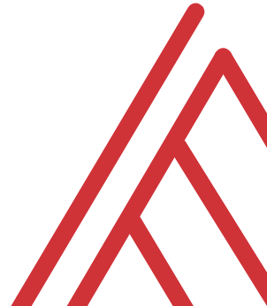
Questions?

