Slide 1


AI for Excel in a Week
Day 2: Power Query and Dataflows – The Preparation Layer
Notes:
Welcome to Day 2. Yesterday was about plumbing — getting Excel connected to Power BI and Dataverse so we have governed sources to work with. Today is about what every analyst privately knows: most of the job isn't analysis, it's cleaning up the mess before you can analyze anything.
Power Query is the tool that ends manual cleanup, and Dataflows are how you take that cleanup and lift it into the cloud so it works for everybody, automatically, on a schedule. By the end of today, you'll have built a real cleaning pipeline that the rest of your organization can plug into — and you'll have done it without writing a single line of traditional code.
I'll also weave in something important: every modern AI tool, including Copilot, is dramatically better when it's pointed at clean, structured data. Today is the day we earn the right to use AI well.

Slide 2

Day 1 recap
Connected Excel to Power BI + Dataverse
Moved data Excel → Power BI → Excel
Introduced semantic models for governed, shared data
Showed why clean, cloud data = better AI
Notes:
Quick anchor before we dive in. Yesterday we did three things.
One — we connected Excel to two cloud sources that matter: Power BI semantic models for governed analytics, and Dataverse for governed operational data. We saw that Excel doesn't have to be the destination anymore. It can be a starting point, a destination, or a window into something bigger.
Two — we walked through the round trip. Excel data model up to Power BI, then Power BI back into Excel as a live connection. Then we did the same with Dataverse. Different connections give you different things: semantic models give you a clean curated view, Dataverse gives you the full governed object with all its system columns intact. Knowing the difference is the foundation for everything else.
Three — and this is the bit I want you to carry into today — we tied it all to AI. Garbage in, garbage out, just faster. AI tools like Copilot are only as good as the data foundation underneath them. Today is the day we go build that foundation properly.

Slide 3
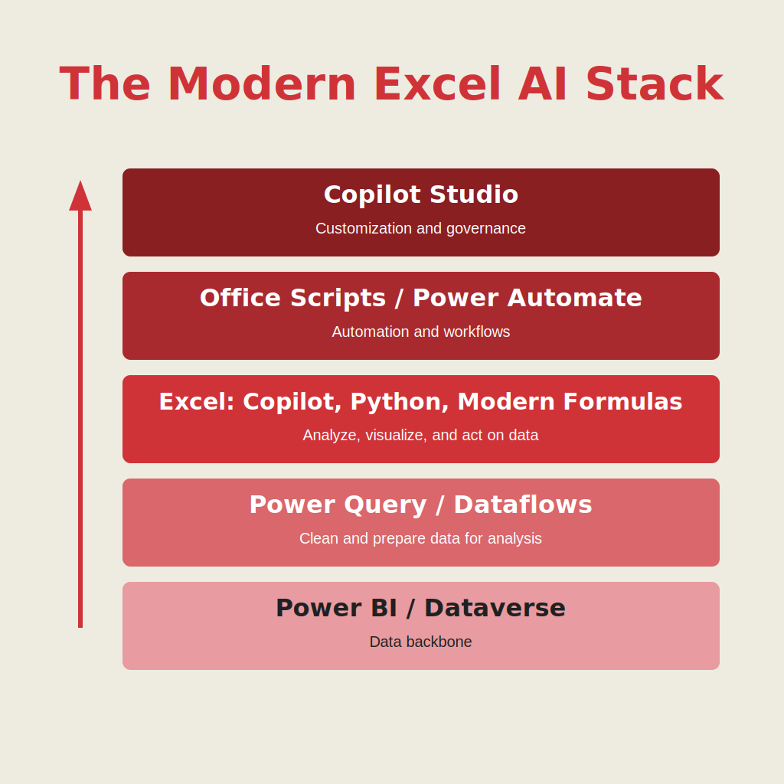
Welcome to the modern Excel AI stack
https://stringfestanalytics.com/how-to-understand-the-modern-excel-ai-stack/
Notes:
Same diagram as yesterday. Foundation, preparation, intelligence, execution, orchestration. Today we're climbing one rung up the ladder — from foundation to preparation. Power Query and Dataflows are the entire preparation layer.
The reason this matters: every layer above this one — the AI in Excel tomorrow, the automations on Thursday, the custom copilot on Friday — assumes that clean, refreshable, governed data already exists. Skip this rung and the whole stack wobbles.

Slide 4
Agenda for Day 2
Review common real-world data cleaning
Use Analyze Data to test “before vs after” data quality
Apply core transformations in Power Query
Push your cleaning logic to Dataflows in the cloud
Make clean, governed data available in Dataverse
Prep the foundation for Copilot Studio and the Power Platform
Notes:
Here's what today looks like. We'll start by looking at a deliberately messy real-world data file, and we'll point Copilot at it to see what happens when AI meets bad data. Spoiler: it falls apart in some pretty entertaining ways.
Then we'll fix the data — properly, in Power Query — using the core transformations every analyst should know. Unpivot, split, merge, types, names. Boring? A little. The most important skill in modern Excel? Yes.
Once the local cleanup works, we'll lift the same logic into a Dataflow. This is the mindset shift I want you to internalize today: Power Query in Excel cleans the file on your laptop, Dataflows clean the data source in the cloud for everybody. Same tool, completely different scale.
The cleaned table will land in Dataverse. Now it's governed, refreshable, secure, and shareable across Excel, Power BI, Power Automate, Copilot Studio, the works. By the end of the hour, you'll have built a real, production-grade data pipeline. And on Friday when we build a custom copilot, this is the table it's going to reach for.

Slide 5

Demo: Clean in Excel, scale to the cloud
Use Power Query in Excel to clean and shape an insurance claims dataset
Publish the same transformation logic to a Dataflow
Apply that logic to enterprise Dataverse tables
Show how one transformation can serve every workflow across the Power Platform
Workbook: wholesale-customers.xlsx
Notes:
Let me set the stakes for this demo first. The dataset we're using is structured the way real-world Excel files actually look — quarters spread across columns, inconsistent naming, the works. To a human eye it looks fine. To an AI tool it's a nightmare.
So step one, before we touch Power Query: I'm going to ask Copilot a couple of basic questions about this data and let you watch it stumble. "What are the total claims paid out?" "Show me all Q1 claims for David Lee." Copilot will try, but the wide quarterly layout completely confuses it. This isn't a knock on Copilot. It's a knock on the data structure. And it's the most important lesson of the week: AI doesn't fix bad data, it amplifies the consequences of bad data.
Then we'll bring Copilot back in as a thinking partner — not a fixer. I'll ask it to diagnose the issues, not solve them. It'll flag a bunch of stuff, but it'll usually miss the real problem, which is that those quarterly columns need to be unpivoted. That's a beautiful teaching moment: AI sees symptoms, humans see structure.
Then we go fix it for real in Power Query. Unpivot, rename, types, sort. I'll walk you through the steps slowly. The script you should end up with looks like the one in claims-data-pq-pre-copilot.txt.
Here's a fun trick: even though Copilot can't click around in Power Query, we CAN paste our M code into Copilot and ask it to clean up the script — better names, clearer structure, cleaner logic. Then we paste the improved version back into the Advanced Editor. That's a great example of using AI for what it's good at and not for what it isn't.
Once the local cleanup is solid, I'll show you how to lift the exact same logic into a Dataflow at make.powerapps.com. Same M code. Same transformations. But now it runs in the cloud, on a schedule, against the source file in OneDrive, and lands in Dataverse. One cleanup, used everywhere. That's the whole point of today.

Slide 6
So what for AI?
AI needs consistent, well-defined tables, not one-off cleanup
Dataflows give Copilot Studio reliable inputs for reasoning and actions
You cannot build strong copilots without strong data foundations
Notes:
Two minutes on why all of this matters for AI. AI tools — Copilot, Analyze Data, Python in Excel, agentic workflows — are not magic. They are pattern machines that need consistent, well-defined tables to reason over. They need to know that "Region" is always a column, that "Q1" isn't a column header, that customer IDs always look the same.
Dataflows are how you guarantee that consistency at scale. When your cleaning logic lives in a Dataflow, every consumer downstream — every Excel workbook, every Power BI report, every Copilot Studio agent — gets the same shape every time. That consistency is the difference between an AI experience that feels reliable and one that hallucinates.
This is the bigger message I want you to leave with today: you cannot build strong copilots without strong data foundations. Great AI experiences don't start with prompts. They start with clean, governed, cloud-based data. Everything we did today is the foundation for the smarter, more powerful copilots we'll build later in the week.

Slide 7
Day 3 preview: The intelligence layer with Excel
Use Copilot inside Excel to create formulas, charts, and insights
Run Python for analytics, modeling, and forecasting
See how Copilot handles multi step analytical tasks
Notes:
Quick preview of tomorrow. Day 3 is the intelligence layer — the part of the stack where Excel actually starts feeling like an AI tool.
We'll use Copilot directly inside Excel to generate formulas, build charts, and surface insights. You'll see how much faster everything goes when the data underneath is the kind of clean, structured table we built today.
We'll also dig into Python in Excel for the analytical work that goes beyond formulas — correlations, regressions, clustering, plotting. You don't need to be a programmer. We'll use Python the same way you use any other Excel feature.
And we'll spend real time on Agent Mode, which is the big addition this year. Agent Mode is what happens when Copilot stops being an assistant and starts being a junior analyst — planning, executing, and self-correcting through multi-step workflows on its own. That's where things get genuinely exciting.

Slide 8
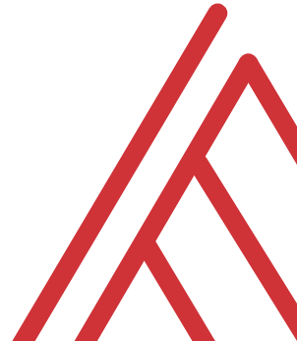
Questions?

Slide 9
THANK YOU

