Slide 1


AI for Excel in a Week
Day 4: Office Scripts and Power Automate – The Execution Layer
Notes:
Welcome to Day 4. This is the day Excel stops being a place you go and starts being a process that runs without you.
Yesterday we made Excel intelligent — Copilot, Python, Agent Mode. But intelligence without execution is just expensive thinking. Today we're closing that gap. Office Scripts capture the steps you take inside Excel; Power Automate runs those steps on triggers — schedules, file uploads, email arrivals, form submissions, you name it.
The other big focus today is what's new in Power Automate itself: it now has serious AI baked in. Copilot inside the flow designer can build flows from a sentence of plain English. AI Builder actions can extract, classify, summarize, and prompt right inside a flow. By the end of the hour you'll see how to combine an Office Script with an AI prompt action and a Teams notification — and that pattern alone will save most of you hours every week.

Slide 2

Recap of Day 3
Excel is now an intelligent workspace
But so what: how do you get data in, get results out, and connect it all?
Notes:
Quick anchor. Yesterday we made Excel intelligent.
Copilot inside Excel for fast formulas, charts, and explanations. Python in Excel for the deeper analytical work — correlations, plots, regressions, clustering. And Agent Mode, which is the new thing this year — it doesn't just answer prompts, it plans and executes whole multi-step workflows on its own. We watched it build a loan calculator, a variance analysis, and a financial close pack from a single prompt each.
That made Excel feel like an intelligent workspace, which it is. But here's the thing the day ended on: AI inside Excel can analyze, but it can't move data in, and it can't move results out. If you want Copilot's insights to actually change the business, something has to wire Excel to the rest of your tools. That's today.

Slide 3
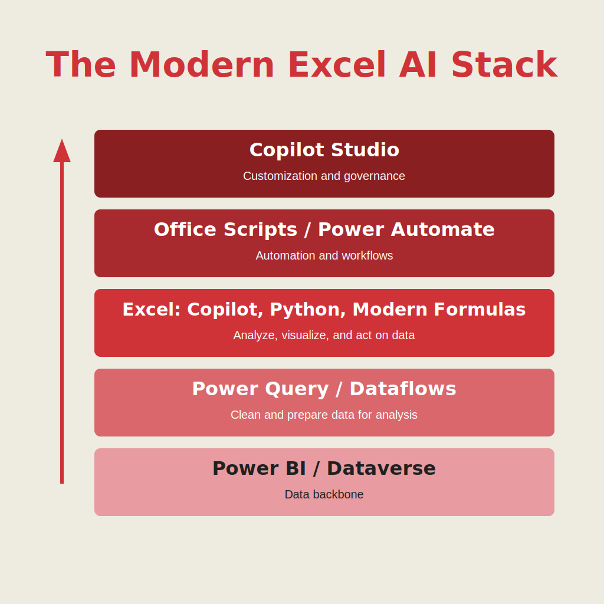
Welcome to the modern Excel AI stack
https://stringfestanalytics.com/how-to-understand-the-modern-excel-ai-stack/
Notes:
Same stack, climbing one more rung. Foundation, preparation, intelligence, execution, orchestration. We're now at execution. This is the layer that takes everything we built earlier in the week and makes it run on its own.
Office Scripts capture the steps inside Excel. Power Automate runs them outside Excel. Together, they're how analysts stop being the bottleneck. You build the logic once, and the system runs it forever.
And critically — Power Automate is increasingly an AI tool in its own right. Not just "trigger something, do something, end something." Modern flows can read documents, extract structured data, generate text, classify content, and call out to AI prompt actions in the middle of a process. We'll see all of that today.

Slide 4

Office Scripts + Power Automate, part 1
Run a TOC updater script on schedule
Files: power-automate-office-scripts.xlsx, add-toc.txt
Notes:
First demo. We're going to take a real, mildly annoying problem — keeping a table of contents in a multi-sheet workbook up to date — and turn it into something that runs by itself on a schedule.
Step one is the script. Open the workbook, go to the Automate tab, and either record a TOC update by clicking through it or paste in the script from add-toc.txt. Talk through what the script does line by line — it iterates through worksheets, builds a list of names and links, and writes them onto a TOC sheet. Office Scripts is TypeScript, but you don't have to write TypeScript to use it. You can record actions, edit the resulting code, and that's most of what you need.
Step two: take that script to the cloud. Save it to OneDrive so Power Automate can call it. Then over to make.powerautomate.com — create a new Scheduled cloud flow, point it at the workbook, and add an "Run script" action that calls our TOC script. Set the schedule.
Step three: run it manually first to confirm it works, then let the schedule take over. Now you have an Excel maintenance task that does itself. Forever. Without you.
The mental model I want you to leave with: anywhere in your week where you find yourself doing the same Excel clicks more than twice, that's a candidate for an Office Script + a flow. Today we're TOCs. Tomorrow it's monthly close prep. Next month it's that one report your boss never stops asking about.

Slide 5
Office Scripts + Power Automate, part 2
How can we apply the same script to multiple workbooks?
Use conditional logic to validate filetype
Folder: multiple-workbooks
Notes:
Second demo, building on the first. Same TOC script, but now: how do we apply it to multiple workbooks at once? This is where Power Automate stops being a fancy scheduler and starts being a real workflow engine.
The flow we'll build: trigger when a new file arrives in a specific OneDrive folder, validate it's an Excel file (this is the conditional logic part — you don't want the flow trying to update a TOC inside a PDF), then run the TOC script against the file, then move the processed file to an "Updated" subfolder. Optional bonus: post a confirmation message to a Teams channel.
The pattern you're learning here is what I call "fan-out automation" — one script, many files, one flow that orchestrates the whole thing. Once you've built it for TOCs you can swap in any other Office Script and the rest of the flow stays the same. That reusability is the magic.
Heads up: Power Automate has its own quirks around file picker actions vs path-based actions. I'll show you both and explain when to use each.

Slide 6
So what for AI?
AI gives insights: Scripts + Flows make them happen
Turns AI-generated logic into repeatable, scheduled workflows
Gives Copilot a place to hand off real work (refresh, clean, notify)
Builds the “execution layer” of the Modern Excel AI Stack.
Notes:
Here's where I want to land Day 4. AI is great at giving you insights — Copilot in Excel, Agent Mode, Python — but insights alone don't change the business. Someone, or something, has to actually do the work that turns an insight into a result.
That's the role of Office Scripts and Power Automate. They take Copilot-generated logic and run it on a schedule, with a trigger, against the right files, on behalf of the right people. They handle the boring-but-essential execution work that AI itself doesn't touch — refreshes, file routing, notifications, approvals.
But there's a second layer to this I want to underline: Power Automate is itself an AI platform now. With AI Builder actions and the new Copilot prompt actions, you can put intelligence directly inside the flow. A flow can read a PDF, extract the fields, ask an AI to classify the document, summarize the contents, and route it accordingly — all without a human in the loop. That's a profound change from Power Automate two years ago, and it's why Day 4 of this course got significantly more important this year.
Together, scripts and AI-powered flows form the execution layer of the Modern Excel AI Stack. They're what carries your insights out of Excel and into the real world.

Slide 7
Day 5 preview: The intelligence layer with Excel
Build your own Copilot for your team or department.
Connect it to Excel, Power Automate, Teams, and your data.
See how your Scripts + Flows become actions your Copilot can call.
Learn the orchestration layer, where AI starts coordinating your whole workflow.
Notes:
Quick preview of tomorrow, the final day. Day 5 is the orchestration layer — Copilot Studio.
This is where all the pieces come together. You're not just using Copilot anymore. You're building your own custom Copilot for your team or department. It's connected to Excel, Power Automate, Teams, SharePoint, Dataverse — wherever your work actually lives.
And here's the payoff for everything we've done this week: the Office Scripts you wrote today and the Power Automate flows you built today become actions your custom Copilot can call. Instead of you running the workflow, your Copilot becomes the coordinator. Pulling data, cleaning it, analyzing it, sending updates, triggering processes. End to end.
That's where AI stops being a helper and starts becoming a system. See you tomorrow.

Slide 8
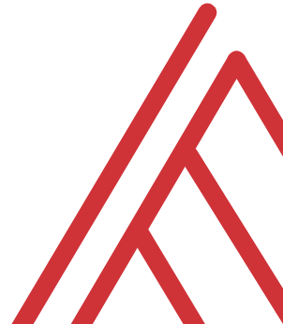
Questions?

Slide 9
THANK YOU

