Slide 1


AI for Excel in a Week
Day 5: Copilot Studio – The Orchestration Layer
Notes:
Welcome to the final day. Today is the payoff for everything we've built this week — the day where all five layers of the Modern Excel AI Stack snap together into something you can actually hand to a colleague.
Copilot Studio is Microsoft's tool for building custom AI agents — copilots that you design, that know your business, that connect to your data, and that can take actions on your behalf. We're going to build two of them today. First, a knowledge-grounded chatbot that answers questions from a curated source. Second, an automated workflow that uses an AI prompt action inside a flow to generate a report and post it to Teams.
By the end of this hour you'll have shipped a working Copilot. Not a demo, not a toy — a real one that runs on real data and produces a real result. And more importantly, you'll have a mental model for what's possible so you can go back to your team and start identifying the workflows that are worth building copilots around.

Slide 2

Class logistics
All recordings, files used and communication will be on Teams channel
Be sure to use your email used to sign up for the course!
Email me with any questions: george@stringfestanalytics.com
Notes:
Last day's housekeeping. Recordings stay up for 60 days minimum. Teams group stays up for 60 days. After class today I'll send a form for you to claim your ebook and your certificate of completion — that's where you'll choose Modern Data Analytics in Excel or one of my other titles.

Slide 3
Recap of Day 4
Turned Excel steps into reusable Office Scripts
Used Power Automate to run them on schedules or triggers
Connected Excel to Teams, Outlook, SharePoint, and other systems
Built the execution layer: AI → Scripted logic → automated Flows → real business actions.
Notes:
Yesterday we built the execution layer.
We turned ordinary Excel steps into Office Scripts — repeatable, reusable, cloud-stored versions of the things you do by hand every week. We used Power Automate to fire those scripts automatically, on schedules and on triggers like new files arriving in a folder. We connected the whole thing to Teams, Outlook, and SharePoint so the results actually reach the people who need them.
And we spent meaningful time on the new AI-powered side of Power Automate — Copilot in the flow designer that builds flows from plain English, AI Builder actions, prompt actions that let you put GPT-class intelligence in the middle of a workflow. Power Automate isn't just a scheduler anymore. It's an AI-native automation platform.
Together, all of that is the execution layer: AI gives us insights, scripts capture the steps, flows run the steps, and the business sees the result. Today we add the final layer on top — orchestration.

Slide 4
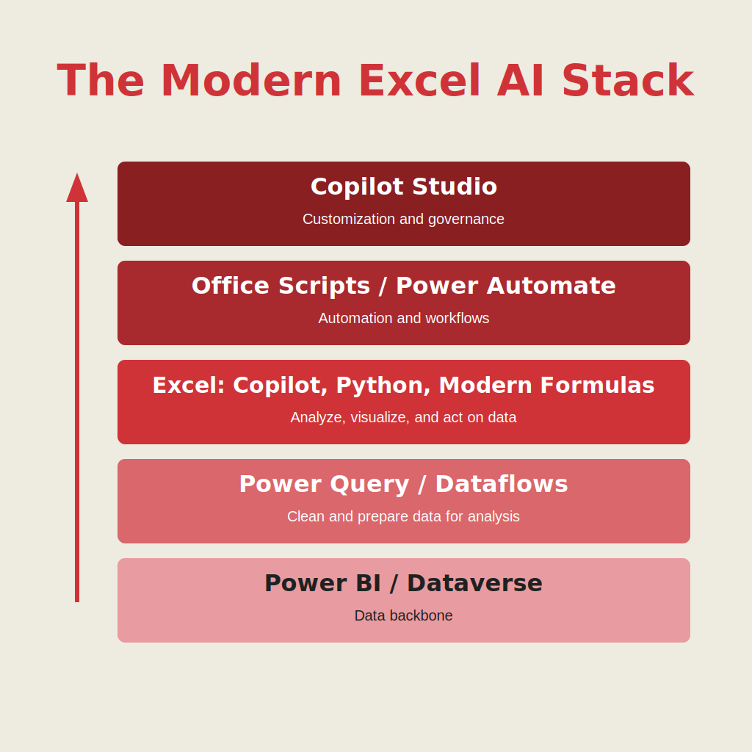
Welcome to the modern Excel AI stack
https://stringfestanalytics.com/how-to-understand-the-modern-excel-ai-stack/
Notes:
Final time we look at this diagram. Foundation, preparation, intelligence, execution, orchestration. Today we're climbing the last rung.
Orchestration is where everything we built earlier in the week becomes accessible to a non-technical user through a single interface. The custom Copilot we build today doesn't replace anything we did Days 1–4. It packages all of it. The Dataverse tables from Day 1, the Dataflows from Day 2, the Copilot prompts from Day 3, the scripts and flows from Day 4 — your custom Copilot can call any of them. From the user's perspective, they just type a question or click a button. From your perspective as the builder, you've coordinated a small orchestra.
That's why this is the orchestration layer. You're conducting.

Slide 5

Creating an Excel MVP chatbot
Create a custom Copilot agent in Copilot Studio tailored for specific Excel-related use cases
Add and manage trusted knowledge sources (like MVP websites) to ensure high-quality, domain-specific responses
Test and publish the agent with simple topics added
File: mvp-knowledge-base-instructions.docx
Notes:
First demo: building a knowledge-grounded chatbot. The use case is intentionally simple so we can focus on the mechanics — we're going to build a Copilot that answers questions about Excel by drawing on a curated set of MVP blog posts and websites as its knowledge base.
The instructions doc for this demo is mvp-knowledge-base-instructions.docx in the folder — that file walks through the exact knowledge sources, system prompt, and topic suggestions I want you to use.
Walk through the four pillars of any custom Copilot as we build: Instructions (the system prompt that tells the Copilot who it is and how to behave), Knowledge (the data sources it can search — websites, files, SharePoint, Dataverse), Topics (the predefined conversational paths it knows how to handle), and Actions (the things it can DO — call a flow, query a system, write back to a database). Today's demo focuses on Instructions and Knowledge. The Actions piece comes in the second demo.
After we publish, we'll test it together. I want you to ask it a few questions and watch how it cites its sources, how it stays within scope when you ask it something off-topic, and how it falls back gracefully when it doesn't know.
The big takeaway: a knowledge-grounded Copilot is the easiest, highest-value thing you can build for your team. Pick a domain where people ask the same question over and over, point a Copilot at the source of truth, and you've eliminated a recurring drain on someone's calendar.

Slide 6
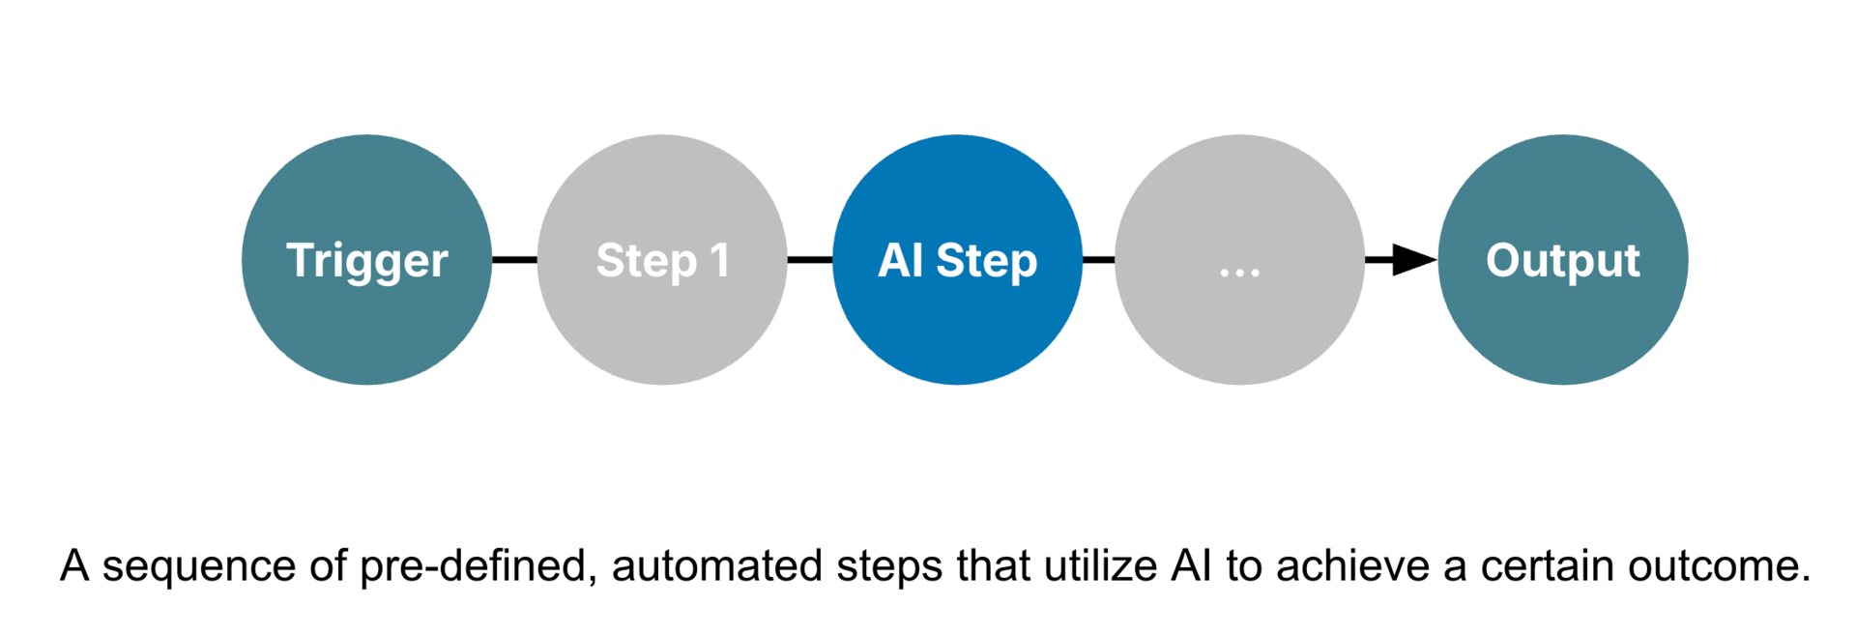
Automated AI workflows with Power Automate + Copilot
Source: https://blog.tobiaszwingmann.com/p/ai-workflows-vs-ai-agents-vs-everything-in-between
Notes:
Quick framing slide before the second demo. This diagram is from Tobias Zwingmann again — same author as the framework on Day 3.
What you're looking at is the anatomy of a modern AI workflow. It starts with a trigger — a file arriving, a schedule firing, a form being submitted. Then a preparation step — Power Automate grabs the data and shapes it. Then an AI step — this is the new part of the picture — where an AI model classifies, summarizes, extracts, or generates something. Then output steps — the result lands in Excel, in Teams, in SharePoint, in an email.
The key thing I want you to notice: this is a fixed sequence. You decide the steps in advance. The AI is a step inside the pipeline, not a brain that runs the pipeline. That's an important distinction, and it's what separates an "automated AI workflow" from an "agentic workflow," which we'll look at on the next slide.
Both have a place. Workflows are predictable and auditable, which is what most business processes need. Agents are flexible and adaptive, which is what some processes need. Knowing which to reach for is half the skill.

Slide 7
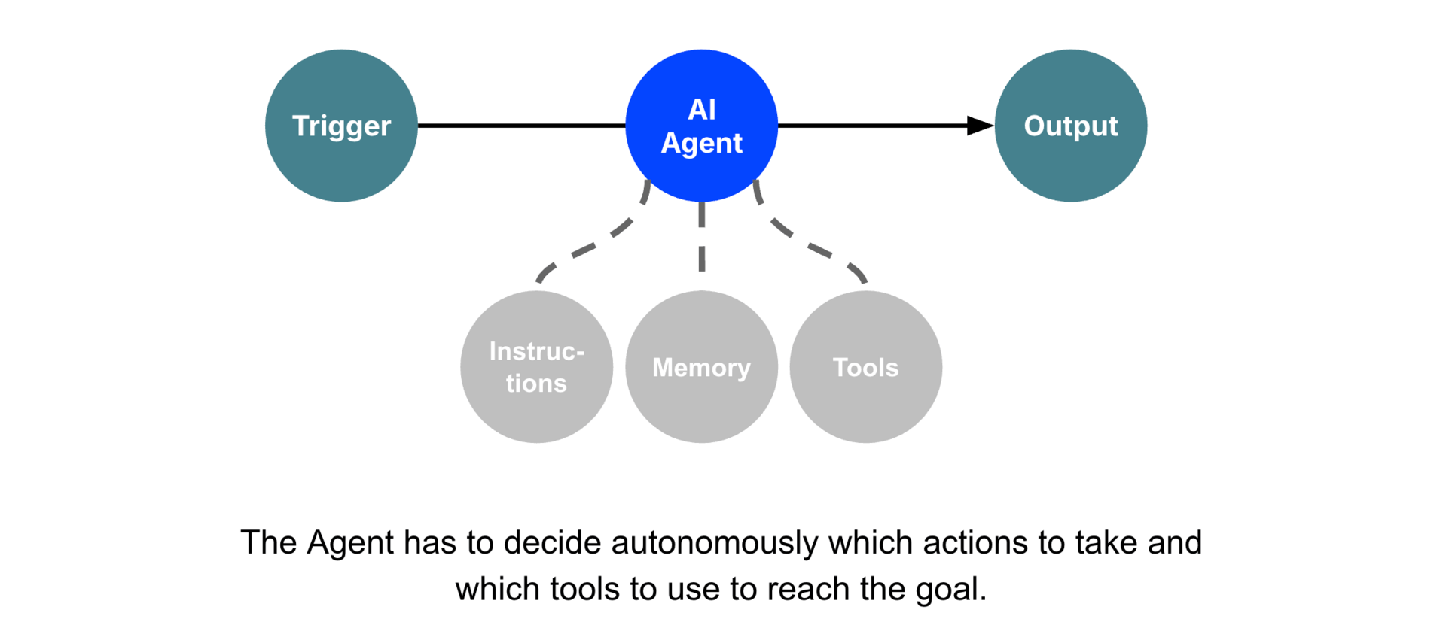
Agentic workflows with Copilot Studio + Agent Flows
Source: https://blog.tobiaszwingmann.com/p/ai-workflows-vs-ai-agents-vs-everything-in-between
Notes:
And here's the contrast — agentic workflows. Same starting point, a trigger fires. But now control passes to an AI agent, and the agent decides what to do.
Notice what the agent has access to: instructions you wrote, memory it can read and update, and a set of tools it's allowed to use — connectors, APIs, flows, retrieval sources. The agent's job is to figure out, in real time, which tools to use and in what order to reach the goal you set. It can adjust as it goes. It can retry. It can choose to ask the user a clarifying question. It can chain steps you didn't anticipate.
That's a big shift. In a workflow you decide the path. In an agent you decide the goal and the agent decides the path.
And here's the part that matters for us: even though we're building this in Copilot Studio with Power Platform plumbing, the workflow can be agent-like. Your custom Copilot can plan its own multi-step responses against the actions and knowledge you've given it. It's not just answering questions. It's executing on behalf of the user.
That's the orchestration we've been building toward all week.

Slide 8
Building and deploying an AI-powered workflow
Dataset: autompg.xlsx
Load Excel data into Dataverse
Create a flow in Power Automate
Run AI prompt as part of the flow
Switch prompt to structured JSON output
Build and map an Adaptive Card for Teams
Run the flow and review the generated report
Notes:
Second demo. This is the more ambitious one and it pulls together everything we've built this week.
The scenario: we have data in Excel — autompg.xlsx — and we want a workflow that, on demand, runs an AI prompt against that data, generates a structured report, and posts it as a Teams Adaptive Card to a specific channel.
Step one: load the autompg data into Dataverse so it's a governed table our flow can read. (Day 1 territory.)
Step two: create a new flow in Power Automate. Trigger is a manual button for now — production, you'd swap this for a schedule or another trigger.
Step three: add a Copilot prompt action and write a prompt that asks the AI to analyze the autompg data and produce a summary of fuel-efficiency trends by year and origin. Run it once and look at the unstructured response. It's... fine.
Step four: switch the prompt to structured JSON output. This is the key trick of the day — when you tell the AI to return JSON with specific fields, you can map those fields directly into downstream actions. It's the difference between "AI sometimes" and "AI in production."
Step five: build an Adaptive Card in Teams that maps each JSON field into a card row. Title, key insights, top three models, recommendation. Visually clean.
Step six: run the flow and watch the card show up in Teams.
What you've just built: a Copilot Studio-adjacent workflow that takes data from Dataverse, runs it through an AI model, structures the result, and delivers it to where your team actually works. That's the entire stack from Day 1 to Day 5 firing in sequence. Take a moment to appreciate it.

Slide 9
So what for AI?
Turn everything from Days 1–4 into a working AI assistant
Build copilots that run multi-step workflows across Excel + Teams + Power Automate
Package your scripts and flows into reusable actions anyone can trigger
Use agents to create always-on automations that monitor and respond
Shift from AI giving answers to AI getting work done for you
Notes:
Closing thought for the week. Everything we've done from Day 1 to today comes together in this one slide.
You started Monday by connecting Excel to governed data sources. You spent Tuesday cleaning and shaping that data into something AI can actually reason over. Wednesday you used Copilot, Python, and Agent Mode to extract intelligence from the clean data. Thursday you wrapped that intelligence in scripts and flows so it could run on its own. And today you packaged the whole thing inside a custom Copilot that anyone on your team can use without knowing how the plumbing works.
That's the Modern Excel AI Stack. Five layers, all of which exist already, all of which you now have hands-on experience with.
The biggest mindset shift I want you to leave with this week: AI isn't a feature you bolt onto Excel. It's a pattern of working that touches every layer of your data stack. The people who get the most out of AI aren't the ones who write the cleverest prompts. They're the ones who build the cleanest foundations underneath those prompts.
Go back to work next week and pick one workflow. Just one. The one where you find yourself thinking "I can't believe I still do this by hand." And rebuild it using what you've learned. That's how this course pays off.

Slide 10
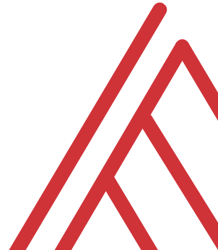
Questions?

Slide 11
Final course logistics
All course recordings will stay up for at least 60 days
I will keep the Teams group up for at least 60 days
Please fill out the form I will send to claim your ebook and certificate
Notes:
Thank you for being part of this cohort. Recordings and Teams group stay up for 60 days minimum. I'll send a form for your ebook claim — Modern Data Analytics in Excel is the default but if you'd rather have a different title from my catalog, the form has options. You'll also get a certificate of completion you can post to LinkedIn.
If you got value from this week, the single most helpful thing you can do for me is leave a recommendation on LinkedIn or refer a colleague to the next cohort. And if something didn't land — if a topic was too fast, too slow, too shallow, too deep — please email me. I rebuild this course every cohort and your feedback is exactly what makes it better.
Thank you. Genuinely.

Slide 12
THANK YOU!

