Slide 1


AI for Excel in a Week
Day 3: The Excel Intelligence Layer – Copilot, Python, Agent Mode

Slide 2

Class logistics
All recordings, files used and communication will be on Teams channel
  Be sure to use your email used to sign up for the course!
  Email me with any questions: george@stringfestanalytics.com

Slide 3

Welcome to the modern Excel AI stack
https://stringfestanalytics.com/how-to-understand-the-modern-excel-ai-stack/

Slide 4
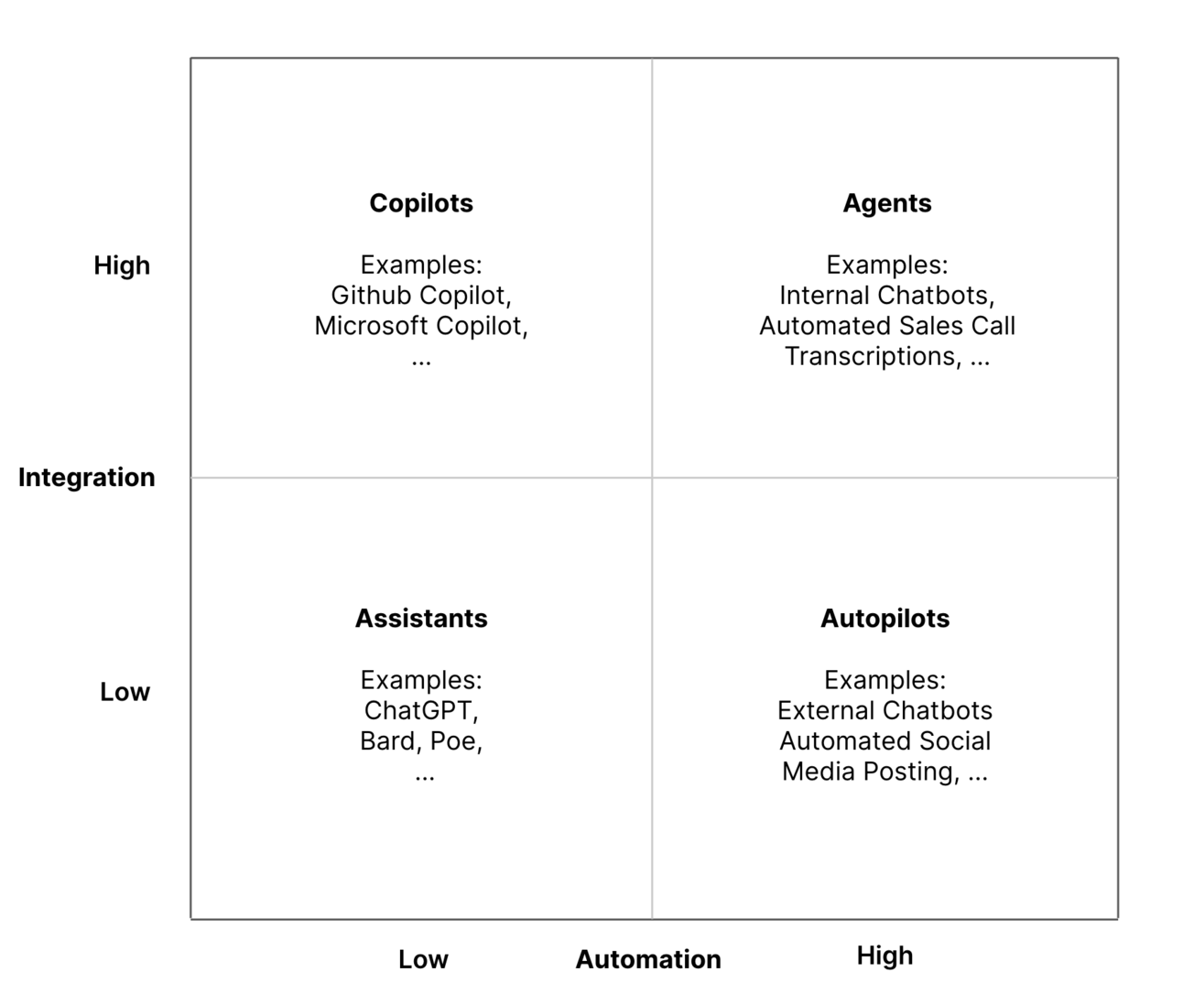
The integration-automation AI framework
https://blog.tobiaszwingmann.com/p/integration-automation-ai-framework
Notes:
This chart shows the spectrum of AI tools based on two dimensions: how deeply they’re integrated into your workflow, and how much they can automate on their own.
In the bottom left, we have Assistants like ChatGPT or Bard. These tools are conversational and flexible, but they exist outside your main work environment. They can generate ideas, write text, or help explain concepts, but you have to feed them the context yourself. They don’t automatically connect to your files or data.
Moving up to the top left are Copilots, like Microsoft Copilot in Excel. These tools are highly integrated into your daily work tools. Copilot in Excel knows your workbook, formulas, and tables. It can help you analyze data, write formulas, and generate summaries—all inside Excel. But it’s still assistive, not autonomous. You’re in control, and it only acts when you prompt it.
On the bottom right are Autopilots, which handle repetitive processes automatically but without much awareness of your data. These might include automated social media posting or simple scheduled tasks. They act independently but lack real integration with your work context.
Finally, in the top right are Agents. These combine deep integration with high automation. Agents can understand your business data and act proactively—like automatically generating reports, summarizing meetings, or triggering workflows across apps.
Copilot in Excel sits in the “Copilot” quadrant—it’s deeply embedded in your tools but still relies on you to guide it. Agent Mode is what happens when that same intelligence gains the ability to take initiative. It builds on Copilot’s understanding of your data but can connect across multiple apps and act without waiting for your command.
In short, Copilot helps you do the work; Agent Mode will start doing the work for you.

Slide 5

Studying penguins with Copilot
Workbook: penguins.xlsx
Getting data Copilot-friendly
Formatting data as a Table
Creating calculated columns
Building summary charts
Using PivotTables
Exploring advanced analysis with Python in Excel

Slide 6
Excel Copilot vs Excel Agent Mode
Feature | Excel Copilot | Agent Mode
Interaction | One-shot prompts | Iterative, self-guided workflow
Task Scope | Single actions (formulas, charts, summaries) | Multi-step processes across sheets
Error Handling | User re-prompts or fixes | Agent reviews, retries, self-corrects
User Role | You do, Copilot helps | You manage, Agent executes
Output Quality | Fast but shallow | Verified and repeatable
Best For | Quick wins, ad-hoc tasks | Structured, high-stakes workflows
Analogy | Smart assistant | Junior analyst
Notes:
When people hear Copilot and Agent Mode, they often assume they are the same thing, but they represent very different stages in how AI works inside Excel.
Copilot is what most of us have used so far. It is a great assistant when you need to generate a formula, summarize some data, or clean up a quick report. You ask it a question, it gives an answer, and then it is up to you to decide what to do next. It is reactive. It waits for your prompt each time.
Agent Mode takes this a step further. Instead of a single prompt and response, the agent can plan, execute, and evaluate multiple steps on its own. It does not just answer you, it actually works with you, refining its approach until it gets the result right. Think of it as the difference between giving someone an instruction versus giving them a project.
That also changes your role as the analyst. With Copilot, you are still the one doing the work, just faster. With Agent Mode, you become more of a manager or reviewer, someone who guides, oversees, and checks the agent’s work. The focus shifts from “Can I get this formula right?” to “Can I structure and verify the workflow my agent is running?”
In terms of output, Copilot is great for speed. You will get something usable right away. Agent Mode is built for reliability. It double checks itself, validates formulas, and produces outputs that are more auditable and refreshable. That is what makes it better suited for more complex or higher stakes workflows like financial models, reconciliations, or recurring dashboards.
So the short version is: Copilot accelerates your work. Agent Mode begins to do the work. The real opportunity for Excel professionals is learning how to manage and guide these new digital teammates effectively.

Slide 7
Demo: Agent Mode in action
Loan calculator
Variance analysis
Monthly close pack
What does Agent Mode do well, poorly, or not at all?
How does this relate to other tools in the Excel AI stack?

Slide 8
So what for AI?
AI in Excel is only one layer of the workflow
You still need to get data in, secure it, and move it across systems
Power Automate connects Excel logic to real business processes
Dataverse keeps everything consistent so AI can trust your data
These tools together make AI reliable, scalable, and production ready

Slide 9
Day 4 preview: Turning analysis into action
Office Scripts automate the clicks and steps you already take in Excel
Power Automate turns those scripts into real workflows that run on their own
Flows push data and results to Teams, Outlook, SharePoint and more
Together they form the execution layer that carries your work beyond the workbook

Slide 10

Questions?

Slide 11
THANK YOU

