Slide 1


AI for Excel in a Week
Day 1: Power BI and Dataverse – The Foundation Layer

Slide 2
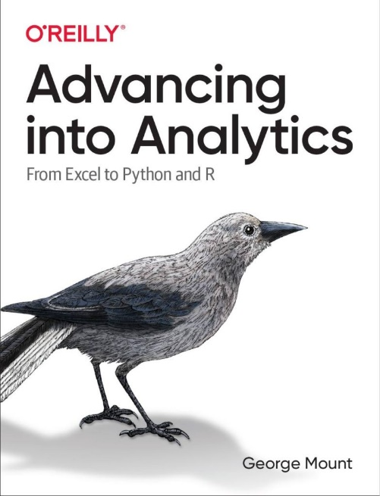
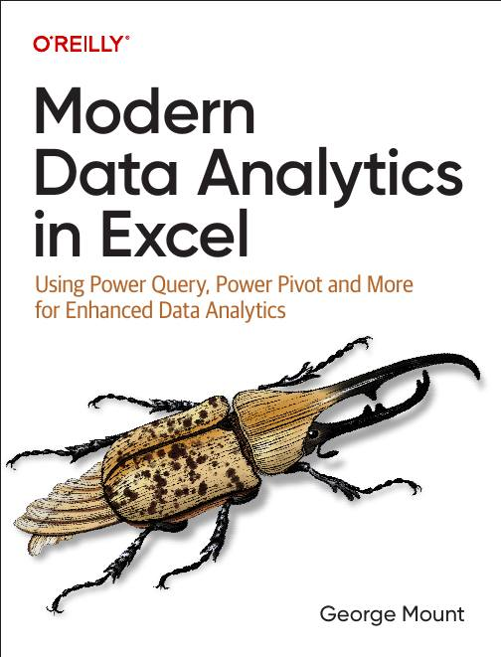



About me

Slide 3

Objectives for this course
Connect Excel to Power BI and Dataverse for live, governed data
Build repeatable cleaning workflows with Power Query and Dataflows
Use Copilot, Python, and Agent Mode for analysis and forecasting
Automate Excel tasks with Office Scripts and Power Automate
Build and connect custom copilots in Copilot Studio for real workflows

Slide 4
Class logistics
All meetings will be on Teams URL
All recordings and messages will be sent to the email you used to register
  Email me with any questions: george@stringfestanalytics.com

Slide 5

Welcome to the modern Excel AI stack
https://stringfestanalytics.com/how-to-understand-the-modern-excel-ai-stack/

Slide 6
Demo: to Excel and back
Excel data model to Power BI semantic model
Power BI back to Excel
(tomorrow) Excel to Dataverse
(instructor demo) Dataverse to Excel
What’s the takeaway for AI?
Workbook: superstore.xlsx
Notes:
https://chatgpt.com/c/691fb29d-0794-8331-95af-5fa280ce17fb

Slide 7
So what for AI?
AI depends on clean, governed, trusted data
Cloud connected Excel gives Copilot real context and structure
Semantic models teach AI the meaning of your data
Dataverse provides consistent tables and relationships AI can use
Better data foundations mean better prompts, better answers, fewer errors
Notes:
AI depends on clean, governed, trusted data
When people think “AI,” they think prompts — but the real magic actually comes from your data foundation. Copilot can only work with what you give it. If your data is messy, inconsistent, or missing key fields, your AI results will reflect that. Garbage in, garbage out… just faster.
Cloud-connected Excel gives Copilot real context and structure
When your workbook is connected to the cloud — OneDrive, SharePoint, Fabric, Dataverse — Excel actually knows what your tables are, how they relate, and how often they change. That gives Copilot a stable structure to work with instead of trying to interpret a bunch of disconnected spreadsheets.
Semantic models teach AI the meaning of your data
A semantic model is basically the “brain” of your data: it defines your tables, your relationships, your measures, and your business logic. When you connect to a Power BI semantic model from Excel, Copilot can reason about the meaning behind your fields — not just their labels. It understands what “Revenue,” “Customer,” or “Region” actually mean in your organization.
Dataverse provides consistent tables and relationships AI can use
Dataverse is your governed, standardized data layer. Everything has proper types, relationships, and metadata. When Excel pulls from Dataverse, Copilot works with data that’s already clean and modeled, instead of 50 different versions of the same dataset floating around in personal spreadsheets.
Better data foundations mean better prompts, better answers, fewer errors
At the end of the day, strong data foundations make you look like a genius with AI. Prompts land more accurately. Copilot produces cleaner results. And you spend far less time debugging formulas or rewriting analyses. This is why Modern Excel isn’t just about AI — it’s about preparing your data so AI can actually help you.

Slide 8
Day 2 preview: Data cleaning the modern way
Build repeatable cleaning and shaping steps with Power Query
Publish transformations to the cloud as Dataflows
Feed clean, certified data into Excel and Power BI
Set the stage for reliable AI, automation, and reporting
Notes:
Day 2 preview: Data cleaning the modern way
Tomorrow we shift from “what AI needs” to “how we actually get there.” The modern data stack starts with cleaning and shaping your raw data so everything downstream — AI, automation, reporting — actually works.
Build repeatable cleaning and shaping steps with Power Query
Power Query is where you stop fixing data manually. Every transformation you apply — splitting columns, fixing data types, removing errors — is recorded as a step. So instead of rebuilding cleanup every week, you just click Refresh. This is where analysts start saving hours per report.
Publish transformations to the cloud as Dataflows
Once your Power Query steps are working locally, you can publish them as Dataflows in the cloud. That turns your one-off cleanup into a reusable, centralized process that your whole team can use. It’s the same logic, just elevated from “my file” to “our shared data pipeline.”
Feed clean, certified data into Excel and Power BI
With Dataflows, the clean data becomes a source you can pull into both Excel and Power BI — and you know everyone is pulling the same, consistent version. No more email attachments and no more “which file is the right one?”
Set the stage for reliable AI, automation, and reporting
When your cleanup is automated and standardized, everything built on top of it becomes more reliable. Copilot works better. Office Scripts and Power Automate flows work better. And your reports stop breaking the night before the meeting. Clean data isn’t glamorous, but it’s the foundation of every good AI workflow.

Slide 9

Questions?

Slide 10
THANK YOU

