Slide 1


AI for Excel in a Week
Day 5: Copilot Studio – The Orchestration Layer

Slide 2

Class logistics
All recordings, files used and communication will be on Teams channel
  Be sure to use your email used to sign up for the course!
  Email me with any questions: george@stringfestanalytics.com

Slide 3
Recap of Day 4
Turned Excel steps into reusable Office Scripts
Used Power Automate to run them on schedules or triggers
Connected Excel to Teams, Outlook, SharePoint, and other systems
Built the execution layer: AI → Scripted logic → automated Flows → real business actions.
Notes:
Day 4 was all about taking the logic we build in Excel and making it actually run without us.
We started by turning normal Excel steps into Office Scripts — the repeatable, reusable version of what you already do by hand.
Then we used Power Automate to fire those scripts automatically, either on a schedule or when something happens: a file lands in a folder, a form is submitted, a report needs refreshing.
We also saw how flows push results out into the real world — Teams messages, Outlook notifications, SharePoint updates, whatever the process needs.
Together, this becomes the execution layer:
AI gives us insights, scripts define the steps, flows run the steps, and the business actually sees the result.

Slide 4

Welcome to the modern Excel AI stack
https://stringfestanalytics.com/how-to-understand-the-modern-excel-ai-stack/

Slide 5

Creating an Excel MVP chatbot
Create a custom Copilot agent in Copilot Studio tailored for specific Excel-related use cases
Add and manage trusted knowledge sources (like MVP websites) to ensure high-quality, domain-specific responses
Test and publish the agent with simple topics added
File: mvp-knowledge-base-instructions.docx
Notes:
False!
Function, Formula, Function
Argument

Slide 6
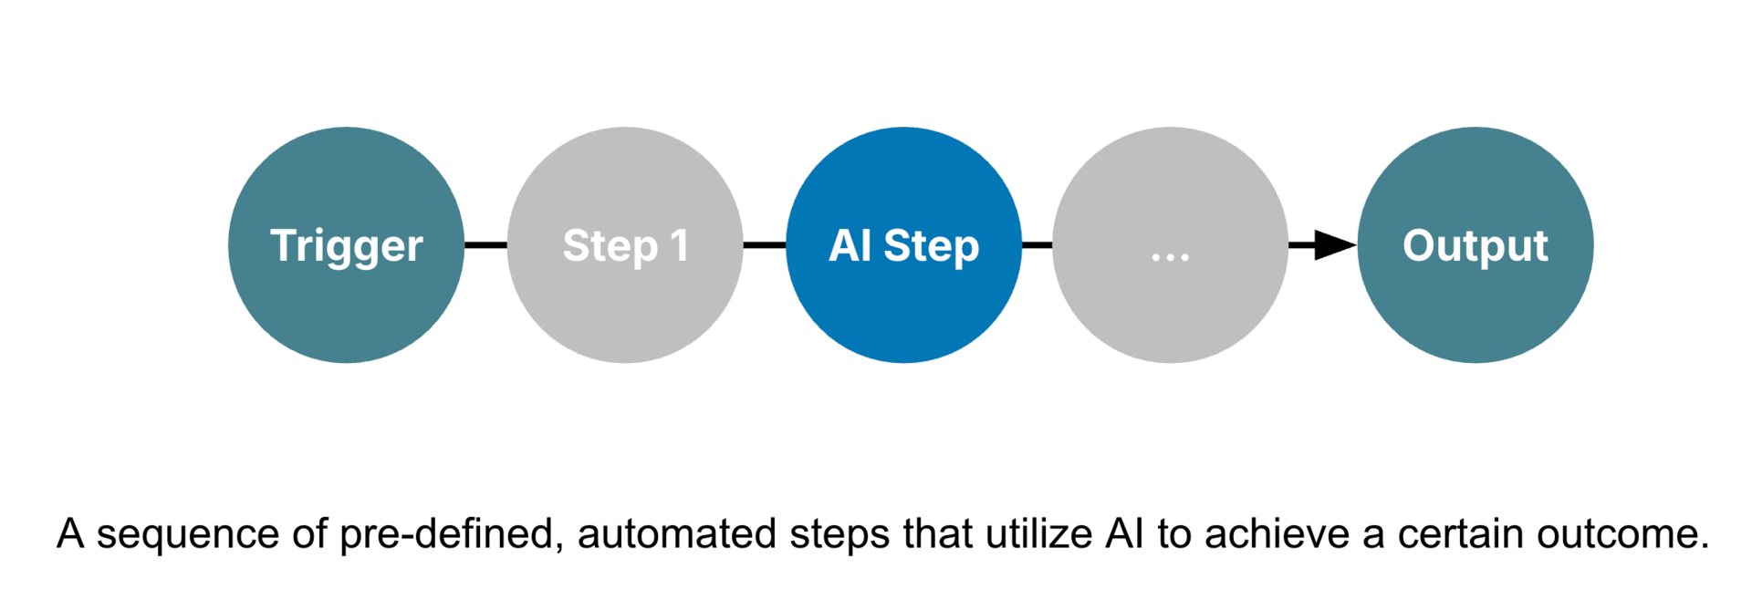
Automated AI workflows with Power Automate + Copilot
Source: https://blog.tobiaszwingmann.com/p/ai-workflows-vs-ai-agents-vs-everything-in-between
Notes:
This diagram shows what an automated AI workflow looks like — a sequence of predefined steps that move from a trigger to a final output. You can think of it as a chain reaction: something starts the process, different actions happen automatically, and along the way, AI steps in to add intelligence or decision-making.
It all begins with a trigger — something that tells the workflow to start. In Excel or Power Automate, that could be a new row added to a table, a file uploaded to OneDrive, or even a scheduled time like “every Monday morning.” The trigger is what kicks everything off without you having to manually do anything.
Then we have Step 1, which is often a preparation step. Maybe it’s collecting the data, formatting it, or sending it into Excel. This could be where Power Automate connects to a SharePoint list, a form submission, or a Teams message and feeds that data into your workbook.
Next comes the AI Step — this is where Copilot or another AI model gets involved. This could be an AI Builder action inside Power Automate that summarizes text, classifies feedback, or extracts key details from a document. Or it might be Copilot inside Excel generating a formula, building a chart, or explaining data patterns automatically. The AI step takes what used to be manual analysis and turns it into an automated, intelligent action.
After that, there can be more steps — maybe sending results back to Excel, notifying someone in Teams, or updating a dashboard. Each step builds on the last, flowing seamlessly without human intervention.
Finally, we reach the output, which is the end goal of the automation. That might be a refreshed Excel report, an email summary, or a new dataset ready for review. The beauty of it is that the whole process runs automatically once it’s designed — no constant copying, pasting, or checking formulas.
So, in short, this kind of workflow connects automation tools like Power Automate with AI capabilities from Copilot or AI Builder to take everyday Excel tasks — things like reporting, data cleaning, or summarizing — and turn them into intelligent, repeatable processes.

Slide 7
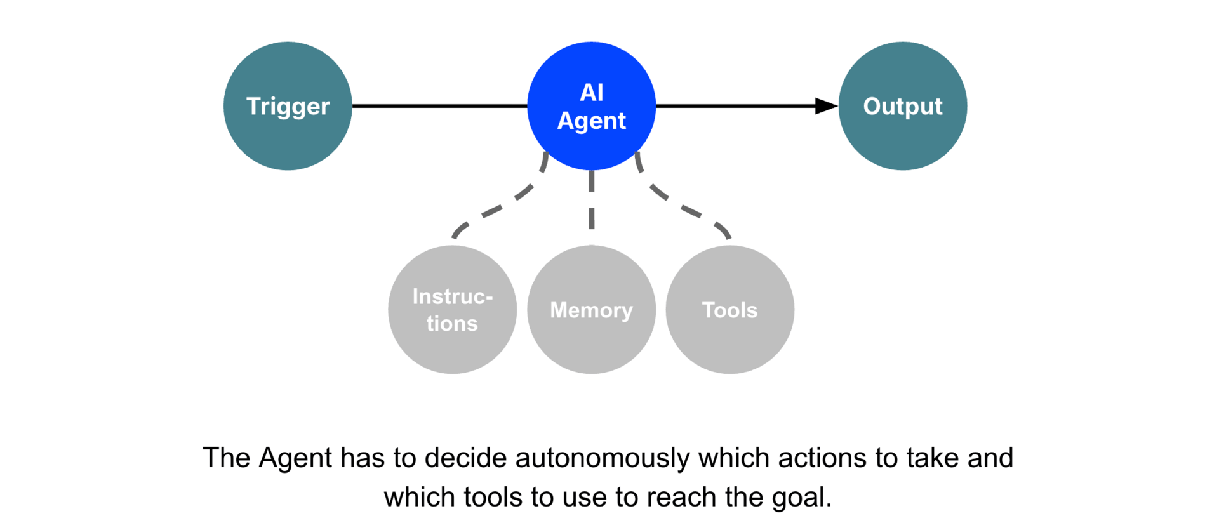
Agentic workflows with Copilot Studio + Agent Flows
Source: https://blog.tobiaszwingmann.com/p/ai-workflows-vs-ai-agents-vs-everything-in-between
Notes:
This diagram shows the core idea behind an agentic workflow. Everything starts with a trigger. That could be a scheduled time, a user action, an event in another system, or even a message. Once the trigger fires, control passes to the AI agent.The agent’s job is to figure out the steps needed to reach the goal. And the important part is that the agent isn’t just following a script. It can draw on three things: the instructions you gave it, the memory it has access to, and the tools it’s allowed to use. Those might include connectors, APIs, retrieval sources, or actions in Power Automate.From there, the agent decides which actions to take and in what order. It keeps adjusting based on the context it sees, and it keeps working until it produces an output. That output might be a document, a dataset, a message, an update in a system, or something else entirely.So even though we’re building this in Copilot Studio, the workflow here is very agent-like. It’s not just a single prompt. It’s a goal-directed system that figures out the how on its own.

Slide 8
Building and deploying an AI-powered workflow
Dataset: autompg.xlsx
Load Excel data into Dataverse
Create a flow in Power Automate
Run AI prompt as part of the flow
Switch prompt to structured JSON output
Build and map an Adaptive Card for Teams
Run the flow and review the generated report
Notes:
False!
Function, Formula, Function
Argument

Slide 9
So what for AI?
Turn everything from Days 1–4 into a working AI assistant
Build copilots that run multi-step workflows across Excel + Teams + Power Automate
Package your scripts and flows into reusable actions anyone can trigger
Use agents to create always-on automations that monitor and respond
Shift from AI giving answers to AI getting work done for you
Notes:
Today is where everything from Days 1–4 comes together.
We’re not just using Copilot anymore — we’re turning the whole stack into a working AI assistant.
You’ll see how to build copilots that run multi-step workflows across Excel, Teams, and Power Automate, using the scripts and flows you already created.
All that logic becomes reusable actions your Copilot can call on demand, so anyone on your team can trigger a full workflow without knowing how it works underneath.
And with agents, those workflows can even stay “always on,” monitoring for changes and responding automatically.
This is the shift from AI giving you answers… to AI actually getting work done for you.

Slide 10

Questions?

Slide 11
Final course logistics
All course recordings will stay up for at least 60 days
I will keep the Teams group up for at least 60 days
Please fill out the form I will send to claim your ebook and certificate
Notes:
There will be a line item in there if you want something BESIDES Modern Analytics in Excel book

Slide 12
THANK YOU

Slide 13
THANK YOU
SERIOUSLY, THANK YOU!

