Slide 1
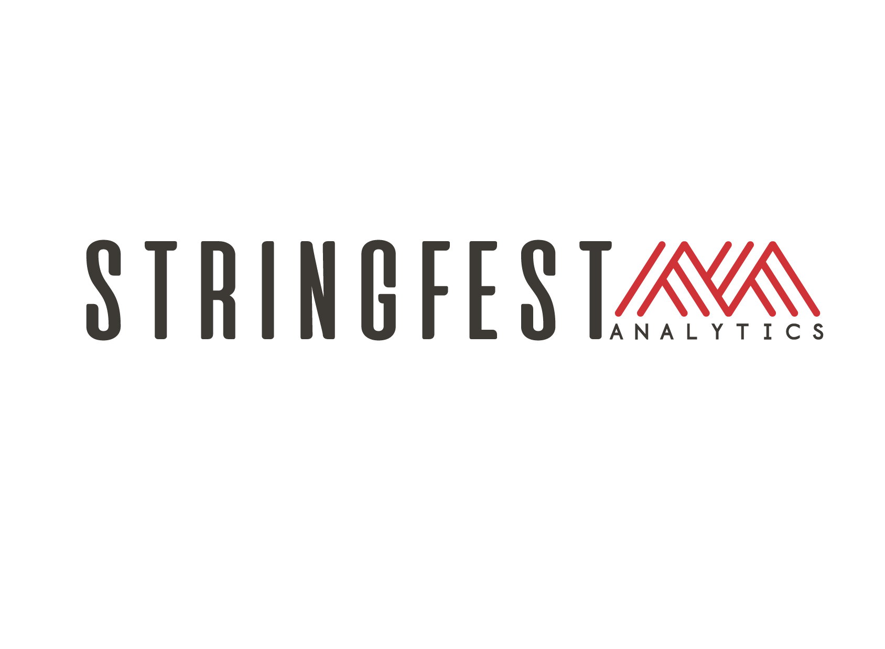
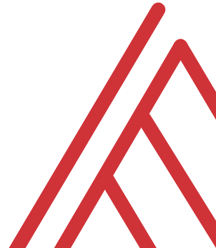
Advancing into Analytics: From Excel to R and Python
Week 1 Bootcamp

Slide 2
Learning objectives
Situate Excel, R and Python in the data analytics stack
Prepare a Windows computer to work in all three
Run summary statistics on a dataset in all three

Slide 3

It’s all about the audience
What makes them money?
What keeps their boss or customers happy?
What do they assume to be true?
What does it mean if they’re wrong?
https://corporate.discovery.com/blog/2016/03/01/mythbusters-goes-out-with-a-bang/

Slide 4
Learning objectives
Situate Excel, R and Python in the data analytics stack
Prepare a Windows computer to work in all three
Run summary statistics on a dataset in all three

Slide 5

What’s in a dataset?
Variables… vary
Observations… are observed

Slide 6
What’s in an eda?
Interview the data:
What sorts of stories are possible?
What types of variables are there?
How can we “summarize” them (frequencies, descriptive statistics, etc.)?
How can we depict them visually?

Slide 7
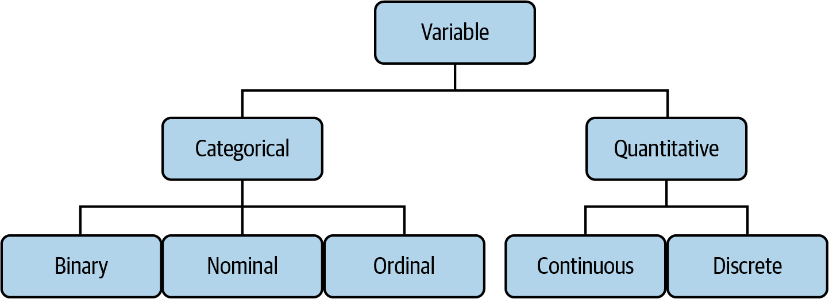
The tree of data
Mount, George. Advancing into Analytics: From Excel to Python and R. O’Reilly Media, 2021
Notes:
Now this figure comes from my book and it’s a very broad conceptualization of the various slices of the stack. You know we hear engineers or web developers talk about being “full stack” all the time but it’s not so common an expression as it could be.

Slide 8
“How much?”
Mount, George. Advancing into Analytics: From Excel to Python and R. O’Reilly Media, 2021
Notes:
Now this figure comes from my book and it’s a very broad conceptualization of the various slices of the stack. You know we hear engineers or web developers talk about being “full stack” all the time but it’s not so common an expression as it could be.

Slide 9
“How much/how many?”
Mount, George. Advancing into Analytics: From Excel to Python and R. O’Reilly Media, 2021
Notes:
Now this figure comes from my book and it’s a very broad conceptualization of the various slices of the stack. You know we hear engineers or web developers talk about being “full stack” all the time but it’s not so common an expression as it could be.

Slide 10

Drill
File: titanic.xlsx
Categorize each variable
Notes:
OK so now you will see R’s equivalent to some of those features you saw with Python. I think that for different reasons Python seems to be taking the lead on Excel automation, but R has some pretty robust features and in some ways are richer than Python’s.

Slide 11
Demo
Summarizing categorical variables
How many
Notes:
OK so now you will see R’s equivalent to some of those features you saw with Python. I think that for different reasons Python seems to be taking the lead on Excel automation, but R has some pretty robust features and in some ways are richer than Python’s.

Slide 12
Questions?

Slide 13
Have you downloaded the Analysis ToolPak?
https://bit.ly/3jZaw9X

Slide 14
Conclusion/Next steps

Slide 15
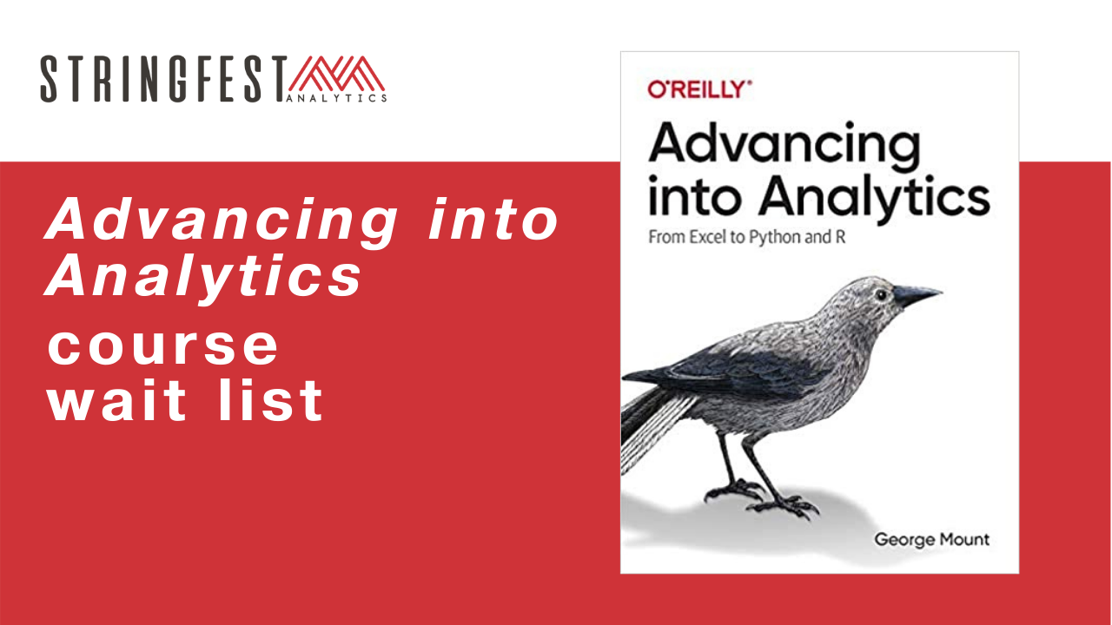
Want more?
Sign up for course waiting list: https://stringfestanalytics.com/aina-waiting/
Notes:
By the end of this book, you should be able to conduct exploratory data analysis and
hypothesis testing using a programming language.

Slide 16
Event survey: https://forms.office.com/r/0ZnD0LxpZy

Slide 17
Questions?

Slide 18
THANK YOU
george@stringfestanalytics.com
linkedin.com/in/gjmount
stringfestanalytics.com/contact

