Slide 1

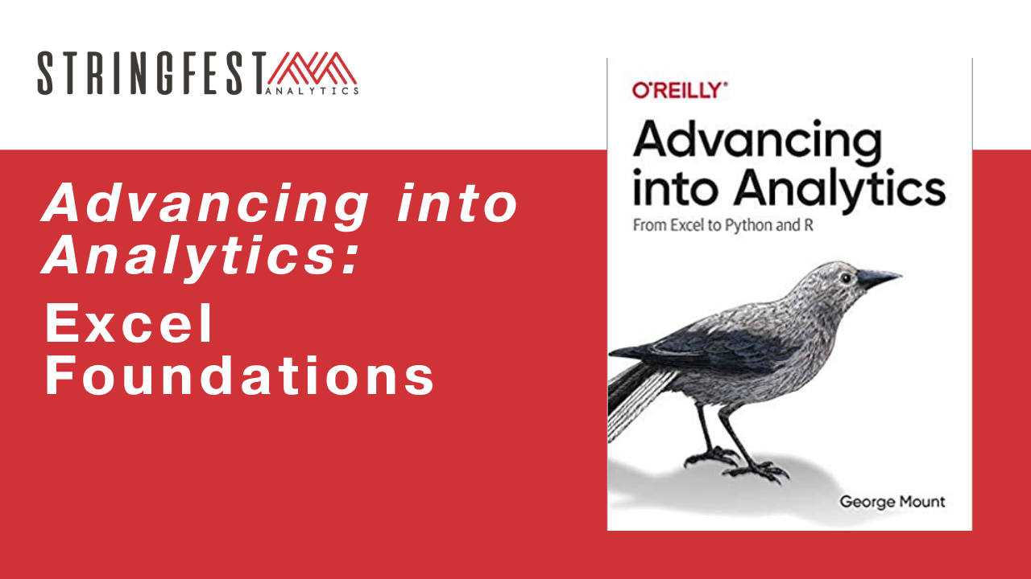
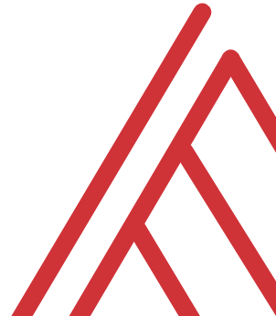
Advancing into Analytics: From Excel to R and Python

Slide 2
Learning objectives
Establish aims of exploratory data analysis (EDA)
Perform basic EDA in Excel

Slide 3

What’s in a dataset?
Variables… vary
Observations… are observed

Slide 4
What’s in an eda?
Interview the data:
What sorts of stories are possible?
What types of variables are there?
How can we “summarize” them (frequencies, descriptive statistics, etc.)?
How can we depict them visually?

Slide 5
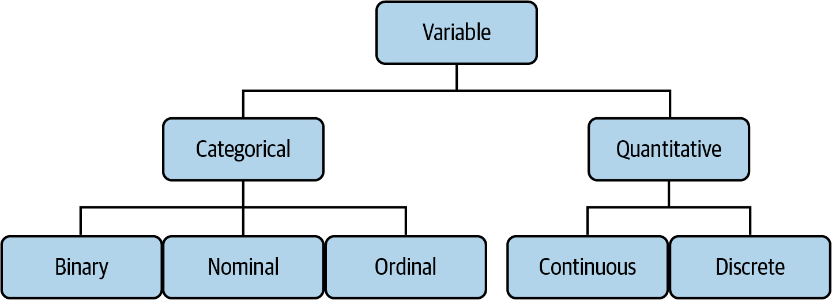
The tree of data
Mount, George. Advancing into Analytics: From Excel to Python and R. O’Reilly Media, 2021
Notes:
Now this figure comes from my book and it’s a very broad conceptualization of the various slices of the stack. You know we hear engineers or web developers talk about being “full stack” all the time but it’s not so common an expression as it could be.

Slide 6
“How much?”
Made purchase?
Yes or No
ZIP code
44134, 90210, etc.
Beverage size:
Small, medium, large… extra large?
Notes:
Now this figure comes from my book and it’s a very broad conceptualization of the various slices of the stack. You know we hear engineers or web developers talk about being “full stack” all the time but it’s not so common an expression as it could be.

Slide 7
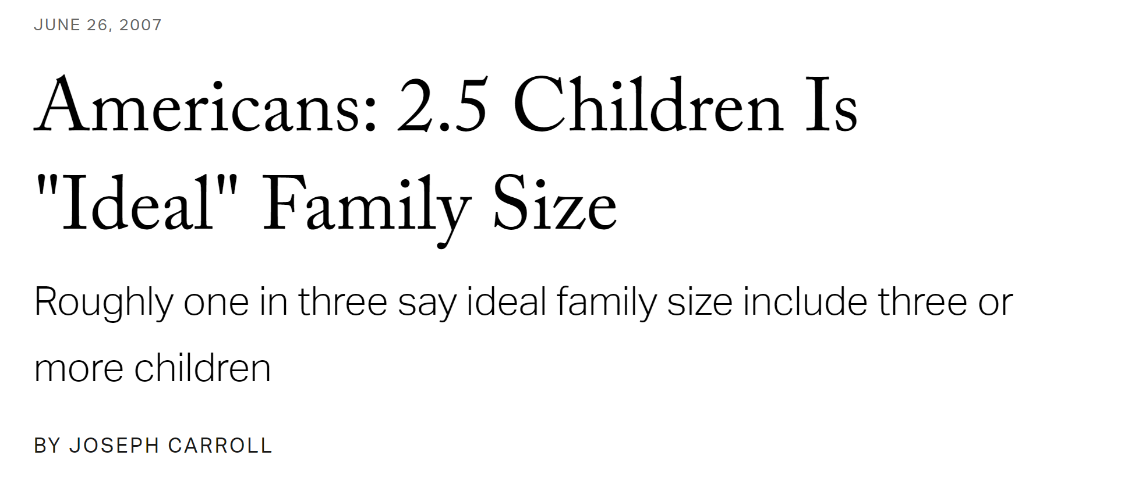
“How much/how many?”
🤔
pH level
Height
Number of children
Units sold
Notes:
Now this figure comes from my book and it’s a very broad conceptualization of the various slices of the stack. You know we hear engineers or web developers talk about being “full stack” all the time but it’s not so common an expression as it could be.

Slide 8

Drill
File: titanic.xlsx
Categorize each variable
Notes:
OK so now you will see R’s equivalent to some of those features you saw with Python. I think that for different reasons Python seems to be taking the lead on Excel automation, but R has some pretty robust features and in some ways are richer than Python’s.

Slide 9
Demo
Summarizing categorical variables
How many of each category?
PivotTables
Bar charts
Notes:
OK so now you will see R’s equivalent to some of those features you saw with Python. I think that for different reasons Python seems to be taking the lead on Excel automation, but R has some pretty robust features and in some ways are richer than Python’s.

Slide 10
Questions?

Slide 11
Have you downloaded the Analysis ToolPak?
https://bit.ly/3jZaw9X

Slide 12
Demo
Summarizing continuous variables
What does the distribution of values look like?
Where are they centered?
How far from the center are they?
Descriptive statistics (ToolPak)
Histogram
Notes:
OK so now you will see R’s equivalent to some of those features you saw with Python. I think that for different reasons Python seems to be taking the lead on Excel automation, but R has some pretty robust features and in some ways are richer than Python’s.

Slide 13
Questions?

Slide 14
Conclusion/Next steps

Slide 15
Take home
Dataset: penguins.xlsx
Classify each variable
Find the frequencies of two categorical variables
Get descriptive statistics and histogram for one continuous
Solutions: penguins-solutions.xlsx
Notes:
By the end of this book, you should be able to conduct exploratory data analysis and
hypothesis testing using a programming language.

Slide 16
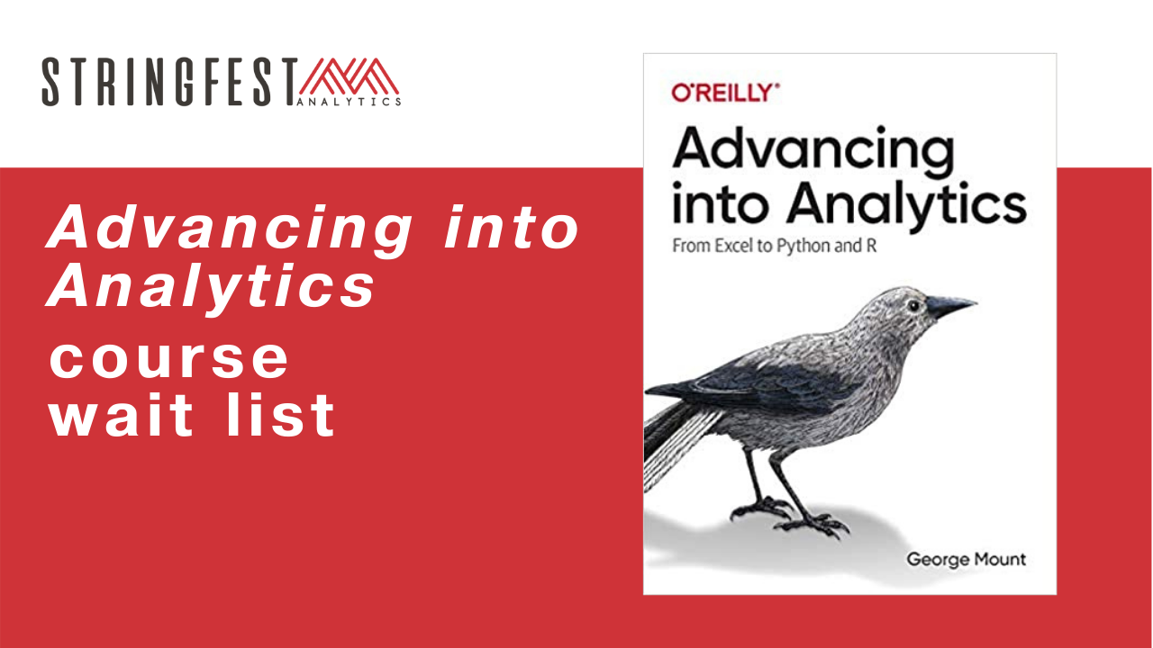
Want more?
Sign up for course waiting list: https://stringfestanalytics.com/aina-waiting/
Notes:
By the end of this book, you should be able to conduct exploratory data analysis and
hypothesis testing using a programming language.

Slide 17
Event survey: https://forms.office.com/r/0ZnD0LxpZy

Slide 18
Questions?

Slide 19
THANK YOU
george@stringfestanalytics.com
linkedin.com/in/gjmount
stringfestanalytics.com/contact

