Slide 1
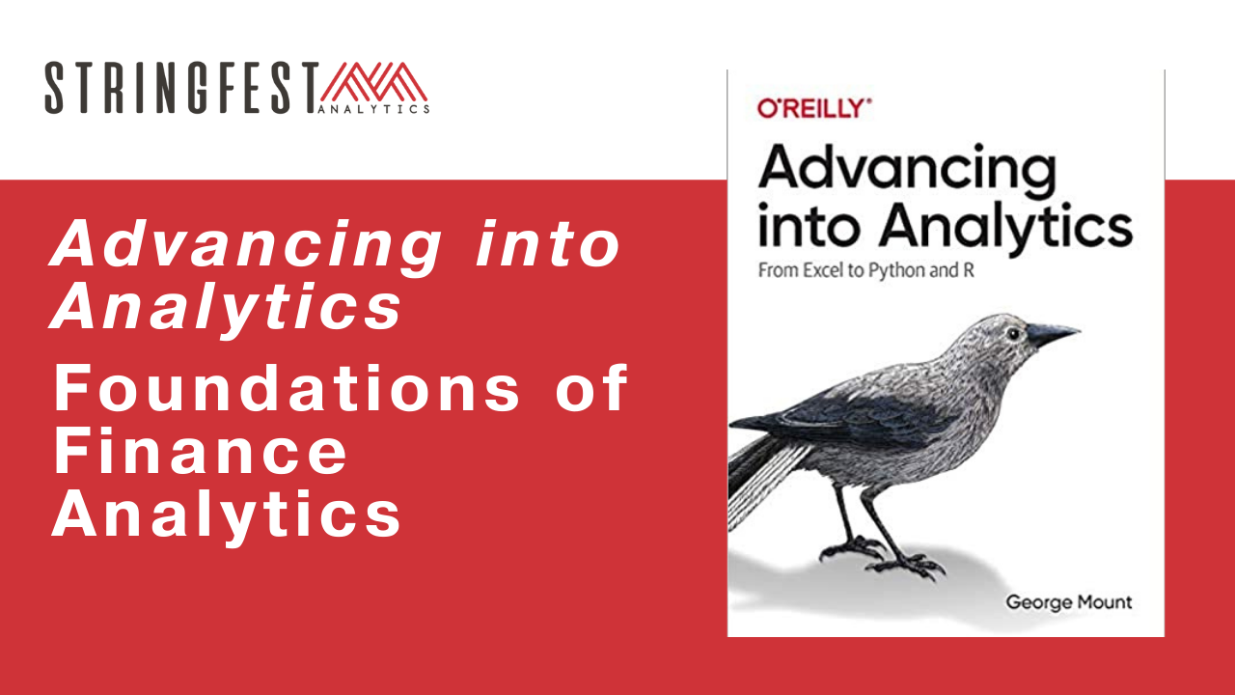
✓ Microphone off?
✓ Camera off?
✓ Fun on?

Slide 2
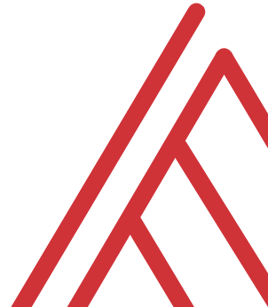
Chat me up…
What excites you about these topics? What scares you?
What finance areas are you coming from? (Poll)
What use cases are you interested in?
Notes:
Product
Social media
Email
Other

Slide 3
Learning objectives
Situate Excel, R and Python in the data analytics stack
Prepare a Windows computer to work in both
Analyze data in them all

Slide 4
Follow along
Download resources: https://github.com/stringfestdata/aina-finance-foundations
Code > Download ZIP
Notes:
\

Slide 5

Questions?

Slide 6
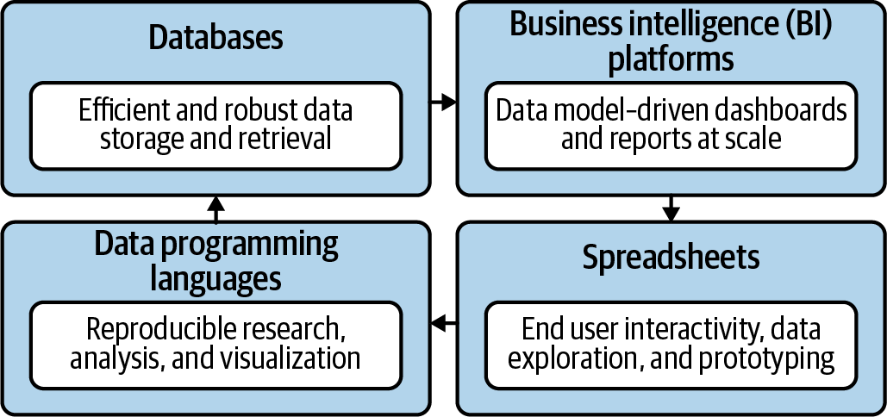
Become a full-stack marketing analyst
Mount, George. Advancing into Analytics: From Excel to Python and R. O’Reilly Media, 2021
Notes:
Now this figure comes from my book and it’s a very broad conceptualization of the various slices of the stack. You know we hear engineers or web developers talk about being “full stack” all the time but it’s not so common an expression as it could be.

Slide 7

Demos
Data: housing.xlsx
Explore housing price differences in Excel
Confirm them in R
Model a linear regression in Python
Read more about the dataset: https://rdrr.io/cran/Ecdat/man/Housing.html

Slide 8
Questions?

Slide 9
Demo
Data analytics in Excel
Is there a difference in housing prices between homes with and without air conditioners?
Demo notes: excel-demo.docx
Solution: housing-solution.xlsx

Slide 10
Questions?

Slide 11



Imagine a world…
SOLD: $60,000
SOLD: $60,000
α = .05
If the null were true (i.e. no real difference in means), we would find a significant difference in 5% of our samples due to random error.
Notes:
Let’s take an example from the housing prices dataset in the book. Let’s say that our null is there is no difference in sales prices for homes with our without air conditioning. If we did indeed live in this world, and we tested for significance at the 95% confidence level, then we would still find a significant difference in sales prices in 5% of our samples, due to random error.
That’s a 1 in 20 chance of finding a significant difference when there is none! So if we do a bunch of tests, the higher our chances that we will hit a significant finding due to random chance. This is called experimentwise error.

Slide 12

The package two-step…
Install the “app” (This has been done for you for Python)
Open it to run
Notes:
Let’s take an example from the housing prices dataset in the book. Let’s say that our null is there is no difference in sales prices for homes with our without air conditioning. If we did indeed live in this world, and we tested for significance at the 95% confidence level, then we would still find a significant difference in sales prices in 5% of our samples, due to random error.
That’s a 1 in 20 chance of finding a significant difference when there is none! So if we do a bunch of tests, the higher our chances that we will hit a significant finding due to random chance. This is called experimentwise error.

Slide 13

Demo
Data analytics in R
How likely will this difference generalize to larger population of stores?
Script: t-test.r
Notes:
See next slide for some instructions

Slide 14

Demo
Data analytics in Python
Does a homes’s lot size significantly impact its price?
Script: regression.ipynb

Slide 15
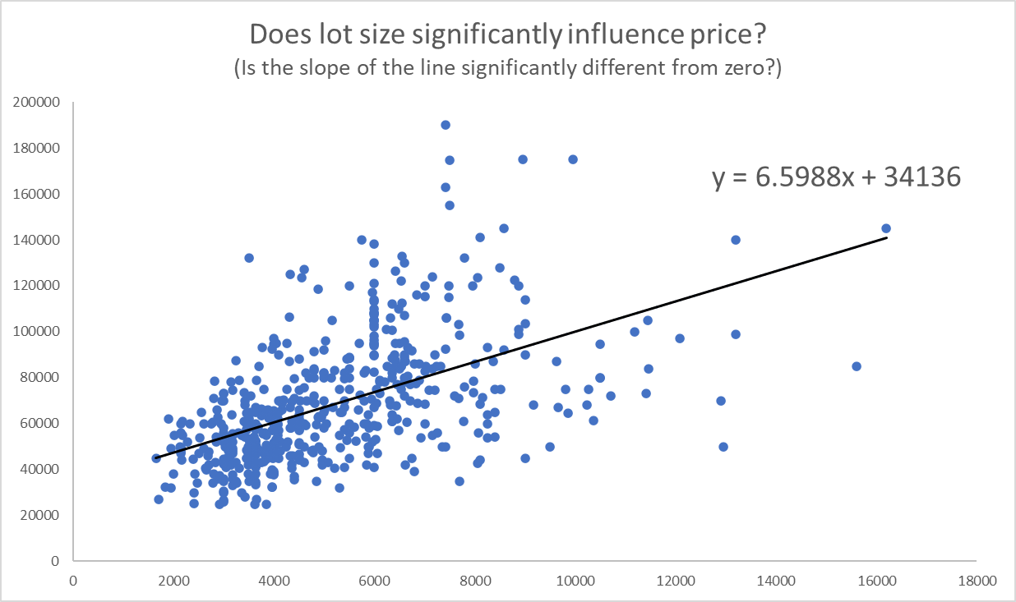
Does a line run through it?
(And what is the slope and intercept?)

Slide 16
Questions?

Slide 17
Conclusion/Next steps

Slide 18

PQ thank you
https://stringfestdata.gumroad.com/l/fs-pq
Promocode: CLARKS

Slide 19
Cracking the book
The underlying math & philosophy of analytics
Data cleaning in R & Python
Further data visualizations

Slide 20
Event survey: https://forms.office.com/r/0ZnD0LxpZy

Slide 21
THANK YOU
Happy reading 📚
george@stringfestanalytics.com
linkedin.com/in/gjmount
stringfestanalytics.com/contact

