Slide 1
✓ Microphone off?
✓ Camera off?
✓ Fun on?

Slide 2


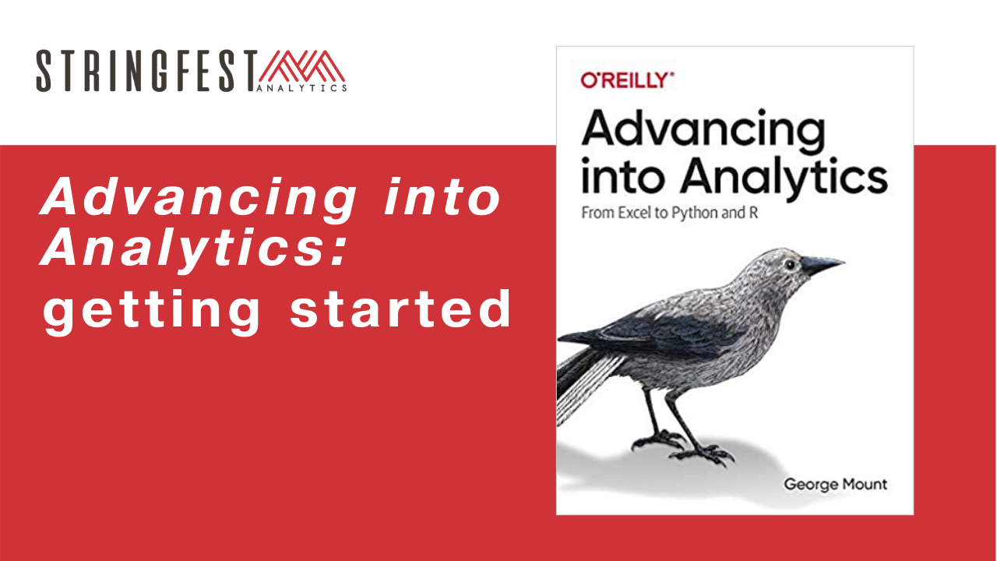
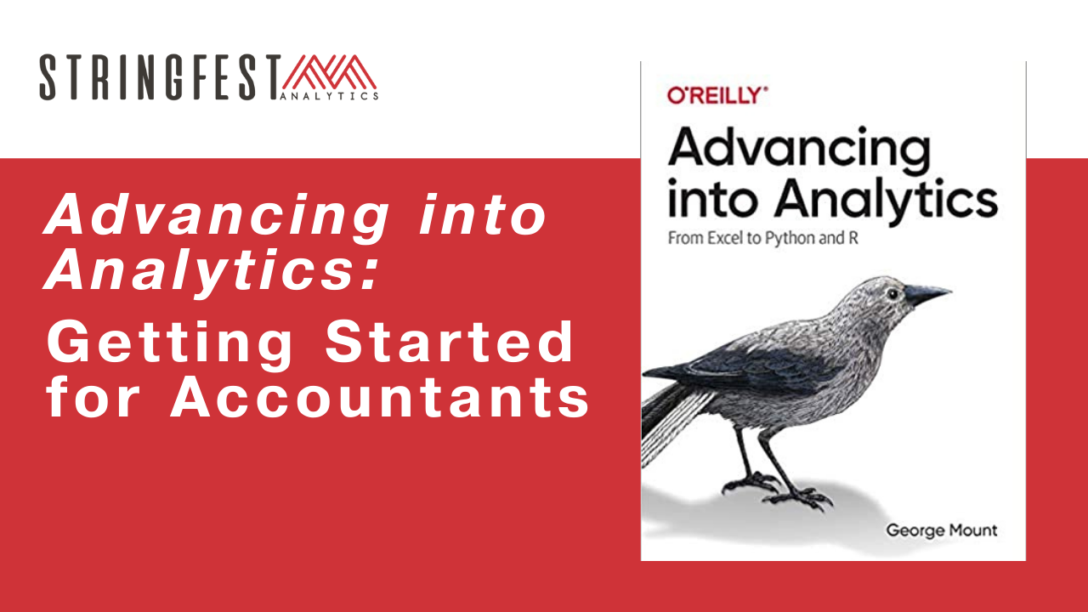

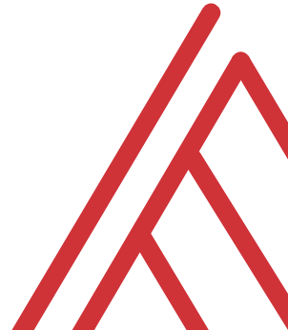
Advancing into Analytics: From Excel to R and Python

Slide 3
Chat me up…
What excites you about these topics? What scares you?
What research areas are you coming from? (Poll)
What use cases are you interested in?
Notes:
Healthcare
Agriculture
Academia

Slide 4
Learning objectives
Situate Excel, R and Python in the data analytics stack
Prepare a Windows computer to work in all three
Run summary statistics on a dataset in all three

Slide 5
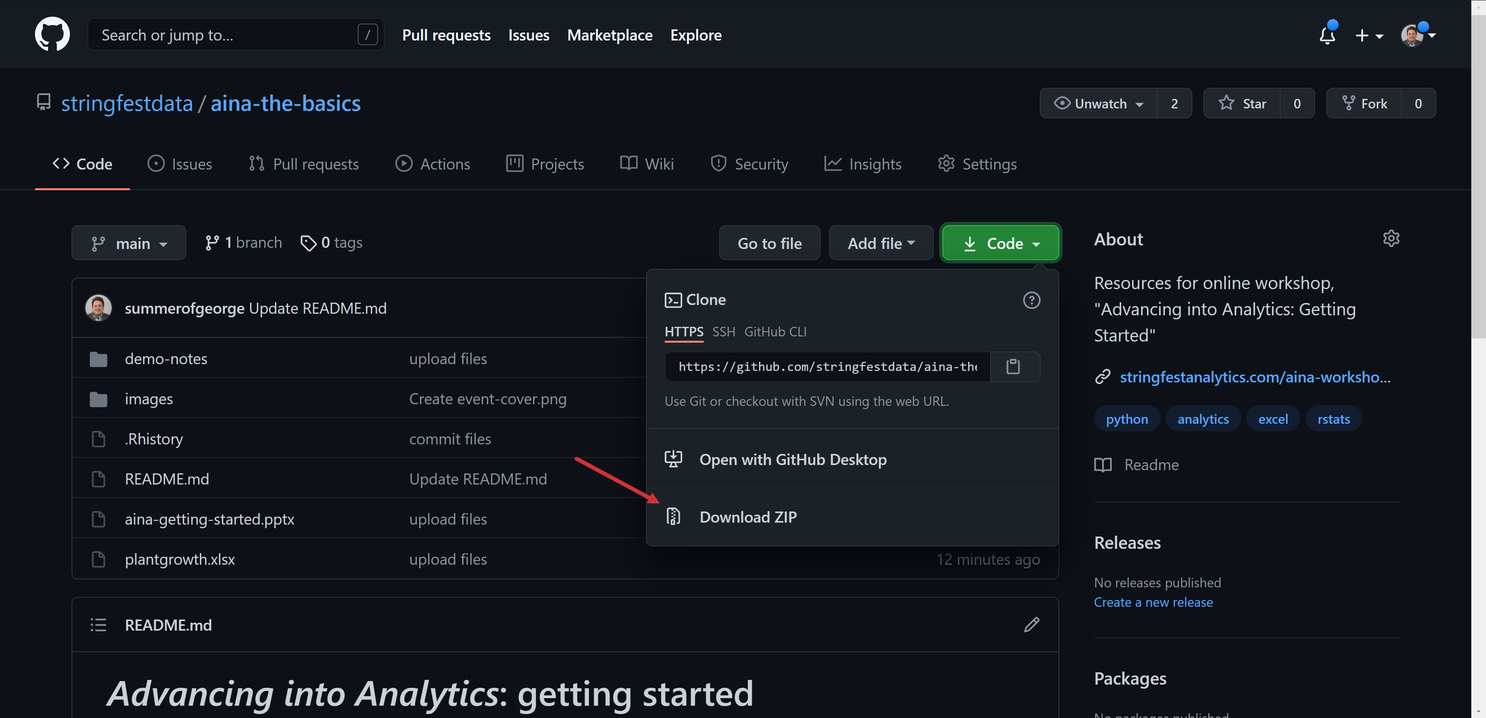
Follow along
Download resources: https://github.com/stringfestdata/aina-getting-started
Notes:
If you’d like to follow along with the presentation, all resources are available at this link.
I also wanted to give a shout-out to Alan Turing, born on this day in 1912.

Slide 6
Questions?

Slide 7
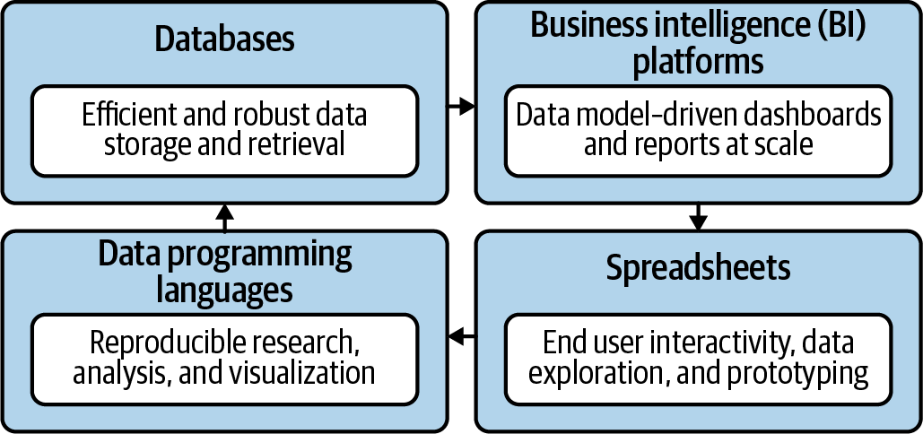
Become a full-stack analyst
Mount, George. Advancing into Analytics: From Excel to Python and R. O’Reilly Media, 2021
Notes:
Now this figure comes from my book and it’s a very broad conceptualization of the various slices of the stack. You know we hear engineers or web developers talk about being “full stack” all the time but it’s not so common an expression as it could be.

Slide 8

Demos
Downloads and summary statistics:
Excel
R
Python
Follow along with demo notes for each
Let’s get situated…
File to summarize: loans.xlsx
Notes:
OK so now you will see R’s equivalent to some of those features you saw with Python. I think that for different reasons Python seems to be taking the lead on Excel automation, but R has some pretty robust features and in some ways are richer than Python’s.

Slide 9
Questions?

Slide 10
Conclusion/Next steps

Slide 11
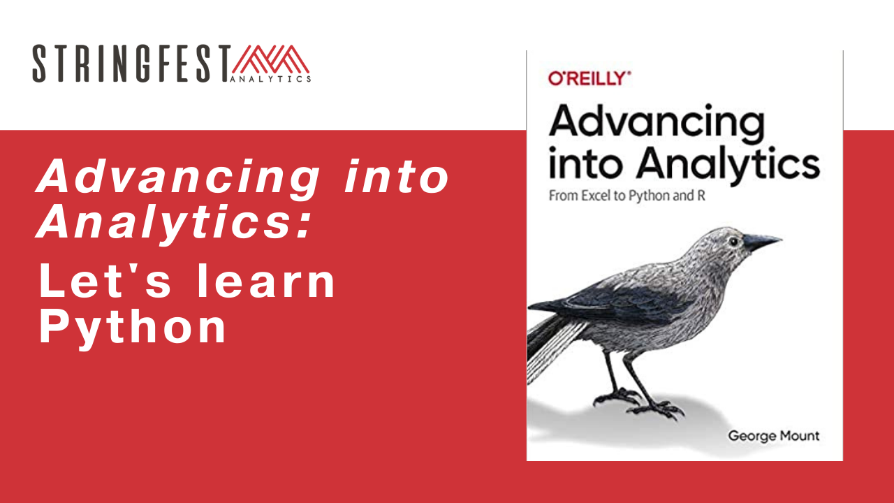
Let’s learn Python, thrs
Get 20% off with promocode LEDGER https://swiy.io/66Oy
Half-day Python workshop
Free ebook copy of Advancing into Analytics
Workshop recording
Demo notes and handouts
Free download of a 90-minute video course walking through all exercises from the book
Notes:
By the end of this book, you should be able to conduct exploratory data analysis and
hypothesis testing using a programming language.

Slide 12
Event survey: https://forms.office.com/r/0ZnD0LxpZy

Slide 13
Questions?

Slide 14
THANK YOU
george@stringfestanalytics.com
linkedin.com/in/gjmount
stringfestanalytics.com/contact

