Slide 1


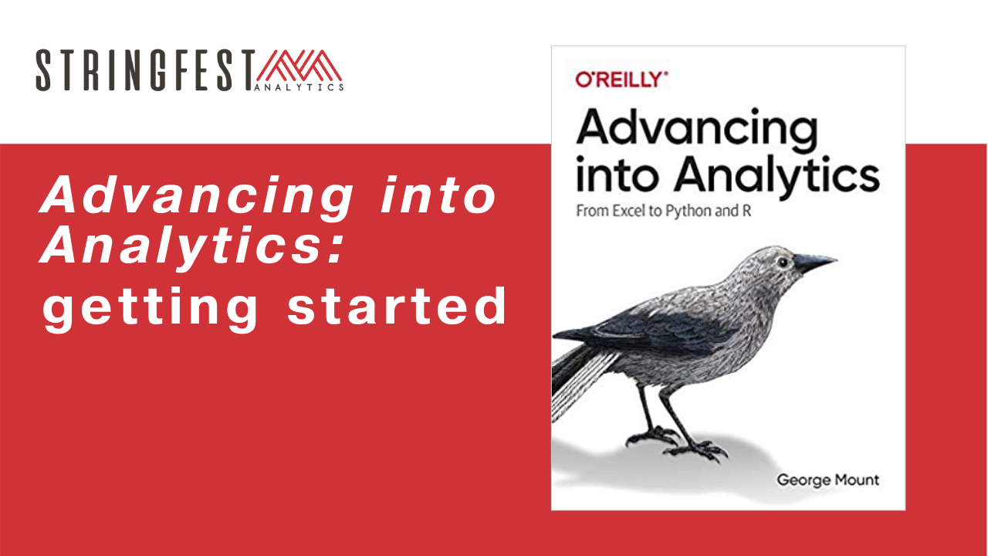
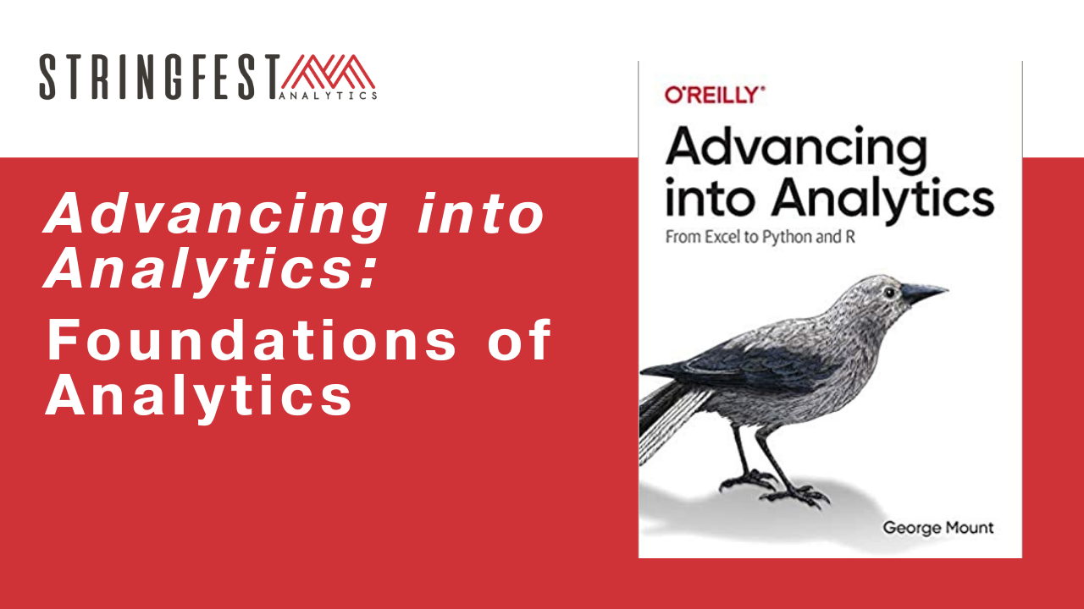
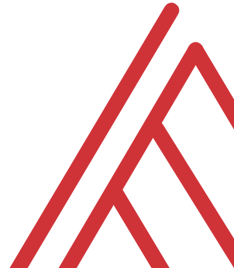
Advancing into Analytics: From Excel to R and Python

Slide 2
Learning objectives
How do you communicate your findings?
What other statistical tests are there?
What else can Excel do for you?

Slide 3
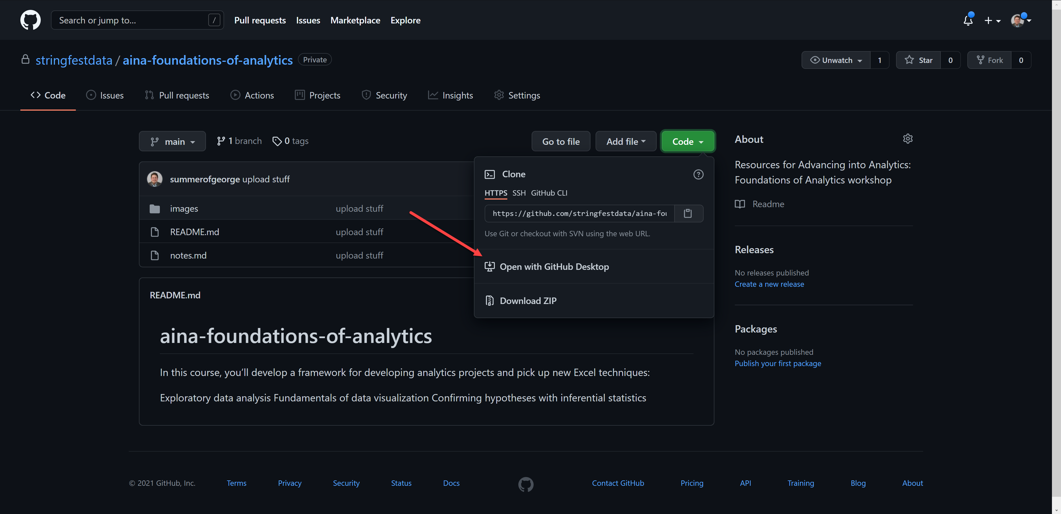
Follow along
Download resources: https://github.com/stringfestdata/aina-foundations-of-analytics
Notes:
The additional courses will dive into using GitHub.

Slide 4
Questions?
Tell us about yourself in the chat!

Slide 5
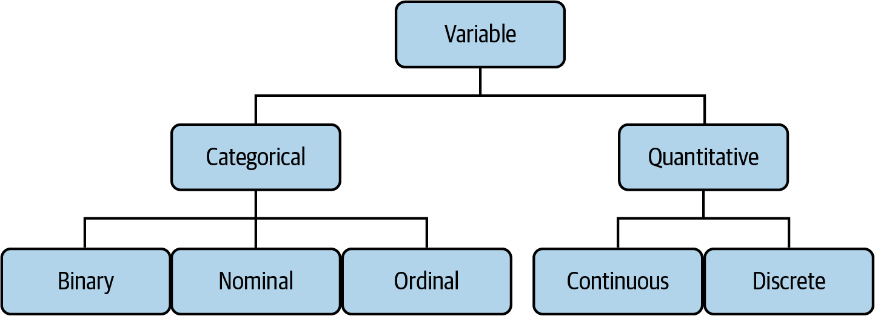

Drill
File: datasets/computers.xlsx
Classify each variable type
Mount, George. Advancing into Analytics: From Excel to Python and R. O’Reilly Media, 2021
Notes:
Also feel free to

Slide 6
Demo
File: datasets/computers.xlsx
Is there a difference in price of computers with and without a CD-ROM?
Notes:
Ask a student if they’d like to share their screen and walk through it

Slide 7
What is analytics, anyway?

Slide 8
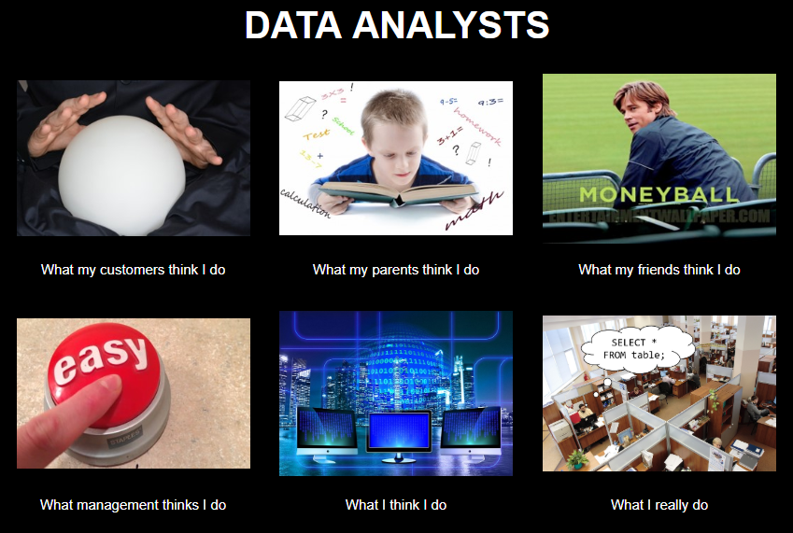
Chat me up…
What does analytics mean to you?
What does this look like for you?
ANALYTICS

Slide 9
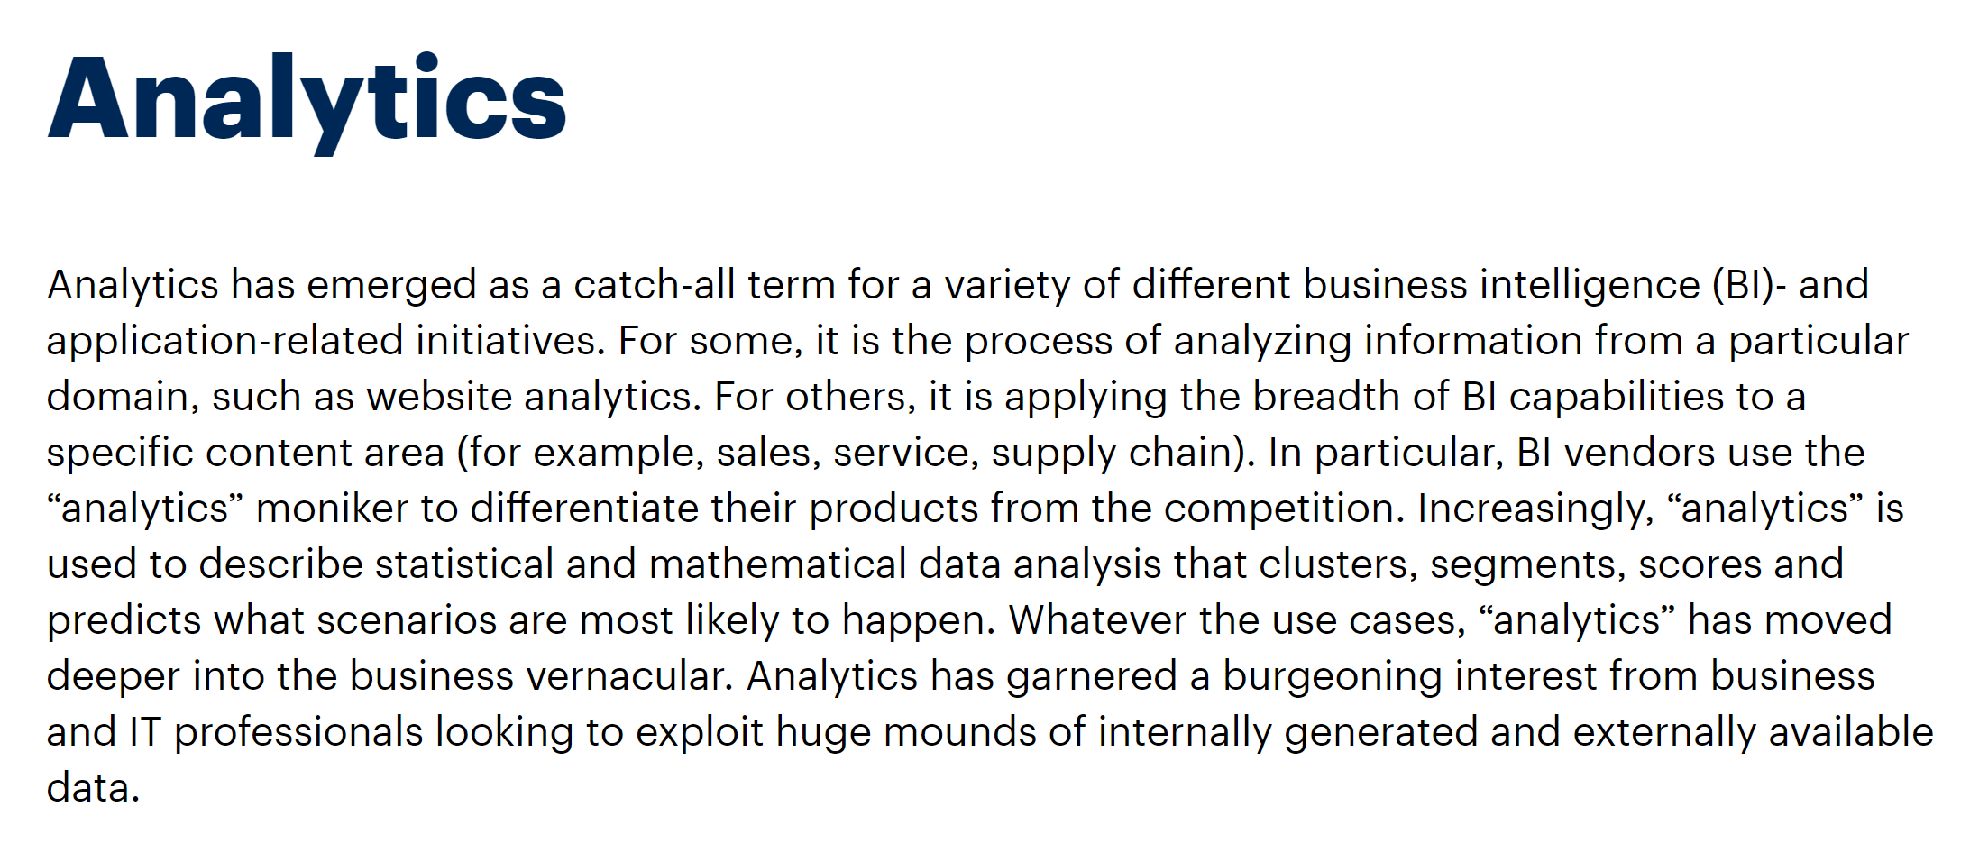
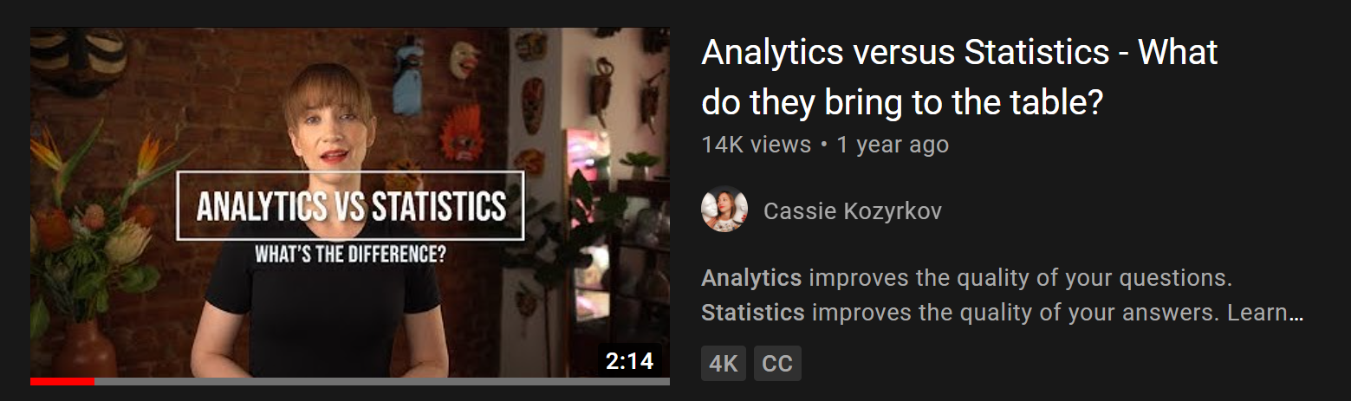
A working definition?
“Using data to make recommendations about what to do given what’s happened”
But wait… there’s more!
https://www.gartner.com/en/information-technology/glossary/analytics
https://www.youtube.com/watch?v=YsrPImZyisI
Notes:
The Gartner definition is very comprehensive…
What do you think about Cassie’s video?

Slide 10
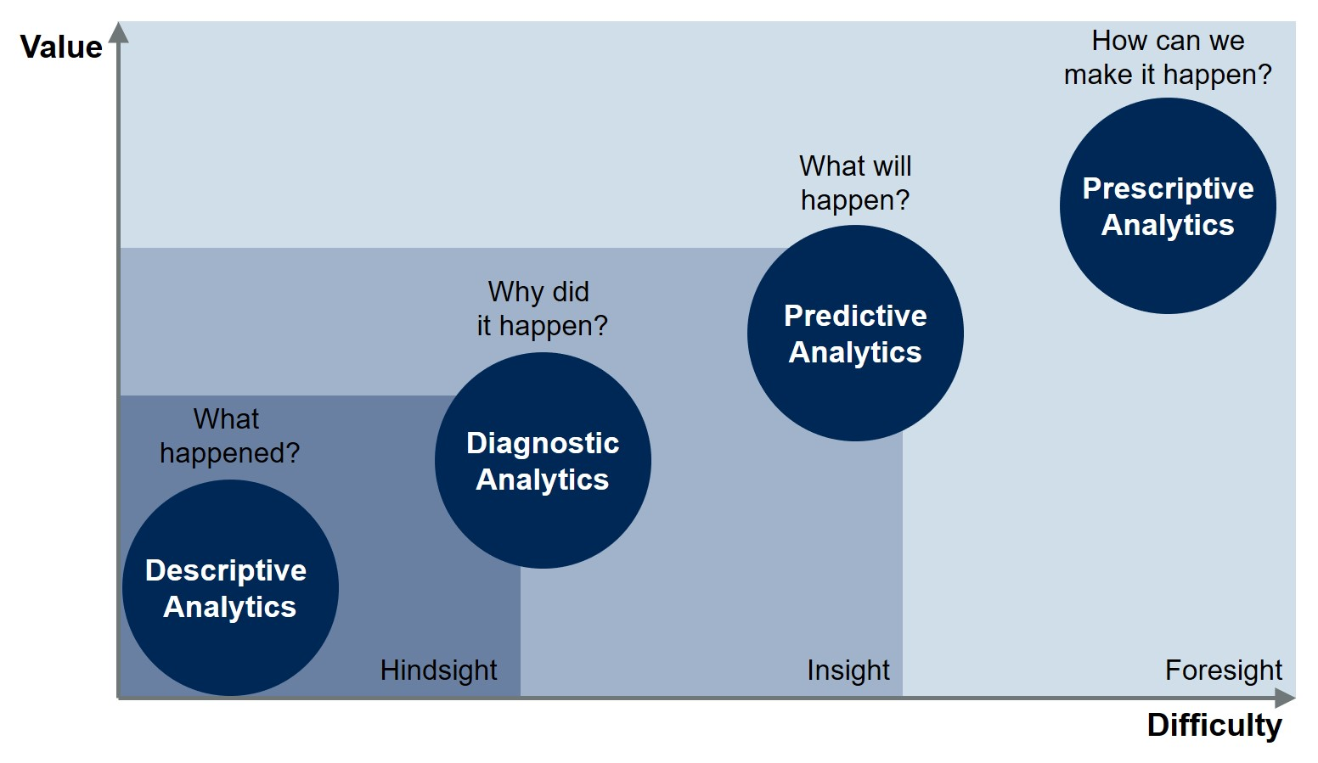
Starting somewhere
https://blogs.gartner.com/jason-mcnellis/2019/11/05/youre-likely-investing-lot-marketing-analytics-getting-right-insights/
Notes:
The Gartner definition is very comprehensive…
What do you think about Cassie’s video?

Slide 11
Starting somewhere
Inferential statistics
Confirmatory data analysis
Descriptive/summary statistics
Exploratory data analysis
https://blogs.gartner.com/jason-mcnellis/2019/11/05/youre-likely-investing-lot-marketing-analytics-getting-right-insights/
Notes:
The Gartner definition is very comprehensive…
What do you think about Cassie’s video?

Slide 12
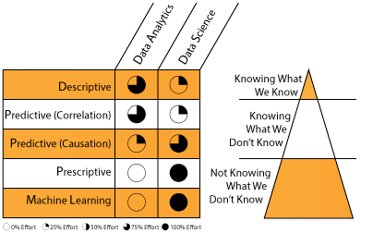
A division of labor
https://datascientistinsights.com/2013/09/09/data-analytics-vs-data-science-two-separate-but-interconnected-disciplines/
Notes:
The Gartner definition is very comprehensive…
What do you think about Cassie’s video?

Slide 13
Questions?

Slide 14
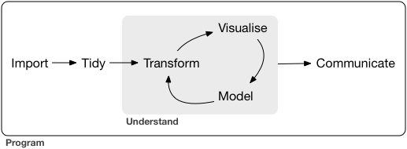
What all analytics has in common
https://r4ds.had.co.nz/introduction.html

Slide 15
Begin with the end in mind

Slide 16

What makes for compelling analytics?
What does your audience assume to be true?
What if they’re wrong?
What myths can you bust?
What urban legends can you tame?
https://corporate.discovery.com/blog/2016/03/01/mythbusters-goes-out-with-a-bang/

Slide 17
Showing how the data gets tidied?
Matters to the audience
Probably doesn’t

Slide 18
Sizing up a dataset
(So far this is optional; run through the timings)

Slide 19
An analytics presentation in six acts
downloads/a-data-presentation-in-six-acts.pdf
datasets/diabetes.xlsx
Is there a difference in the glucose levels of patients with and without diabetes?

Slide 20

1. Introduction
“Buy the hook, and they’ll buy the story”
Lead with a quote or anecdote… draw them in
Drill:
Who’s the audience?
How can you hook them?
Try it in our doc: https://bit.ly/3taMsoC
Notes:
How could we hook this?

Slide 21
Questions?

Slide 22
2. Hypotheses
You have an opinion… but the data has the truth!
Drill:
State the statistical hypotheses for this analysis
Why are they stated this way?
Notes:
This is your time to "hook" the audience into your work and situtate the project into its wider context. Explain what makes the topic interesting and how you arrived at the questions you asked. Consider leading off with an interesting quote or anecdote related to the topic

Slide 23

3. Data
Where did the data come from?
Why are you using it?
Show, don’t tell: visualizations
Notes:
This is your time to "hook" the audience into your work and situtate the project into its wider context. Explain what makes the topic interesting and how you arrived at the questions you asked. Consider leading off with an interesting quote or anecdote related to the topic

Slide 24
Demo
File: continue with diabetes.xlsx
Profile and clean data with Power Query
Demo notes: docs/data-profiling.docx
What should our “Data” discussion include? Try it in our doc: https://bit.ly/3taMsoC
Notes:
Ask a student if they’d like to share their screen and walk through it

Slide 25







Extract – Transform - Load
This is your behind-the-scenes work
Notes:
This is your time to "hook" the audience into your work and situtate the project into its wider context. Explain what makes the topic interesting and how you arrived at the questions you asked. Consider leading off with an interesting quote or anecdote related to the topic

Slide 26
Questions?

Slide 27

4. Methods
What methods did you use?
Why > how
Notes:
This is your time to "hook" the audience into your work and situtate the project into its wider context. Explain what makes the topic interesting and how you arrived at the questions you asked. Consider leading off with an interesting quote or anecdote related to the topic

Slide 28
Drill
File: continue with diabetes.xlsx
What method would we use to test relationship of glucose and being diabetic?
What assumptions are there?
What parameters are there?
Answer in our doc: https://bit.ly/3taMsoC
Notes:
Ask a student if they’d like to share their screen and walk through it

Slide 29

5. Results
What actually happened?
What evidence does this lend to your hypotheses?
Notes:
This is your time to "hook" the audience into your work and situtate the project into its wider context. Explain what makes the topic interesting and how you arrived at the questions you asked. Consider leading off with an interesting quote or anecdote related to the topic

Slide 30
Drill
File: continue with diabetes.xlsx
What are the results of our work?
Answer in the doc: https://bit.ly/3taMsoC
Notes:
Ask a student if they’d like to share their screen and walk through it

Slide 31
Interlude: Beyond the straight t

Slide 32
Demo
File: continue with diabetes.xlsx
Is there a relationship between having been pregnant and becoming diabetes?
Recode a binary variable
Compare two binary variables: Chi-square
Demo notes: chi-square.xlsx
Notes:
Ask a student if they’d like to share their screen and walk through it

Slide 33
What test for what variables?
If your independent variable is… | And your dependent variable is… | Then look into using…
Binary | Continuous | Independent samples t-test
Categorical | Categorical | Chi-square
Continuous at time 1 | Continuous at time 2 | Paired samples t-test
Categorical | Continuous | ANOVA
Continuous | Continuous | Correlation
Continuous | Continuous | Regression
Continuous | Binary | Logistic regression
Notes:
By the end of this book, you should be able to conduct exploratory data analysis and
hypothesis testing using a programming language.

Slide 34
Questions?

Slide 35
Remember this?
E – T – L
Introduction
Hypotheses
Data
Methods
Results
Discussion/recommendations
Appendix
Explore
Confirm

Slide 36
6. Discussion/recommendations
Knowing what they know now, how should your audience behave differently?
What follow-ups questions are there and how might you answer them?
Answer in the doc: https://bit.ly/3taMsoC
Notes:
This is your time to "hook" the audience into your work and situtate the project into its wider context. Explain what makes the topic interesting and how you arrived at the questions you asked. Consider leading off with an interesting quote or anecdote related to the topic

Slide 37
7. Bonus! Appendix
Knowing what they know now, how should your audience behave differently?
What follow-ups questions are there and how might you answer them?
Answer in the doc: https://bit.ly/3taMsoC
Notes:
This is your time to "hook" the audience into your work and situtate the project into its wider context. Explain what makes the topic interesting and how you arrived at the questions you asked. Consider leading off with an interesting quote or anecdote related to the topic

Slide 38
Drill
Practice the seven acts:
File: datasets/housing.xlsx
Is there a difference in the sale price of homes with and without a rec room?
Breakout rooms/reconvene
Notes:
Split into breakout grups and work on it….

Slide 39
Questions?

Slide 40
The future of Excel

Slide 41




Data: more than rows and columns
Structured
Unstructured

Slide 42
Demo
Unstructured data: coming to Excel
File: datasets/sentiment.xlsx
Analyze the sentiment of each review (positive/negative/neutral)
Is there a relationship between sentiment and polarity?
Demo notes: docs/excel-sentiment.xlsx
Notes:
Ask a student if they’d like to share their screen and walk through it

Slide 43
Event survey: https://forms.office.com/r/0ZnD0LxpZy

Slide 44
THANK YOU
george@stringfestanalytics.com
linkedin.com/in/gjmount
stringfestanalytics.com/contact

Slide 45
Conclusion/Next steps

Slide 46
Assignments for Analytics Systems

Slide 47
Got Git?
Download Git for Windows: https://git-scm.com/download/win
Create a GitHub account: https://github.com
Download GitHub Desktop: https://desktop.github.com
Good documentation on setting up Git & GitHub here

Slide 48
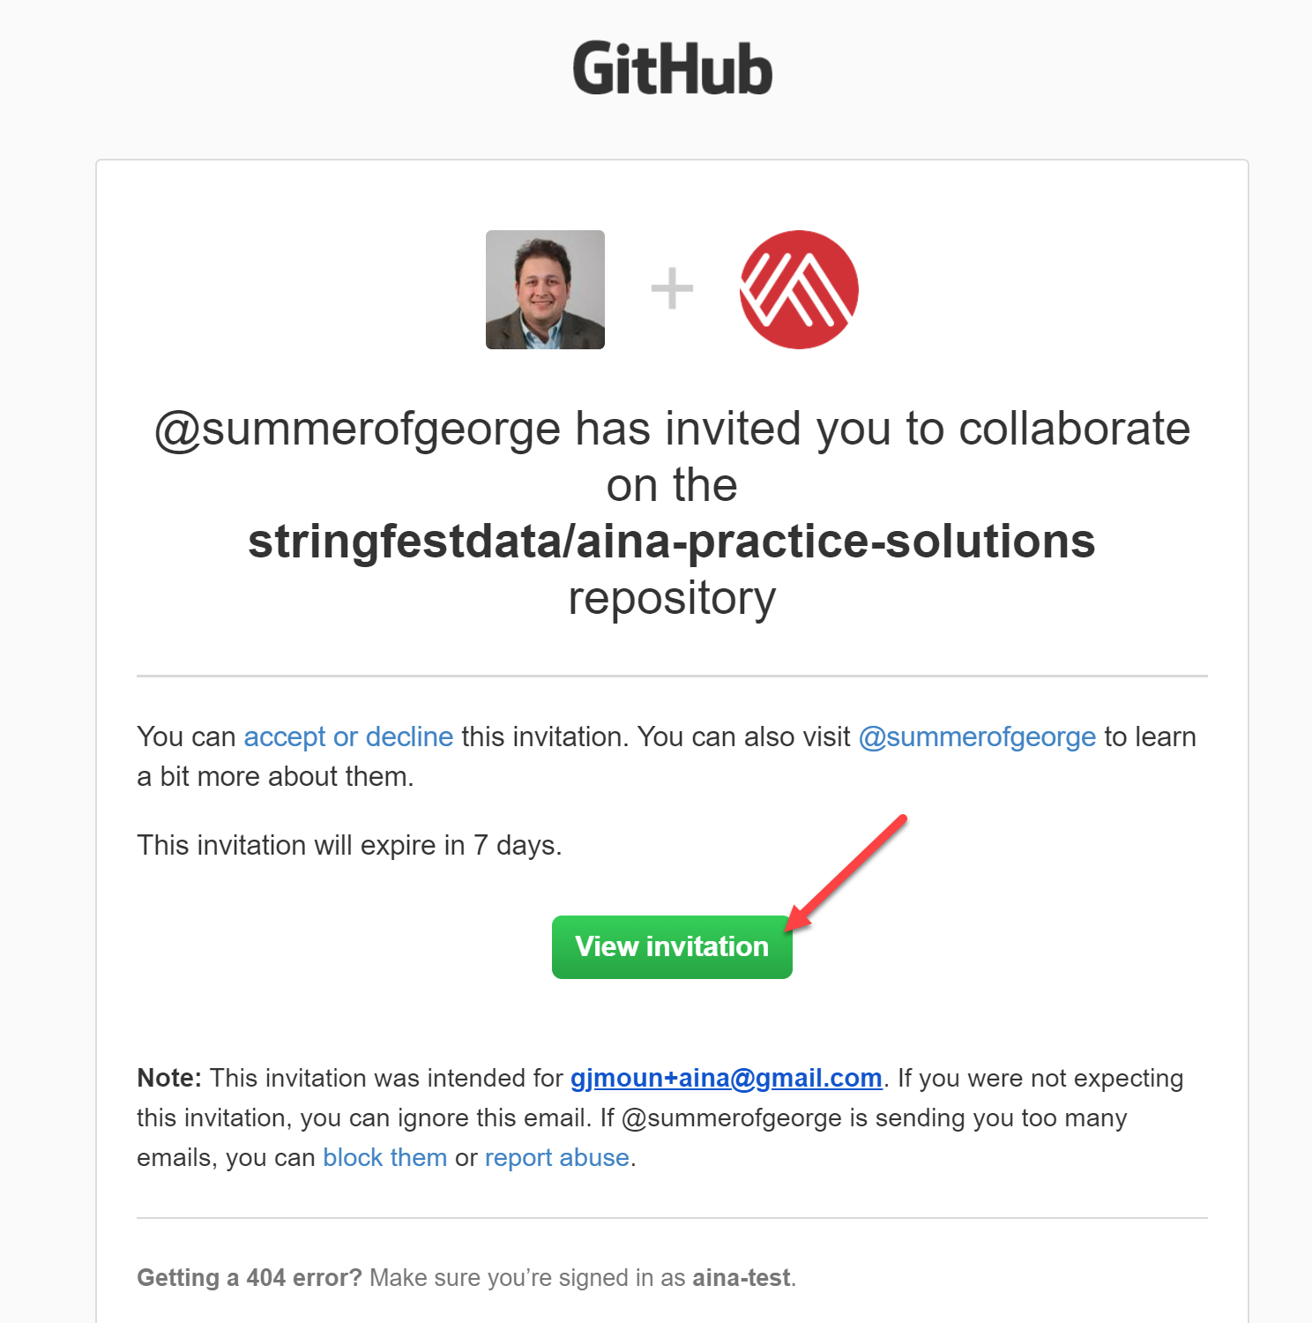
The super-secret AinA repos 😉
aina-practice-solutions: accompanies this test bank
aina-analytics-systems: resources for next course
docs/accessing-repos.docx: notes on accessing repo

