Slide 1


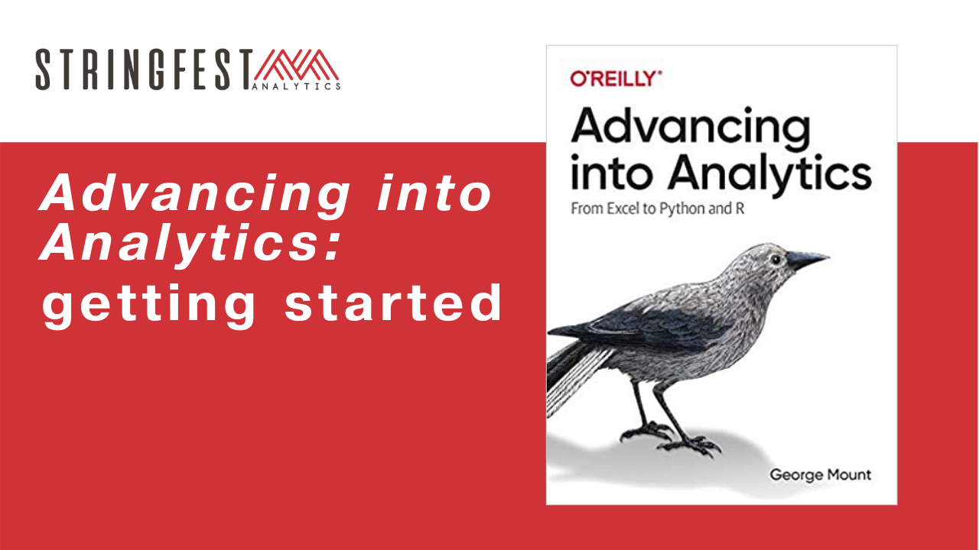
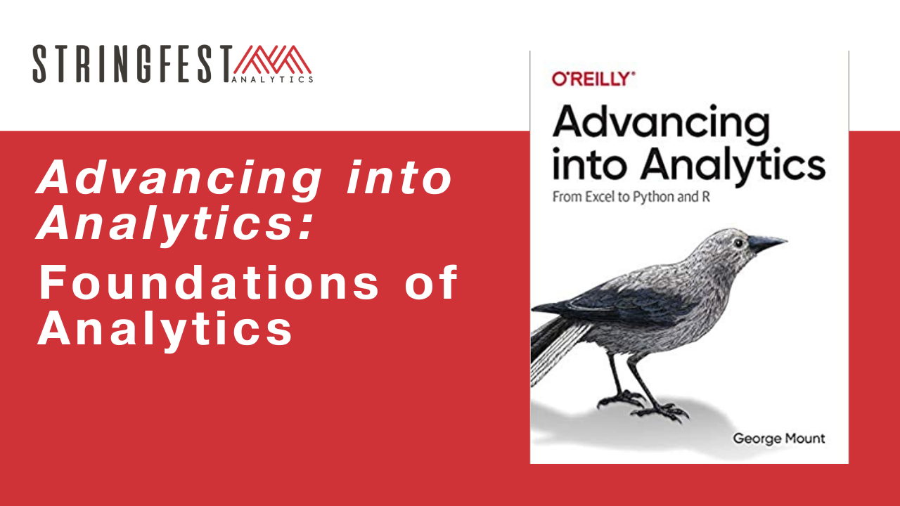
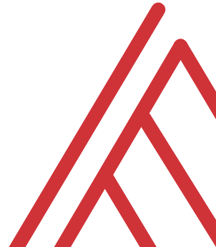
Advancing into Analytics: From Excel to R and Python

Slide 2
Learning objectives
How do you communicate your findings?
How do you structure an analysis project?
What else can Excel do for you?

Slide 3
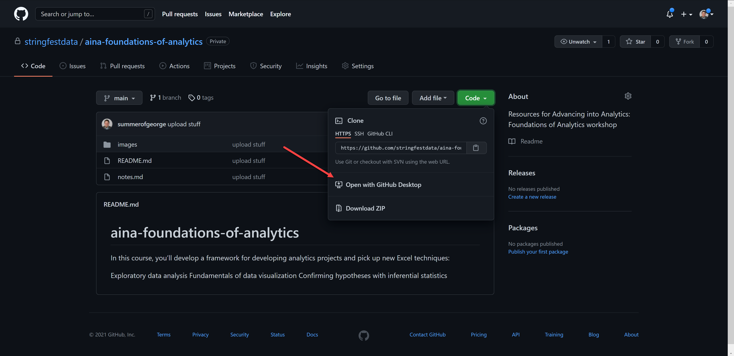
Follow along
Download resources: https://github.com/stringfestdata/aina-foundations-of-analytics
Notes:
The additional courses will dive into using GitHub.

Slide 4
Questions?

Slide 5
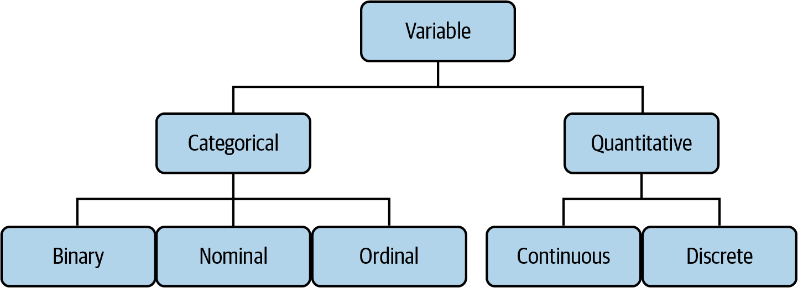

Drill
File: datasets/computers.xlsx
Classify each variable type
Mount, George. Advancing into Analytics: From Excel to Python and R. O’Reilly Media, 2021
Notes:
Also feel free to

Slide 6
Demo
File: datasets/computers.xlsx
Is there a difference in price of computers with and without a CD-ROM?
Notes:
Ask a student if they’d like to share their screen and walk through it

Slide 7
Questions?

Slide 8
What is analytics, anyway?

Slide 9
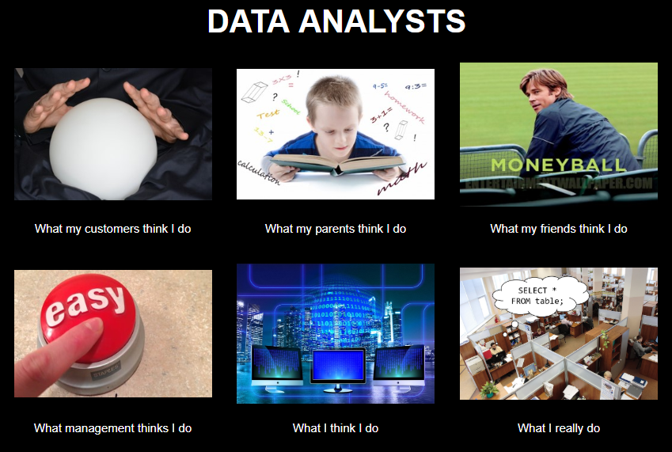
Chat me up…
What does analytics mean to you?
What does this look like for you?
ANALYTICS

Slide 10
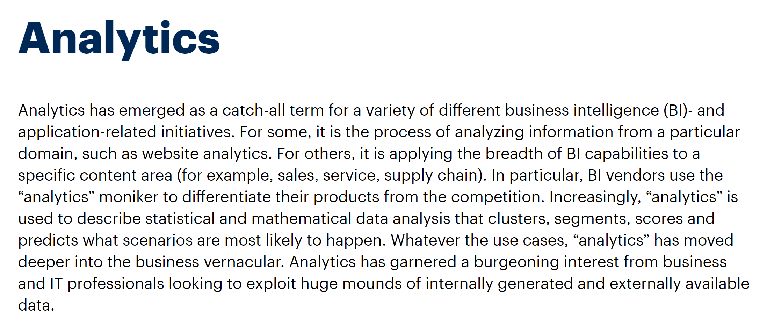
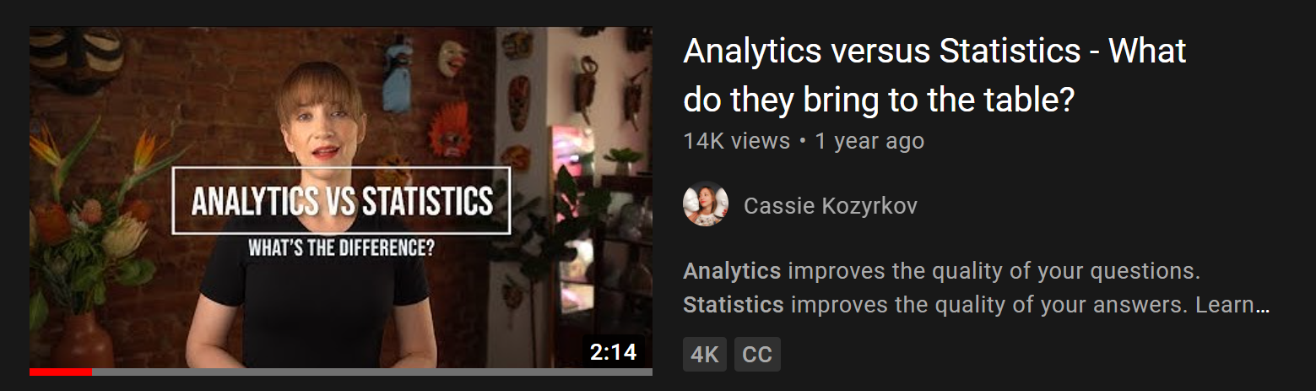
A working definition?
“Using data to make recommendations about what to do given what’s happened”
But wait… there’s more!
https://www.gartner.com/en/information-technology/glossary/analytics
https://www.youtube.com/watch?v=YsrPImZyisI
Notes:
The Gartner definition is very comprehensive…
What do you think about Cassie’s video?

Slide 11
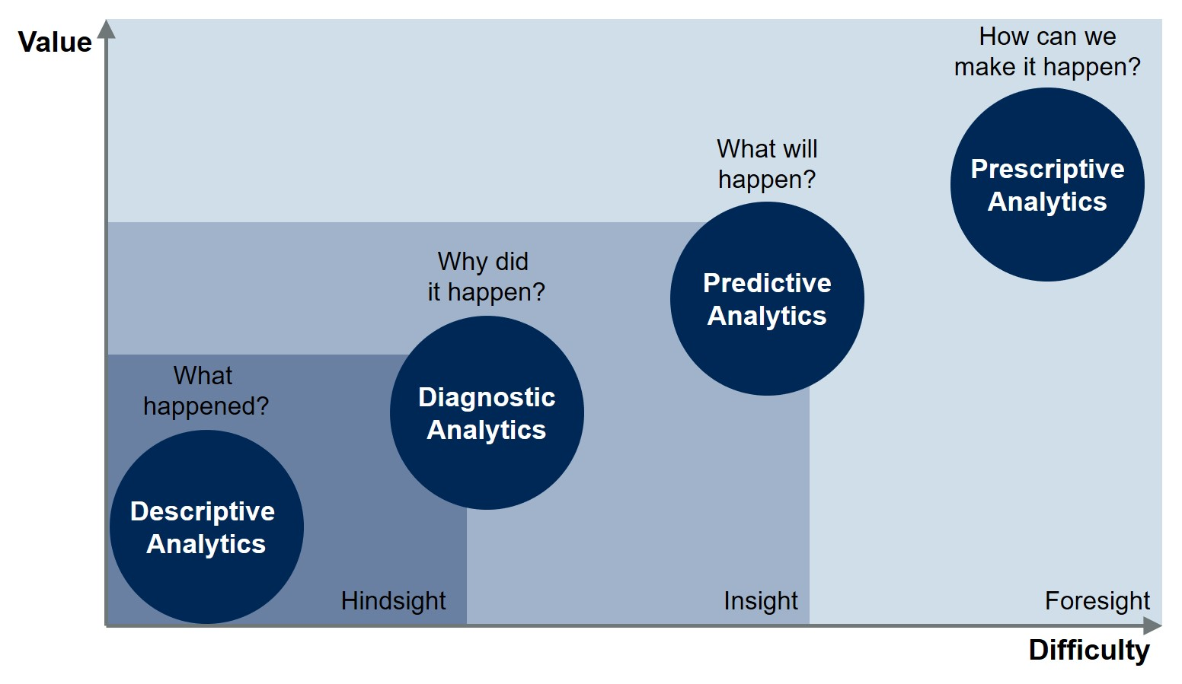
Starting somewhere
https://blogs.gartner.com/jason-mcnellis/2019/11/05/youre-likely-investing-lot-marketing-analytics-getting-right-insights/
Notes:
The Gartner definition is very comprehensive…
What do you think about Cassie’s video?

Slide 12
Starting somewhere
Inferential statistics
Confirmatory data analysis
Descriptive/summary statistics
Exploratory data analysis
https://blogs.gartner.com/jason-mcnellis/2019/11/05/youre-likely-investing-lot-marketing-analytics-getting-right-insights/
Notes:
The Gartner definition is very comprehensive…
What do you think about Cassie’s video?

Slide 13
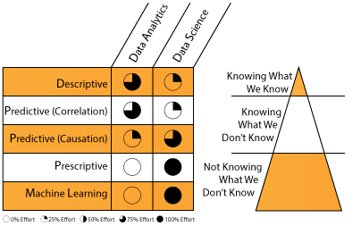
A division of labor
https://datascientistinsights.com/2013/09/09/data-analytics-vs-data-science-two-separate-but-interconnected-disciplines/
Notes:
The Gartner definition is very comprehensive…
What do you think about Cassie’s video?

Slide 14
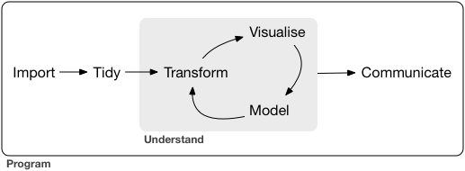
What all analytics has in common
https://r4ds.had.co.nz/introduction.html

Slide 15
Begin with the end in mind

Slide 16

What makes for compelling analytics?
What does your audience assume to be true?
What if they’re wrong?
What myths can you bust?
What urban legends can you tame?
https://corporate.discovery.com/blog/2016/03/01/mythbusters-goes-out-with-a-bang/

Slide 17
Showing how the data gets tidied?
Matters to the audience
Probably doesn’t

Slide 18
An analytics presentation in six acts
downloads/a-data-presentation-in-six-acts.pdf
datasets/diabetes.xlsx
Is there a difference in the glucose levels of patients with and without diabetes?

Slide 19

1. Introduction
“Buy the hook, and they’ll buy the story”
Lead with a quote or anecdote… draw them in
Drill:
Who’s the audience?
How can you hook them?
Try it in our doc: https://bit.ly/3taMsoC
Notes:
How could we hook this?

Slide 20
2. Hypotheses
You have an opinion… but the data has the truth!
Drill:
State the statistical hypotheses for this analysis
Why are they stated this way?
Notes:
This is your time to "hook" the audience into your work and situtate the project into its wider context. Explain what makes the topic interesting and how you arrived at the questions you asked. Consider leading off with an interesting quote or anecdote related to the topic

Slide 21

3. Data
Where did the data come from?
Why are you using it?
Show, don’t tell: visualizations
Notes:
This is your time to "hook" the audience into your work and situtate the project into its wider context. Explain what makes the topic interesting and how you arrived at the questions you asked. Consider leading off with an interesting quote or anecdote related to the topic

Slide 22
Demo
File: continue with diabetes.xlsx
Profile and clean data with Power Query
Demo notes: docs/data-profiling.docx
What should our “Data” discussion include? Try it in our doc: https://bit.ly/3taMsoC
Notes:
Ask a student if they’d like to share their screen and walk through it

Slide 23







Extract – Transform - Load
This is your behind-the-scenes work
Notes:
This is your time to "hook" the audience into your work and situtate the project into its wider context. Explain what makes the topic interesting and how you arrived at the questions you asked. Consider leading off with an interesting quote or anecdote related to the topic

Slide 24

4. Methods
What methods did you use?
Why > how
Notes:
This is your time to "hook" the audience into your work and situtate the project into its wider context. Explain what makes the topic interesting and how you arrived at the questions you asked. Consider leading off with an interesting quote or anecdote related to the topic

Slide 25
Drill
File: continue with diabetes.xlsx
What method would we use to test relationship of glucose and being diabetic?
What assumptions are there?
What parameters are there?
Answer in our doc: https://bit.ly/3taMsoC
Notes:
Ask a student if they’d like to share their screen and walk through it

Slide 26
5. Results
What actually happened?
What evidence does this lend to your hypotheses?
Notes:
This is your time to "hook" the audience into your work and situtate the project into its wider context. Explain what makes the topic interesting and how you arrived at the questions you asked. Consider leading off with an interesting quote or anecdote related to the topic

Slide 27
Drill
File: continue with diabetes.xlsx
What are the results of our work?
Answer in the doc: https://bit.ly/3taMsoC
Notes:
Ask a student if they’d like to share their screen and walk through it

Slide 28
Interlude: Beyond the straight t

Slide 29
Demo
File: continue with diabetes.xlsx
Is there a relationship between having been pregnant and becoming diabetes?
Recode a binary variable
Compare two binary variables: Chi-square
Demo notes: chi-square.xlsx
Notes:
Ask a student if they’d like to share their screen and walk through it

Slide 30
What test for what variables?
If your independent variable is… | And your dependent variable is… | Then look into using…
Binary | Continuous | Independent samples t-test
Categorical | Categorical | Chi-square
Continuous at time 1 | Continuous at time 2 | Paired samples t-test
Categorical | Continuous | ANOVA
Continuous | Continuous | Correlation
Continuous | Continuous | Regression
Continuous | Binary | Logistic regression
Notes:
By the end of this book, you should be able to conduct exploratory data analysis and
hypothesis testing using a programming language.

Slide 31
Demo
File: datasets/computers.xlsx
Is there a difference in price of computers with and without a CD-ROM?
Notes:
Ask a student if they’d like to share their screen and walk through it

Slide 32
What makes for compelling analytics?
What does your audience assume to be true?
What if they’re wrong?
What myths can you bust?
What urban legends can you tame?
https://corporate.discovery.com/blog/2016/03/01/mythbusters-goes-out-with-a-bang/

Slide 33
What all analytics has in common
Surprises, but doesn’t scale
Scales, but doesn’t surprise

Slide 34
The future of Excel

Slide 35




Data: more than rows and columns
Structured
Unstructured

Slide 36
Demo
Unstructured data: coming to Excel
File: datasets/sentiment.xlsx
Analyze the sentiment of each review (positive/negative/neutral)
Is there a relationship between sentiment and polarity?
Demo notes: docs/excel-sentiment.xlsx
Notes:
Ask a student if they’d like to share their screen and walk through it

Slide 37
Conclusion/Next steps

Slide 38
Assignments for Analytics Systems

Slide 39
Got Git?
Download Git for Windows: https://git-scm.com/download/win
Create a GitHub account: https://github.com
Download GitHub Desktop: https://desktop.github.com
Good documentation on setting up Git & GitHub here

Slide 40
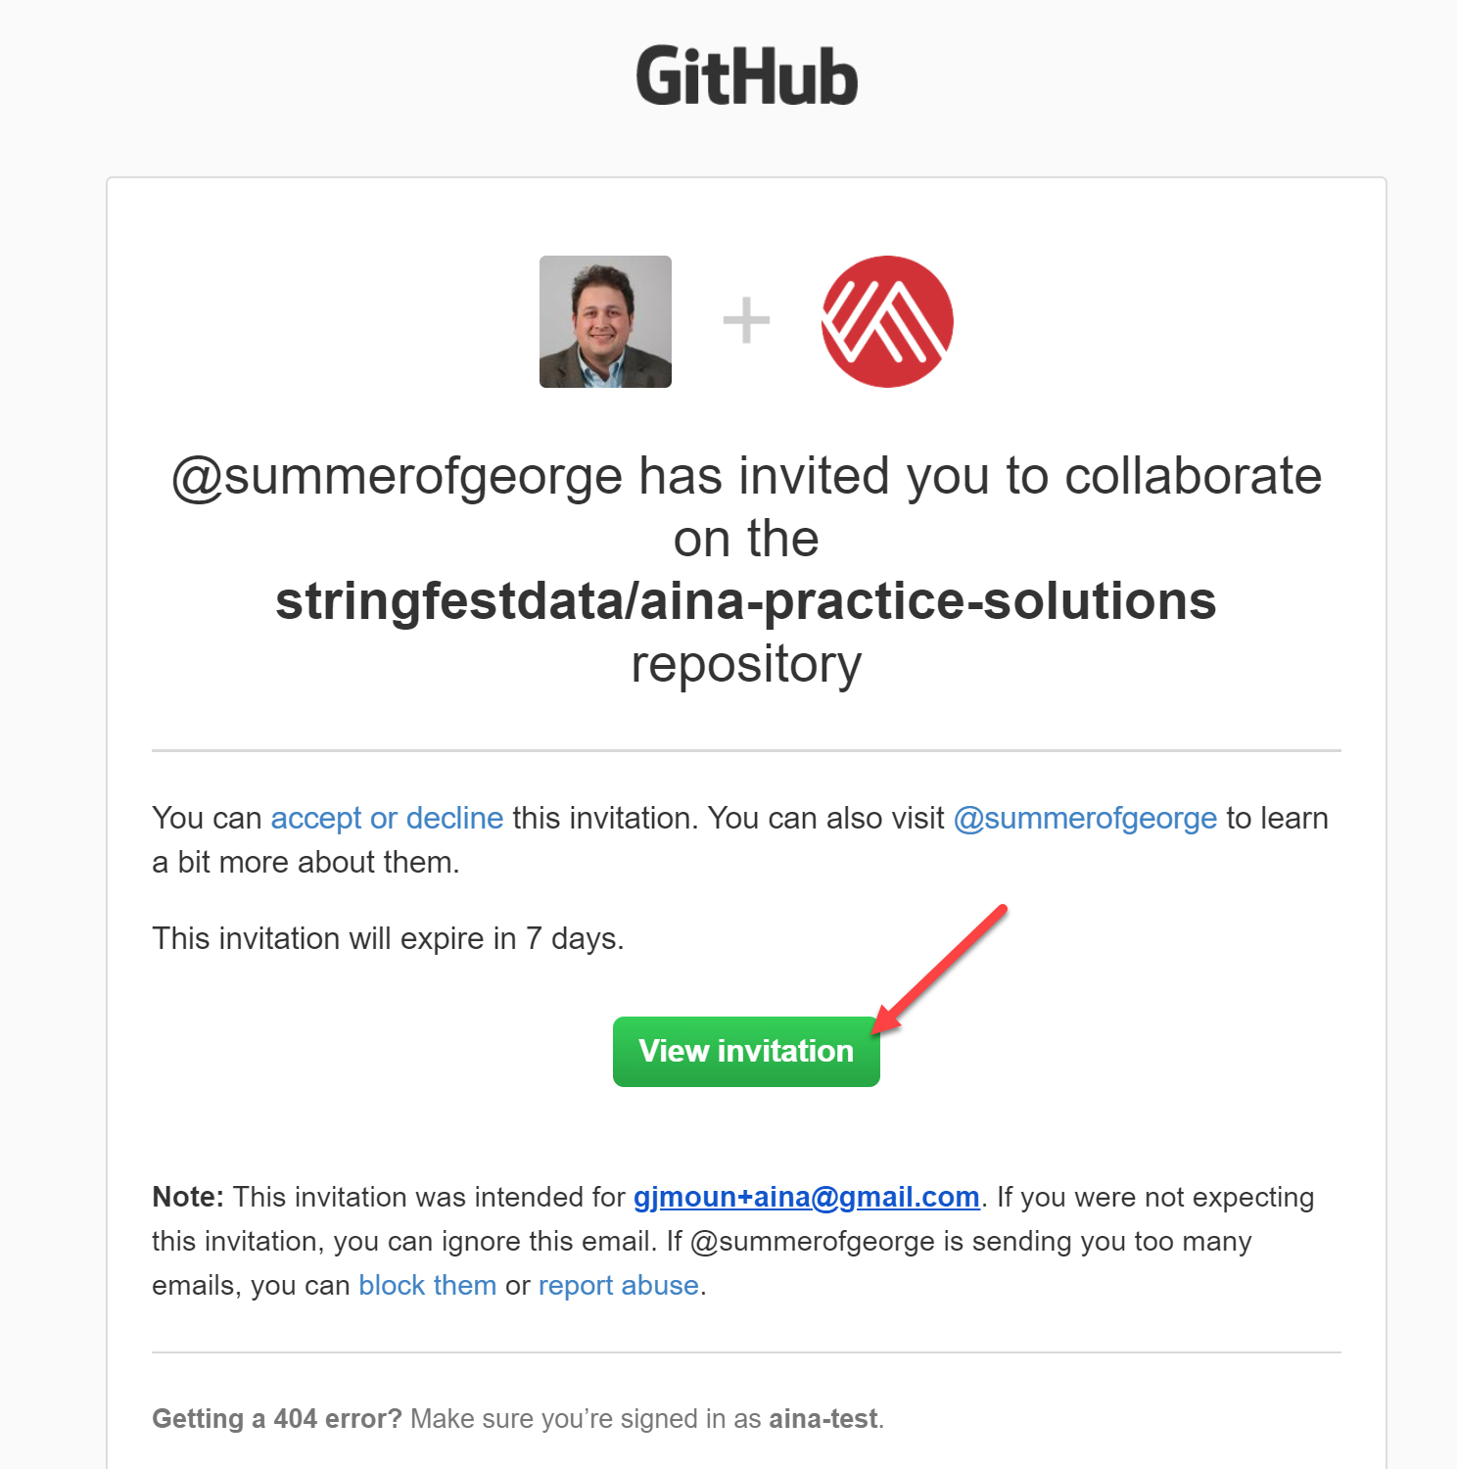
The super-secret AinA repos 😉
aina-practice-solutions: accompanies this test bank
aina-analytics-systems: resources for next course
docs/accessing-repos.docx: notes on accessing repo

Slide 41
Questions?

Slide 42
Event survey: https://forms.office.com/r/0ZnD0LxpZy

Slide 43
THANK YOU
george@stringfestanalytics.com
linkedin.com/in/gjmount
stringfestanalytics.com/contact

