Slide 1


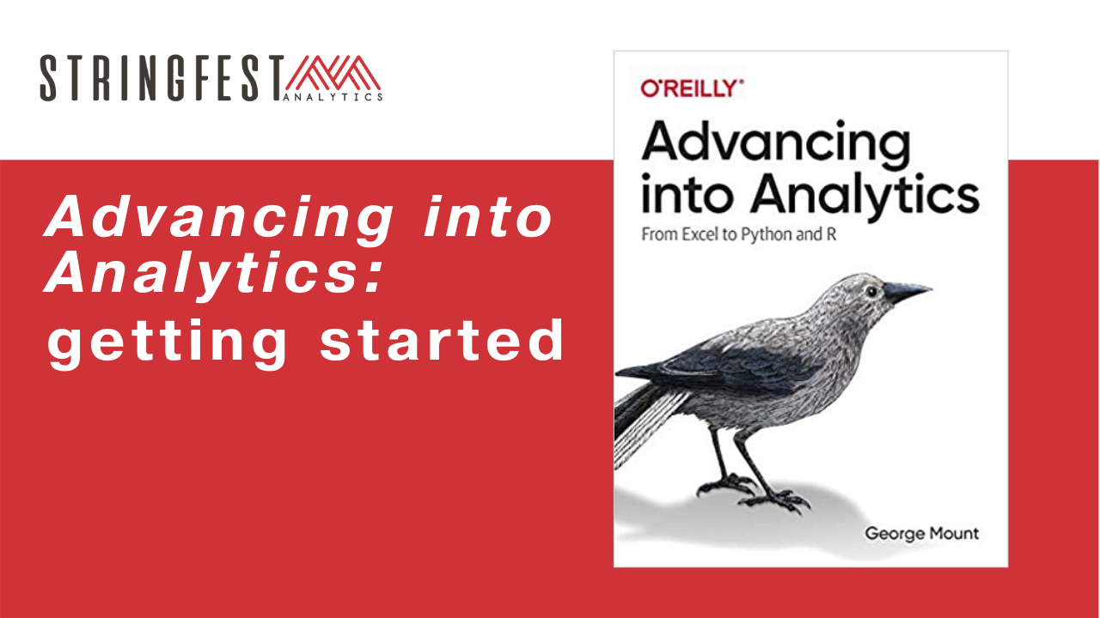
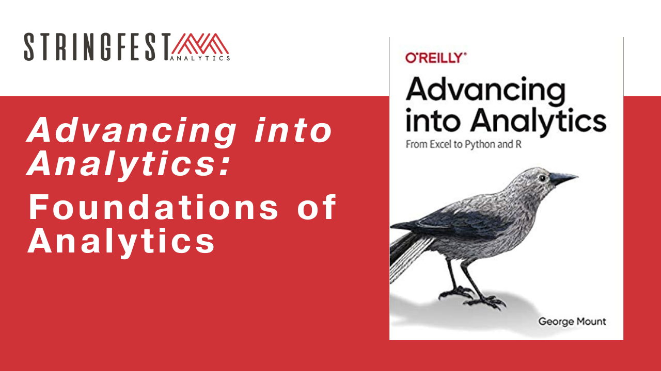
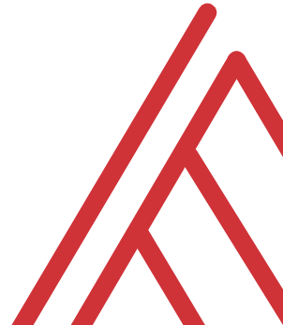
Advancing into Analytics: From Excel to R and Python

Slide 2
Learning objectives
How do you communicate your findings?
What is analytics, anyway? How does data science fit in?
How do they work together? In Excel?

Slide 3
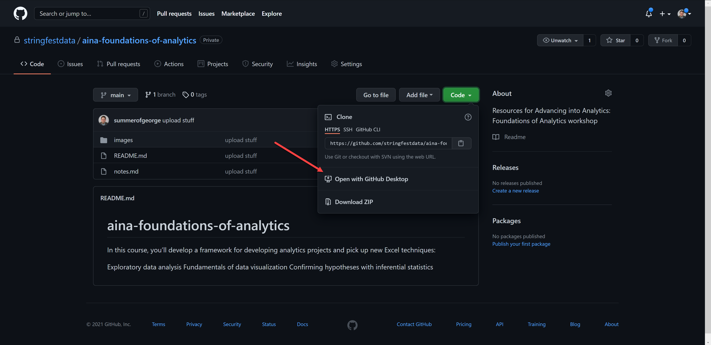
Follow along
Download resources: https://github.com/stringfestdata/aina-foundations-of-analytics
Notes:
The additional courses will dive into using GitHub.

Slide 4
Questions?
Tell us about yourself in the chat!

Slide 5
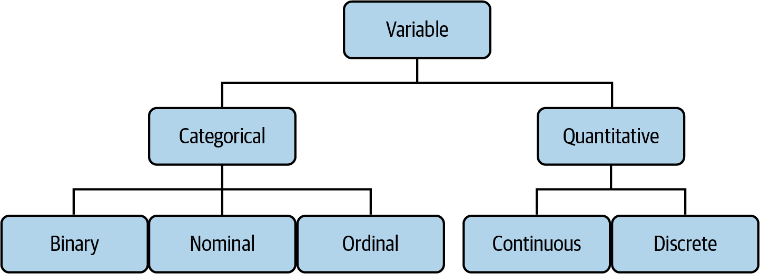

Drill
File: datasets/computers.xlsx
Classify each variable type
Variable descriptions: https://bit.ly/3BJJyue
Mount, George. Advancing into Analytics: From Excel to Python and R. O’Reilly Media, 2021
Notes:
What would happen if we had a brand on here? What if the screen size said small, medium, large?

Slide 6
Demo
File: datasets/computers.xlsx
Is there a difference in price of computers with and without a CD-ROM?
Notes:
Ask a student if they’d like to share their screen and walk through it

Slide 7
Demo
File: datasets/computers.xlsx
Is there a difference in price of computers with and without a CD-ROM?
More book practice: https://github.com/stringfestdata/advancing-into-analytics-practice
Solutions available in Analytics Systems
Notes:
I won’t spend a lot of time with this part as you learned it in the book. But at the same time it’s really important to keep practicing this stuff. So here’s some more if you’d like.

Slide 8
What is analytics, anyway?
Notes:
OK with our refresher done let’s get more theoretical What is analytics, anyway? I talk about it in the book but I really hope to “do” more of it for this course.
But before I provide some ideas I’d like to hear from you; what is analytics to you?

Slide 9
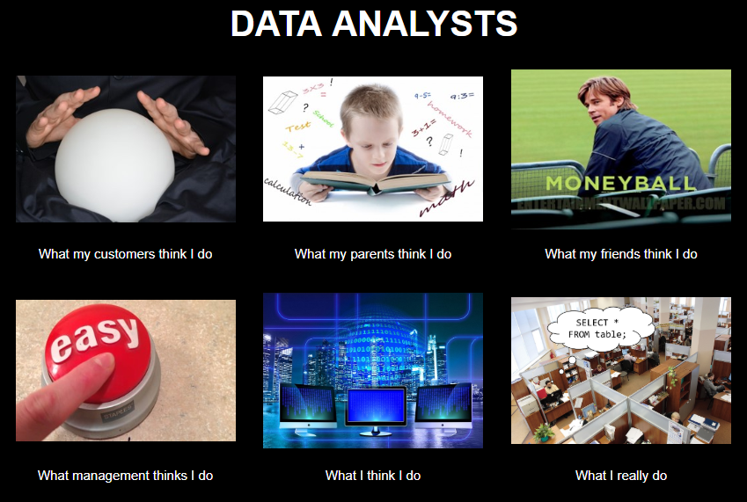
Chat me up…
What does analytics mean to you?
What does this look like for you?
There’s no right answer
ANALYTICS
Notes:
Let me know in the chat or if you’d like to come onstage, what does analytics mean to you? There are so many competing visions of what analytics is. I’m sure you have friends or family members who have no idea what you do or really misunderstand it. So you’re in a “safe place” with other analysts who get it.

Slide 10
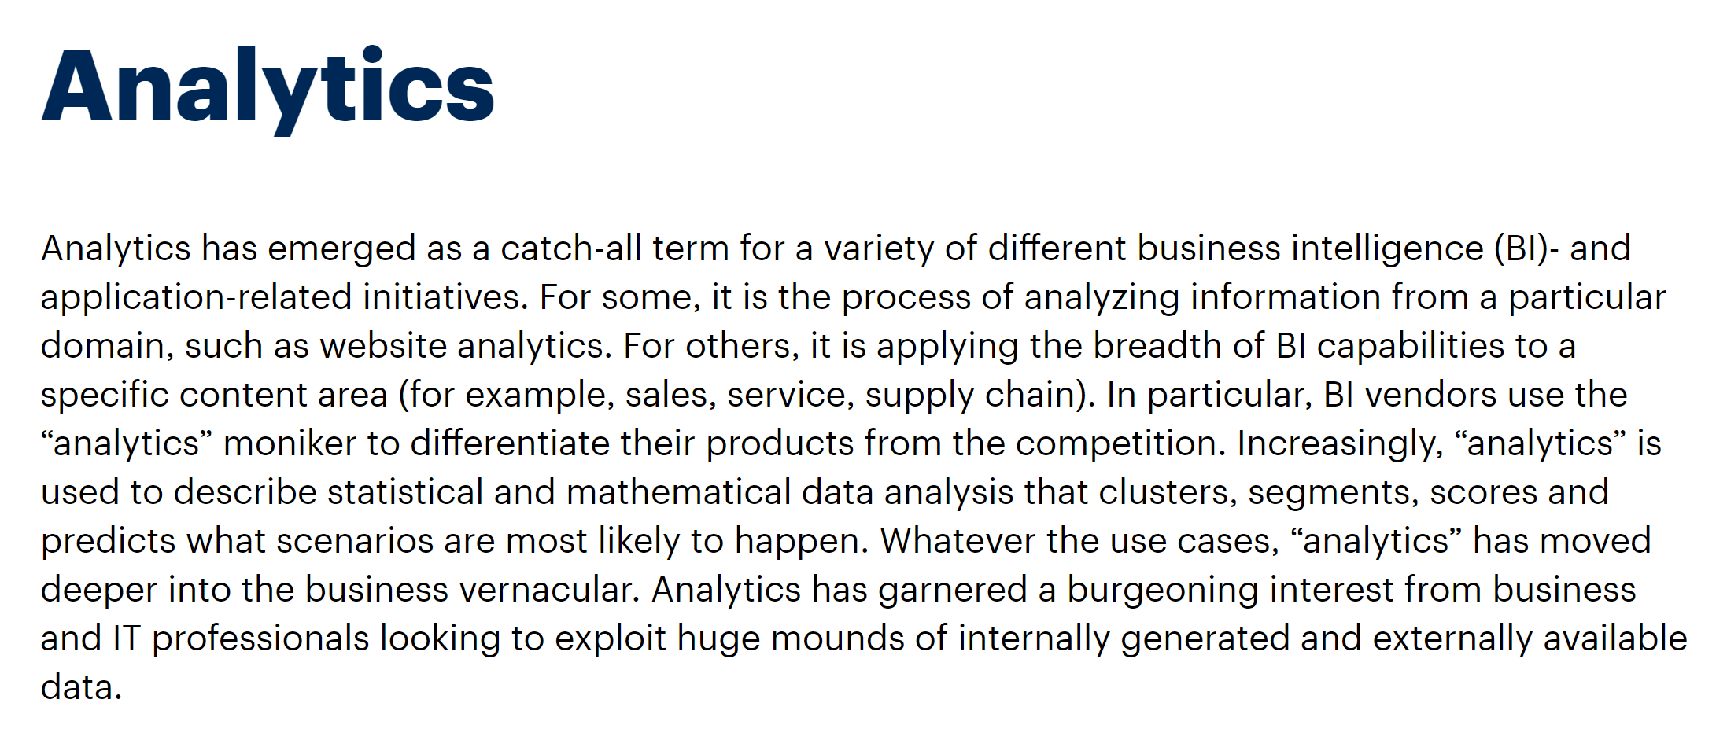
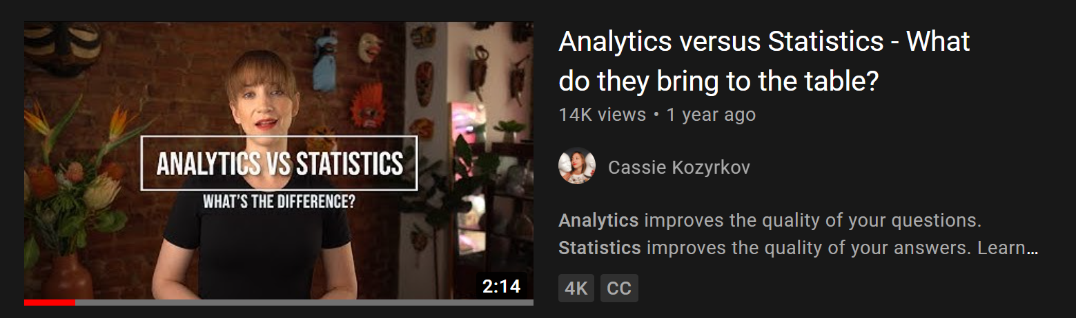
A working definition?
“Using data to make recommendations about what to do given what’s happened”
But wait… there’s more!
https://www.gartner.com/en/information-technology/glossary/analytics
https://www.youtube.com/watch?v=YsrPImZyisI
Notes:
My brief working definition is here…
Gartner has a lengthy definition that brings up some important points. For example if when you say you do analytics people ask, “Oh is that web analytics?”
Cassie Kozkyrov who is chief decision scientist at Google has a description of analytics and how it compares to statistics. We will discuss further how data analytics and data science intersect.

Slide 11
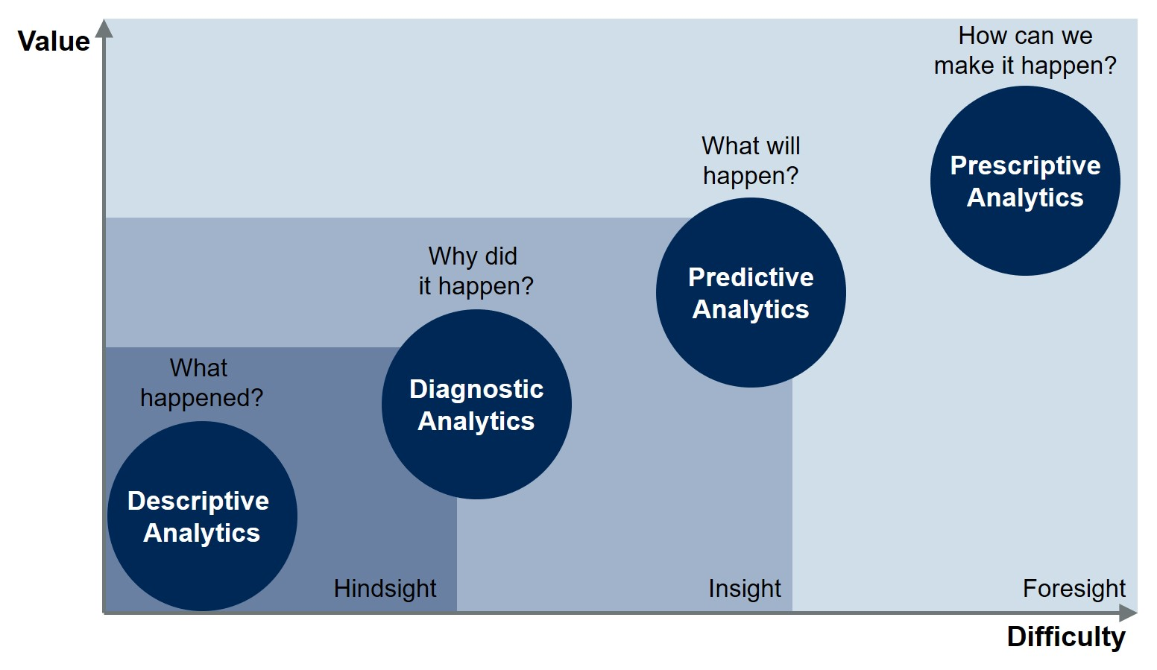
Starting somewhere
https://blogs.gartner.com/jason-mcnellis/2019/11/05/youre-likely-investing-lot-marketing-analytics-getting-right-insights/
Notes:
This is another famous visual from Gartner about analytics maturity.
Think about the types of analytics you’re familiar with and/or use at work. Where do they relate?

Slide 12
Starting somewhere
Inferential statistics
Confirmatory data analysis
Descriptive/summary statistics
Exploratory data analysis
https://blogs.gartner.com/jason-mcnellis/2019/11/05/youre-likely-investing-lot-marketing-analytics-getting-right-insights/
Notes:
Here’s where I would fit in the things covered in the book. We’re looking mostly at descriptive and diagnostic analytics. And you need that solid foundation to get to the next level.

Slide 13
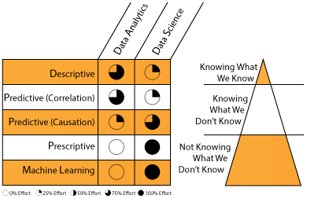
A division of labor
https://datascientistinsights.com/2013/09/09/data-analytics-vs-data-science-two-separate-but-interconnected-disciplines/
Notes:
OK, so who actually does what? I really like this depiction because it breaks down who does what, and what they are actually doing. How machine learning fits in.

Slide 14
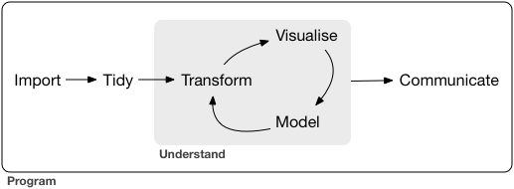
What all analytics has in common
https://r4ds.had.co.nz/introduction.html
Notes:
OK, now that you have a bit more lay of the land and may feel inferior or whatever – don’t! It doesn’t matter what stage of analytics you’re doing; the general process is going to be the same, and a great visualization of that process comes from Hadley Wickham (a name you might remember from the book).
Tidying and transforming are wrangling

Slide 15
Questions?
Notes:
Any questions thus far?

Slide 16
Begin with the end in mind
Notes:
OK so you know what analytics is, or maybe I confused you more. And you have a handle on all the steps that make up analytics. So where does that leave us? Well in the book you learned bits and pieces of the process. But we didn’t spend a ton of time on the communication. So there’s what I want to focus on today.

Slide 17

What makes for compelling analytics?
What does your audience assume to be true?
What if they’re wrong?
What myths can you bust?
What urban legends can you tame?
https://corporate.discovery.com/blog/2016/03/01/mythbusters-goes-out-with-a-bang/
Notes:
OK so let’s say you’ve been assigned some sort of analytics project and I’m guessing if you’re here you’d like to be. How is it going to work, what is your role? I consider the role of analyst to be like that of mythbuster. Finding interesting things that people assume to be true and seeing what the evidence has to say.
So you know your basic mission and ultimately your product is that. What rhetorical questions, urban myths etc can the data answer?

Slide 18
Showing how the data gets tidied?
Matters to the audience
Probably doesn’t
Notes:
All right, so you know our end goal here is to communicate our busted myths to the audience. We will get to the how later. For now let’s start on the what – what are we going to show the audience?
The later into this process we are, the more likely the audience is going to care. There’s not a sharp dropoff pont.

Slide 19
Sizing up a dataset
(So far this is optional; run through the timings)

Slide 20
An analytics presentation in six acts
downloads/a-data-presentation-in-six-acts.pdf
datasets/diabetes.xlsx
Is there a difference in the glucose levels of patients with and without diabetes?

Slide 21

1. Introduction
“Buy the hook, and they’ll buy the story”
Lead with a quote or anecdote… draw them in
Drill:
Who’s the audience?
How can you hook them?
Try it in our doc: https://bit.ly/3taMsoC
Notes:
How could we hook this?

Slide 22
Questions?

Slide 23
2. Hypotheses
You have an opinion… but the data has the truth!
Drill:
State the statistical hypotheses for this analysis
Why are they stated this way?
Notes:
This is your time to "hook" the audience into your work and situtate the project into its wider context. Explain what makes the topic interesting and how you arrived at the questions you asked. Consider leading off with an interesting quote or anecdote related to the topic

Slide 24

3. Data
Where did the data come from?
Why are you using it?
Show, don’t tell: visualizations
Notes:
This is your time to "hook" the audience into your work and situtate the project into its wider context. Explain what makes the topic interesting and how you arrived at the questions you asked. Consider leading off with an interesting quote or anecdote related to the topic

Slide 25
Demo
File: continue with diabetes.xlsx
Profile and clean data with Power Query
Demo notes: docs/data-profiling.docx
What should our “Data” discussion include? Try it in our doc: https://bit.ly/3taMsoC
Notes:
Ask a student if they’d like to share their screen and walk through it

Slide 26







Extract – Transform - Load
This is your behind-the-scenes work
Notes:
This is your time to "hook" the audience into your work and situtate the project into its wider context. Explain what makes the topic interesting and how you arrived at the questions you asked. Consider leading off with an interesting quote or anecdote related to the topic

Slide 27
Questions?

Slide 28

4. Methods
What methods did you use?
Why > how
Notes:
This is your time to "hook" the audience into your work and situtate the project into its wider context. Explain what makes the topic interesting and how you arrived at the questions you asked. Consider leading off with an interesting quote or anecdote related to the topic

Slide 29
Drill
File: continue with diabetes.xlsx
What method would we use to test relationship of glucose and being diabetic?
What assumptions are there?
What parameters are there?
Answer in our doc: https://bit.ly/3taMsoC
Notes:
Ask a student if they’d like to share their screen and walk through it

Slide 30

5. Results
What actually happened?
What evidence does this lend to your hypotheses?
Notes:
This is your time to "hook" the audience into your work and situtate the project into its wider context. Explain what makes the topic interesting and how you arrived at the questions you asked. Consider leading off with an interesting quote or anecdote related to the topic

Slide 31
Drill
File: continue with diabetes.xlsx
What are the results of our work?
Answer in the doc: https://bit.ly/3taMsoC
Notes:
Ask a student if they’d like to share their screen and walk through it

Slide 32
Interlude: Beyond the straight t

Slide 33
Demo
File: continue with diabetes.xlsx
Is there a relationship between having been pregnant and becoming diabetes?
Recode a binary variable
Compare two binary variables: Chi-square
Demo notes: chi-square.xlsx
Notes:
Ask a student if they’d like to share their screen and walk through it

Slide 34
What test for what variables?
If your independent variable is… | And your dependent variable is… | Then look into using…
Binary | Continuous | Independent samples t-test
Categorical | Categorical | Chi-square
Continuous at time 1 | Continuous at time 2 | Paired samples t-test
Categorical | Continuous | ANOVA
Continuous | Continuous | Correlation
Continuous | Continuous | Regression
Continuous | Binary | Logistic regression
Notes:
By the end of this book, you should be able to conduct exploratory data analysis and
hypothesis testing using a programming language.

Slide 35
Questions?

Slide 36
Remember this?
E – T – L
Introduction
Hypotheses
Data
Methods
Results
Discussion/recommendations
Appendix
Explore
Confirm

Slide 37
6. Discussion/recommendations
Knowing what they know now, how should your audience behave differently?
What follow-ups questions are there and how might you answer them?
Answer in the doc: https://bit.ly/3taMsoC
Notes:
This is your time to "hook" the audience into your work and situtate the project into its wider context. Explain what makes the topic interesting and how you arrived at the questions you asked. Consider leading off with an interesting quote or anecdote related to the topic

Slide 38
7. Bonus! Appendix
Knowing what they know now, how should your audience behave differently?
What follow-ups questions are there and how might you answer them?
Answer in the doc: https://bit.ly/3taMsoC
Notes:
This is your time to "hook" the audience into your work and situtate the project into its wider context. Explain what makes the topic interesting and how you arrived at the questions you asked. Consider leading off with an interesting quote or anecdote related to the topic

Slide 39
Drill
Practice the seven acts:
File: datasets/housing.xlsx
Is there a difference in the sale price of homes with and without a rec room?
Breakout rooms/reconvene
Notes:
Split into breakout grups and work on it….

Slide 40
Questions?

Slide 41
The future of Excel

Slide 42




Data: more than rows and columns
Structured
Unstructured

Slide 43
Demo
Unstructured data: coming to Excel
File: datasets/sentiment.xlsx
Analyze the sentiment of each review (positive/negative/neutral)
Is there a relationship between sentiment and polarity?
Demo notes: docs/excel-sentiment.xlsx
Notes:
Ask a student if they’d like to share their screen and walk through it

Slide 44
Event survey: https://forms.office.com/r/0ZnD0LxpZy

Slide 45
THANK YOU
george@stringfestanalytics.com
linkedin.com/in/gjmount
stringfestanalytics.com/contact

Slide 46
Conclusion/Next steps

Slide 47
Assignments for Analytics Systems

Slide 48
Got Git?
Download Git for Windows: https://git-scm.com/download/win
Create a GitHub account: https://github.com
Download GitHub Desktop: https://desktop.github.com
Good documentation on setting up Git & GitHub here

Slide 49
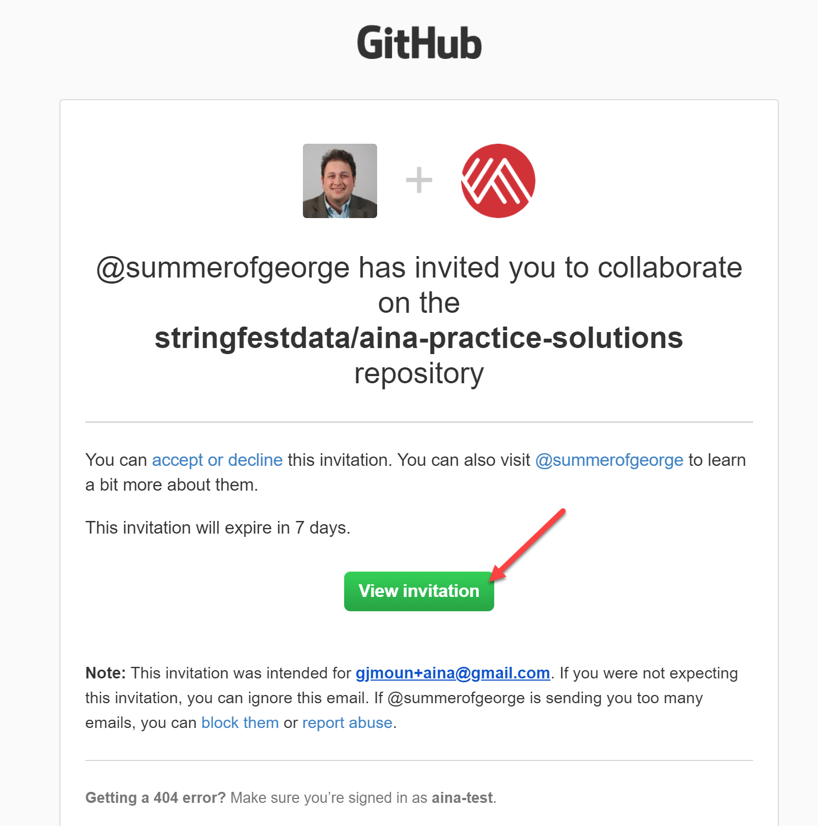
The super-secret AinA repos 😉
aina-practice-solutions: accompanies this test bank
aina-analytics-systems: resources for next course
docs/accessing-repos.docx: notes on accessing these repos

