Slide 1
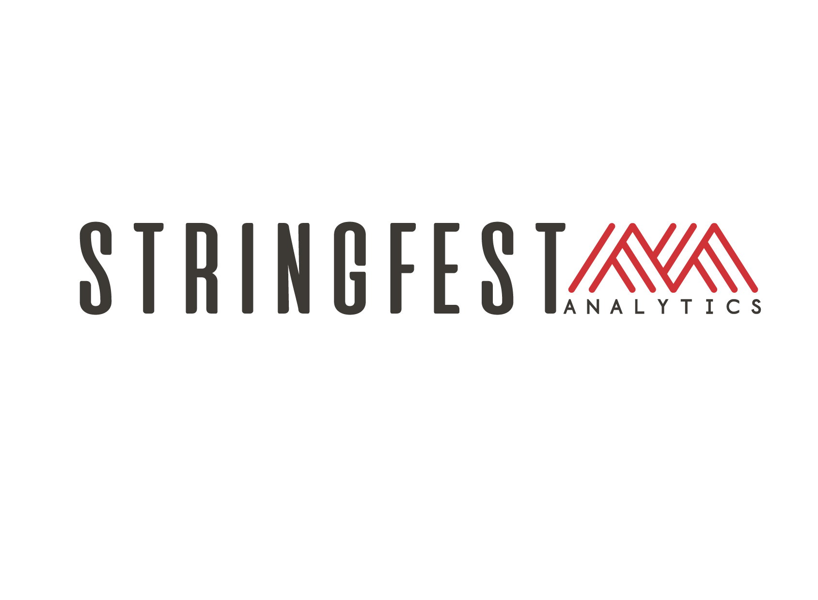

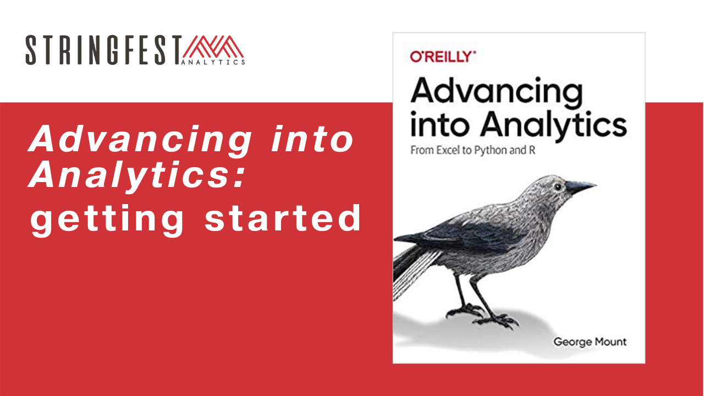
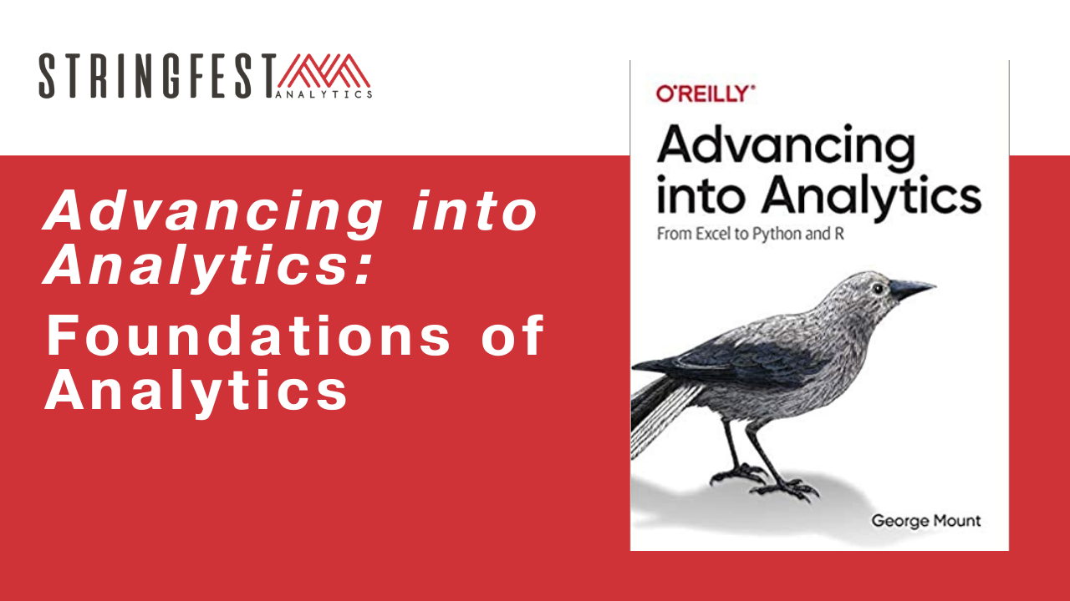
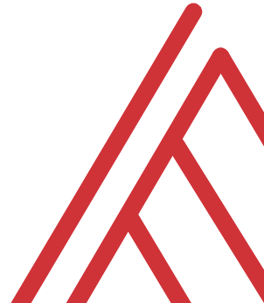
Advancing into Analytics: From Excel to R and Python
Notes:
Thank you all for coming – we have a lot to get to today so I will just keep going. A recording will be sent to you after the event.

Slide 2
Learning objectives
How do you communicate your findings?
What is analytics, anyway? How does data science fit in?
How do they work together? In Excel?
Notes:
Now today’s class is going to be conducted exclusively in Excel, and as you read in the book Excel is a valued part of the data analytics stack. We are going to dive deeper into presenting analytics findings, I will give you a framework for making those presentations.
We’ll also revisit the concept of analytics as a whole; what is it, anyway? Some of you may be interested in data science or machine learning – the book talks a bit about this and we’ll do more here to situate how data analytics and data science relate together. As mentioned in the book, there is usually more that unites than divides the fields of data analytics and data science, and we’ll look an example of using them together right within Excel.

Slide 3
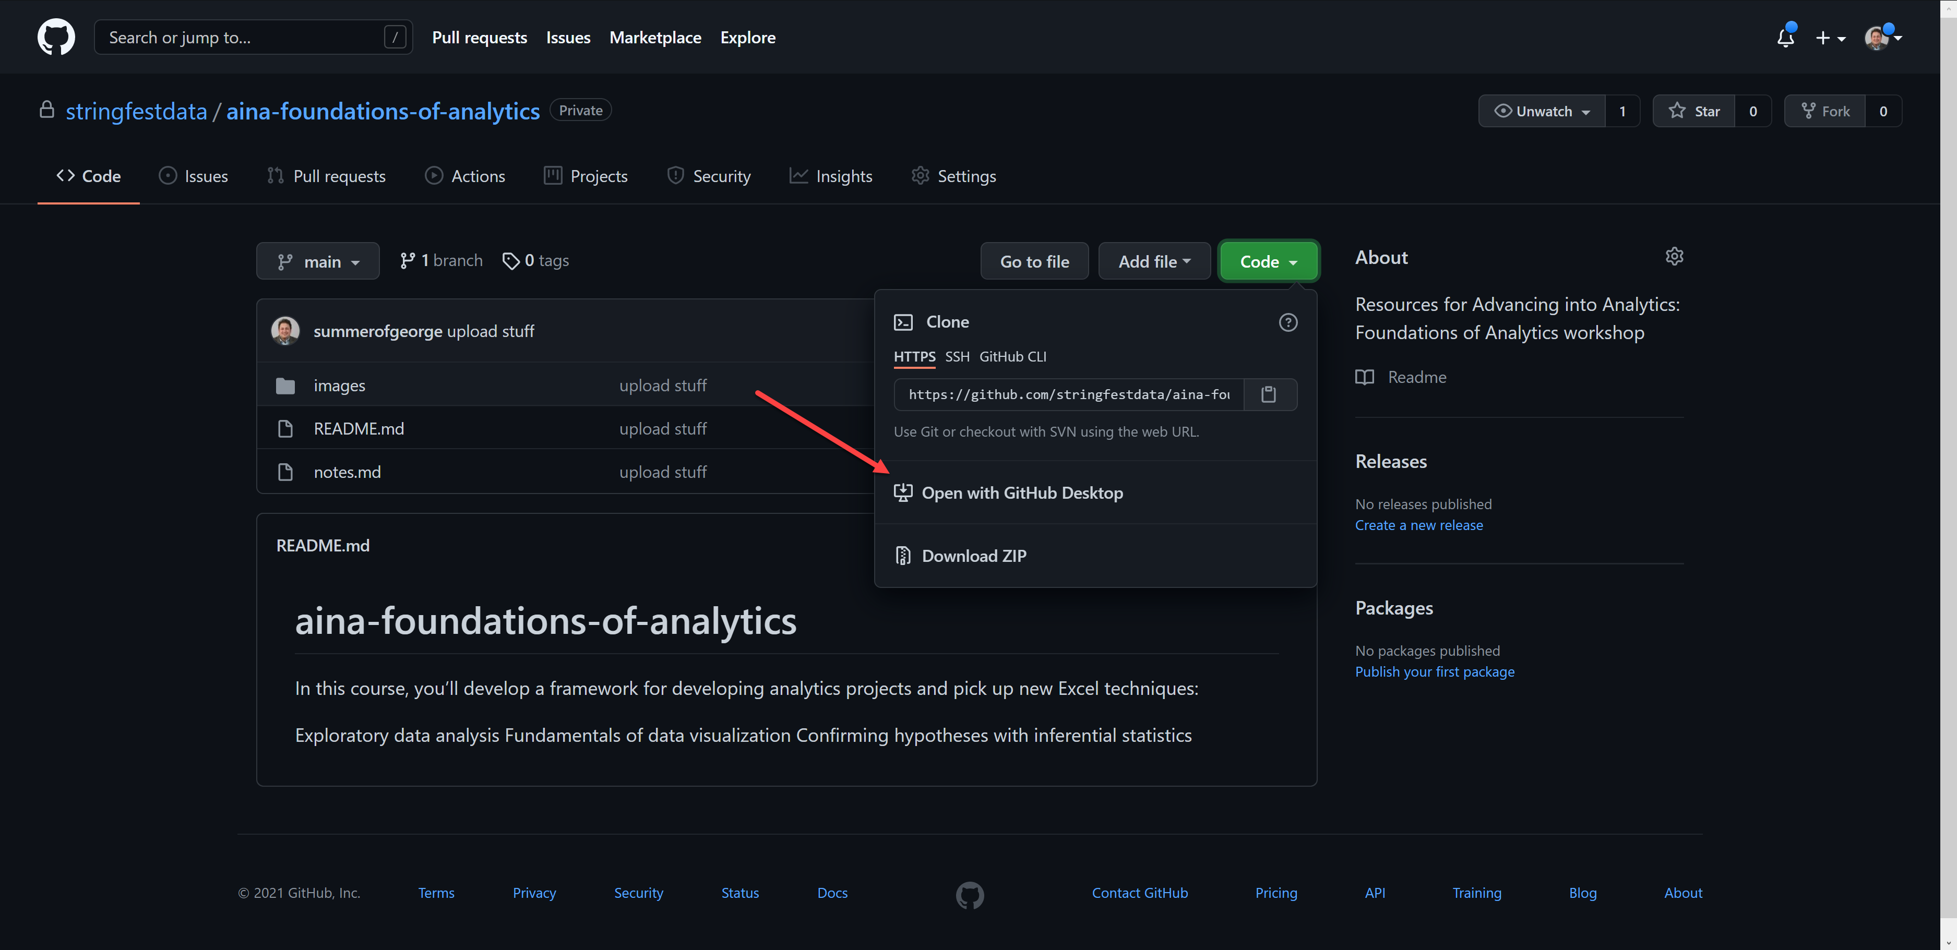
Follow along
Download resources: https://github.com/stringfestdata/aina-foundations-of-analytics
Notes:
Let’s walk through how to download the resources for today on GitHub. If you’d like to learn more about collaboration with GitHub, check out one of the other courses.

Slide 4
Questions?
Tell us about yourself in the chat!
Notes:
Now you are always welcome to leave your questions in the chat. Tell us about yourself and where you are coming from in the chat.

Slide 5
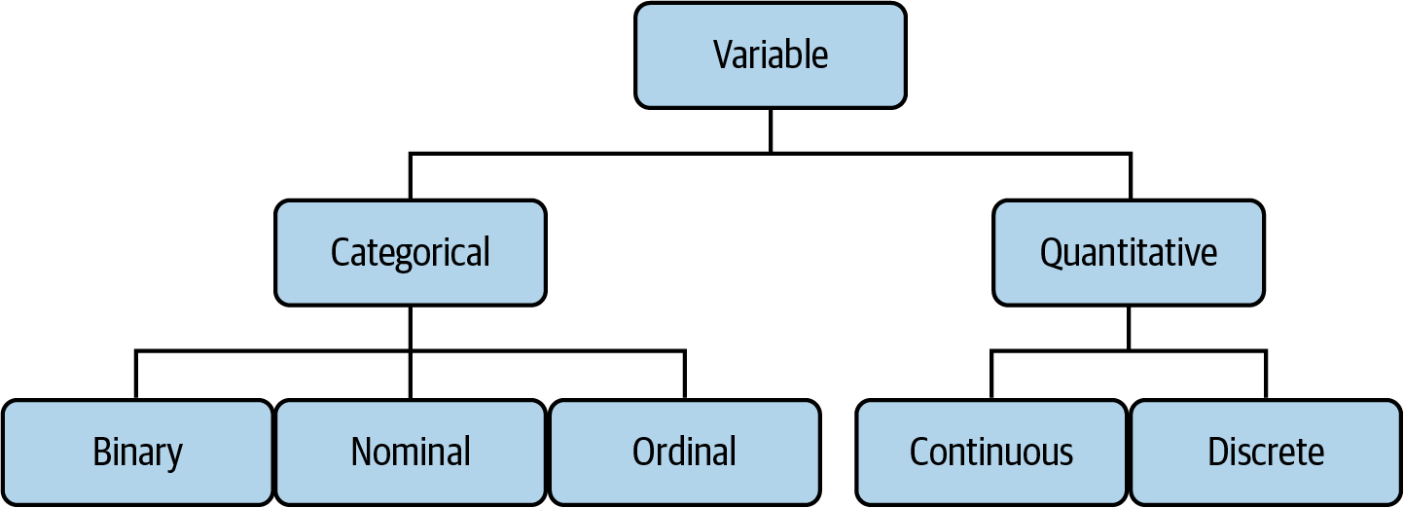

Drill
File: datasets/computers.xlsx
Classify each variable type
Variable descriptions: https://bit.ly/3BJJyue
Mount, George. Advancing into Analytics: From Excel to Python and R. O’Reilly Media, 2021
Notes:
OK, before moving into these topics, let’s take some time practicing some things from the book.
I am going to split you into breakout rooms and you can classify these variables. The dataset is available in the datasets folder.
What would happen if we had a brand on here? What if the screen size said small, medium, large?

Slide 6
Demo
File: datasets/computers.xlsx
Is there a difference in price of computers with and without a CD-ROM?
Notes:
Cool, I hope that last one refreshed your memory. Let’s do one more exercise you should be familiar with from the book. Does anyone want to volunteer walking through it? If not I will do it.

Slide 7
Demo
File: datasets/computers.xlsx
Is there a difference in price of computers with and without a CD-ROM?
More book practice: https://github.com/stringfestdata/advancing-into-analytics-practice
Solutions available in Analytics Systems
Notes:
I won’t spend a lot of time with this part as you learned it in the book. But at the same time it’s really important to keep practicing this stuff. So here’s some more if you’d like.

Slide 8
What is analytics, anyway?
Notes:
OK with our refresher done let’s get more theoretical What is analytics, anyway? I talk about it in the book but I really hope to “do” more of it for this course.
But before I provide some ideas I’d like to hear from you; what is analytics to you?

Slide 9
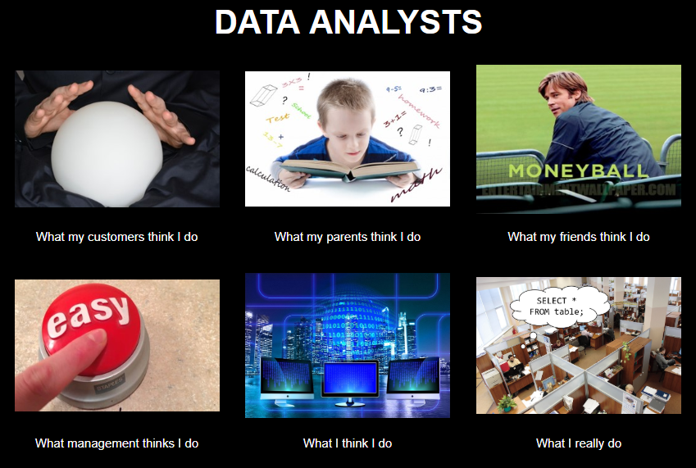
Chat me up…
What does analytics mean to you?
What does this look like for you?
There’s no right answer
ANALYTICS
Notes:
Let me know in the chat or if you’d like to come onstage, what does analytics mean to you? There are so many competing visions of what analytics is. I’m sure you have friends or family members who have no idea what you do or really misunderstand it. So you’re in a “safe place” with other analysts who get it.

Slide 10
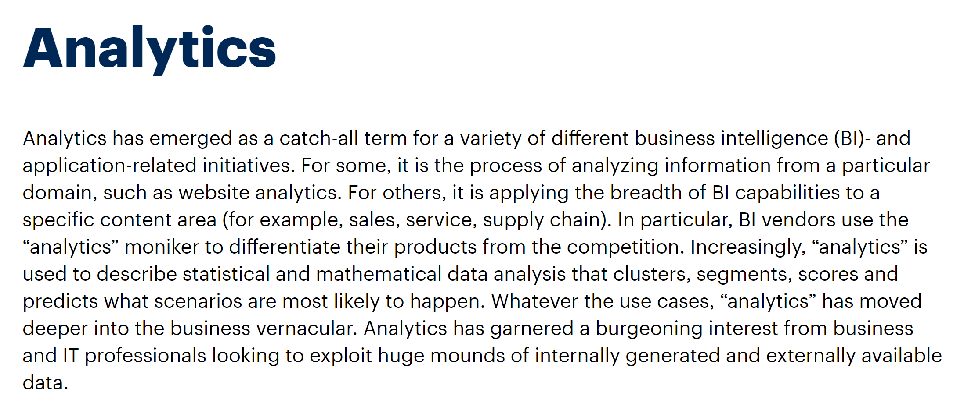
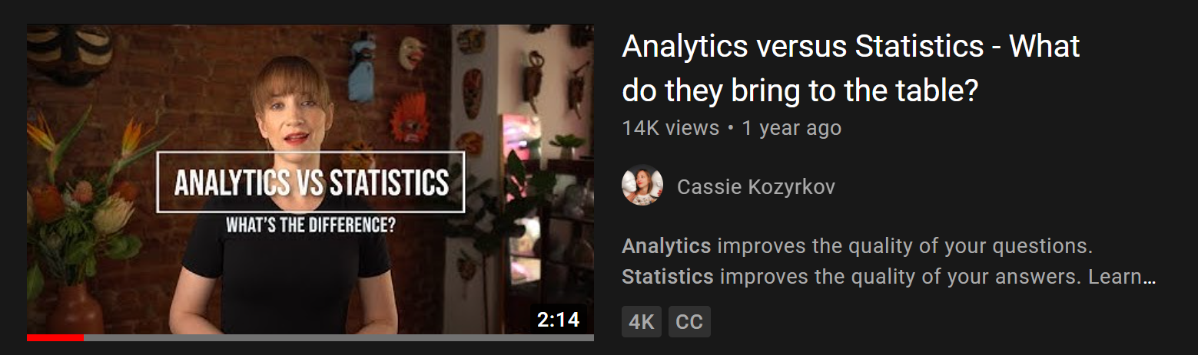
A working definition?
“Using data to make recommendations about what to do given what’s happened”
But wait… there’s more!
https://www.gartner.com/en/information-technology/glossary/analytics
https://www.youtube.com/watch?v=YsrPImZyisI
Notes:
My brief working definition is here…
Gartner has a lengthy definition that brings up some important points. For example if when you say you do analytics people ask, “Oh is that web analytics?”
Cassie Kozkyrov who is chief decision scientist at Google has a description of analytics and how it compares to statistics. We will discuss further how data analytics and data science intersect.

Slide 11
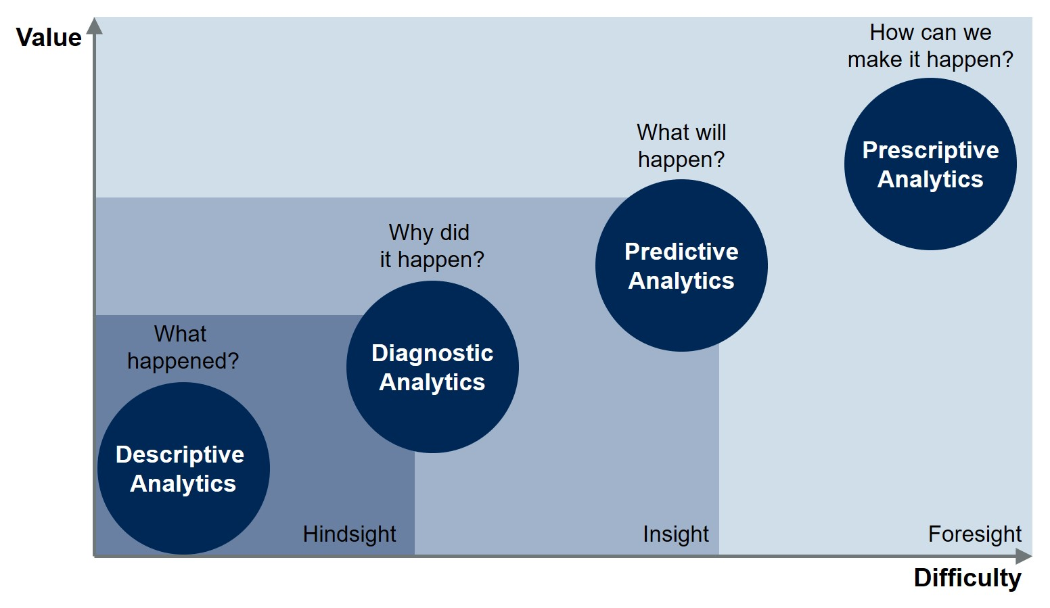
Starting somewhere
https://blogs.gartner.com/jason-mcnellis/2019/11/05/youre-likely-investing-lot-marketing-analytics-getting-right-insights/
Notes:
This is another famous visual from Gartner about analytics maturity.
Think about the types of analytics you’re familiar with and/or use at work. Where do they relate?
Descriptive: A variance analysis is a good example. You just find that there is a variance and not necessarily why.
Diagnostic gets into the why. You can identify the root cause of the problem or map out some relationship.
Predictive gets into forecasting. You might predict the likelihood of something happening or otherwise what the result will be.
Finally prescriptive gets into evaluating various scenarios and guiding your decision on what to do next. A traffic application helping you find the best route home is a good example. Often this is the kind of data that’s incorporating realtime streaming data with historical models and this is going to be more prevalent with internet of things and so forth.

Slide 12
Starting somewhere
Inferential statistics
Confirmatory data analysis
“Statistics”
Descriptive/summary statistics
Exploratory data analysis
“Analytics”
https://blogs.gartner.com/jason-mcnellis/2019/11/05/youre-likely-investing-lot-marketing-analytics-getting-right-insights/
Notes:
Here’s where I would fit in the things covered in the book. We’re looking mostly at descriptive and diagnostic analytics. There are some analogies to be drawn between descriptive statistics and exploratory data analysis in that first step. Then a term we really didn’t talk about but is related is confirmatory data analysis. That is equivalent to inferential statistics. These two levels in my mind are what Cassie Kozkyrov is talking about when she distinguishes analytics from statistics.
And you need that solid foundation to get to the next level.

Slide 13
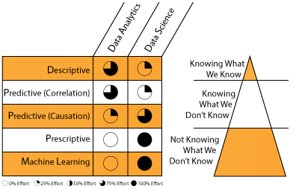
A division of labor
https://datascientistinsights.com/2013/09/09/data-analytics-vs-data-science-two-separate-but-interconnected-disciplines/
Notes:
OK, so who actually does what? I really like this depiction because it breaks down who does what, and what they are actually doing. How machine learning fits in. Again, data analysts tend to start the process off by exploring what happened and why. Once that is confirmed it gets handed off to the data scientists to build predictive models. But this is a gradual handoff and there is some overlap, especially when it comes to predictive analytics. Remember a lot of these models are the same, like linear regression. They are just being used differently

Slide 14
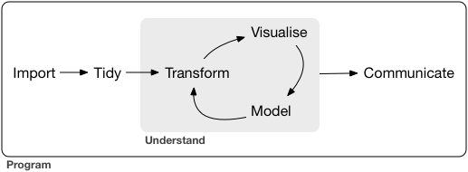
What all analytics has in common
https://r4ds.had.co.nz/introduction.html
Notes:
OK, now that you have a bit more lay of the land and may feel inferior or whatever – don’t! It doesn’t matter what stage of analytics you’re doing; the general process is going to be the same, and a great visualization of that process comes from Hadley Wickham (a name you might remember from the book).
You learned a bit about many of these steps in the book, you learned how to bring in data, clean it and build charts, etc. What we didn’t do a lot of and what I want to focus on a bit more during our class, is how to present these insights.

Slide 15
Questions?
Notes:
Any questions thus far? About what analytics is, what data analysts vs data scientists do, etc?

Slide 16
Begin with the end in mind
Notes:
OK so you know what analytics is, or maybe I confused you more. And you have a handle on all the steps that make up analytics. So where does that leave us? Well in the book you learned bits and pieces of the process. But we didn’t spend a ton of time on the communication. So there’s what I want to focus on today.

Slide 17
Chat me up
What questions do you have about analytics presentations?
What has blocked you in the past?
Notes:
Before I give my thoughts, I would love to hear from you – what do you think about when you hear analytics presentations? Or what has stopped you from doing your best in the past?

Slide 18

What makes for compelling analytics?
What does your audience assume to be true?
What if they’re wrong?
What myths can you bust?
What urban legends can you tame?
https://corporate.discovery.com/blog/2016/03/01/mythbusters-goes-out-with-a-bang/
Notes:
OK so let’s say you’ve been assigned some sort of analytics project and I’m guessing if you’re here you’d like to be. How is it going to work, what is your role? I consider the role of analyst to be like that of mythbuster. Finding interesting things that people assume to be true and seeing what the evidence has to say.
So you know your basic mission and ultimately your product is that. What rhetorical questions, urban myths etc can the data answer?

Slide 19
Showing how the data gets tidied?
Matters to the audience
Probably doesn’t
Notes:
All right, so you know our end goal here is to communicate our busted myths to the audience. We will get to the how later. For now let’s start on the what – what are we going to show the audience?
The later into this process we are, the more likely the audience is going to care. There’s not a sharp dropoff pont.

Slide 20
Sizing up a dataset
(So far this is optional; run through the timings)

Slide 21
An analytics presentation in six acts
Notes:
Here are six steps to guide as a framework. Given all you know about analytics thus far you might not expect a completely one-size-fits-all approach.

Slide 22
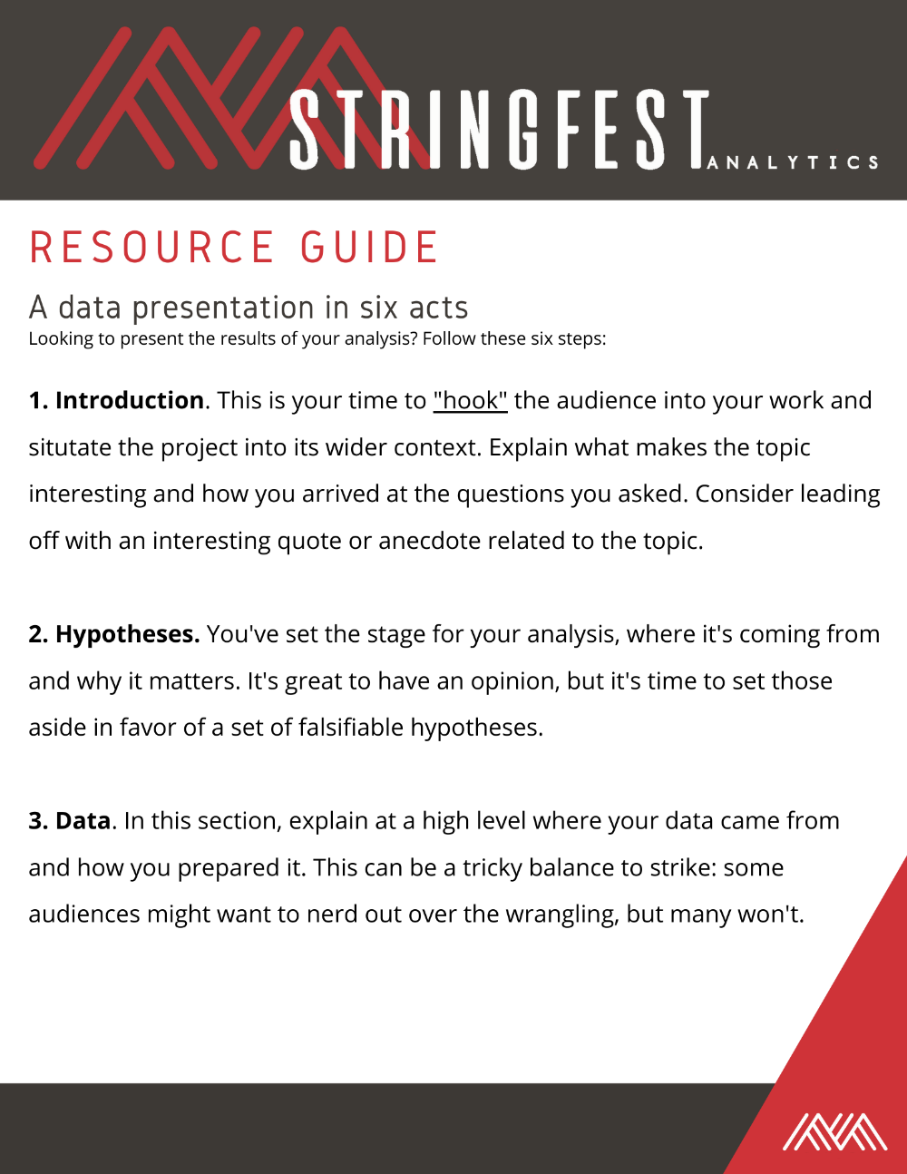
An analytics presentation in six acts
docs/a-data-presentation-in-six-acts.pdf
Notes:
You will find a PDF in your docs folder with a write up of what we’re talking about here.

Slide 23
An analytics presentation in six acts
datasets/diabetes.xlsx
Is there a difference in the glucose levels of patients with and without diabetes?
Notes:
OK, let’s move onto an example that we’ll work together. Of course when you’re an analyst you generally aren’t handed one off the shelf, but bear with me.
We’re going to go through the six steps and collaborate together in a Google doc answering them.

Slide 24
An analytics presentation in six acts
Let’s write one together: https://bit.ly/3taMsoC
Notes:
OK, let’s move onto an example that we’ll work together. Of course when you’re an analyst you generally aren’t handed one off the shelf, but bear with me.
We’re going to go through the six steps and collaborate together in a Google doc answering them.

Slide 25
Questions?
Notes:
Questions thus far?

Slide 26

1. Introduction
“Buy the hook, and they’ll buy the story”
Lead with a quote or anecdote… draw them in
Drill:
Who’s the audience?
How can you hook them?
Try it in our doc
Notes:
OK first, the introduction. If you study writing you’ll hear not to bury the lede and to hook the reader. It’s the same thing here. Start with something that really comes out of your audience’s own world, that they relate to.
Of course in one of these lab-baked examples like ours we don’t really know who our audience is, so let’s just guess. Often you do kind of have to guess when you’re doing data work.

Slide 27
2. Hypotheses
You have an opinion… but the data has the truth!
Drill:
State the statistical hypotheses for this analysis
Why are they stated this way?
Write them in our doc
Notes:
OK, now the hypotheses. If you are feeling rusty with how these work, go back to the book. Who would like to write the hypotheses in our doc?

Slide 28

3. Data
Where did the data come from?
Why are you using it?
Show, don’t tell: visualizations
Notes:
In this section, explain at a high level where your data came from and how you prepared it. This can be a tricky balance to strike: some audiences might want to nerd out over the wrangling, but many won’t.
Instead, discuss the philosophy behind what data is being used and why it's right to the hypotheses. This is also a great place to include some data visualizations to really give your audience a sense of the data's look and feel.

Slide 29
Demo
File: continue with diabetes.xlsx
Profile and clean data with Power Query
Demo notes: docs/data-profiling.docx
What should our “Data” discussion include? Try it in our doc
Notes:
How many of you have used Power Query before? (Y/N)
We will use it to profile and clean the data. And then from the results of our data preparation we will do a write up in our doc.

Slide 30





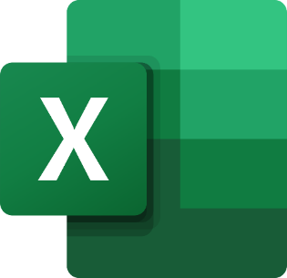

Extract – Transform - Load
This is your behind-the-scenes work
Notes:
Now that you’ve seen Power Query in action, it’s a good time to bring up ETL which is a fundamental process for analytics.
It’s important stuff doing all the cleaning etc. But this is behind the scenes work. I like to draw the analogy of film editors. We so little of their work but that’s kind of the point.

Slide 31
Questions?
Notes:
Questions thus far about this process?

Slide 32

4. Methods
What methods did you use?
Why > how
Notes:
In this section you will cover, again at a high level, what methods you used to conduct the data analysis. If there are any assumptions that your test relies on, call them out here. The same spirit as #3 applies: this is more about explaining why you chose these methods, rather than a deep dive into how you conducted them or how they work.

Slide 33
Drill
File: continue with diabetes.xlsx
What method would we use to test relationship of glucose and being diabetic?
What assumptions are there?
What parameters are there?
Answer in our doc
Notes:
Who wants to try answering these in the doc?

Slide 34

5. Results
What actually happened?
What evidence does this lend to your hypotheses?
Notes:
It's finally time to report what happened when you performed the designated methods on the aforementioned data. What does this mean for your hypotheses? Give the relevant diagnostics and statistics; what's relevant may be dependent on the technical prowess of your audience. The beauty of this framework is there's no fudging the results, as you were transparent about every component of the analysis.

Slide 35
Drill
File: continue with diabetes.xlsx
What are the results of our work?
Answer in the doc
Notes:
Ask a student if they’d like to share their screen and walk through it

Slide 36
Interlude: Beyond the straight t
Notes:
OK before we continue on, while we’re on the topic of methods; a little bit more info about doing this.
So in the book you learned about classifying variables and naming your independent and dependent variables. Now based on the types of your dependent and independent variables, you might use different methods.
The book used t-test and regression; does anyone remember what type your IV and DV should be for that?
There are certainly way more tests and these are the more classic statistical tests. There are even more ways to do them with machine learning, so that can feel even more confusing. But these are the classic methods for inferential statistics that are still used…

Slide 37
Demo
File: continue with diabetes.xlsx
Is there a relationship between having been pregnant and becoming diabetes?
Recode a binary variable
Compare two binary variables: Chi-square
Demo notes: chi-square.xlsx
Notes:
Ask a student if they’d like to share their screen and walk through it

Slide 38
What test for what variables?
If your independent variable is… | And your dependent variable is… | Then look into using…
Binary | Continuous | Independent samples t-test
Categorical | Categorical | Chi-square
Continuous at time 1 | Continuous at time 2 | Paired samples t-test
Categorical | Continuous | ANOVA
Continuous | Continuous | Correlation
Continuous | Continuous | Regression
Continuous | Binary | Logistic regression
Notes:
We’ll cover a few more of these in the book but I hope this can serve as a bit of a cheat sheet for you. These methods are really foundational. A/B tests are just t-tests/; you saw ANOVA used as part of the regression diagnostics.
The ones we haven’t done are paired t-test and ANOVA and walkthroughs of those in Excel are in the docs folder.

Slide 39
Questions?
Notes:
Any questions thus far?

Slide 40
Remember this?
E – T – L
Introduction
Hypotheses
Data
Methods
Results
Discussion/recommendations
Appendix
Explore
Confirm
Notes:
All right, with that sidetrack out of the way, let’s get back to a visualization that should look familiar! What have we done so far – well we learned a bit about ETL, we saw how exploratory and confirmatory data analysis could work together and then we learned how to communicate our work.
But there are still two very important steps left!

Slide 41
6. Discussion/recommendations
Knowing what they know now, how should your audience behave differently?
What follow-ups questions are there and how might you answer them?
Answer in the doc
Notes:
First the recommendations – this is what everything has been leading up to. Knowing what your audience now knows, how should they behave differently? What follow ups are there and how might you answer them?

Slide 42

7. Bonus! Appendix
Let your behind-the-scenes work shine
Notes:
One

Slide 43
Drill
Practice the seven acts:
File: datasets/housing.xlsx
Is there a difference in the sale price of homes with and without a rec room?
Breakout rooms/reconvene
Notes:
Split into breakout grups and work on it….

Slide 44
Questions?

Slide 45
The future of analytics & Excel

Slide 46




Data: more than rows and columns
Structured
Unstructured
Notes:
Now we are used to structured data but unstructured data is coming into vogue and there are ways to use them together…

Slide 47
Demo
Unstructured data: coming to Excel
File: datasets/sentiment.xlsx
Analyze the sentiment of each review
Is there a relationship between sentiment and polarity?
Demo notes: docs/excel-sentiment.xlsx
Notes:
Let’s take an example where we will use Azure to predict the sentiment of a bunch of Yelp reviews and then compare these to the original stars left.

Slide 48
THANK YOU
george@stringfestanalytics.com
linkedin.com/in/gjmount
stringfestanalytics.com/contact

Slide 49
Event survey: https://forms.office.com/r/0ZnD0LxpZy

Slide 50
Next Steps for Analytics Systems

Slide 51
Got Git?
Download Git for Windows: https://git-scm.com/download/win
Create a GitHub account: https://github.com
Download GitHub Desktop: https://desktop.github.com
Download Visual Studio Code: https://code.visualstudio.com
Good documentation on setting up Git & GitHub here

Slide 52
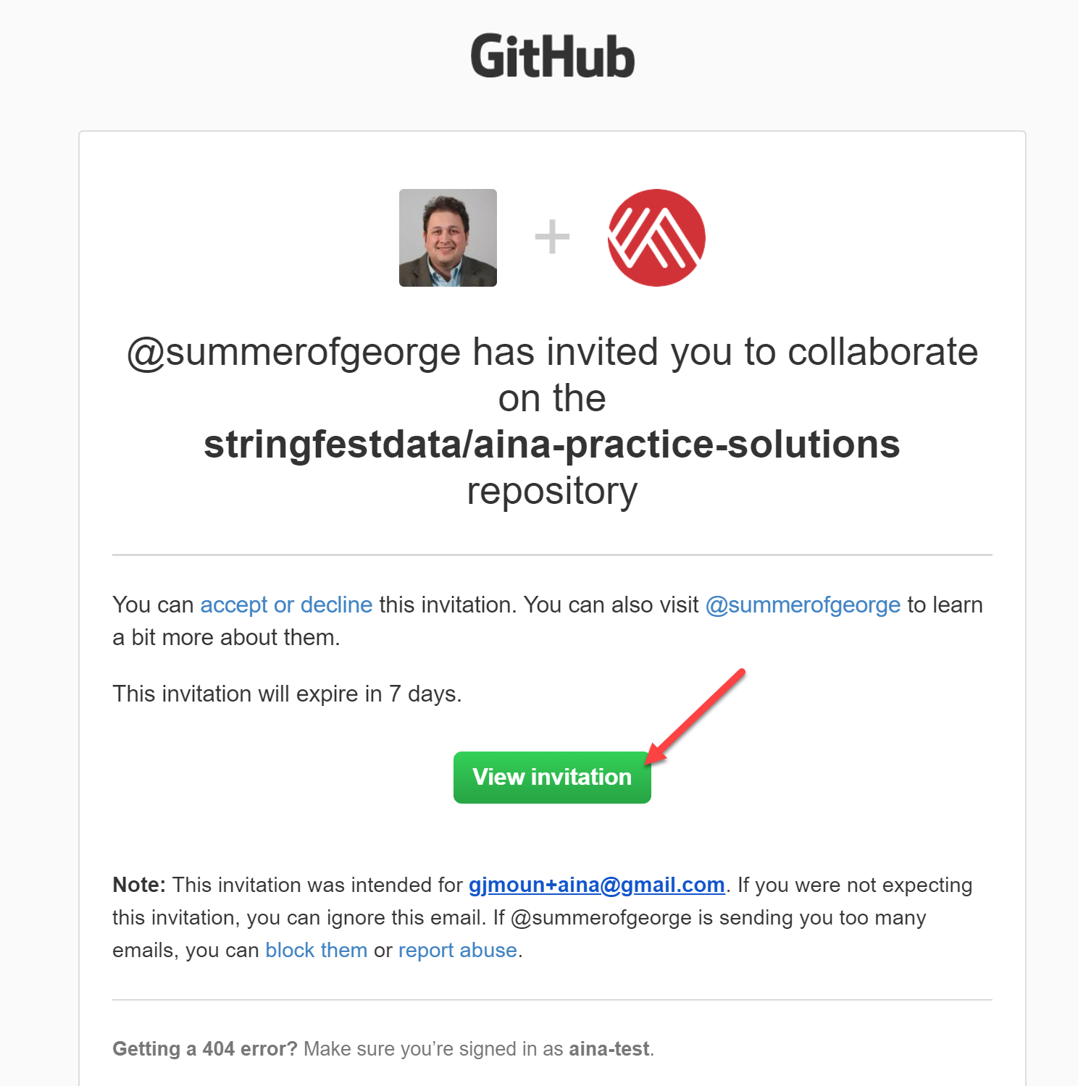
The super-secret AinA repos 😉
aina-practice-solutions: accompanies this test bank
aina-analytics-systems: resources for next course
docs/accessing-repos.docx: notes on accessing these repos

