Slide 1
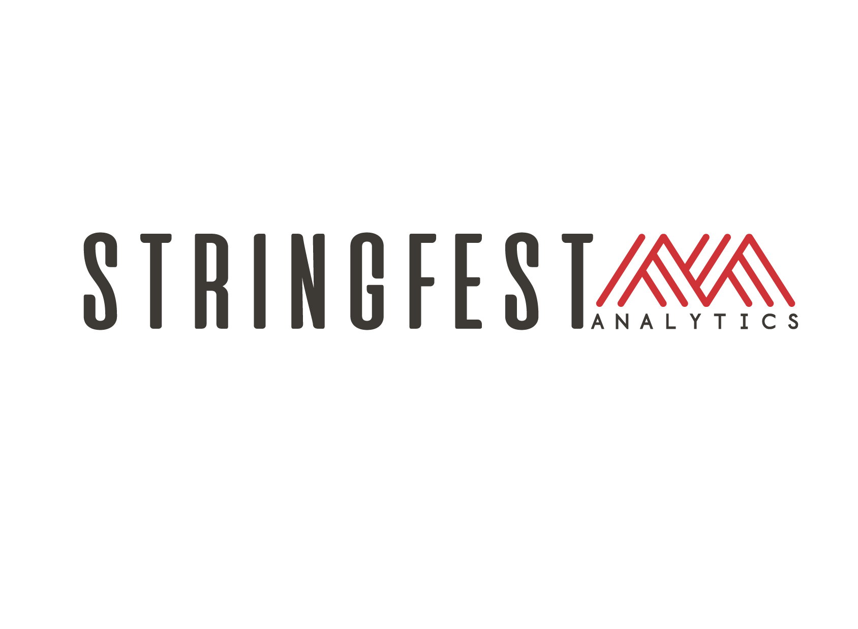
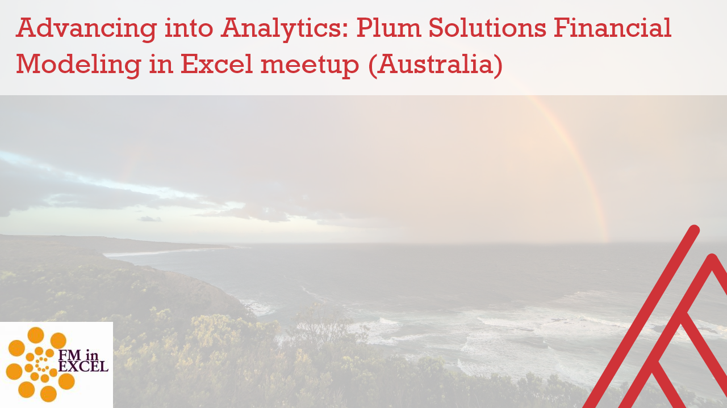
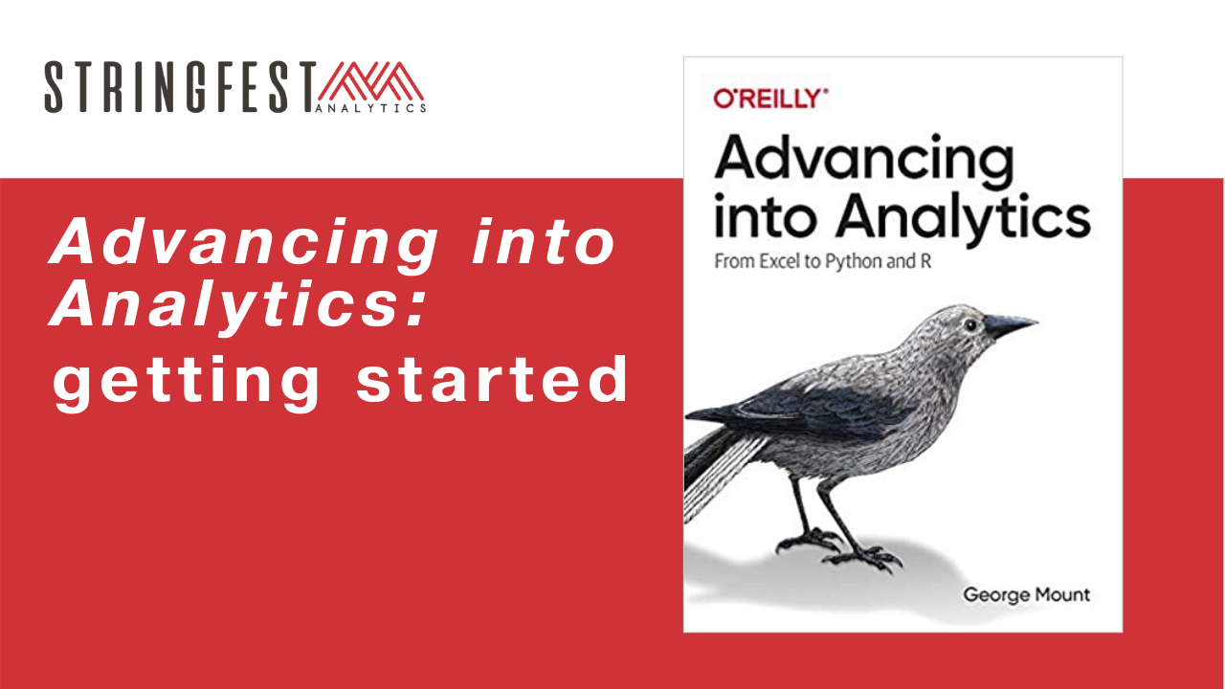
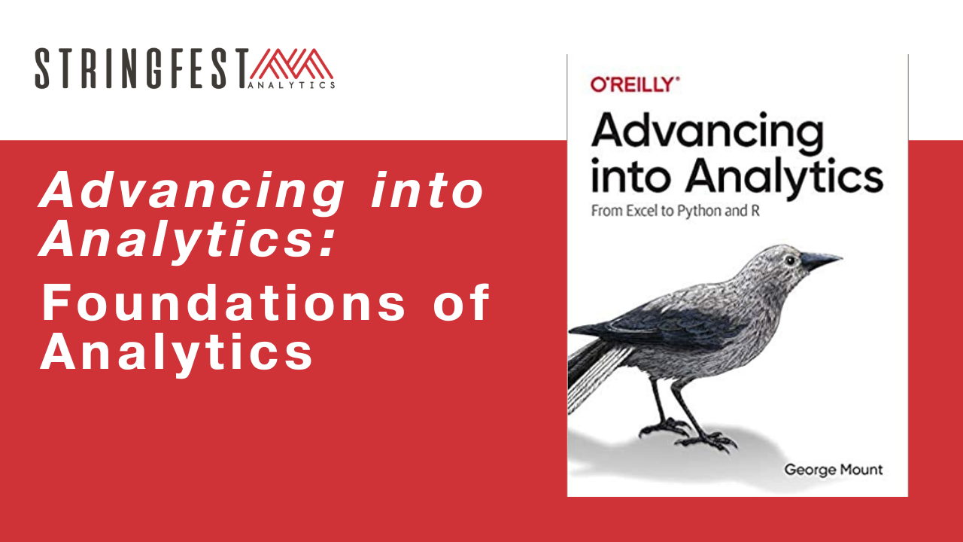
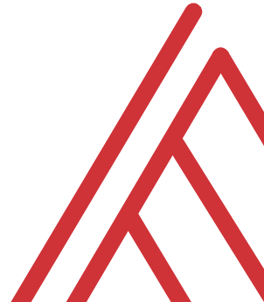
Advancing into Analytics: From Excel to R and Python

Slide 2
Learning objectives
How do you communicate your findings?
How do you structure an analysis project?
What else is there to do in Excel?

Slide 3
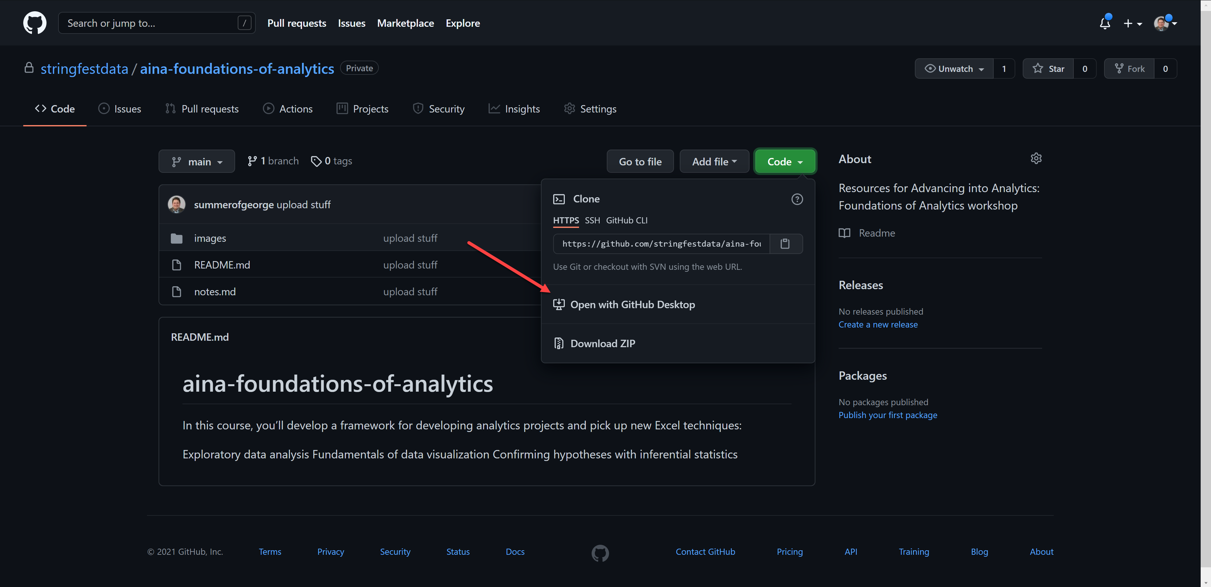
Follow along
Download resources: https://github.com/stringfestdata/aina-foundations-of-analytics
Notes:
The additional courses will dive into using GitHub.

Slide 4
Questions?

Slide 5
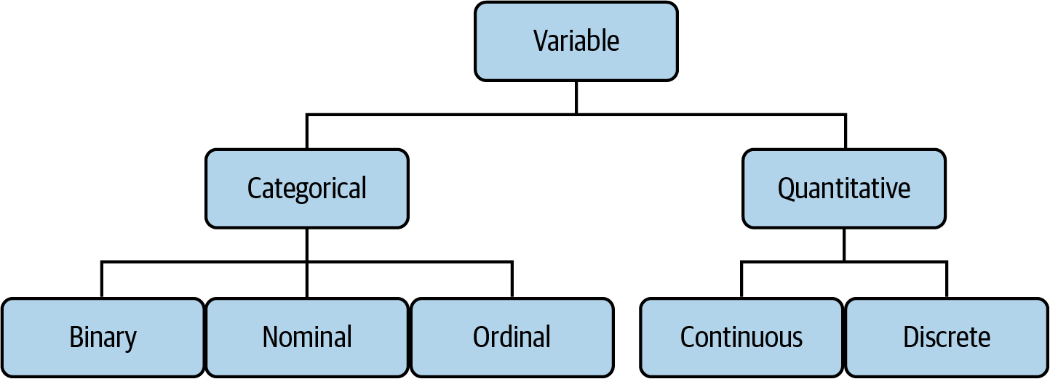

Drill
File: datasets/computers.xlsx
Classify each variable type
Mount, George. Advancing into Analytics: From Excel to Python and R. O’Reilly Media, 2021
Notes:
Also feel free to

Slide 6
Demo
File: datasets/computers.xlsx
Is there a difference in price of computers with and without a CD-ROM?
Notes:
Ask a student if they’d like to share their screen and walk through it

Slide 7
Questions?

Slide 8
What is analytics, anyway?

Slide 9
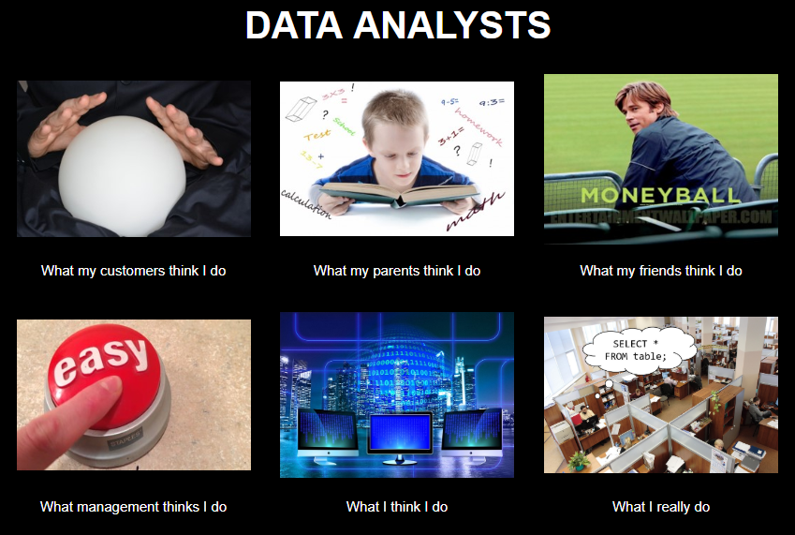
Chat me up…
What does analytics mean to you?
What does this look like for you?
ANALYTICS

Slide 10
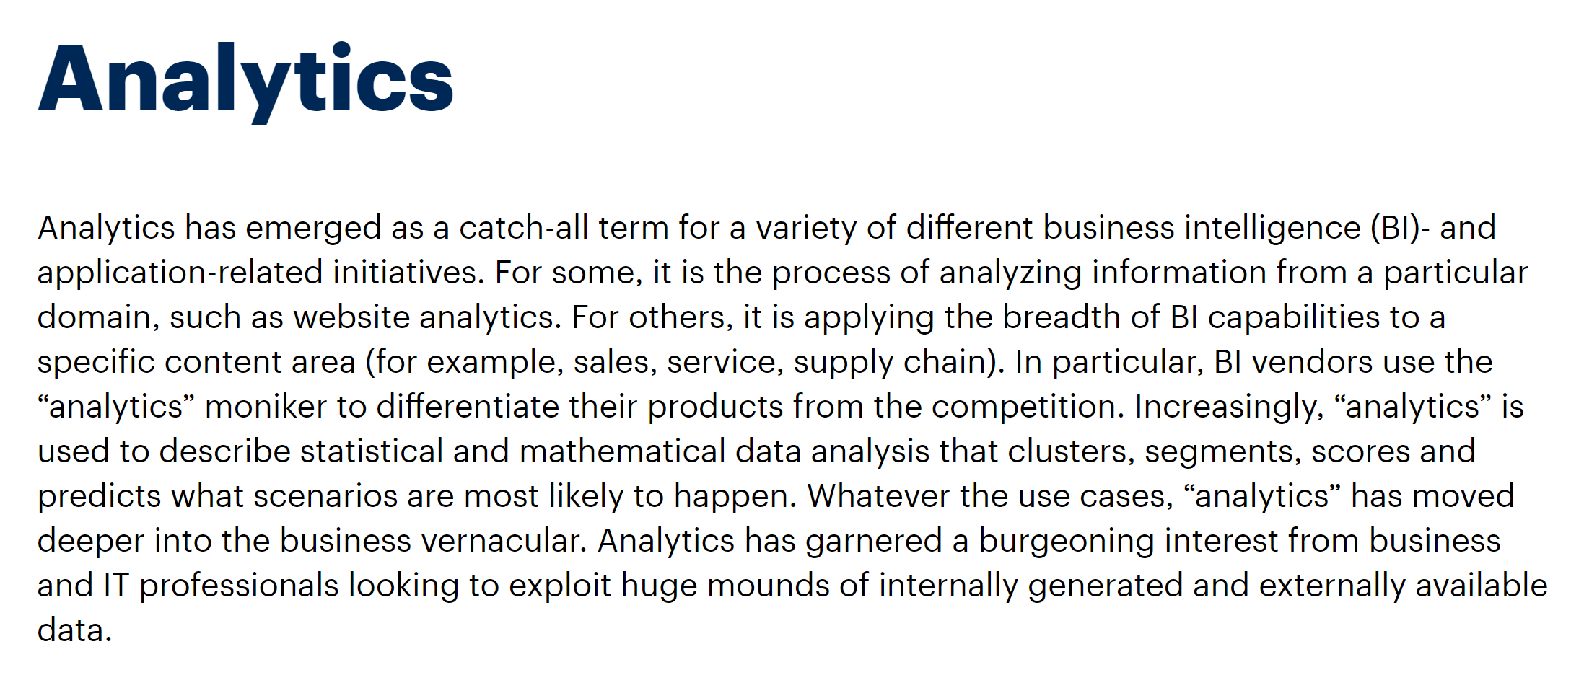
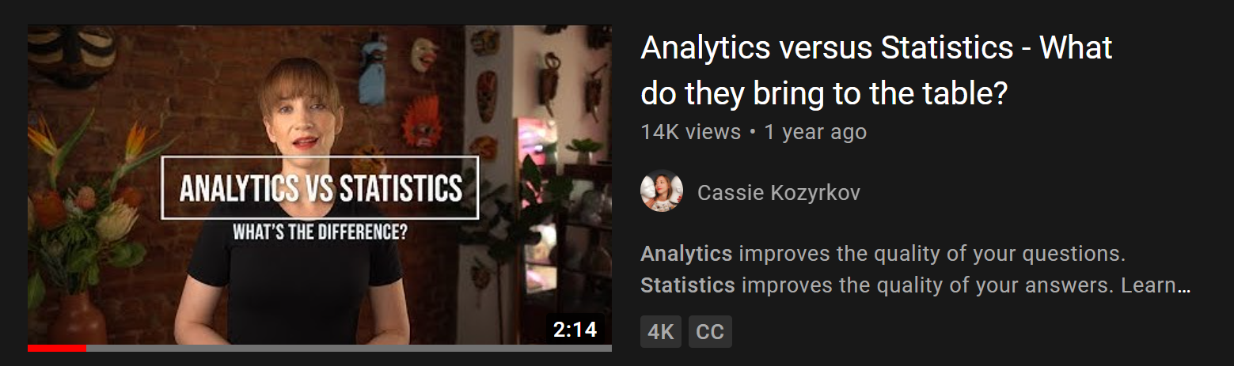
A working definition?
“Using data to make recommendations about what to do given what’s happened”
But wait… there’s more!
https://www.gartner.com/en/information-technology/glossary/analytics
https://www.youtube.com/watch?v=YsrPImZyisI
Notes:
The Gartner definition is very comprehensive…
What do you think about Cassie’s video?

Slide 11
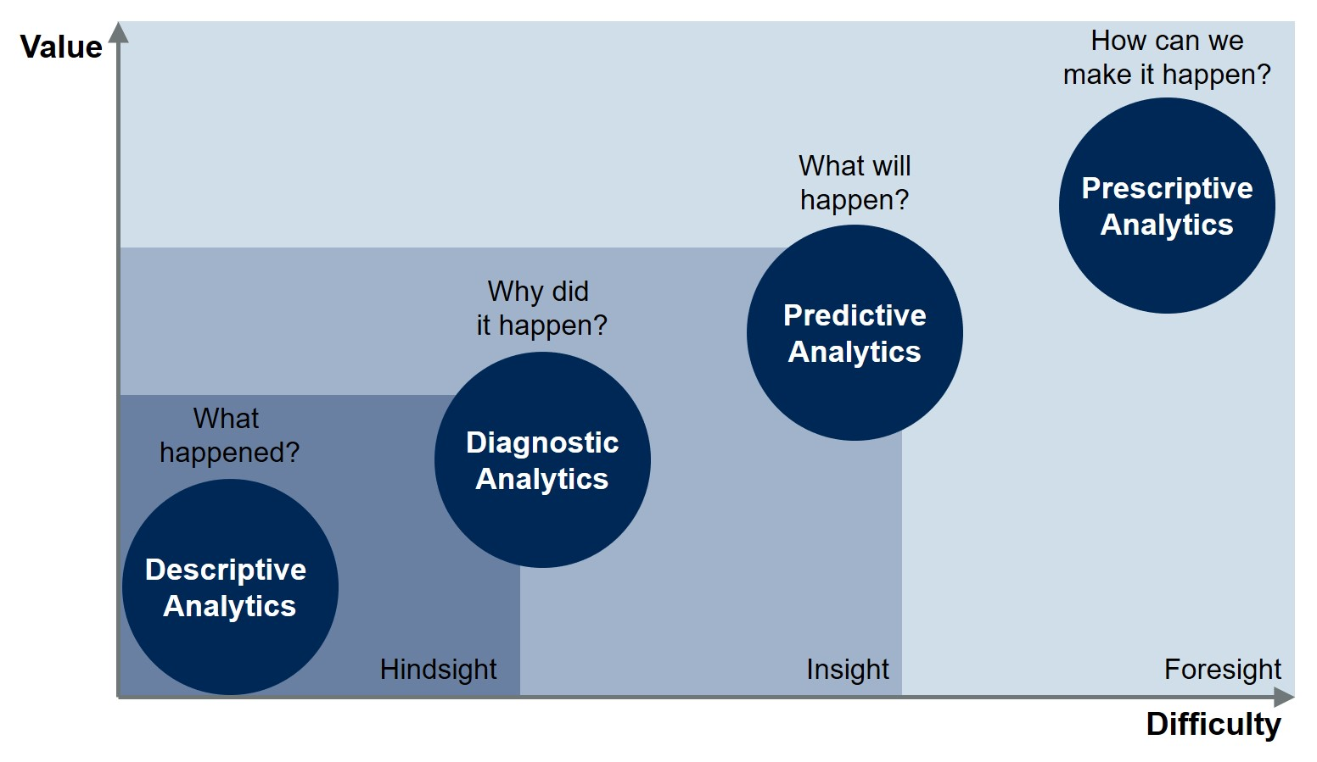
Starting somewhere
https://blogs.gartner.com/jason-mcnellis/2019/11/05/youre-likely-investing-lot-marketing-analytics-getting-right-insights/
Notes:
The Gartner definition is very comprehensive…
What do you think about Cassie’s video?

Slide 12
Starting somewhere
Inferential statistics
Confirmatory data analysis
Descriptive/summary statistics
Exploratory data analysis
https://blogs.gartner.com/jason-mcnellis/2019/11/05/youre-likely-investing-lot-marketing-analytics-getting-right-insights/
Notes:
The Gartner definition is very comprehensive…
What do you think about Cassie’s video?

Slide 13
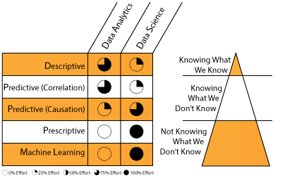
A division of labor
https://datascientistinsights.com/2013/09/09/data-analytics-vs-data-science-two-separate-but-interconnected-disciplines/
Notes:
The Gartner definition is very comprehensive…
What do you think about Cassie’s video?

Slide 14
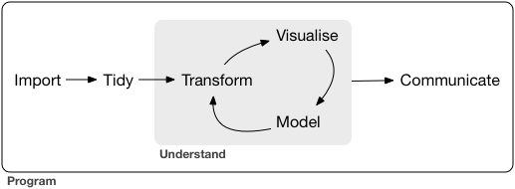
What all analytics has in common
https://r4ds.had.co.nz/introduction.html

Slide 15
Begin with the end in mind

Slide 16

What makes for compelling analytics?
What does your audience assume to be true?
What if they’re wrong?
What myths can you bust?
What urban legends can you tame?
https://corporate.discovery.com/blog/2016/03/01/mythbusters-goes-out-with-a-bang/

Slide 17
Showing how the data gets tidied?
Matters to the audience
Probably doesn’t

Slide 18
An analytics presentation in six acts
downloads/a-data-presentation-in-six-acts.pdf
datasets/diabetes.xlsx
Is there a difference in the glucose levels of patients with and without diabetes?

Slide 19
1. Introduction
“Buy the hook, and they’ll buy the story”
Lead with a quote or anecdote… draw them in
Drill:
Who’s the audience?
How can you hook them?
Try it: https://bit.ly/3taMsoC
Notes:
How could we hook this?

Slide 20
2. Hypotheses
You have an opinion… but the data has the truth!
Drill:
State the
Notes:
This is your time to "hook" the audience into your work and situtate the project into its wider context. Explain what makes the topic interesting and how you arrived at the questions you asked. Consider leading off with an interesting quote or anecdote related to the topic

Slide 21
Demo
File: datasets/computers.xlsx
Is there a difference in price of computers with and without a CD-ROM?
Notes:
Ask a student if they’d like to share their screen and walk through it

Slide 22
What makes for compelling analytics?
What does your audience assume to be true?
What if they’re wrong?
What myths can you bust?
What urban legends can you tame?
https://corporate.discovery.com/blog/2016/03/01/mythbusters-goes-out-with-a-bang/

Slide 23
What all analytics has in common
Surprises, but doesn’t scale
Scales, but doesn’t surprise

Slide 24
Conclusion/Next steps

Slide 25
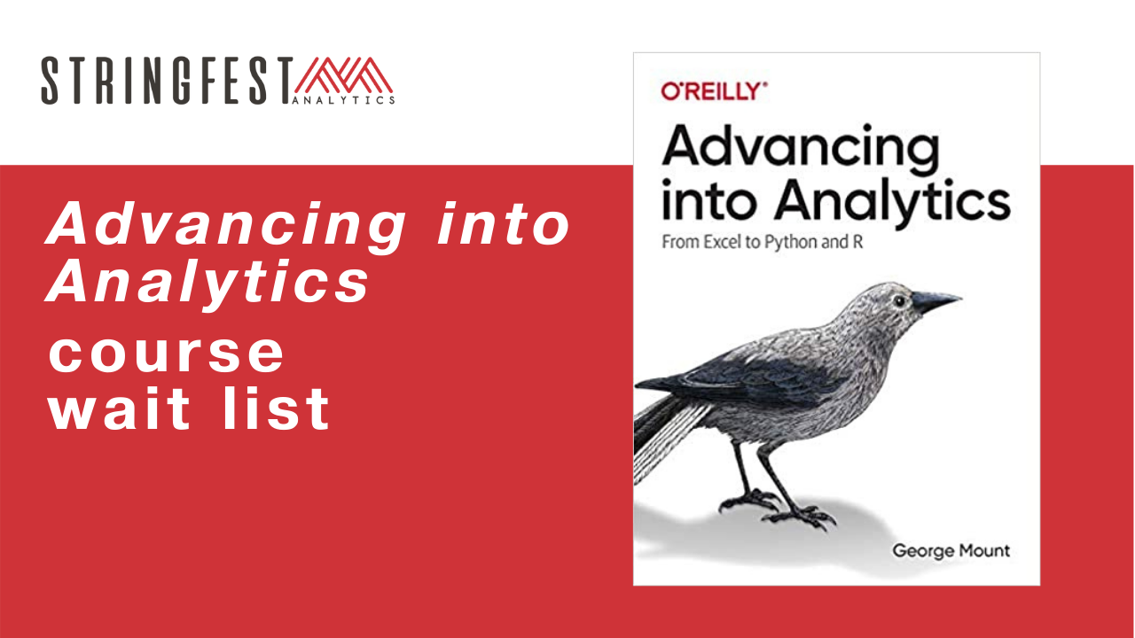
Want more?
Sign up for course waiting list: https://stringfestanalytics.com/aina-waiting/
Notes:
By the end of this book, you should be able to conduct exploratory data analysis and
hypothesis testing using a programming language.

Slide 26
Event survey: https://forms.office.com/r/0ZnD0LxpZy

Slide 27
Questions?

Slide 28
THANK YOU
george@stringfestanalytics.com
linkedin.com/in/gjmount
stringfestanalytics.com/contact

Slide 29
What statistical test should I use?
If your independent variable is… | And your dependent variable is… | Then look into using…
Binary | Continuous | Independent samples t-test
Categorical | Categorical | Chi-square
Continuous at time 1 | Continuous at time 2 | Paired samples t-test
Categorical | Continuous | ANOVA
Continuous | Continuous | Correlation
Continuous | Continuous | Regression
Continuous | Binary | Logistic regression
Notes:
By the end of this book, you should be able to conduct exploratory data analysis and
hypothesis testing using a programming language.

